Slide 1

Jessica Mercerhill, PhD
Senior Director, Educator Preparation
Spring 2019 Update to OCTEO

Slide 2
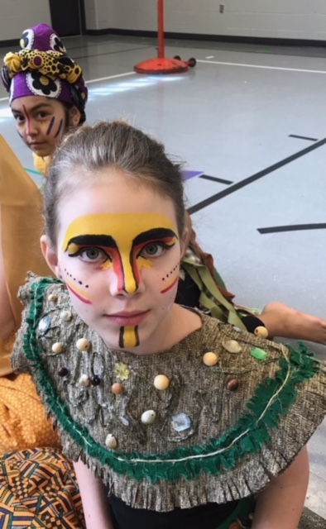
Agenda
Program/Data
  Spring & Summer Surveys
  Program Reviews
Standards Developments and Revisions
Partnership Projects with ODE
  Human Resource Capital Management website
  Diversifying the Educator Pipeline
P-5 Licensure Conversion
  Update to Child Development TAG
EdTPA

Slide 3
Program/Data
Spring Surveys: Pre-Service, Principal Intern, Principal Mentor
  Distribution histories were sent March 30/April 1
  Reminder emails automatically sent April 11 and May 1
  Survey closes June 1.
Please note:
  Links cannot be used by multiple people.
  Institutions cannot send links to students
  Reach out to your mentor teacher and principal mentor partners and ask them to look for and respond to the survey
    From: Ohio Department of Higher Education <noreply@qemailserver.com>

Slide 4
Programs/Data
Spring Program Review Submissions
  Submitted March 15
  Limited state reviews
    finished and pending public posting, legal council review, Chancellor signature
  Full state reviews
    Consultants identified, contracts under development
    June completion is anticipated
Fall Submission Deadline
  October 15
  Forms available online now – please download the most recent version (Don’t just reuse forms from previous submission!)

Slide 5

Standards Development and Revisions
Adapted Physical Education Endorsement
  New national standards updated, committee reviewing
Computer/Technology Endorsement
  Updated ISTE standards (new link provided)
Computer Science Endorsement (new)
  Committee working now, end goal is August
Call for new committee membership for fall work (anticipated pending Board Approval):
  Media Arts Endorsement (new)
  Theater/Drama Endorsement (new)
Middle Childhood Generalist (on hold due to )

Slide 6
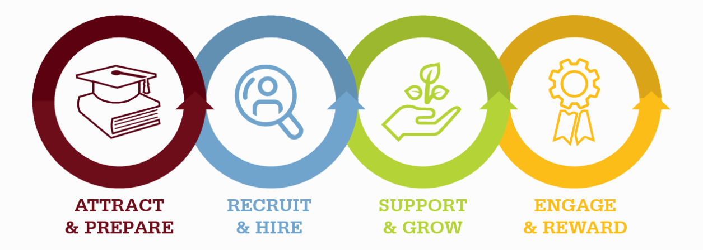

Partnership Projects with ODE
Human Capital Resource Center
Resources to Attract, Hire, and Support the Excellent Educators

Slide 7




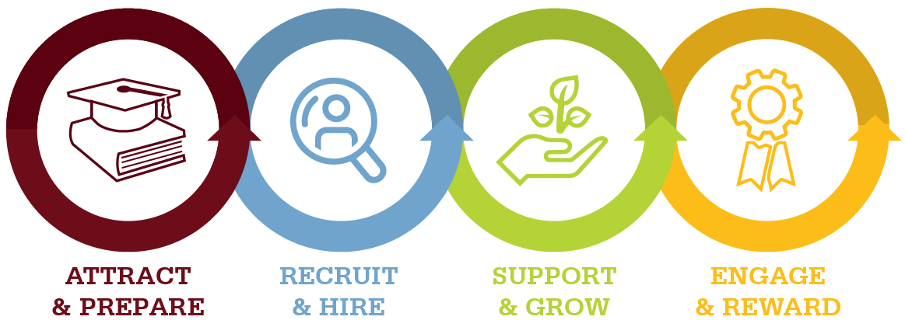
Human Capital Resource Center
1. Exploring Careers in Education
Illuminate a path to pursuing a career in education.
2. Educator Recruitment
Discover strategies to help improve and increase applicant pools.
3. Professional Conduct
Find tools to help navigate difficult waters and support ethical decision making.
4. Mentoring
Discover how to create intentional, integrated support systems to advance practice.
5. Educator Recognition
Explore opportunities that celebrate educators who go above and beyond and engage them as ambassadors for the profession.
www.ohiohcrc.org
Notes:
Five phase one projects were completed.
Exploring careers in education outlines the different types of careers in the education field beginning with have a high school diploma and beyond. This portion helps human capital leaders work with candidates on exploring the education profession and the various roles within it.
Educator recruitment offers new tools to help districts and schools with proactive recruiting.
Professional conduct offers guides to help work with educators on navigating the difficult waters and to help educators make better choices that often get them into trouble.
Mentoring – offers many tools to support a mentoring program for any educator regardless of their role or years of experience
Educator recognition – highlights ways to recognize and celebrate our educators.
In the next phase of work we will address – onboarding, Employer branding, compensation. Please visit the website to find various resources and tools.

Slide 8
Diversifying the Education Profession Taskforce
Three meetings that Center on Great Teachers & Leaders at AIR facilitated in partnership with Cheryl Krohn and Jessica Mercerhill
Examined Root Causes for the lack of diversity in our current workforce, including in Ed Prep
Identified priority recommendations to present to Superintendent DeMaria and Chancellor Gardner

Slide 9

P-5, P-5IS Licensure Conversion

Slide 10
CAEP Elementary Standards, CEC standards
  Spring 2020 ODE Office of Educator Licensure will offer P-5 and P-5IS as an option for e-signing.
  Fall 2020 First Semester First-Year students begin under P-5 program requirements, no new students enrolled into early childhood licensure programs.
  Programs may start as early as Fall 2019, but no later than Fall 2020.
  June 30, 2024 Last issuance date for p-3 licenses. Only candidates on teach-out lists submitted that spring will be granted a license after this date.
  Currently approved EC and ECIS licensure programs do not need to go through state review upon conversion. Beginning in Fall 2020, program review submissions for EC and ECIS should be submitted as the P-5 program.

Slide 11
Child Development TAG Course
Please keep your community college partners in the loop during conversion to ensure smooth transfer programs
General Course Description:
This course focuses on applying knowledge of the characteristics and needs of young children, prenatal to age twelve, for the creation of healthy, respectful, supportive, challenging, and effective learning environments. Multiple and interrelated influences on the development and learning of young children will be examined.

Slide 12
EdTPA
Recommendation made
  NOT for requirement but option
Under review

Slide 13
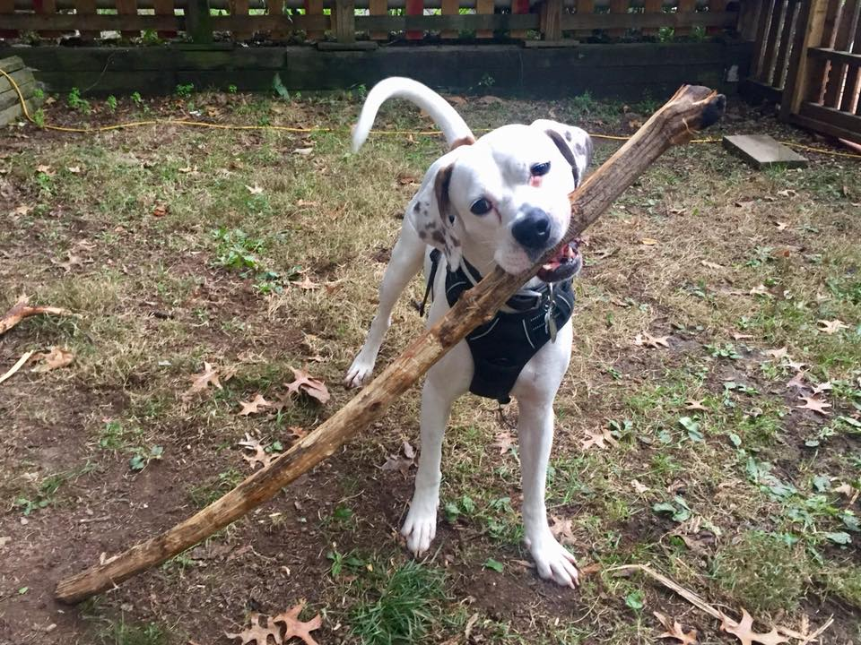
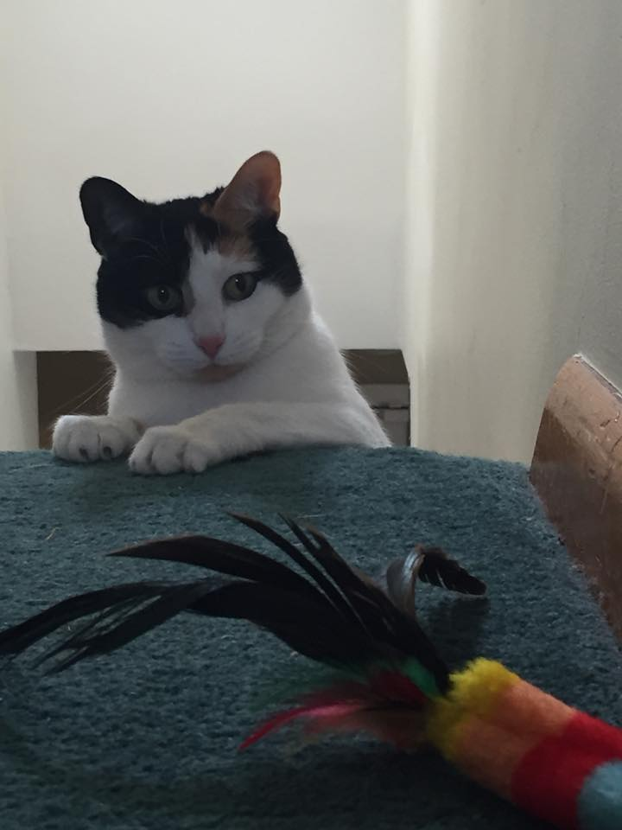
Question and Answer time!

