Slide 1
Ohio Department of Higher Education
Spring 2018 Update to OCTEO
Jessica Mercerhill, PhD
Senior Director, Educator Preparation

Slide 2
Agenda
Program Updates
  Spring Surveys
  Program Approval Submission Deadlines and Process
  Endorsement and Reading Core Standards Revisions
Other Activity updates
  2+2 Articulated Pathways
  CAEP
  edTPA recommendation
  Latino Education Summit
Questions and Answers

Slide 3
Program Updates
Spring Surveys
Pre-Service, Principal Intern, and Principal Mentor surveys sent March 12.
Reminder emails will go out April 3 and 23.
Lists of completion status will be sent next week.
Please note:
Links cannot be used by multiple people.
Institutions cannot send links to students
Please reach out to your mentor teacher and principal mentor partners and ask them to look for and respond to the survey (and check their junk mail!).
  From: Ohio Department of Higher Education <noreply@qemailserver.com>

Slide 4
Program Approval Process
Program Reviews should happen at least the semester BEFORE the approval deadline. Programs not approved on time risk going into “teach out mode” meaning enrolled students may finish, but no more may be admitted.
No more Initial Inquiry process. Forms are posted online and you may access them as you need. *Change requests – send email to EdPrep@highered.ohio.gov to request form.
Deadlines are 5pm March 15 and October 15 from here out. No more rotating deadlines! (If falls on weekend due the Monday after)
All programs should be sent to EdPrep@highered.ohio.gov. Zip files are preferred.

Slide 5

Fall program review update

Slide 6
Endorsements and Reading Core Standards
Reading Core standards revisions
New standards are approved!
Will be online with timeline for roll-out.
January 2020
Current Committees:
Reading Endorsement
Teacher Leader
Now Seeking Committee members:
Gifted Intervention Specialist k-12
Adapted Physical Education
Request will be coming via listserv

Slide 7
Other Activity
2+2 licensure pathways
Committee members soliciting feedback from their colleagues through
April 13
Feedback will be considered, changes made as needed
Goes out for endorsement
CAEP
Speak up! Loop me in.
Identify date of visit year prior, send to me.
edTPA Recommendation
Focus group results showed majority support for edTPA as licensure requirement replacing APK exam.
Chancellor authorized recommendation
ODE is reviewing recommendation

Slide 8
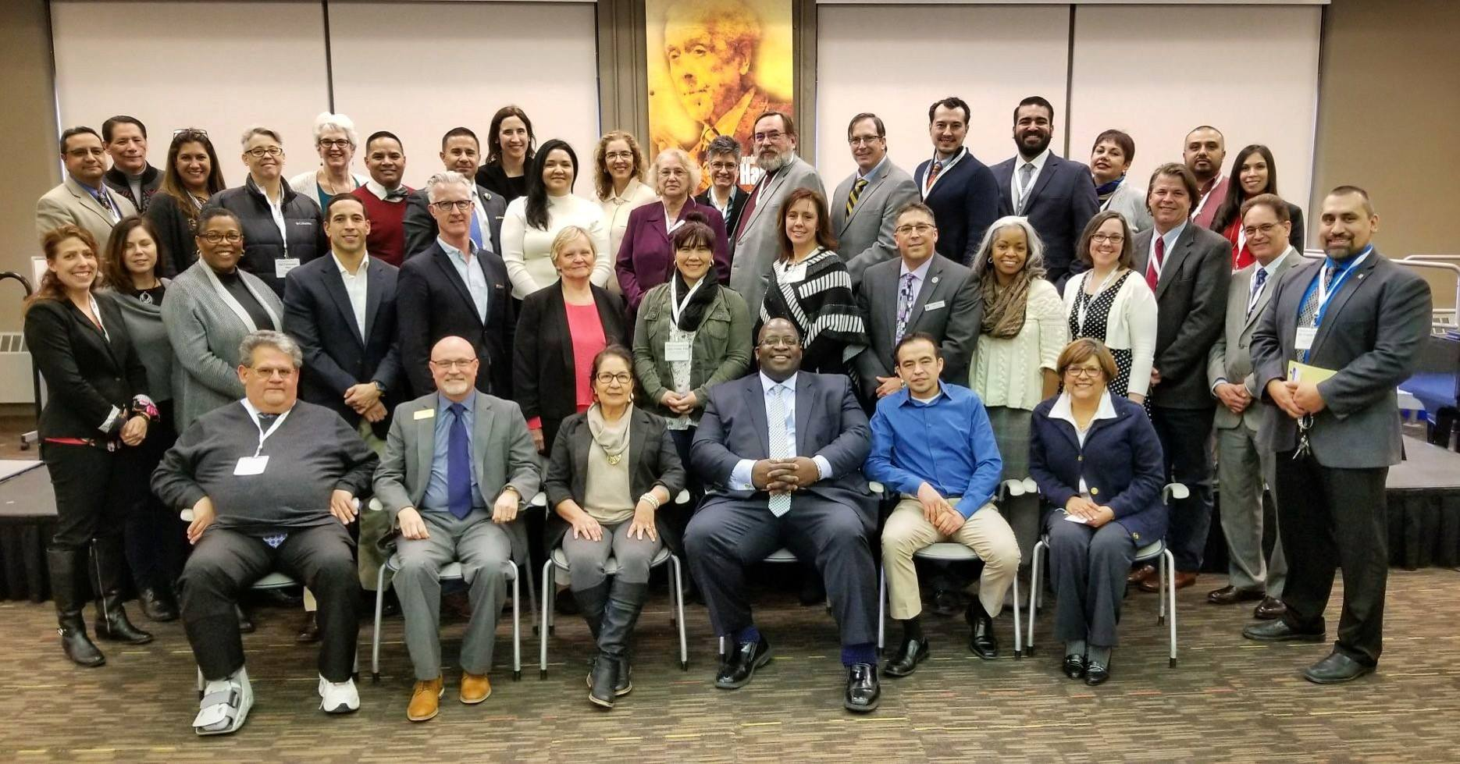
Latino Education Summit
November 9, 2018, Ohio State University Union
Focus will be on Latino teacher recruitment and
cultural responsiveness in the classroom

Slide 9
Ed Prep Listserv
General Ed Prep Questions & Program Review
Email EdPrep@highered.ohio.gov
Specific Questions
Email jmercerhill@highered.ohio.gov
Information Updates
Posted online bi-monthly
https://www.ohiohighered.org/education-programs

Slide 10
Questions and Discussion

