Slide 1
Educating Teacher Candidates for Policy Advocacy
John C. Gillham
The University of Findlay
2018

Slide 2
Pop Quiz Part I
Have you ever…
Been baffled by a new policy that seemed to make no sense?
Been forced to support a policy that ran counter to everything you knew as an educator?
Been forced to do a lot of work for a new policy but saw no tangible returns?
Been forced to make significant changes in order to still be considered a proficient teacher?
Seen a policy rushed in with a roar and a few years later see them sheepishly disappear?
Complained about the policy in the breakroom?

Slide 3
Pop Quiz Part II
Have you ever…
Written your representative about education policy?
Met with your representative to discuss educational concerns?
Used social media to advocate for important education policy
Offered feedback on pending legislation?
Publically advocated for education policy?
Conducted research on a specific policy?
Connected with an advocacy group to impact policy making?

Slide 4
How Education Policy is Made
It is NOT made by experts, but by EDUCATION AMATEURS!
  Ideology
  Convention wisdom – the market theory model
  Their own experience
The “research” behind federal education policy is generally NOT peer reviewed and NOT conducted by educators! (Hollar, 2017)
Research is used selectively and with political intent to support pre-existing views (Henig, 2008)
Education research—and therefore policy—is largely dictated by economists (Goa, 2017)

Slide 5
Reform Issues
The issues that have driven reform over the last decade or more:
School choice
Longer school days
Teacher merit pay
Standardized curricula
Value added measures
Primarily originate with and are advocated for by non-educators!

Slide 6
Private Foundations
Private foundations, sometimes directed by billionaire business persons (notably Gates, Walton, and Broad) exert an enormous influence over education
Gates Foundation assets: $43 billion
There are 41 other foundations with assets over $1 billion each
There are 556 foundations with assets over $100 million
Tompkins-Strange (2016)

Slide 7
Consider Other Fields
Other professions take a more active role in the policy process
Medicine/Pharmacy (AMA)
Airlines (FAA)
Agriculture (Dept. of Ag)
And many more industries where professionals take a much more active role in the policy and regulation in their field
Who sits on your school board???

Slide 8
U.S. Cabinet Secretaries
Sec. of Defense: retired General
Attorney General: Attorney
Sec. of Treasury: Financier
Sec. of Commerce: billionaire businessperson
Sec. of Labor: businessperson
Sec. of Health & Human Services: surgeon
Sec. of Homeland Security: retired General
Sec. of Energy: Governor of Texas (oil industry)
Sec. of Housing and Urban Dev.: surgeon
Sec. of Education: businessperson and political fundraiser

Slide 9
What About the Voices of Teacher Educators?
…Research has been misrepresented to support policies and programs that would simultaneously reduce the role of colleges and universities in preparing U.S. teachers and support the expansion of the role of non-university providers.
(Zelchner & Conklin, 2016, p.4)

Slide 10

The Question is…
When is our profession going to take charge of education policy making?

Slide 11
So you want to get involved…
How do you do that???

Slide 12
Goals for this Session
Examine the policy making process and how educators have been disempowered
1
Identify policy makers and regulatory bodies and how to connect with them
2
Identify and evaluate resources for policy research
3
Strategies for lobbying law makers
5
How to connect with advocacy groups to advance education policy goals
4

Slide 13
Resources for Advocacy

Slide 14
Elected Representatives

Slide 15
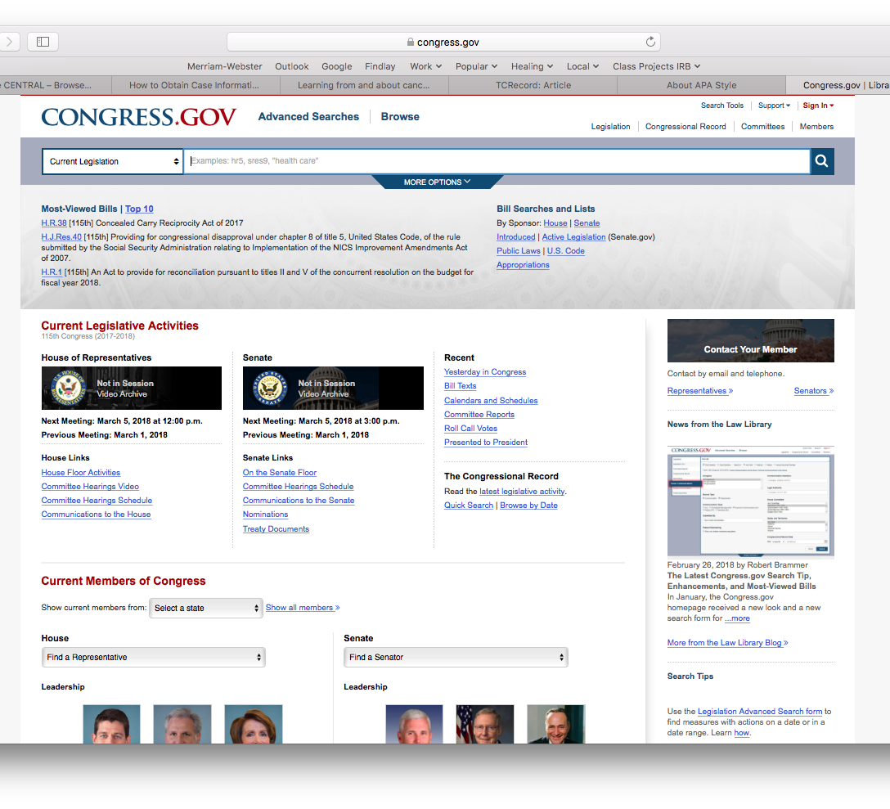
The U.S. Congress
Identify your Senators and Representatives and find their contact information using the links under Contact Your Member.
Congress.gov

Slide 16
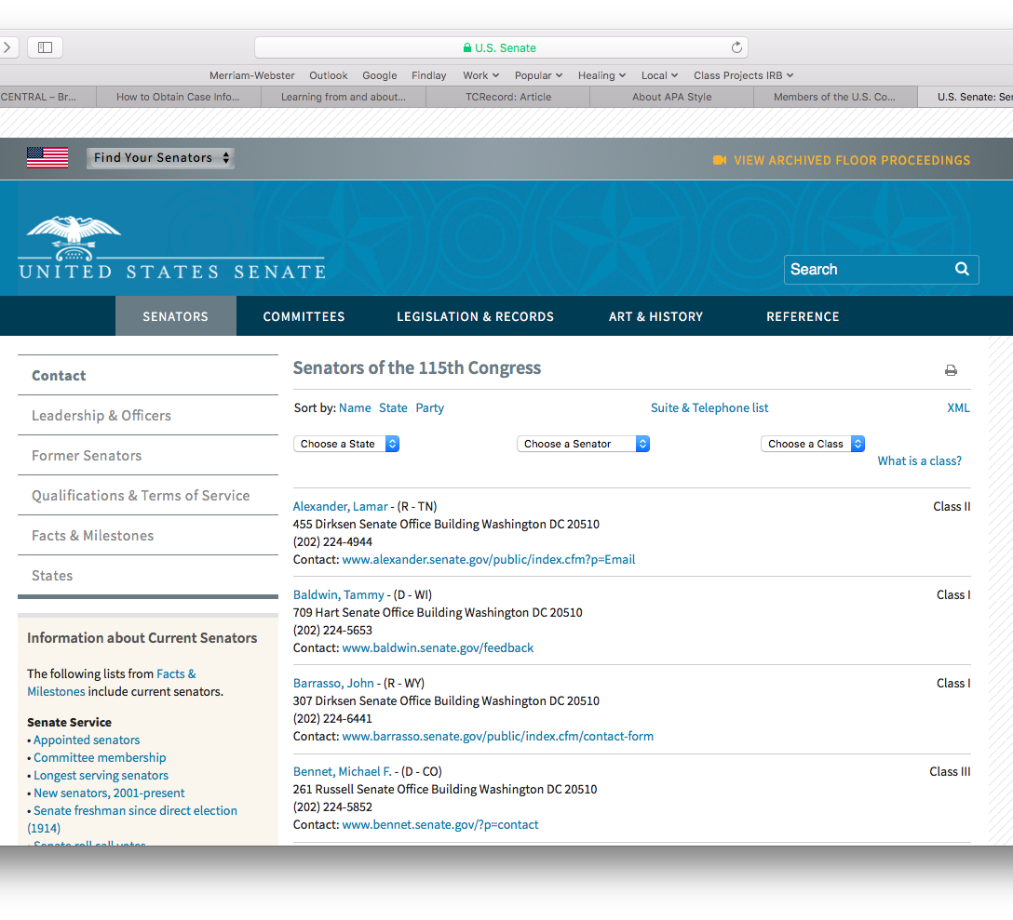
The Senate
To find your Senator, navigate to the U.S. Senates Page and look for the Find Your Senators drop down menu.
https://www.senate.gov/general/contact_information/senators_cfm.cfm

Slide 17
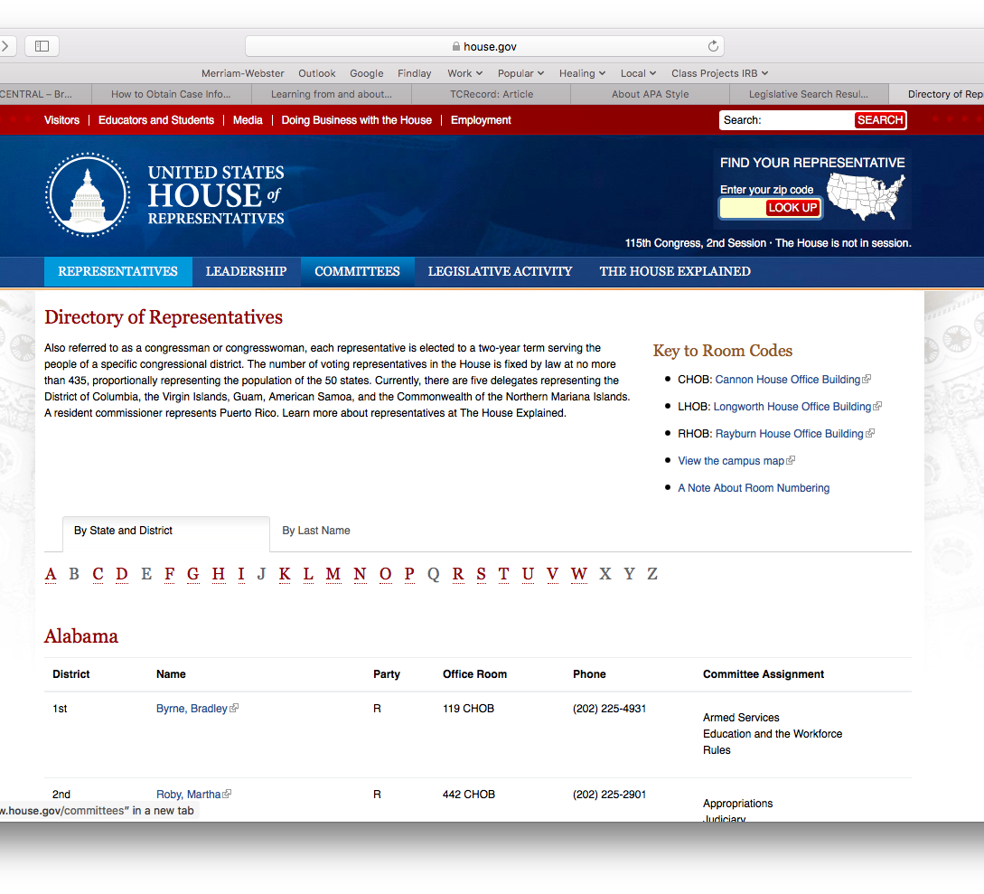
The House of Representatives
To find your Representative in the House, navigate to the House of Representatives Page and look for the search box in the upper right hand corner. Enter your zip code and click on Look Up.
https://www.house.gov/representatives

Slide 18
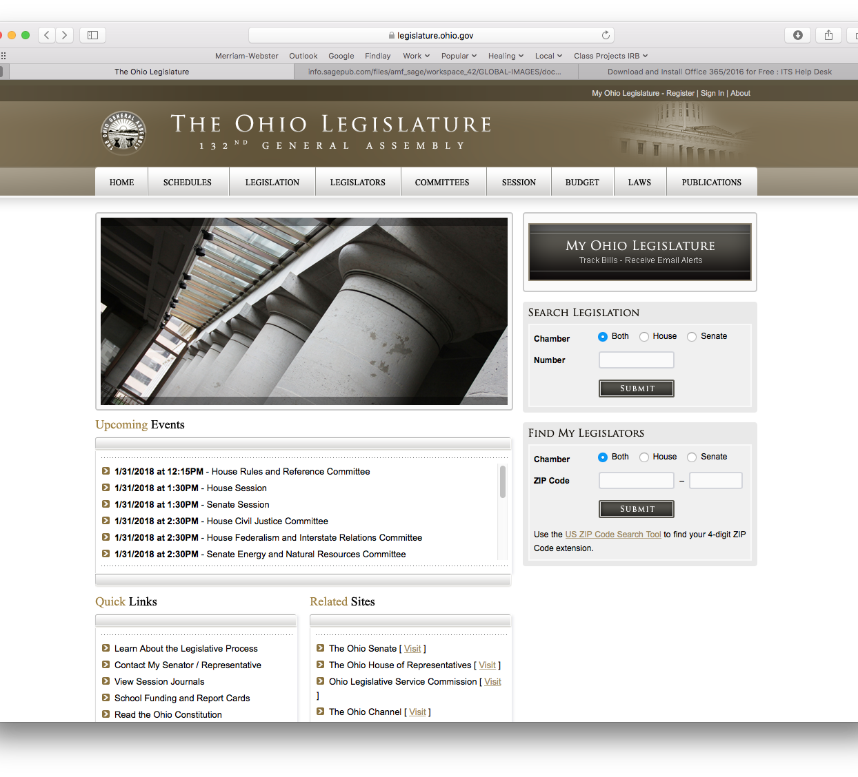
The Ohio Legislator
There are many resources available on this webpage including information on legislation, legislators, budgets, and laws
https://www.legislature.ohio.gov

Slide 19
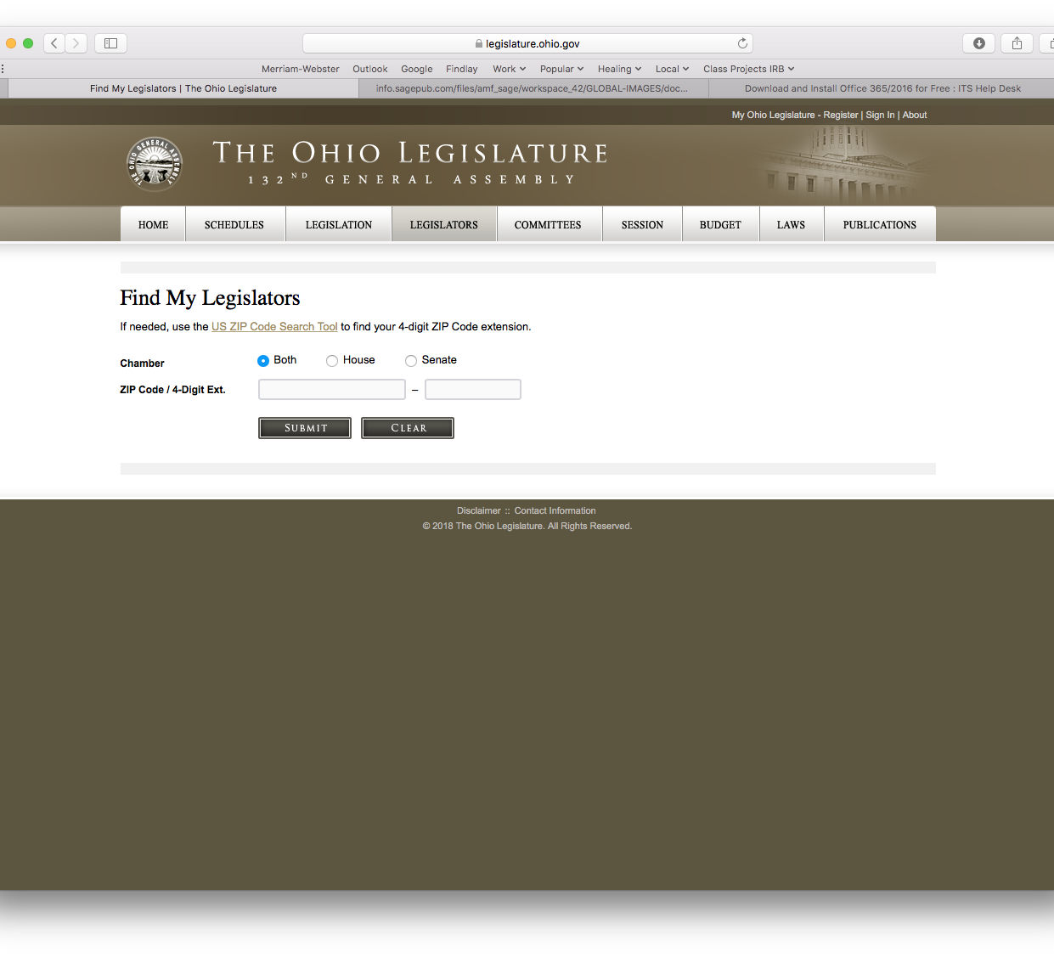
Find My Ohio Legislator
Want to know who represents you in the Ohio Legislature? Here’s how!
https://www.legislature.ohio.gov/legislators/find-my-legislators

Slide 20
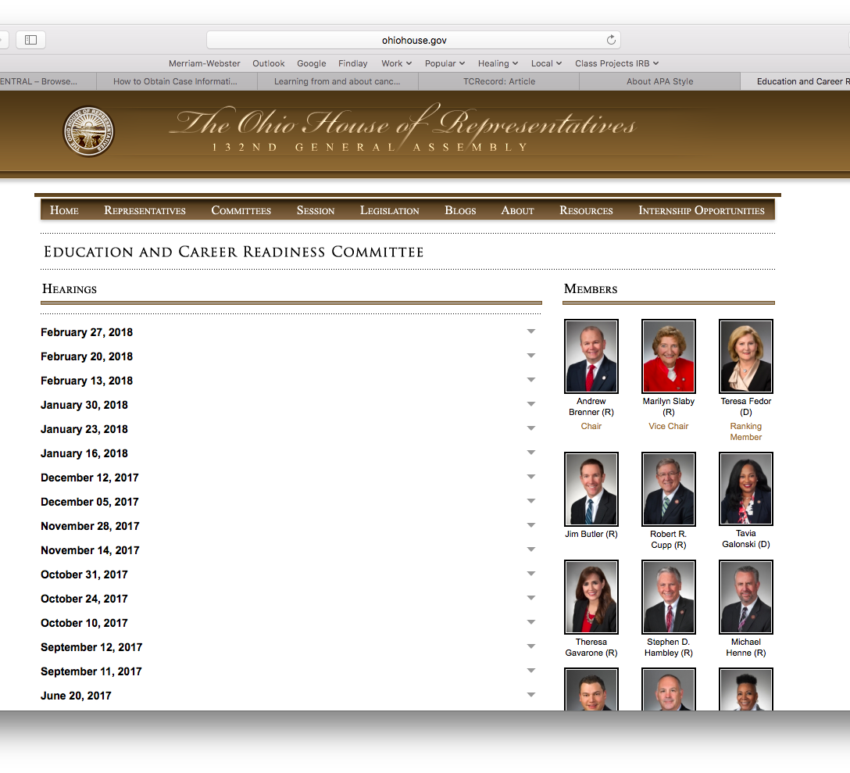
Ohio House of Rep. Education and Career Readiness Committee
Find background information, contact information, press releases, bills and resolutions that they’ve sponsored or cosponsored.
http://www.ohiohouse.gov/committee/education-and-career-readiness

Slide 21
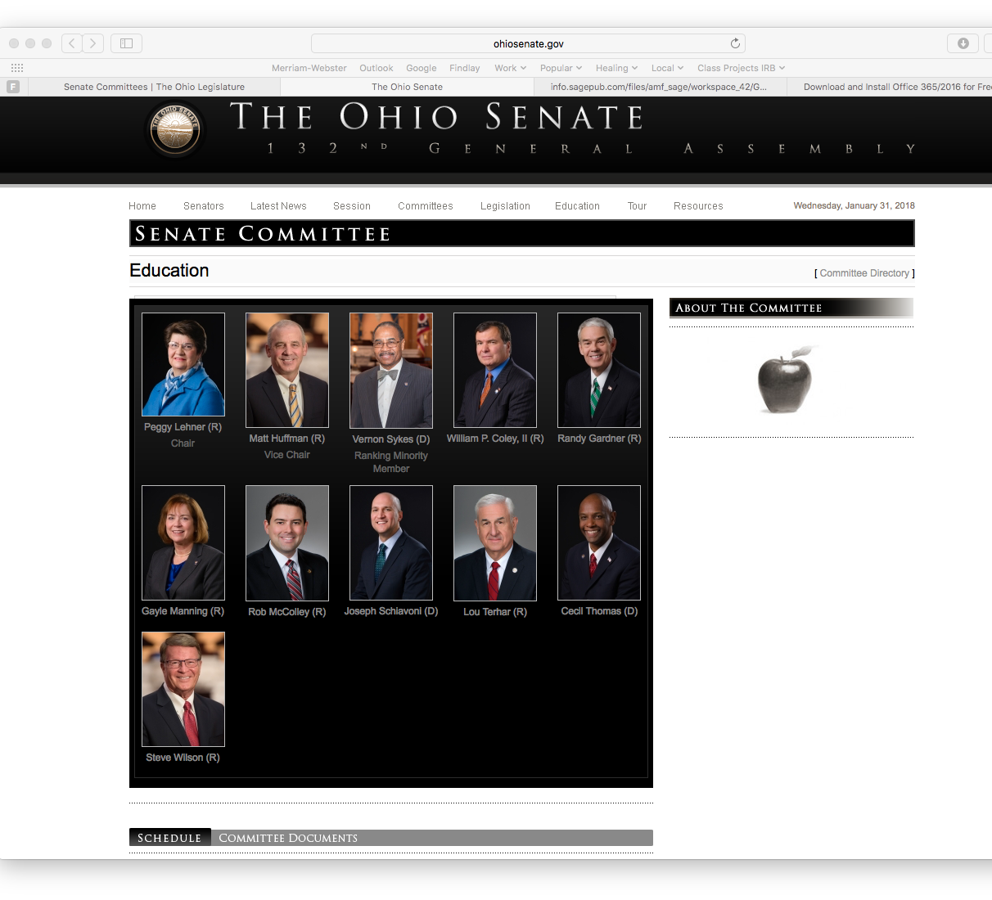
Ohio Senate Education Committee
Access to the committee’s agenda.
http://ohiosenate.gov/committee/education

Slide 22
Regulatory Bodies

Slide 23
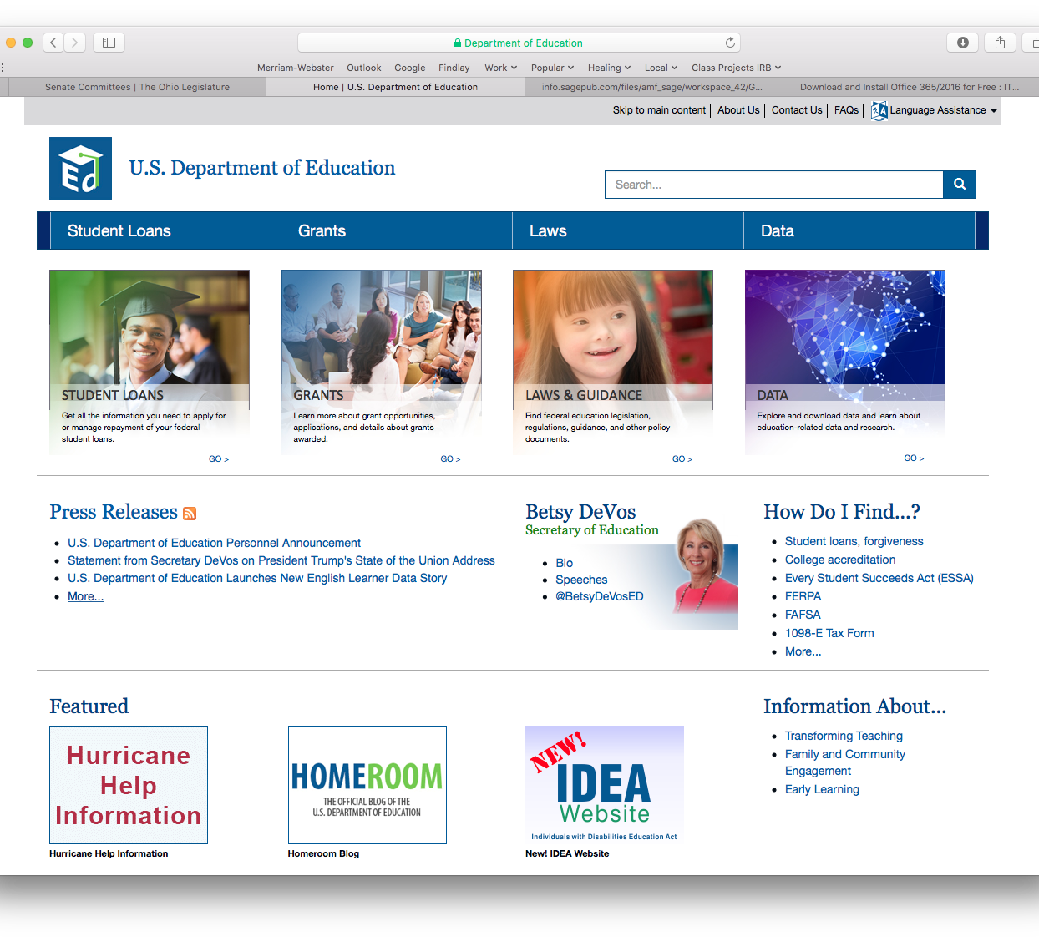
U.S. Department of Education
Click on Laws in the heading for information regarding education law.
https://www.ed.gov

Slide 24

Ohio Department of Education
A resources for state policies.
http://education.ohio.gov

Slide 25
Policy Research

Slide 26
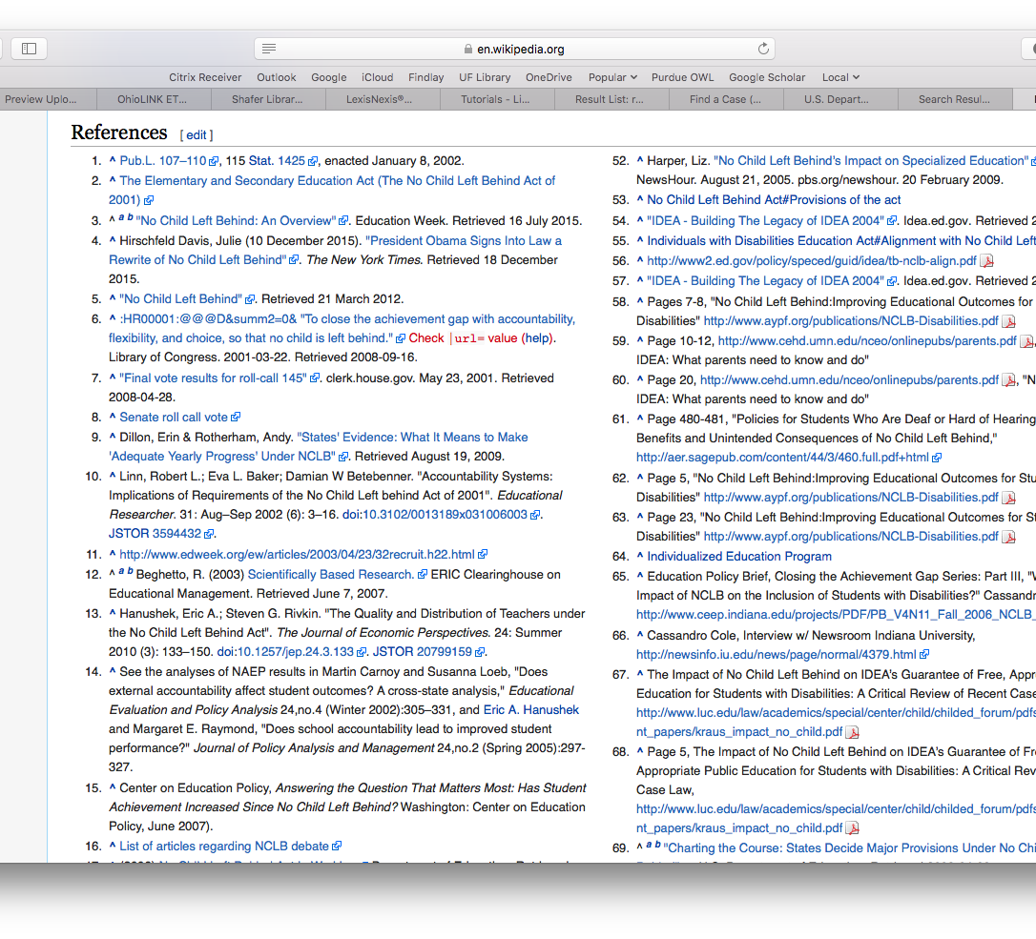
Wikipedia
Use to establish context and sources of information. Some sources will be useful, some will not. But at least it will give you an idea of where to look.
https://en.wikipedia.org/

Slide 27
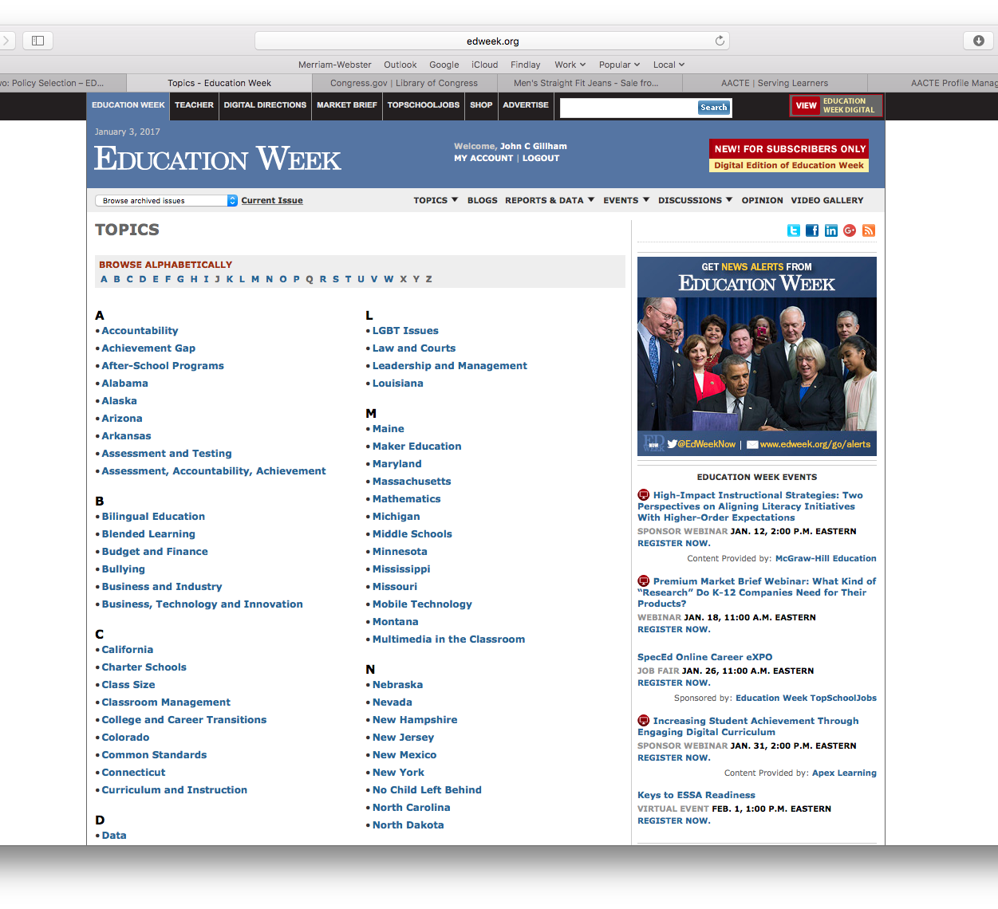
Ed Week Topics Page
The nonprofit weekly journal of education; “America’s most respected source for education news and insight.” A good starting point for background information and updates.
https://www.edweek.org

Slide 28
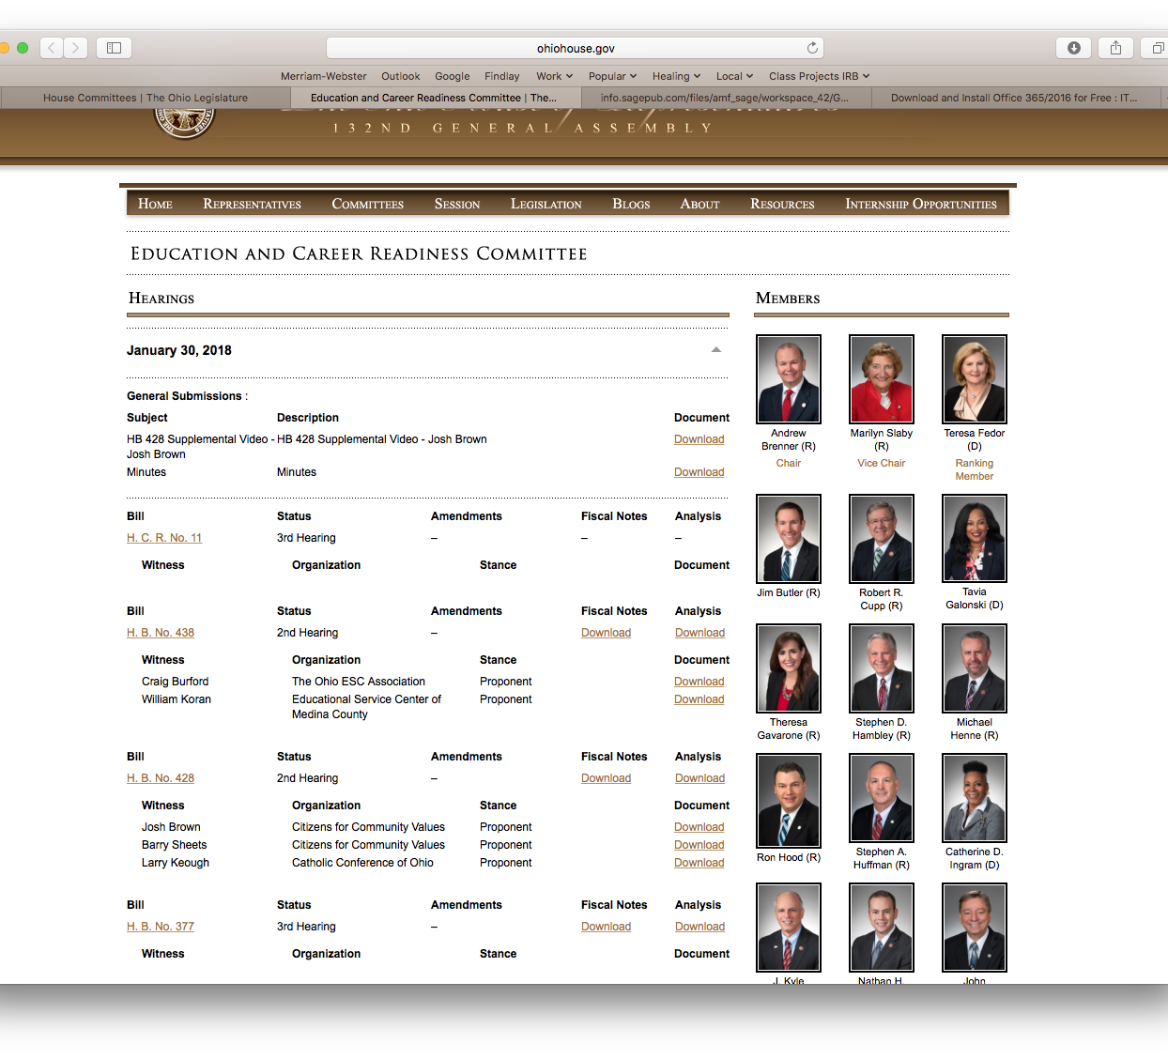
Ohio House of Rep. Education and Career Readiness Committee
Includes committee members, education HR bills, fiscal and analytical notes for download.
http://www.ohiohouse.gov/committee/education-and-career-readiness

Slide 29
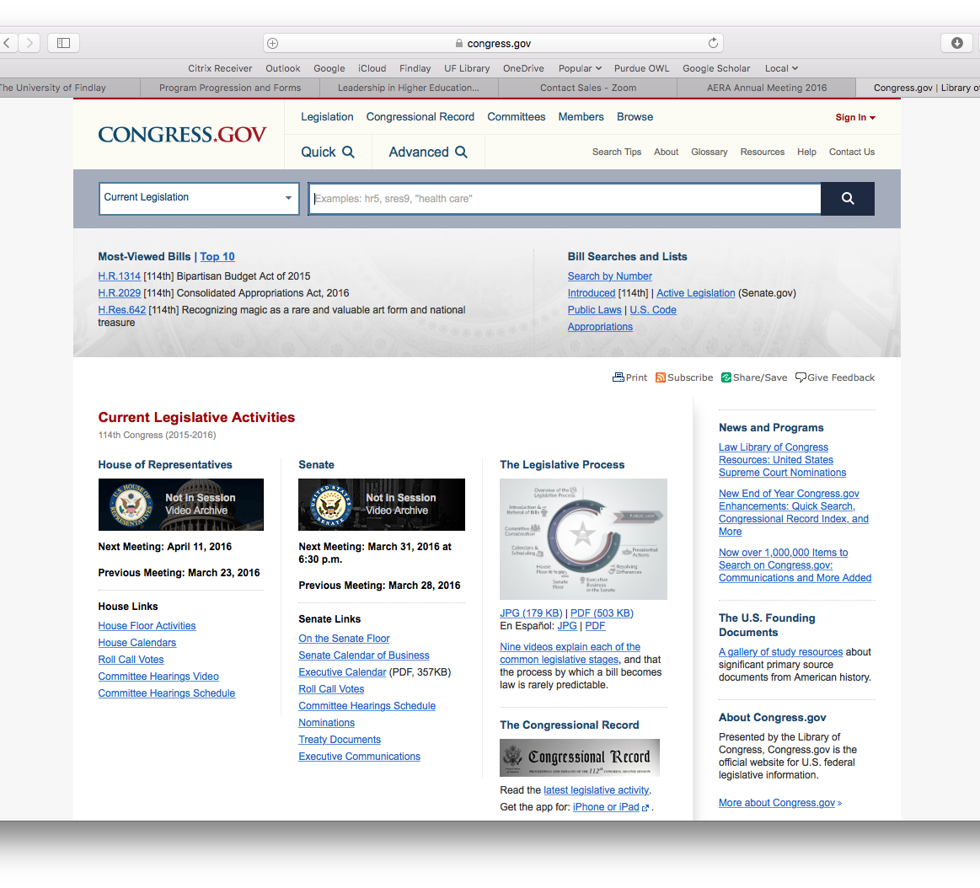
The U.S. Congress
Information on legislation, voting records, public laws, committees, the congressional record, and so on. The data is vast and searchable. This is a great resource!
Congress.gov

Slide 30
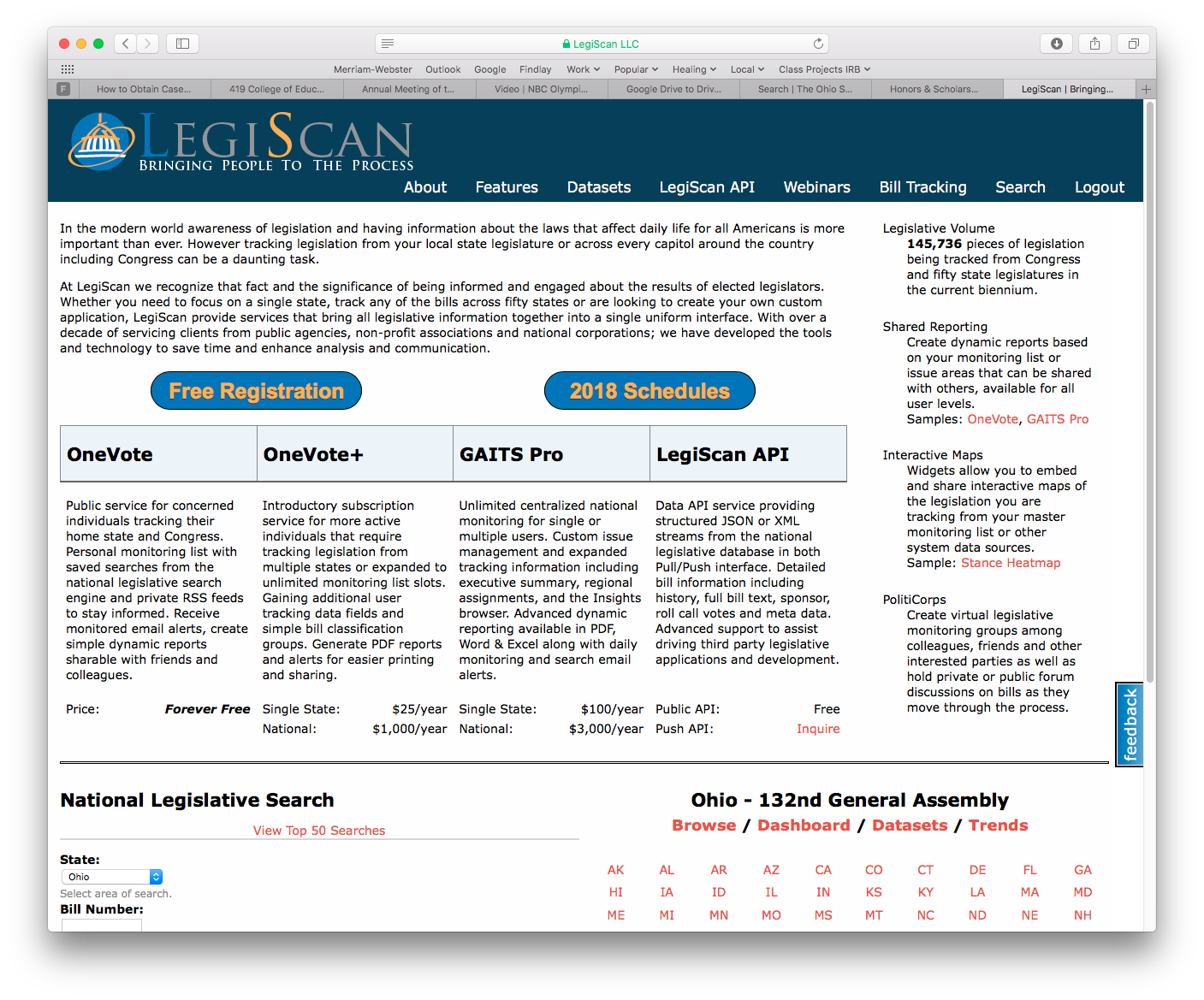
LegiScan
“The nation's first impartial real-time legislative tracking service designed for both public citizens and government affairs professionals across all sectors in organizations large and small.”
You might start by clicking on your state
https://legiscan.com

Slide 31
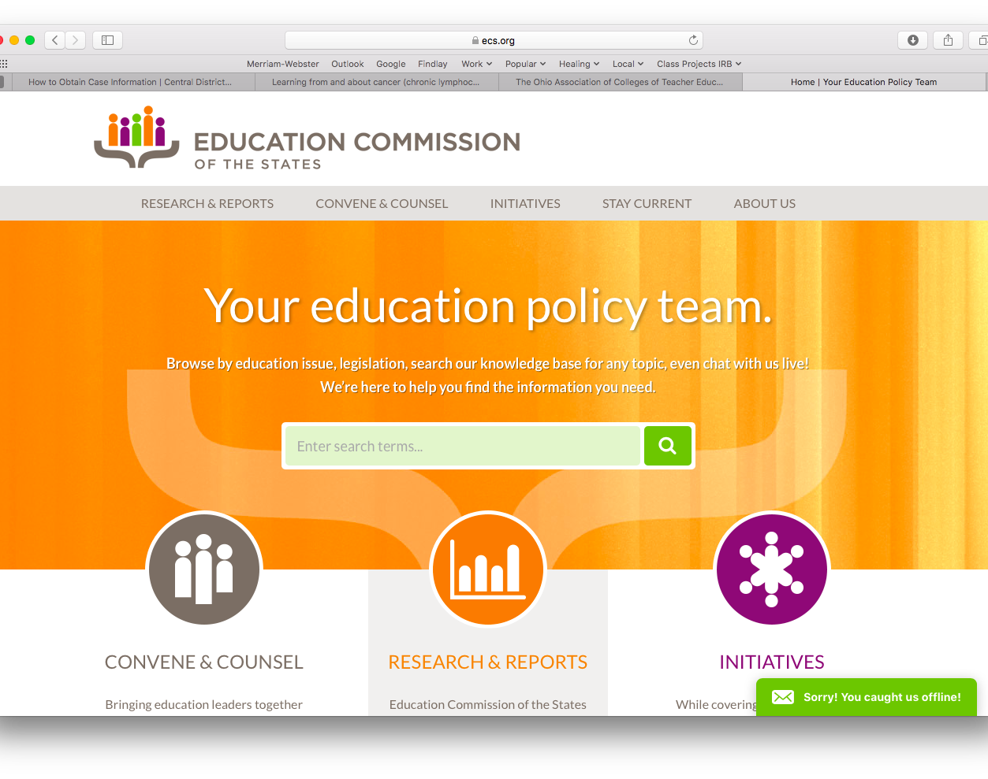
Education Commission of the States
A commission made up of seven representatives from each state, typically including the governor, a state senator, a state representative, and 4 other gubernatorial appointees. A one stop shop for state policy research.
https://www.ecs.org

Slide 32
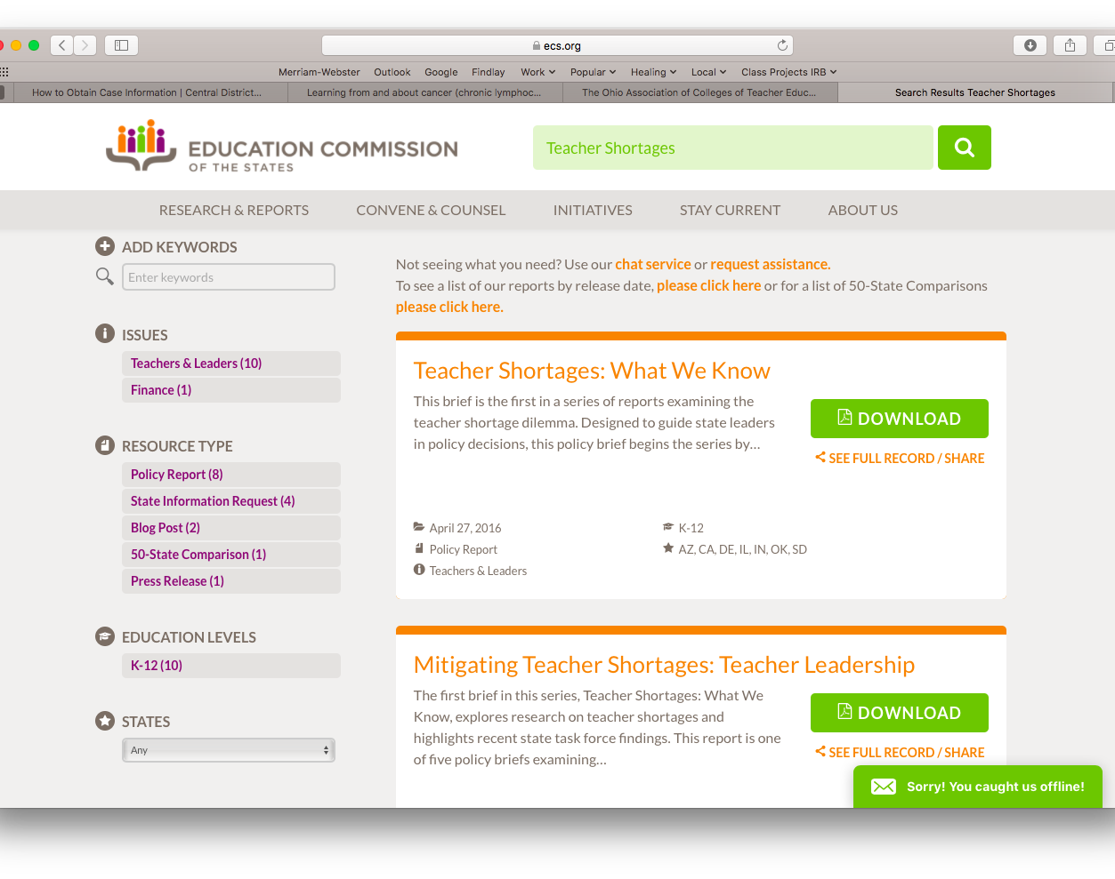
Sample ECS Search
Entering a search term can result in a list of reports generated by the states, most of which are downloadable.

Slide 33
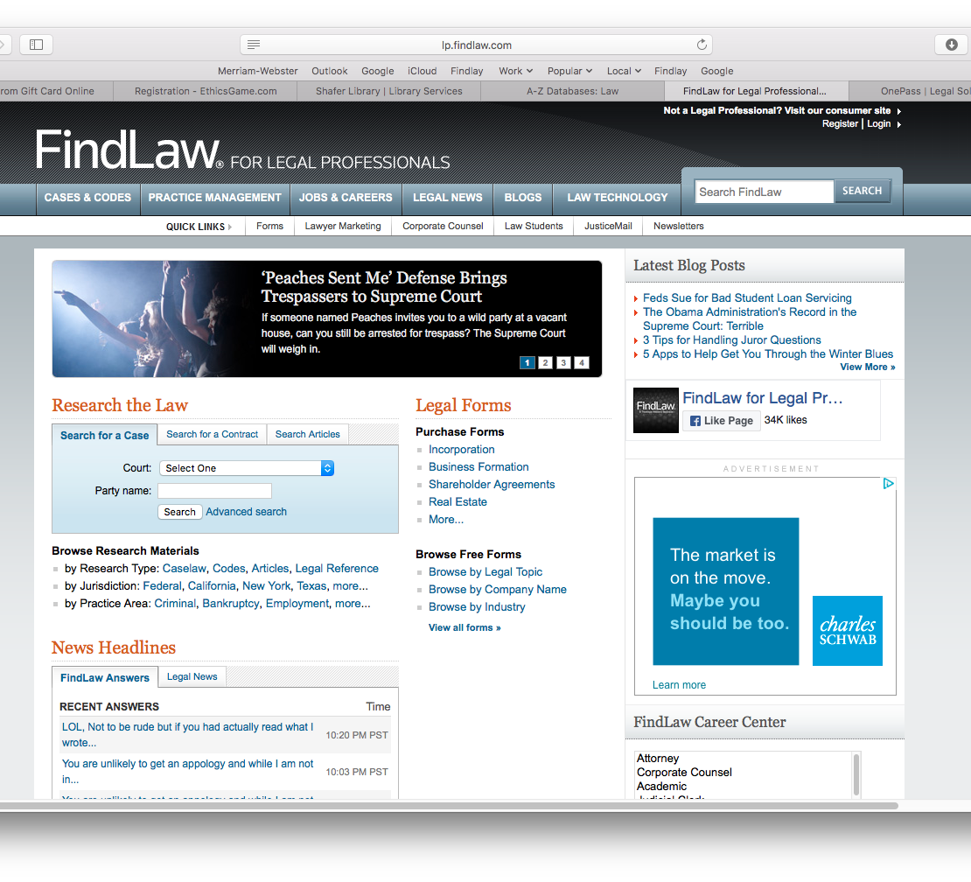
FindLaw for Legal Professionals
Allows you to locate and search laws from around the country, including the Ohio Revised Code.
http://lp.findlaw.com

Slide 34
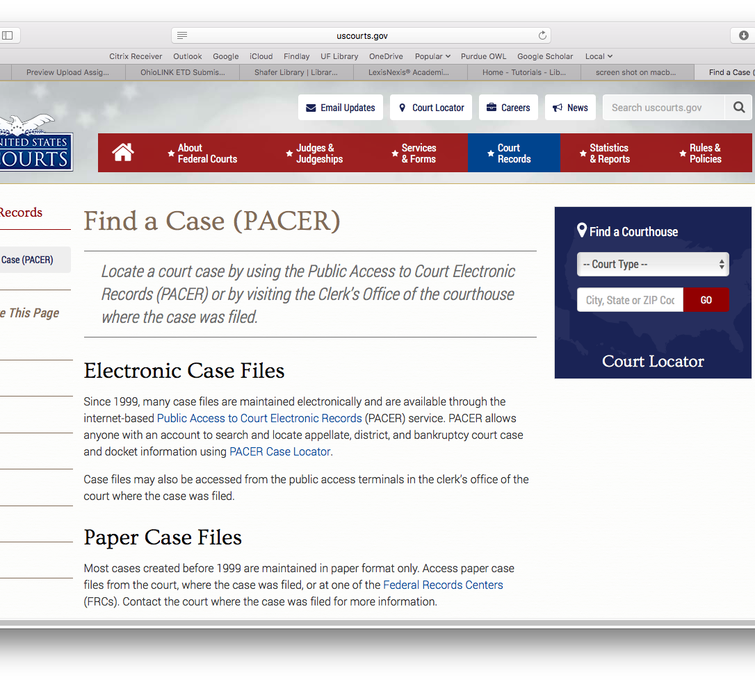
Find a Case
Run by the US Court System. A good reference for case law.
http://www.uscourts.gov/court-records/find-case-pacer

Slide 35
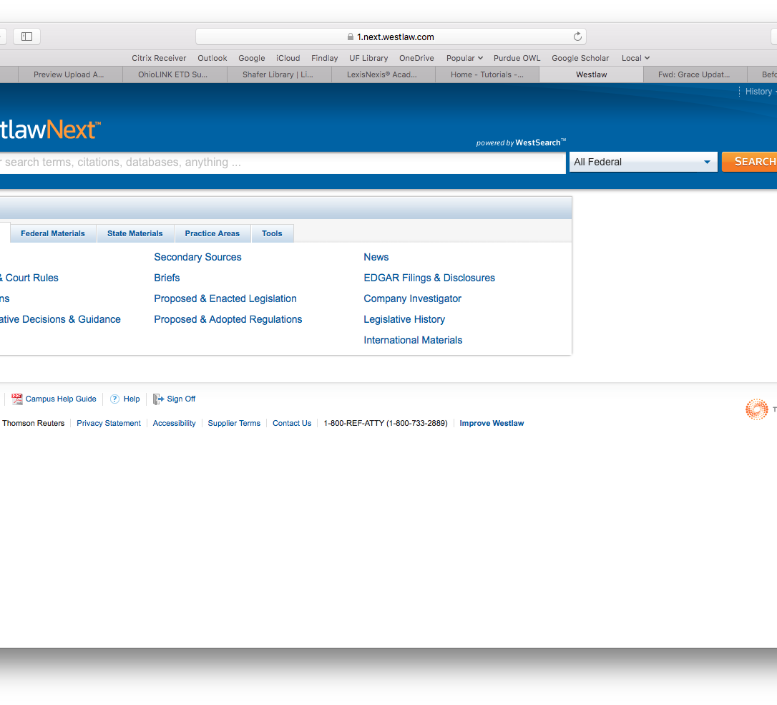
WestLaw
Allows you to search statutes, cases, regulations, administrative decisions, and more. Also provides laws, legislation, and various documents by state.
Note: WestLaw may require an institutional subscription
https://1.next.westlaw.com/Browse/Home/Ohio?transitionType=Default&contextData=(sc.Default)

Slide 36
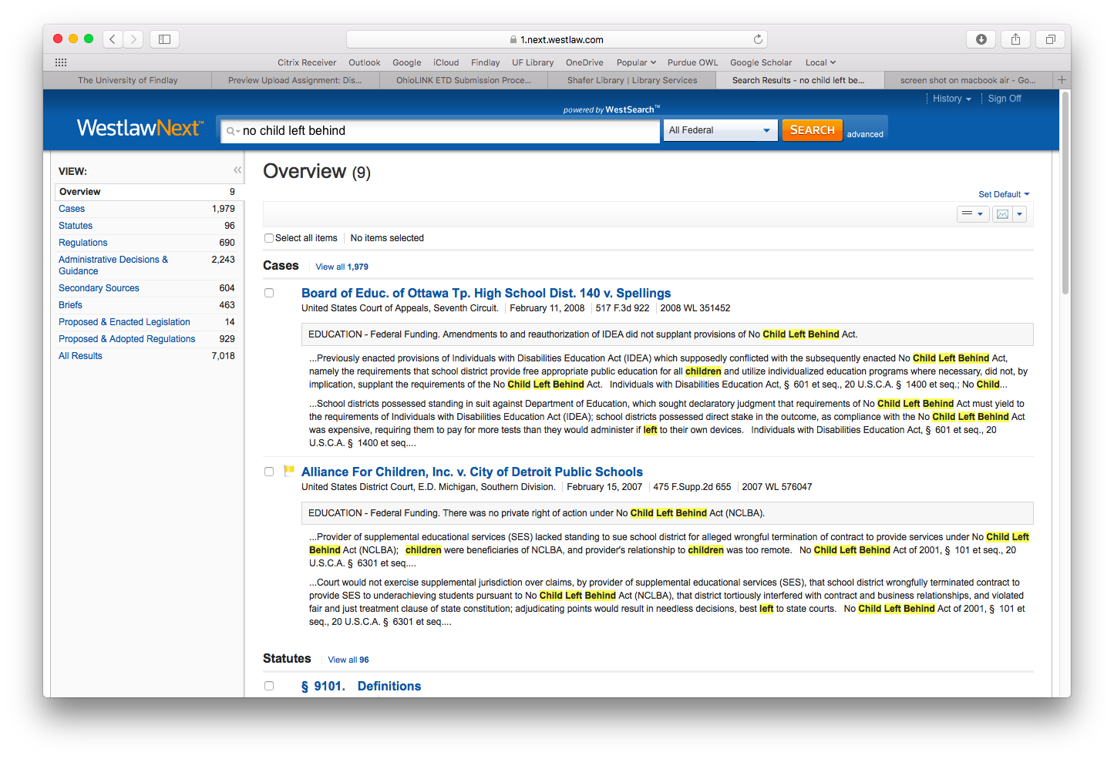
A sample WestLaw search.
Notice all the resources in the left column! Cases, statutes, regulations, administrative decisions, briefs, and so on.

Slide 37
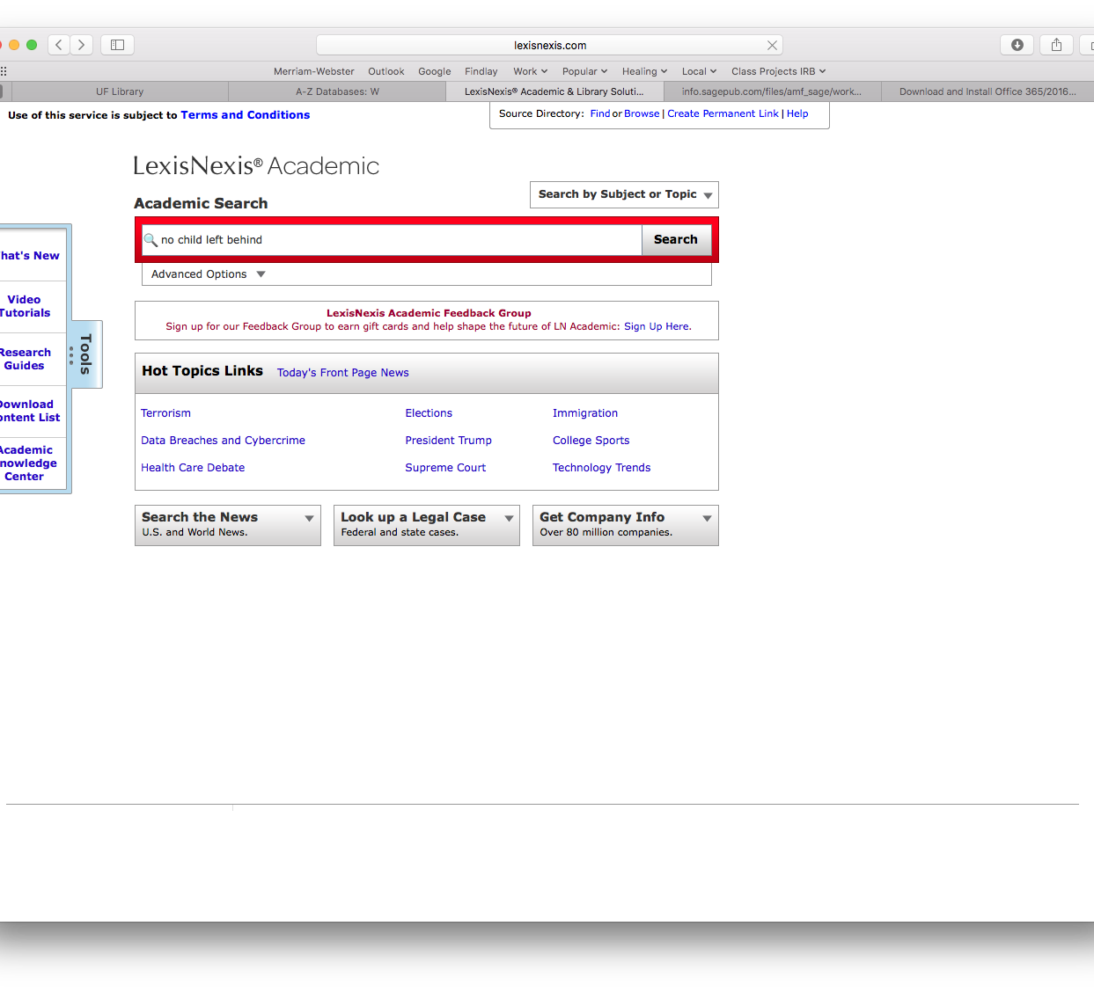
Lexis Nexis Academic
An “academic knowledge center,” a database of information on a variety of topics.
Note: Lexis Nexis may require an institutional subscription
http://www.lexisnexis.com/hottopics/lnacademic/

Slide 38
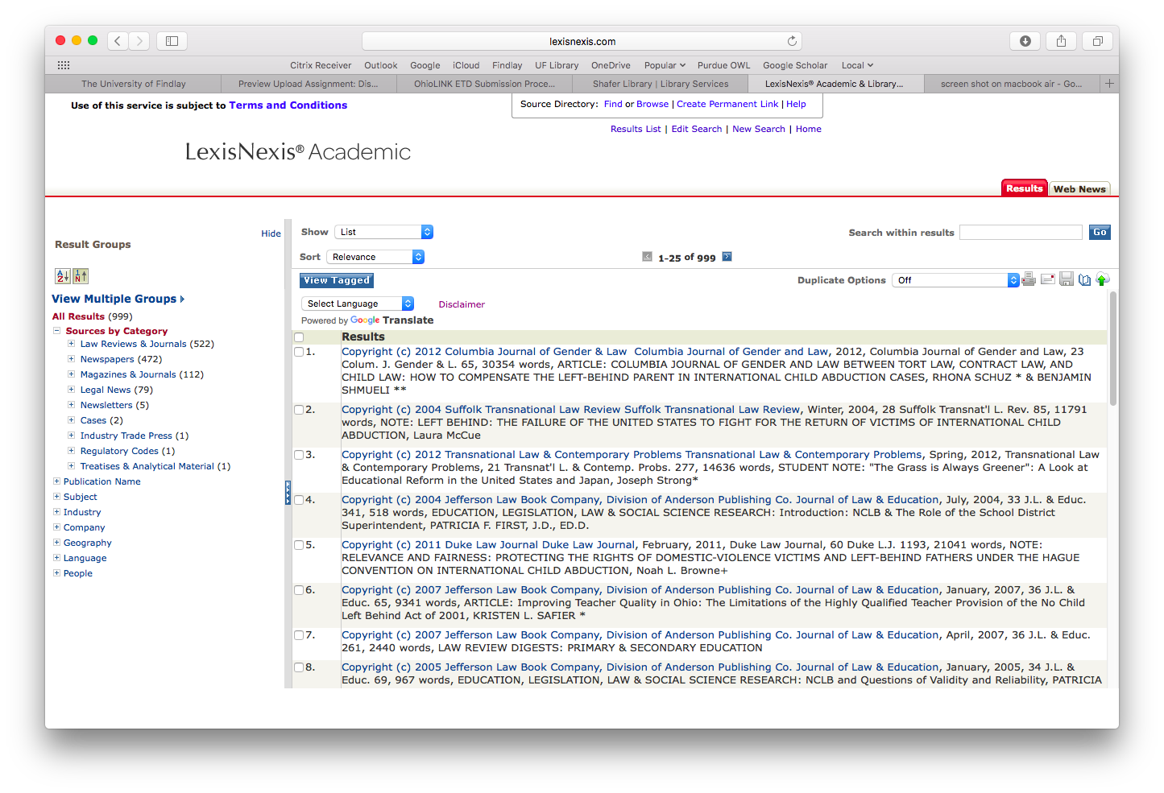
Lexis Nexis Academic Sample Search
This is a sample search. This site also has a list of resources in the left hand column but they are organized according to source. Law Reviews, Cases, Newspapers, Regulatory codes and so on.

Slide 39

The Center On Education Policy
CEP achieves its mission by conducting research, convening meetings and events, and providing expert analyses of current education issues. CEP is nonpartisan and supports the work of many other education, business and civic groups.
https://www.cep-dc.org//

Slide 40

The Consortium for Policy Research in Education
The Consortium for Policy Research in Education (CPRE) brings together education experts from renowned research institutions to contribute new knowledge that informs PK-20 education policy and practice. Our work is peer-reviewed and open-access.
http://www.cpre.org

Slide 41
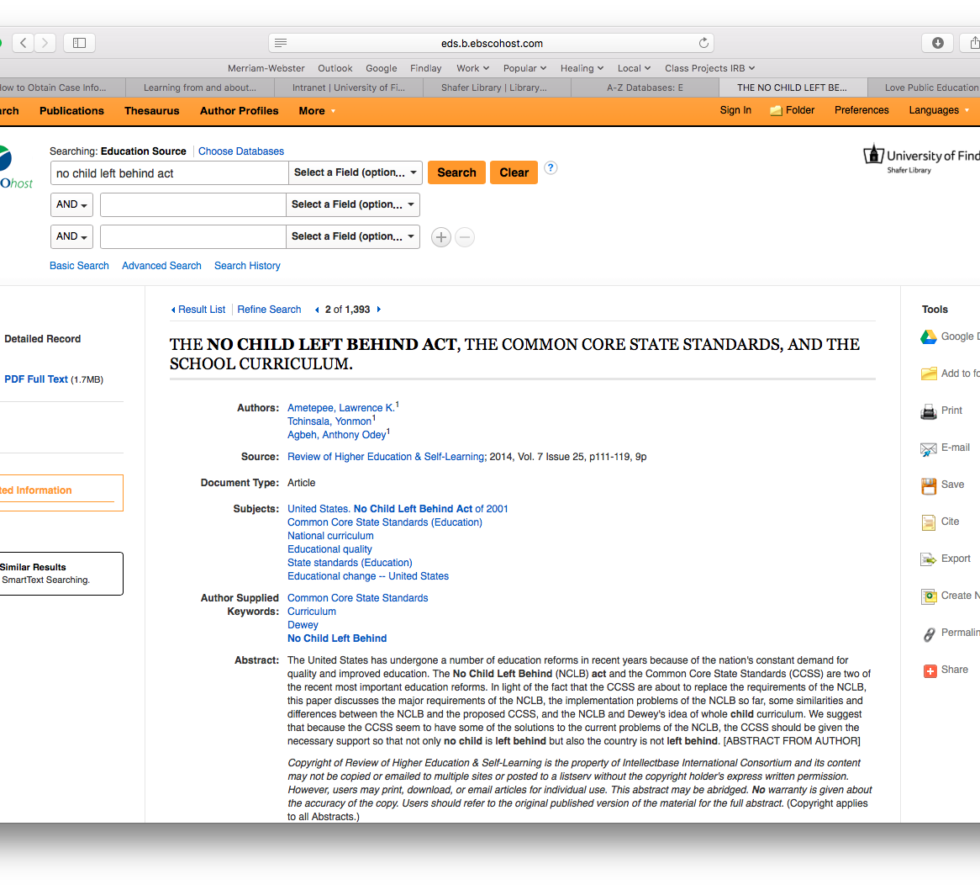
ERIC/EBSCO/Ed Source Searches
Online databases can also provide access to studies, opinion pieces, and expert analysis of particular policies.

Slide 42
Advocacy Groups

Slide 43
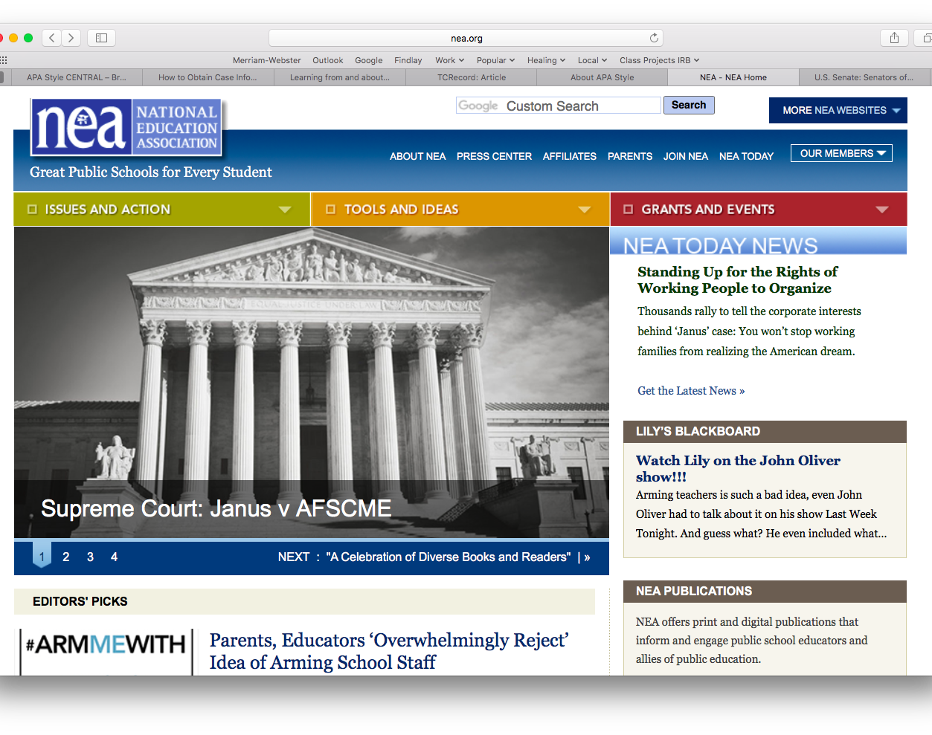
National Education Association
The National Education Association (NEA), the nation's largest professional employee organization, is committed to advancing the cause of public education.
Under the Issues and Action pull down menu, click on Legislative Action Center
nea.org

Slide 44
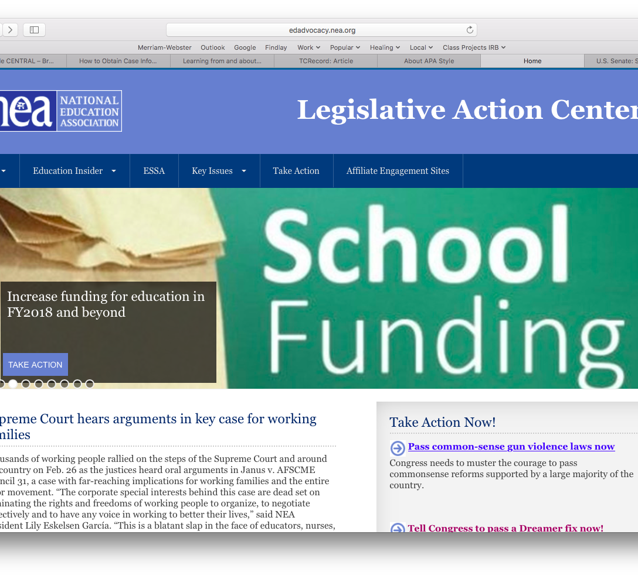
NEA’s Legislative Action Center
The NEA has a ton of resources for policy engagement!
To start getting involved, try clicking on Take Action.
http://edadvocacy.nea.org

Slide 45
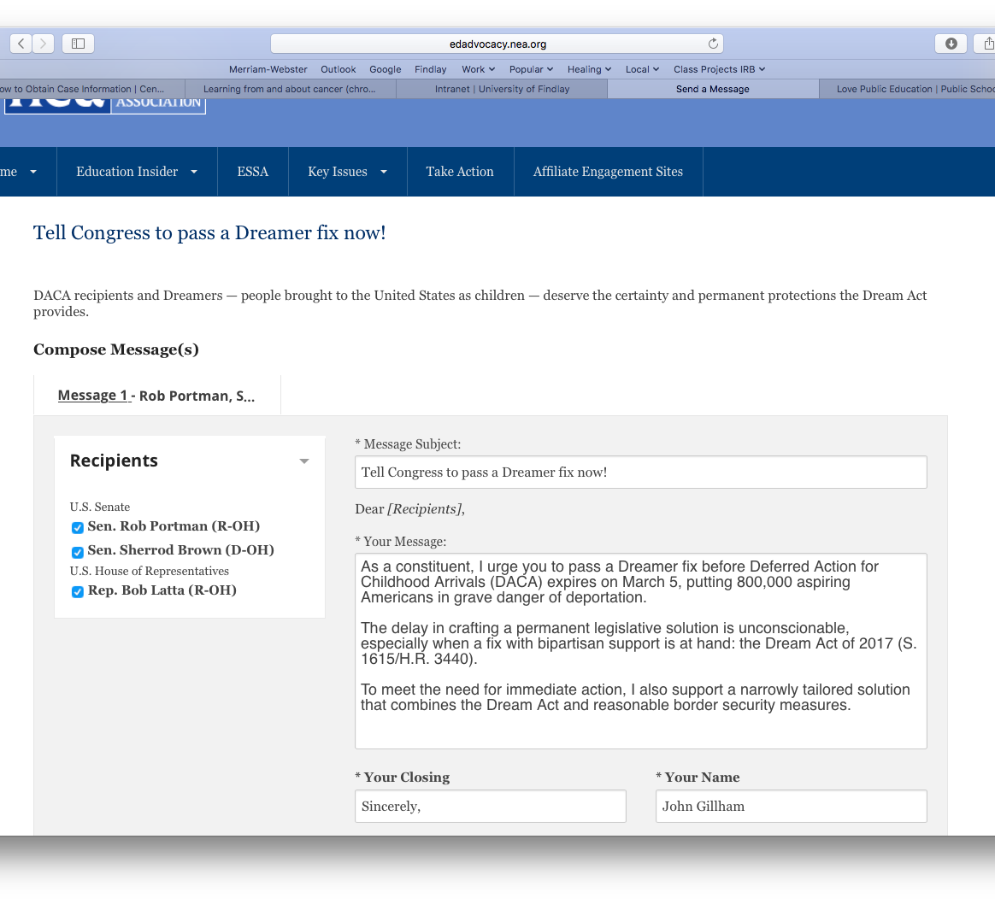
Sample NEA Resource
The NEA has many tools available within it’s Advocacy Center.
One example is the pre-written email. All you need to do is enter your basic contact information and it will provide you with an email that is ready to send!

Slide 46

I Love Public Education (AASA)
The I Love Public Education campaign is a year-long effort to highlight why public schools are essential to developing the future generations that will maintain our country’s status as a world leader.
http://lovepubliceducation.org

Slide 47
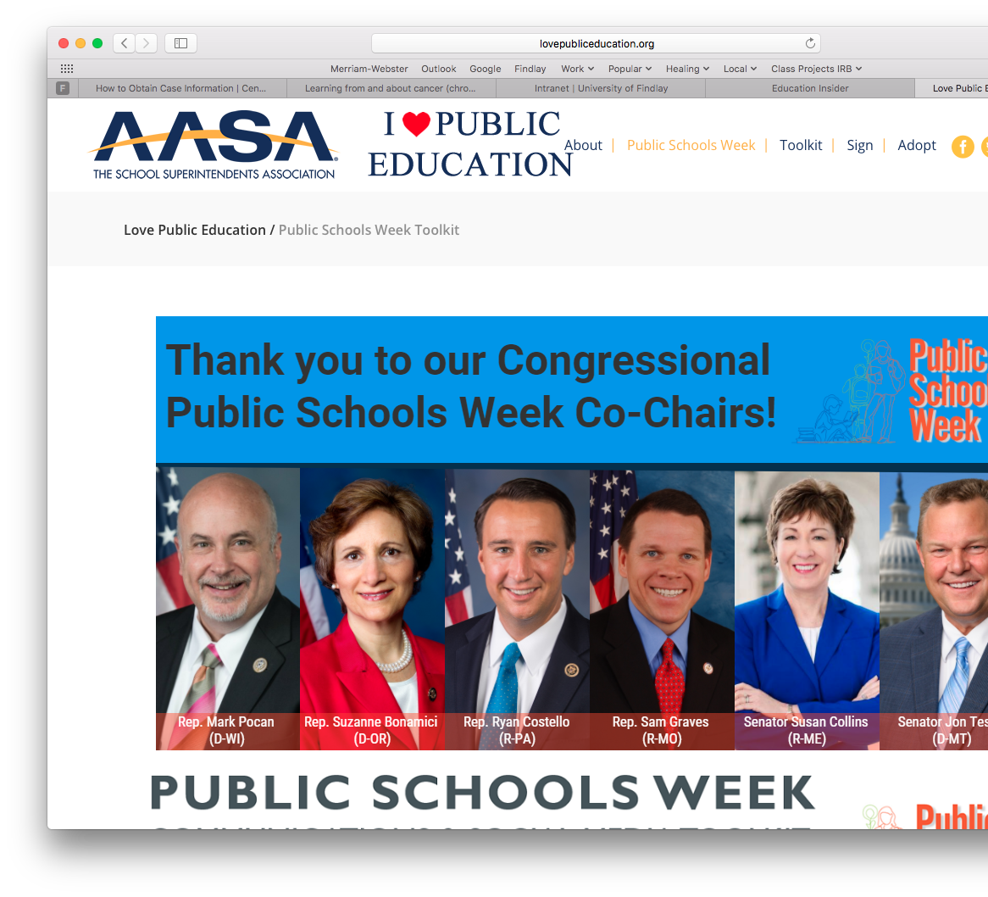
The Public Schools Week Toolkit (AASA)
Free tools for educators including:
What you need to know
Twitter Sample Tweets
Facebook Sample Posts
Press Release Samples
Image Library
http://lovepubliceducation.org/public-schools-week-toolkit/

Slide 48
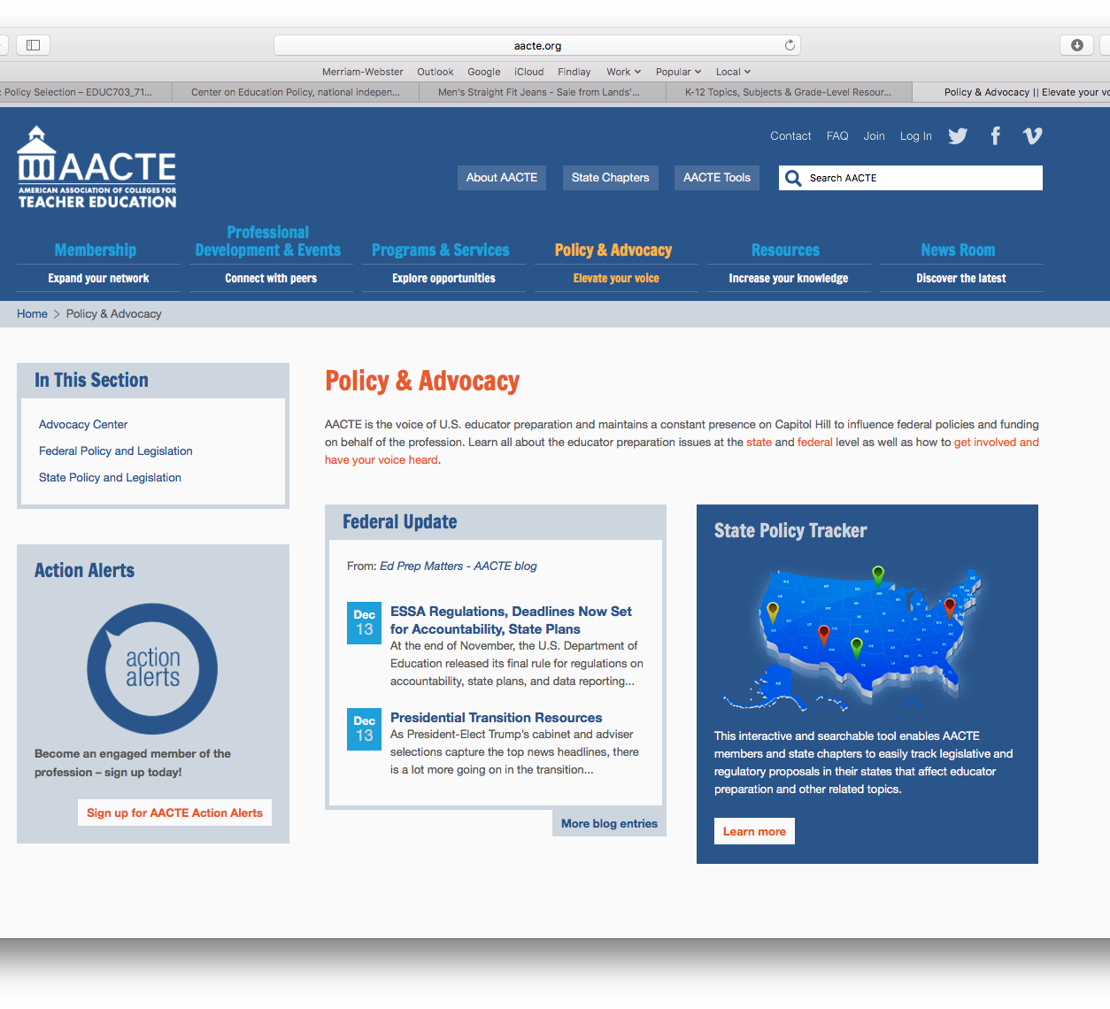
American Association of Colleges for Teacher Education
In the Advocacy Center you will find many resources, including pages for both Federal and State Policy and Legislation.
Click on Policy and Advocacy
Note: full access to the ACCTE website may require an institutional subscription
https://aacte.org

Slide 49

The Education Trust
Fierce advocates for the high academic achievement of all students– particularly those of color or living in poverty. Equity-Driven • Data-Centered • Student-Focused
Select your regional organization in the heading then click on Get Involved.
https://edtrust.org

Slide 50
Sample Resources on Advocacy Websites
Updates on policy
  Documents
  Webinars
  Etc.
State-by-state information
Information on advocating F2F, via social media, etc.
Handouts on policy developments
Pre-written email templates to send to representatives
Other useful information for the non-expert!

Slide 51
Finding Other Advocacy Groups
There are advocacy groups for just about any issue in education
Investigate advocacy groups carefully and be a wise consumer of information before you join.
  National Center for Teacher Quality (NCTQ) vs. Center for Teacher Quality (CTQ)
Pay special attention to their mission, supporters, causes, and position statements.
Caveat emptor!

Slide 52
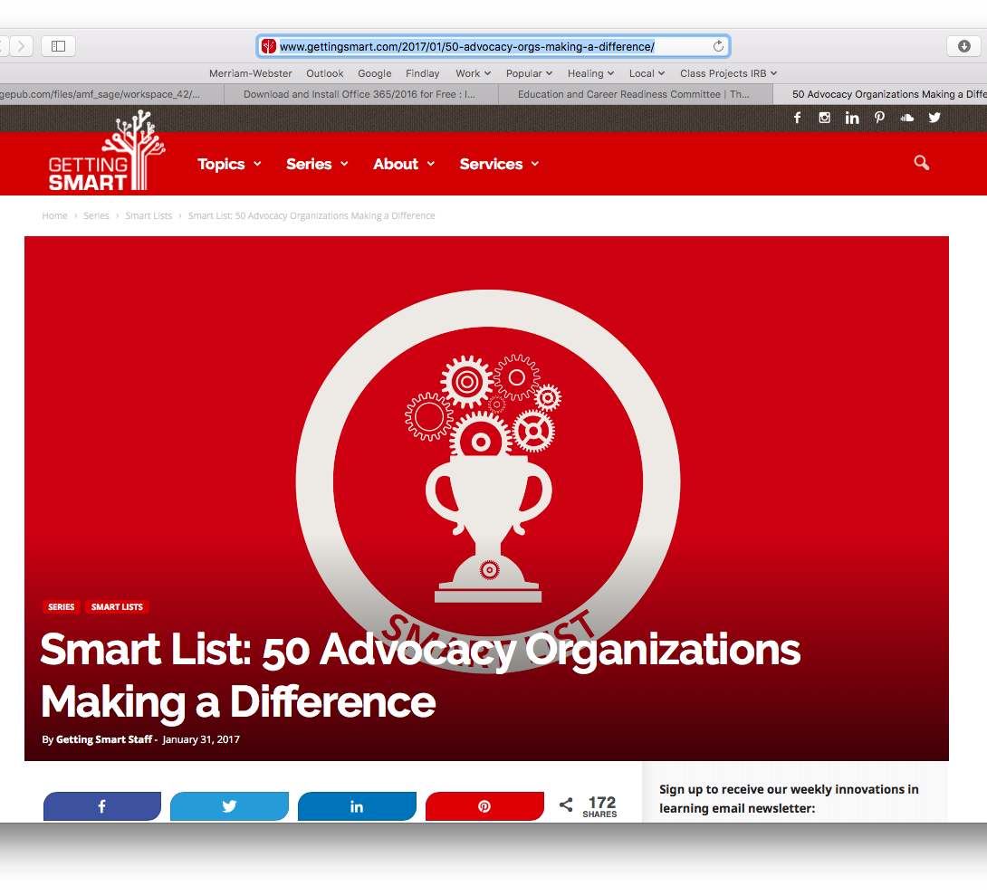
50 Education Advocacy Organizations
This is a list of advocacy groups whose causes and missions vary widely. The list includes groups of all political persuasions and viewpoints.
http://www.gettingsmart.com/2017/01/50-advocacy-orgs-making-a-difference/

Slide 53
Meeting with Policy Makers

Slide 54
How to Set a Meeting
Call or email! It’s simple! If they are available they will meet with you
Try to go with a group of colleagues, if possible
Ask to meet with the representative, but don’t be disappointed if they don’t show up. You may meet with one of their staff members instead. That’s okay, staff members actually write the legislation and talking to them might be even more effective!

Slide 55
Before Your Visit
Be prepared! You will be asked specific questions!
Things you should know:
  Specific details about the policy (regulations, costs, implications, who supports/opposes it, how it relates to other legislation, etc.)
  The background of your representative (their priorities, election cycles, constituent concerns, political alliances, committees they serve on, bills they’ve sponsored, voting record, major actions in congress, etc.)
  Policy’s impact on constituents!

Slide 56
Suggestions for Meeting with Elected Officials
Do your homework!
Before meeting with your representative, set goals for the meeting
Have a clear, simple message and stay on point. What is your “60 second commercial” or your “elevator speech?”
Be positive and polite
Include a local story that illustrates your point
Offer to assist staff in the future with your expertise
Leave behind information
Follow up with a thank you note
Tweet or post a positive comment about the official online. Don’t underestimate social media!

Slide 57
Questions?
John C. Gillham
gillham@findlay.edu

Slide 58
Thank you!

Slide 59
References
Henig, J. (2008). Spin cycle: How research is used in policy debates: The case of charter schools. New York: Russell Sage Foundation.
Hollar, J. (2017). Knowledge distribution as policy limitation? Governance over state teacher equity plans. Paper presented at the Annual Meeting of the American Educational Research Association, San Antonio, TX.
Tompkins-Strange, M. E. (2016). Policy patrons; Philanthropy, education reform, and the politics of influence. Cambridge, MA: Harvard Education Press.
Zelchner, K & Conklin, H. (2016). Beyond knowledge ventriloquism and echo chambers: Raising the quality of the debate in teacher education. Teachers College Record 118(12), p. 1-38.

