Slide 1
Grit to Teach and the Mindset to Stay: Do You Have What It Takes?
Paul G. Young, Ph.D.
Terri Green, M.A.
Debra Dunning, Ph.D.
Danielle Bruning, M.A
Danielle Dunkel, Student
Taylor Maclam, Student
A culture is strong when people work together.
A culture is weak when people work against each other.

Slide 2
About this session…
Teaching grit implies that students will experience and embrace frustration and pain. Aspiring teachers are at a disadvantage if they do not know how to react, respond, and learn from failure. Grit enables teachers to plan, work, and model positive effort, but at the same time summon resilience skills when they don’t succeed.
This session reflects practical applications of grit and mindset theories in college classrooms from research findings of Angela Duckworth, Carol Dweck, Paul Tough, Thomas Hoerr, Jim Grant, the U.S. Department of Education, the Ohio Association of Elementary School Administrators, the Ohio Education Association, and more.

Slide 3
Employability skills are a set of skills and behaviors that are necessary for every job. Employability skills are sometimes called soft skills, foundational skills, work-readiness skills, or job-readiness skills.

Slide 4
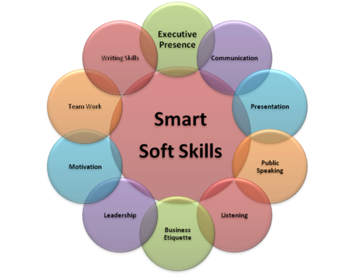
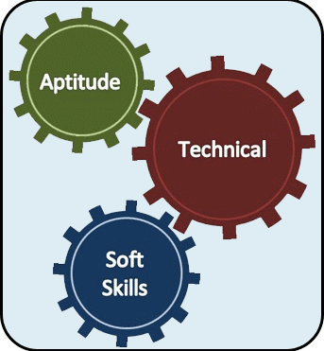

Slide 5
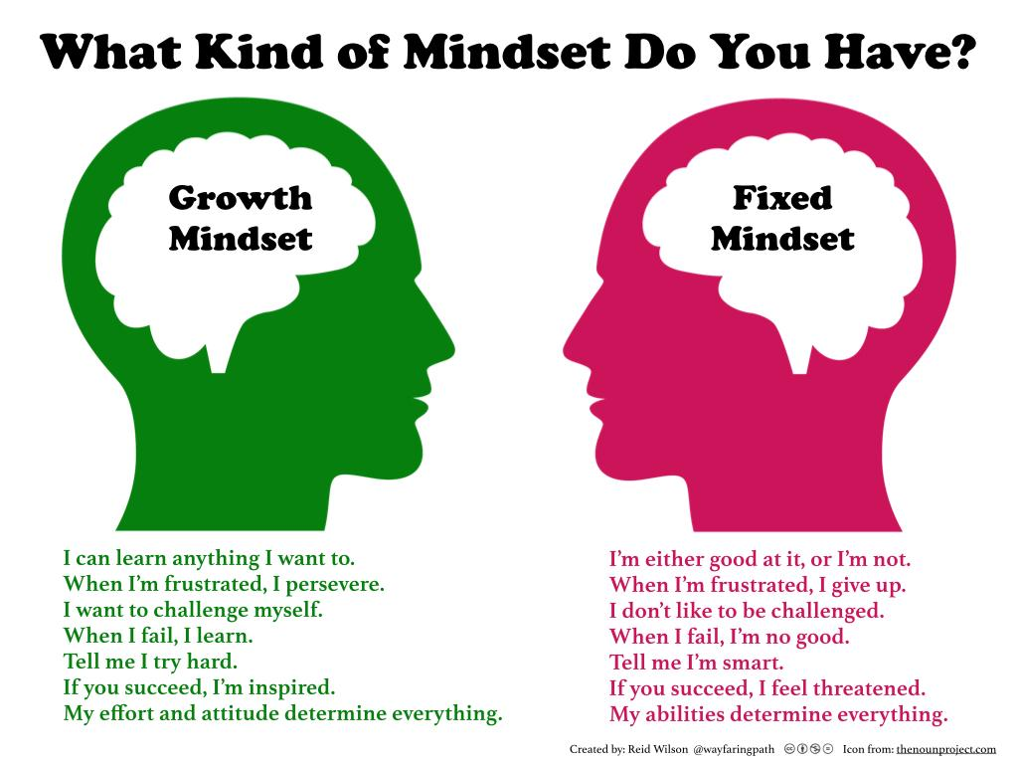
1-C

Slide 6
Come to Class With a Growth Mindset
 | Fixed Mindset (a desire to look smart and just get by) | Growth Mindset (a desire to learn and grow)
Challenges | avoid them | embrace them
Obstacles | give up easily | persist with grit
Effort | fruitless | the path to mastery
Criticism | ignore, even if useful | learn from it
Success of Others | feel threatened by it | become inspired by it
From the work of Carol S. Dweck
Mindset: The New Psychology of Success, 2006
5 arrows

Slide 7
Professional Attitude
Mindset
Habits
Professionalism
Initiative
Reading/Writing
Public Speaking
Personal Care
Preparation
Personal Responsibility

Slide 8
I - Professional Attitude
Do You Have an Attitude?
Do You Have a Sense of Grace and Poise?
Can You Talk to People?

Slide 9
II - Mindset
4. Do You Have a Fixed or Growth Mindset?
5. Do You Know What Grit Is?
6. Are You Envious of Others?
7. Are You Good at Analyzing?
8. Can You Commit to Teaching?
9. Are You Mobile?

Slide 10
III - Habits
10. Do You Have Charisma?
11. Are You a Role Model?
12. What’s Your Excuse?

Slide 11
IV – Professionalism
13. Can You Pass a Background Check? Do You Have Any Secrets?
14. Are Your Tattoos and Piercings Worth Coming in 2nd Place?
15. Do You Know How to Dress Like a Teacher?
16. Is Teaching a Job or a Profession?
17. Do Teachers Have to Tell the Truth?
18. Are You Coachable?

Slide 12
V - Initiative
19. Are You Motivated?
20. Do You Have Curiosity and Know How to Ask Questions?
21. Do You Have a Plan to Achieve Goals?
22. Do You Know How to Click with People?

Slide 13
VI - Reading/Writing
What Do You Read?
Do You Write?
How Extensive Is Your Vocabulary?

Slide 14
VII - Public Speaking
26. Can You Speak Without Using Like, Um, Yeah, So, You Know?
27. Do You Have a Teacher Voice?
28. Do You Suffer from Stage Fright?
29. Can You Communicate with Your Eyes?

Slide 15
VIII - Personal Care
Do Your Friends Bring You Down?
Can You Manage Conflict?
Do You Have Work/Life Balance?
Are You a Multitasking Addict Tied to Your Cell Phone?
Do You Take Care of Yourself?
Do You Have Test Anxiety?

Slide 16
IX – Preparation
36. Can You Envision Professional Career Steps?
37. Do You Have Common Sense?
38. What Is Your Emotional Intelligence Quotient?
39. Are You Historically Literate and On Top of Current Events?
40. Can You Teach Using Current Technologies? Are You Digitally Savvy?
41. Are You Informed About Key Aspects of School Law?
42. Do You Think You Can Teach and Be Politically Correct?
43. Are You Politically Active?

Slide 17
X - Personal Responsibility
44. Can You Reliably Manage Time?
Do You Mind Your Own Business?
Do You Have Any “Pre-Existing” Conditions?
47. Do You Have Eyes in the Back of Your Head?
48. Have You Been Weaned? Are You an Adult?
49. Do You Understand the Concept of Diversity?
50. Can You Showcase Your Passion

Slide 18
Professional Attitude
Mindset
Habits
Professionalism
Initiative
Reading/Writing
Public Speaking
Personal Care
Preparation
Personal Responsibility

Slide 19
EDUCATION MAJORS
Lunch
BUILD THIS DAY AND TIME INTO SPRING SCHEDULE YOUR
Tuesdays
12:30-1:25
SPRING 2017
room 414
Learn
&
Part of OUL’s “So You Think You Can Teach” Seminar Series

Slide 20
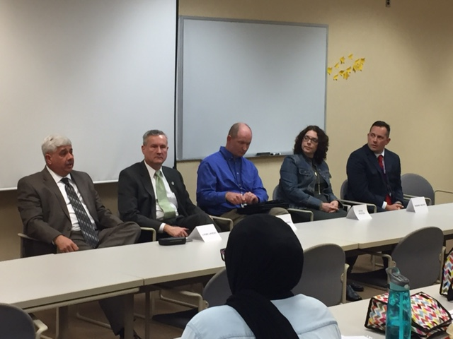
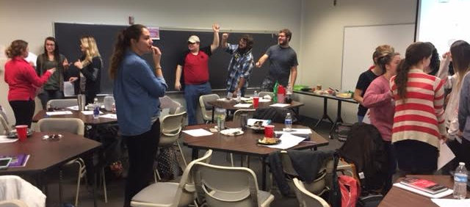
What is Lunch & Learn?
An organized weekly social, learning, and support opportunity for aspiring teachers at Ohio University Lancaster Campus.
Lunch
Learn
&

Slide 21
Objectives of the Seminar Series
Nurture a structured, collegial, supportive campus environment for education majors.
Assist with career discernment decisions.
Address student concerns, issues, and program navigation.
Provide students with knowledge, skills, dispositions, and special insights related to a career in education.
Develop strong relationships with the local education community.
Prepare OUL students with an edge in the job market.

Slide 22
EDUCATION MAJORS
10 Reasons Why YOU Should Attend Lunch & Learn Seminars
Networking opportunities with area educators
Development of soft skill dispositions
Connectedness (teachers, staff, fellow students)
Support from a Professional Learning Community (PLC)
Clarity of expectations related to the major
Enhanced professionalism (thinking, acting, dressing)
Improved social-emotional learning (SEL)
Leadership opportunities
Resume development
Fun, relaxed, hands-on, student-initiated activity

Slide 23
What’s the Importance of Lunch and Learn?
The Lunch and Learn Seminar Series coupled with the Young/Green/Dunning book project have expanded collaborative efforts between the university and the regional schools; specifically strengthening the relationships between colleagues at the university and the teacher/student teacher/professor and school efforts focused on training of aspiring teachers.

Slide 24
SCHEDULE Lunch and Learn, Fall Semester 2016
Date | Time | Location | Topic | Speaker | Organization
August 23 | 12:30-1:25 | Room 414 | OSEA Planning Meeting | Officers Faculty | OUL
August 30 | 12:30-1:25 | Room 414 | Overview of Lunch and Learn: Meet and Eat and Mentoring | Paul Young, OU-L faculty Sue Christian, OEA Maci Sollie, OU-L, OSEA | OUL IGM OSEA
September 6 | 12:30-1:25 | Room 414 | Establishing Your Professional Twitter Page | Danielle Pratt, OU-L, OSEA Sierra Cottrill, OU Athens | OUL OU Athens
September 13 | 12:30-1:25 | Room 414 | Twitter Chat: Professional Development | Danielle Pratt, OUL, OSEA Sierra Cottrill, OU Athens | OUL Athens
September 20 | 12:30-1:25 | Room 414 | OSEA Elections Professional Dispositions | Danielle Bruning, OUL staff | OUL
September 27 | 12;30-1:25 | Room 414 | Child Abuse: ACES Identification | Paul Young, OU-L Faculty Kari Akins, Social Worker | OUL Faculty Fairfield County Jobs and Family Services

Slide 25
Lunch and Learn, Fall Semester 2016
Date | Time | Location | Topic | Speaker | Organization
October 4 | 12:30-1:25 | Room 414 | Wellness and Self-Care: End the Chaos | Annabelle Windon OU-L Student | OSEA@OUL
October 11 | 12:30-1:25 | Room 414 | Establishing a Learner- Centered Environment | Angie Leitnaker, 1st Grade Teacher Keith Robinson, Middle School Social Studies Teacher | Liberty Union-Thurston Local School District
October 18 | 12:30-1:25 | Room 414 | Super Duper Alice Cooper | Danielle Dunkel OU-L Student | OSEA@OUL
October 25 | 12:30-1:25 | Room 414 | Drug Program: DARE | Officer Frost | Pickerington (OH) Police Department
November 1 | 12:30-1:25 | Room 414 | You’re Hired: Good and Bad Resumes | Nathan Hale Director of Personnel | Lancaster City Schools

Slide 26
Lunch and Learn , Fall Semester 2016
Date | Time | Location | Topic | Speaker | Organization
November 8 | 12:30-1:25 | Room 414 | Resume and Cover Letter Writing | Jodi Pavol CLDC | OU Athens
November 15 | 12:30-1:25 | Room 414 | Challenging Student Behaviors | Donna McCance Director of Special Education Jesse Burr, Social Worker | Lancaster City Schools
November 22 | 12:30-1:25 | Room 414 | Recruitment and Retention: Three Perspectives | Jake Campbell, Principal Emily Nelson, Teacher Crystal Wood, OU-L Student | Lancaster City Schools OSEA@OUL
November 29 | 12:30-1:25 | Room 414 | Fall Semester Celebration Spring Semester Planning | Members Danielle Pratt, OU-L; OSEA Slide Show | OSEA@OUL
December 6 | NO SEMINAR | Room 414 | Finals Week

Slide 27
Lunch and Learn, Spring Semester 2017
Date | Time | Location | Topic | Speaker | Organization
Jan.10 | 12:30-1:25 | Room 414 | OSEA Student Leadership and Membership drive | Scott DiMauro; OEA Vice President (Columbus) | OEA/OSEA OSEA-OUL
Jan.17 | 12:30-1:25 | Room 414 | Positive Classrooms | Natalie Brate, Teacher | Liberty Union-Thurston Local School District
Jan. 24 | 12:30-1:25 | Room 414 | Easy Technology Tips | Kelley Savage, Technology Director | Liberty Union-Thurston Local School District
Jan. 31 | 12:30-1:25 | Room 422 | Taco Tuesday Social & Sharing Event | Members | OSEA@OUL Executive Board
Feb. 7 | 12:30-1:25 | Room 414 | Q&A Principal Panel Area School Administrators | Zack Howard, Director Accountability/Assessment Dr. Lynn Landis, Superintendent Debbie Heath, Principal Steve Poston, Principal Dr. Mike Bruning, Director of Transportation | Pickerington LSD Bloom Carroll LSD Logan-Hocking LSD Lancaster City Schools Canal Winchester LSD
Feb. 14 | 12:30-1:25 | Room422 | Social and White Elephant School Supplies Donation | Members | OSEA@OUL Executive Board

Slide 28
Lunch and Learn, Spring Semester 2017
Date | Time | Location | Topic | Speaker | Organization
Feb. 21 | 12:30-1:25 | Room 414 | School Supplies Donation Box Gift Wrapping | Members | OSEA@OUL
Feb. 28 | 12:30-1:25 | Room 414 | Hot Topics in Education | Dr. Jeromey Sheets, Director of Elementary Education | Lancaster City Schools
Mar. 7 | NO SEMINAR | Room 414 | Spring Break
Mar. 14 | 12:30-1:25 | Room 414 | Learning Difficulties and Poverty | Deb Smith (OU-L Faculty) First Lady of Lancaster, Ohio | Community and Child Advocate
Mar. 21 | 12:30-1:25 | Room 414 | International Education Experiences | Leisha Caudill | OUL

Slide 29
Lunch and Learn, Spring Semester 2017
Date | Time | Location | Topic | Speaker | Organization
Mar. 28 | 12:30-1:25 | Brasee 414 | Innovative Teaching Options | Sharon Scheidegger Kellie Demmler | OUL Education Alumni
Apr. 4 | 12:30-1:25 | Brasee 414 | Summer Reading PD | Abbie Wright, OU-L; OSEA Meshach McCann, OU-L | OSEA@OUL
Apr. 11 | 12.30-1:25 | Brasee 414 | OSEA Conference Officer Election | Executive Board | OSEA@OUL
Apr. 18 | 12:30-1:25 | Brasee 414 | Year Celebration/ Officer Installation
Apr. 25 | NO SEMINAR |  | Finals Week

Slide 30
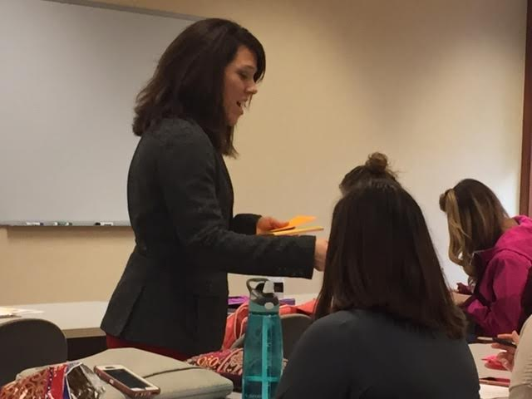
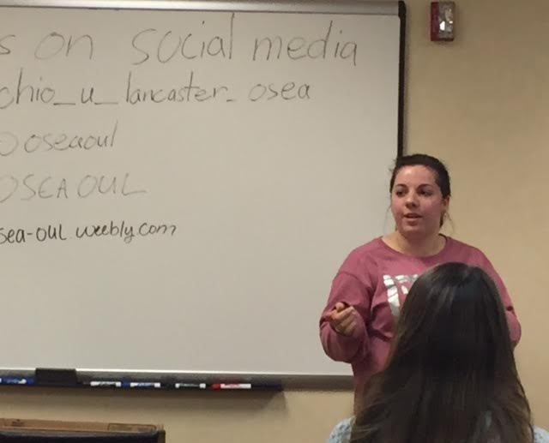
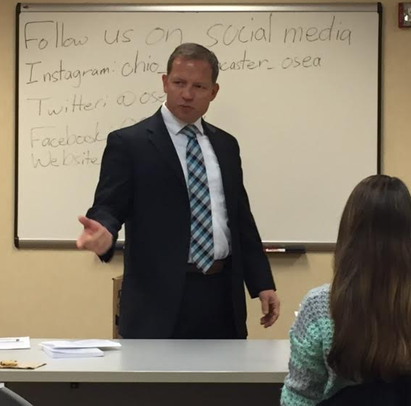
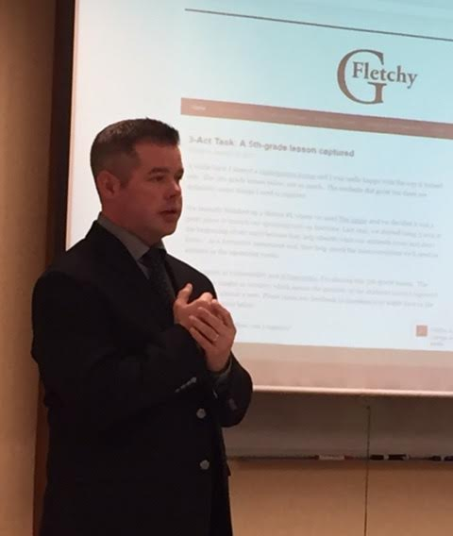
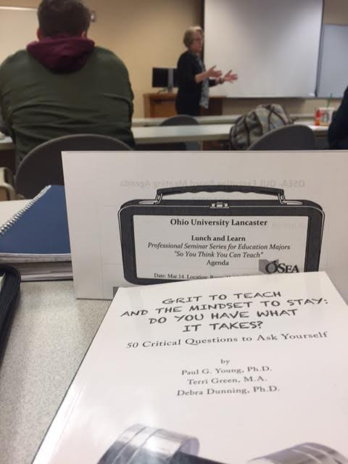
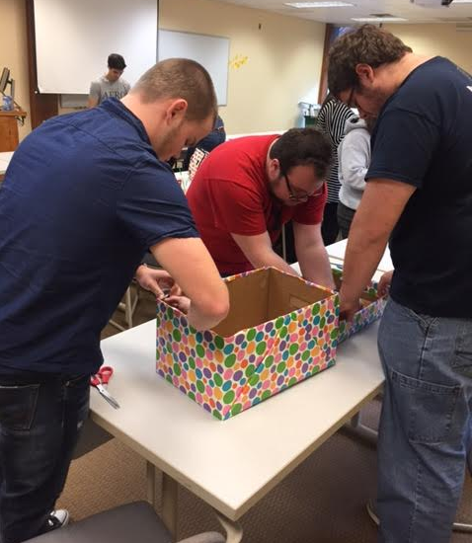
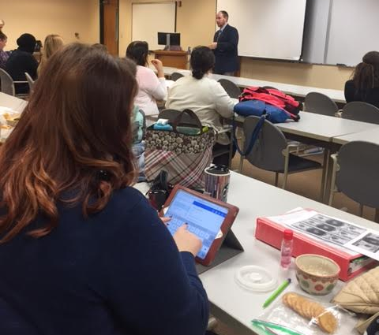

Slide 32
OUTCOMES
Successes
Challenges
Interest/reception from participants
Awards/acknowledgement from OU-Athens
Integration of OSEA and Seminar Series
Promotional support/OUL staff
Variety of presentations
Positive reception/support from area educators/presenters
Coordinators learned from students, presenters, and each other
Schedule conflicts with classes
Student work schedule conflicts
Communication with adjuncts
Buy-in from all campus staff
Time
Funding for food/snacks

Slide 33
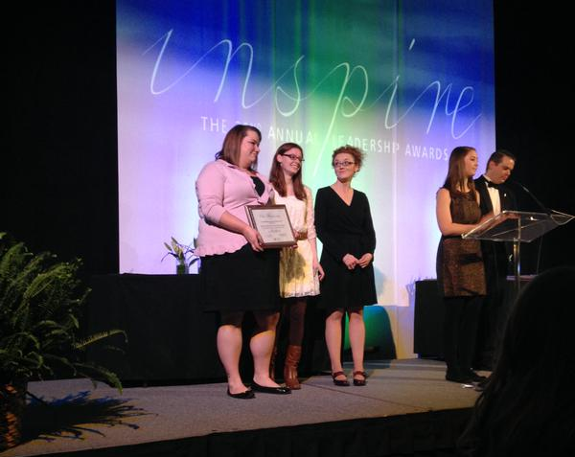
OHIO UNIVERSITY Leadership Awards Gala April 1, 2015
2014-15 Outstanding Programming Award
Ohio Student Education Association
OU-Lancaster Campus “Lunch and Learn”
(fall semester 2014)

Slide 34
Recommendations for EPPs
Include dispositions statements in syllabi as part of course objectives and evaluation.
Have students complete a “soft skills” dispositions pre/post assessment survey and set disposition goals.
Create on campus opportunities to build professional learning communities such as weekly seminars.
Integrate teaching of “soft skills” throughout preparatory program.
Create student organizations related to degrees.
Create a student advisory group related to specific degrees.
//osea-oul.weebly.com/
https://www.facebook.com/OSEAOUL
https://twitter.com/OSEAOUL

Slide 35
What students say…
“ Lunch and Learn is yet another way our university is preparing and putting our future dreams a step closer to reality.”
“ I attended Lunch and Learn so that I would be more prepared and confident in my clinical experience.”
“ Lunch and Learn helped me connect with passionate future colleagues who have knowledge and wisdom, making my dreams seem achievable.”
“ I joined the OSEA and participated in Lunch and Learns to be part of an organization that pushes me to succeed. They’ve been great for all the tips and tricks we don't learn in class, a great way to make new friends, and an opportunity to network with educators in our community.”

Slide 37
We want to know what you think. Let’s connect to share stories and ideas. Together, let’s grow our mindset and become grittier leaders.
@paulyoungohio
https://www.linkedin.com/in/paul-g-young-ph-d-5240961b
https://www.facebook.com/paul.young.7165
paulyoungohio@gmail.com
614-296-4246

Slide 38
Need Assistance? Contact us for support and information about:
Principal Support Services
Staff Training Opportunities
School-Afterschool Connections
Keynote Addresses (Back-to-School)
Teacher Education & Retention
Music Teacher Staff Development
Leadership Presentations
How Can We Help?
Auto to end

Slide 39
References
Benedetti, C. (2016). The Problem with Grit. Phi Delta Kappan, Vol. 9, No. 7. April 2016.
Blanchard, K. Oncken, W. & Burrows, H. (1989). The One Minute Manager Meets the Monkey. New York: William Morrow and Company.
Davis, V. (2014). True Grit: The Best Measure of Success and How to Teach It. Edutopia, January 9, 2014.
Duckworth, A. Google 8- Item Grit Scale.
Duckworth, A. (2016). Grit: The Power of Passion and Perseverance. New York: Simon and Shuster.
Duhigg, C. (2016). Smarter Faster Better. New York: Random House.
Dweck, C. (2007). Mindset: The New Psychology of Success. New York: Random House.
Elmore, T. (2012). Artificial Maturity: Helping Kids Meet The Challenge of Becoming Authentic Adults. San Francisco: Jossey-Bass.
Elmore, T. (2010). Generation iY: Our Last Chance to Save Their Future. Atlanta: Poet Gardener Publishing.

Slide 40
References
Ericsson, A., & Pool, R. (2016). Peak: Secrets from the New Science of Expertise. New York: Houghton Mifflin.
Farber, K. (2010). Why Great Teachers Quit And How We Might Stop the Exodus. Thousand Oaks, CA: Corwin Press.
Hoerr, T. (2013). Fostering Grit: How Do I Prepare My Students For The Real World? Alexandria, VA: ASCD.
Grant, J., Grant, C. & McGreevy, J. (2016). Grit to Go. Peterborough, NH: Staff Development for Educators.
Grant, J. & Grant, C. (2016). What Gritty Kids Do When No One Is Looking. Peterborough, NH: Staff Development for Educators.
Kohn, A. (2014). The Myth of the Spoiled Child: Challenging the Conventional Wisdom about Children and Parenting. Boston: Da Capo Press.
Knight, D., Sheets, J., & Young, P. (2015). Is the Grit Phenomenon Edu-fact or Edu-fad? Principal Navigator, Vol. 10, No. 3, p. 32-35.
Lythcott-Haims, J. (2016). How to Raise an Adult: Break Free of the Overparenting Trap and Prepare Your Kid for Success. New York: Henry Holt and Company.
Meyer, U. (2015). Above the Line: Lessons in Leadership and Life from a Championship Season. New York: Penguin Press.

Slide 41
References
Pappano, L. (2013). “Grit” and The New Character Education. Harvard Education Newsletter Vol. 29, Number 1—Jan./Feb.
Putnam, R., (2015). Our Kids: The American Dream in Crisis. New York: Simon and Schuster.
Ricci, M. (2013). Mindsets in The Classroom: Building a Culture of Success and Student Achievement in Schools. Waco, TX: Purfrock Press, Inc.
Silver, D. (2012). Fall Down 7 Times, Get Up 8. Teaching Kids to Succeed. Thousand Oaks, CA; Corwin Press.
Tough, P. (2012). How Children Succeed: Grit, Curiosity, and the Hidden Power of Character. Boston: Houghton Mifflin Harcourt.
Tough, P. (2016. Helping Children Succeed: What Works and Why. New York: Houghton Mifflin Harcourt.
Tulgan, B. (2009). Not Everyone Gets a Trophy: How to Manage Generation Y. San Francisco: Jossey-Bass.
Wormeli, R. Perseverance and Grit. AMLE Magazine, Jan. 2014, Vol. 1, #5.
Young, P., Green, T., & Dunning, D. (2016). Grit to Teach and the Mindset to Stay: Do You Have What It Takes? Austin, TX: Sentia Publishing.

Slide 42
Recommended Reading

Slide 43
Children’s Books

Slide 44
Web Resources
http://www.edutopia.org/
http://www.mindsetonline.com/
https://sites.sas.upenn.edu/duckworth
http://www.naesp.org/

Slide 45
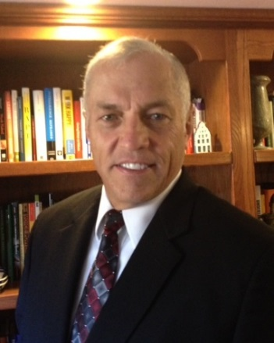
Presenter Contact Information
Paul G. Young, Ph.D.
485 Crestview Drive
Lancaster, OH 43130
614-296-4246 (C)
paulyoungohio@gmail.com
www.youngprinciples.com
Notes:
The PowerPoint Student-Staff Expectations Template is available upon request.

