Slide 1
OCTEO Conference
ODE Update ∙ April 1, 2016

Slide 2
Overview
Ohio Assessments for Educators
Title II Report
Resident Educator Program
K-12 Ohio Learning Standards
School Counselors
Educator Licensure
Contact Email: John.Soloninka@education.ohio.gov

Slide 3

http://www.oh.nesinc.com/
OAE Dance, Reading, ASL Assessments
OAE Middle Grades Assessments Review
Faculty and Teachers needed for the Assessment Validation Studies

Slide 4

Title II Report
View Title II Reports
https://title2.ed.gov/Public/Home.aspx
Westat Technical Assistance
Ph: 877-684-8532
Contact Email: title2@westat.com

Slide 5
Title II Update
Pearson’s website is open to submit teacher candidate data for the 2016 Report
due April 30.
Pearson will conduct a data exchange with ETS and ACTFL.
ODE Contact Email:
Lori.Parker@education.ohio.gov

Slide 6
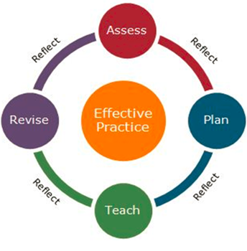
Resident Educator Program
Resident educators must have mentors in years one and two of the program. Two Day Mentor Training is available this summer starting in June at selected ESCs. Cost is $85/day.
Resident educators must take the summative assessment in year three of the program.

Slide 7
Resident Educator Summative Assessment (RESA)
RESA Handbook is available on the Educopia website and at: www.OhioRESA.com
RESA Instrument and RESA Participant Guidebook
Score Reports will be provided by June 15
REs who fail the RESA three times will have their licenses inactivated by ODE
They will have to complete 3 semester hours of coursework in education

Slide 8
Ohio’s Learning Standards
http://education.ohio.gov/Topics/Ohios-Learning-Standards
Sign up for email updates, volunteer for a working group
2016 Revisions:
English Language Arts and Mathematics
  Public Survey ends April 5
  Advisory and Working groups meet Summer and Fall
  Revised Standards posted for Public Comment
  SBOE adopts revised standards December
Educators begin to transition to the revised standards in 2017-2018 School Year

Slide 9
Ohio’s Learning Standards
http://education.ohio.gov/Topics/Ohios-Learning-Standards
2016-2017 Revisions:
Science, Social Studies and Financial Literacy
  Public Survey TBA
  Advisory and Working groups meet TBA
  Revised Standards posted for Public Comment
  SBOE adopts revised standards TBA
Educators begin to transition to the revised standards 2018-2019 School Year

Slide 10
School Counselors http://www.ohioschoolcounselor.org/
Ohio School Counselor Standards
Ohio School Counselor Evaluation Framework
Districts are to have School Counselor Evaluation Framework in place by fall 2016
Contact Email:
Carolyn.George@education.ohio.gov

Slide 11
Office of Educator Licensure
ODE Office of Educator Licensure
http://education.ohio.gov/Topics/Teaching/Educator-Licensure
Kerry Martinez
For Faculty with issues, please contact Kerry by email: Kerry.Martinez@eduation.ohio.gov
For Candidates with issues, please call the OEL specialists: 614-466-3593

Slide 12
CORE
SAFE Account
My Educator Profile Dashboard
STARS

Slide 13
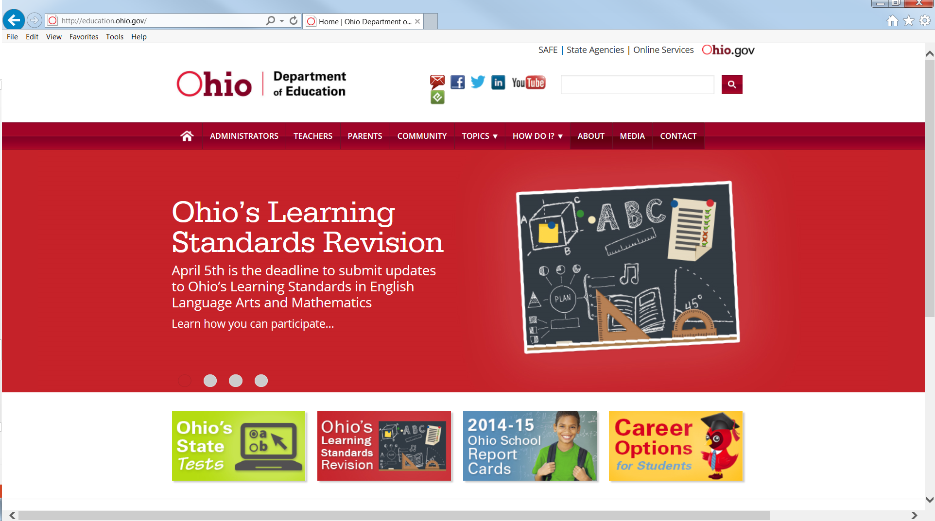
ODE Safe Account www.education.ohio.gov

Slide 14
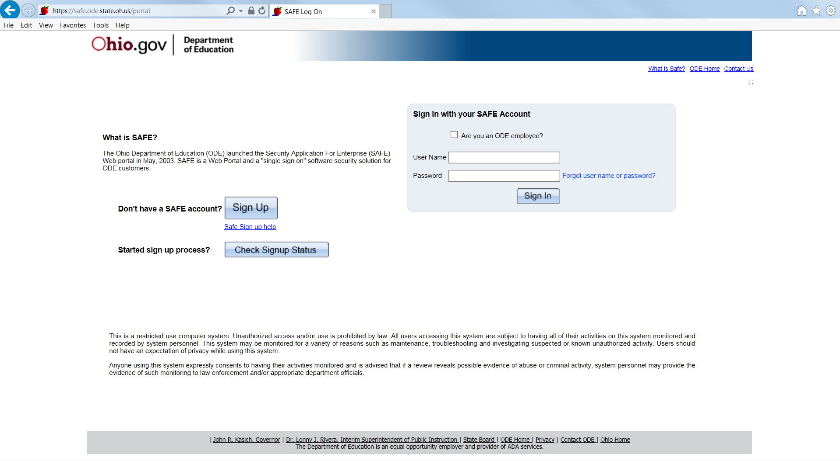
ODE Safe Account www.education.ohio.gov

Slide 15
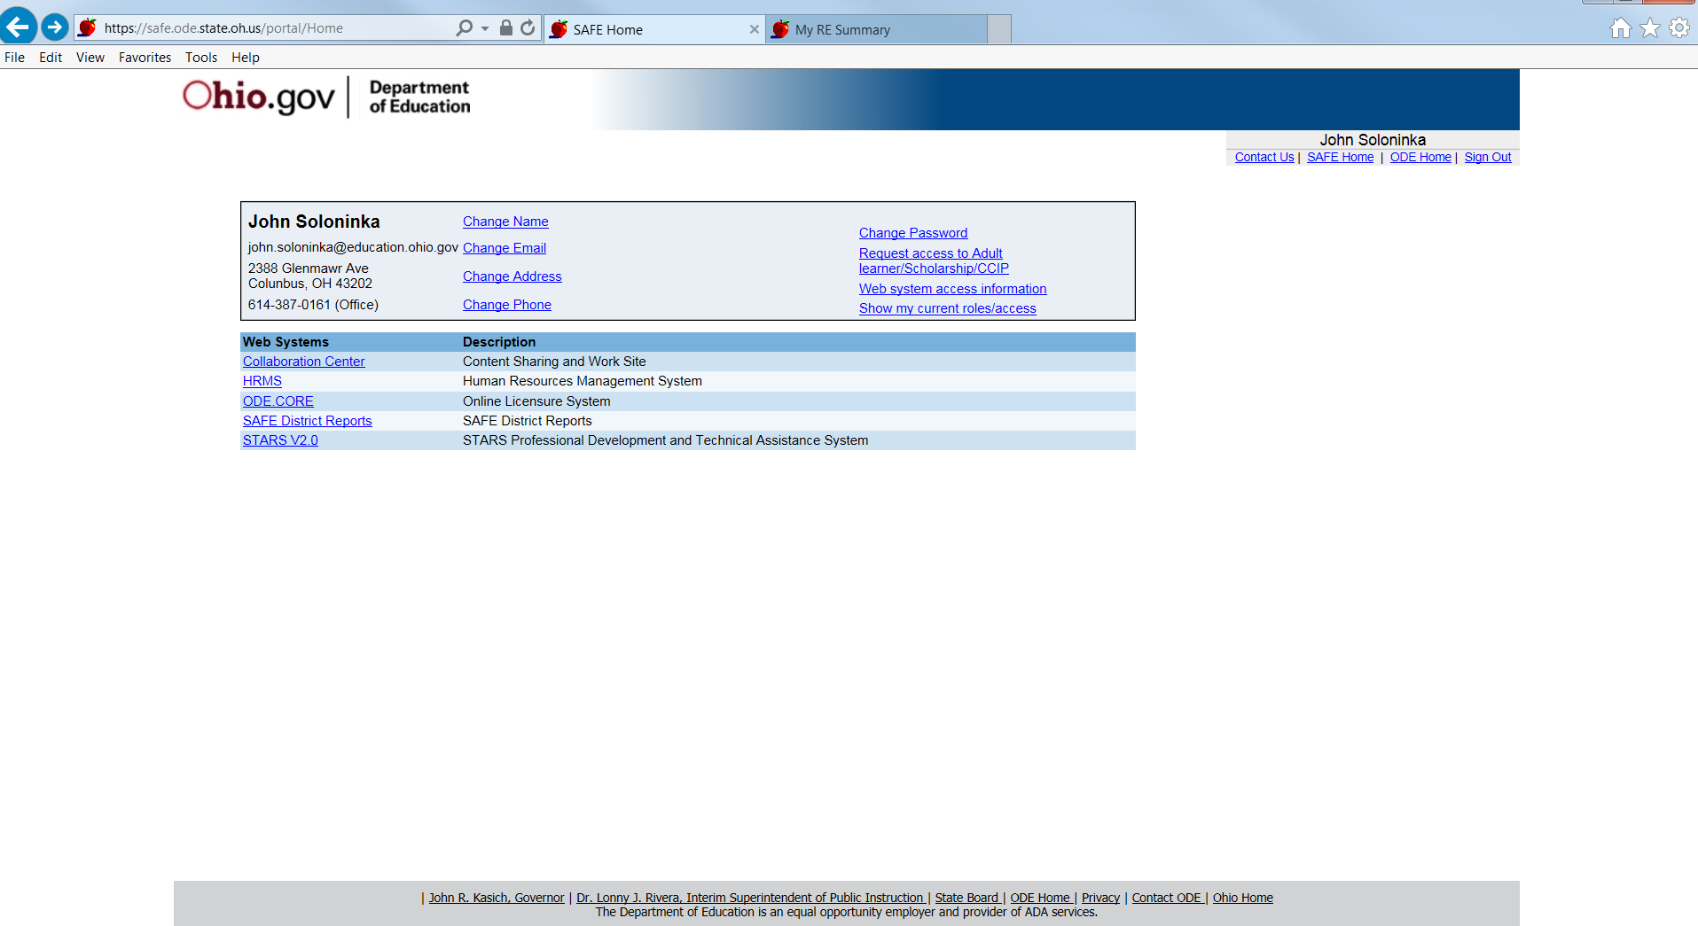
ODE Safe Account www.education.ohio.gov

Slide 16
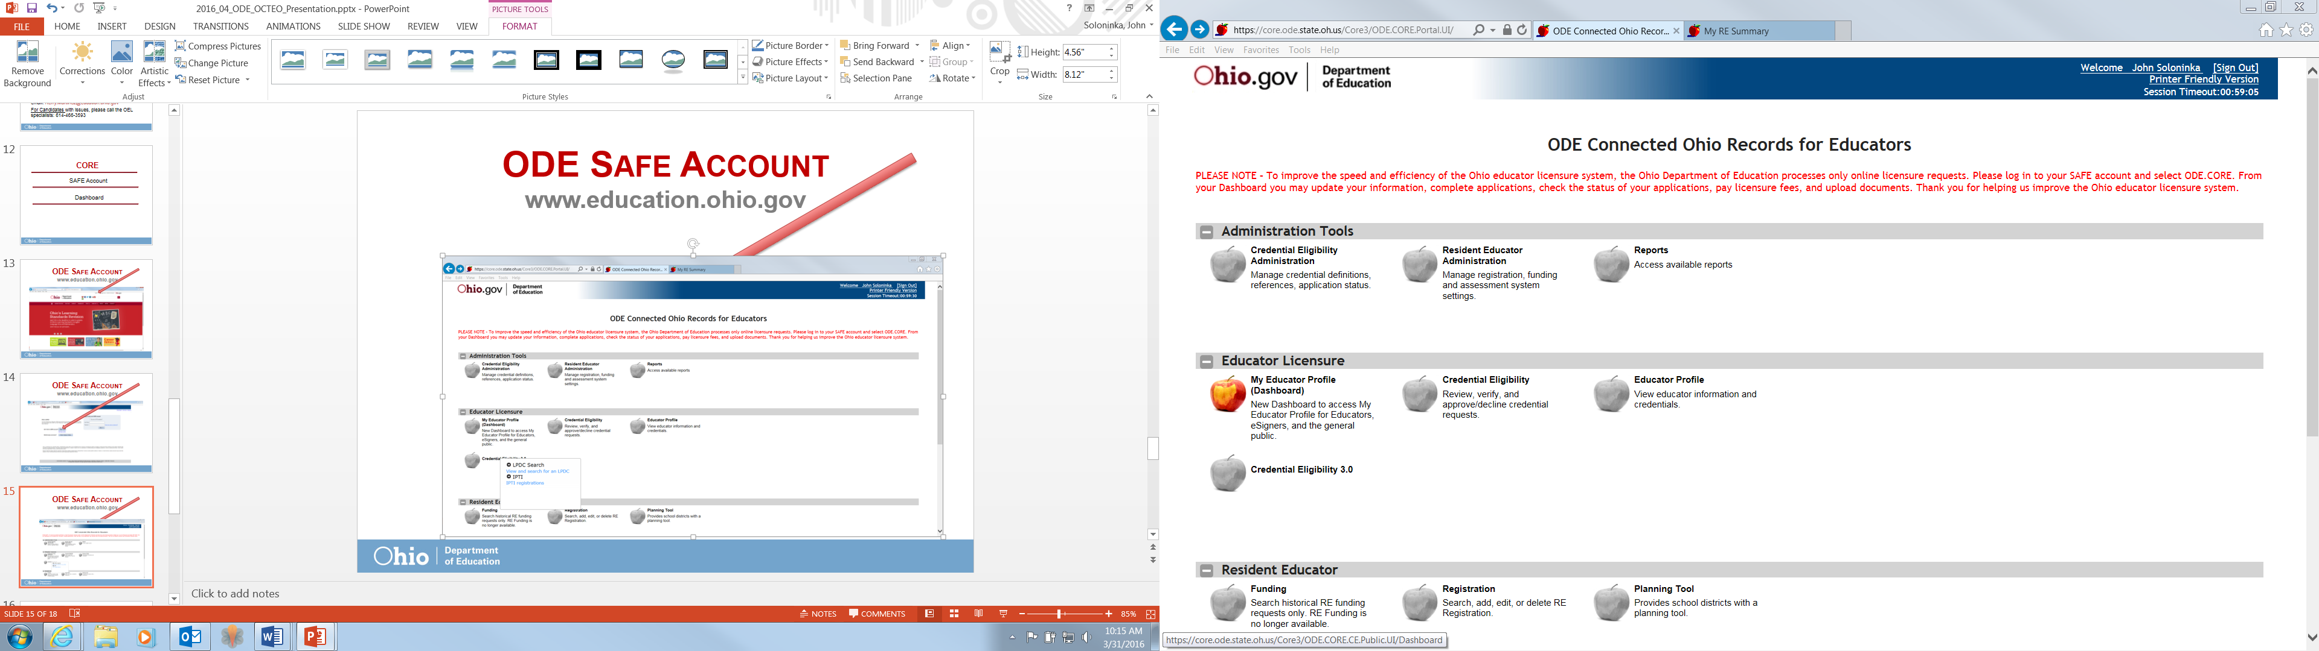
ODE CORE; My Educator Profile www.education.ohio.gov

Slide 17
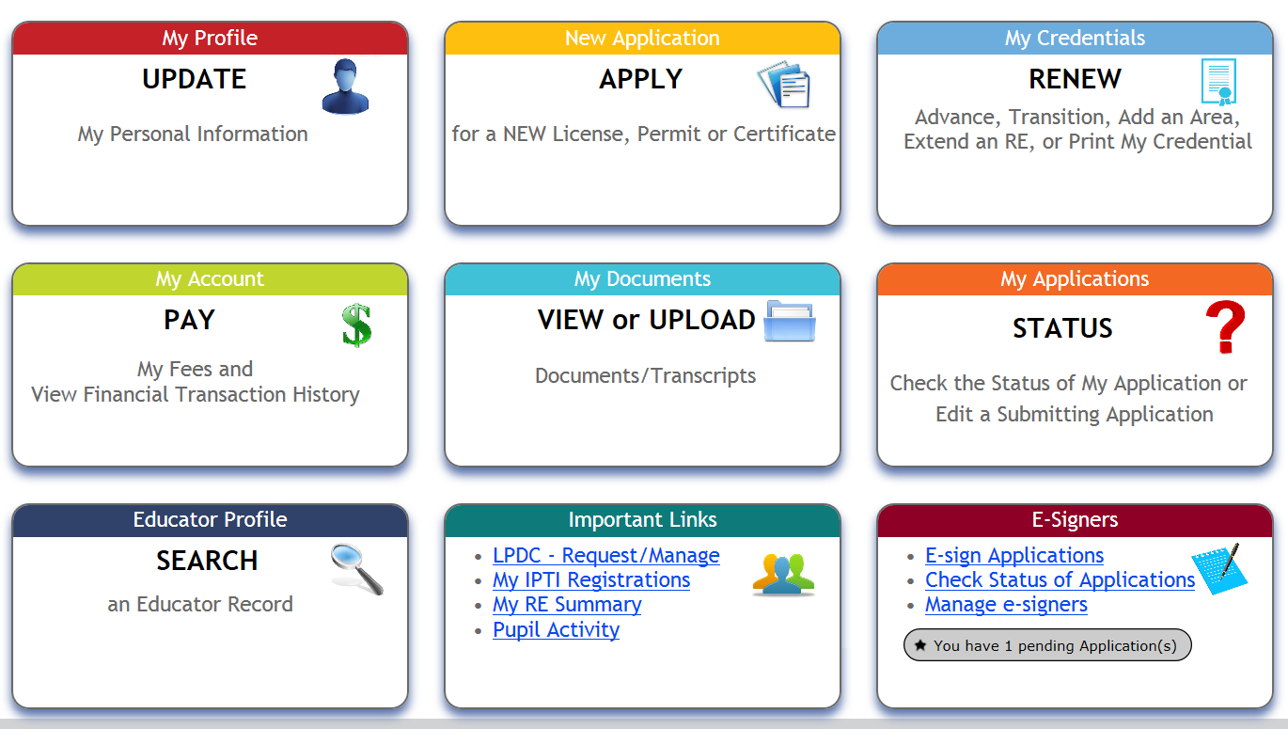
CORE Dashboard

Slide 18

For Veterans
ODE Educator Licensure Fees
Fees for an educator
license, permit or
certificate or renewal will
be waived for veterans of the US armed forces including the National Guard or Reserves. Spouses of active duty service members may also have licensure fees waived.

Slide 19
Stars Account www.education.ohio.gov

Slide 20
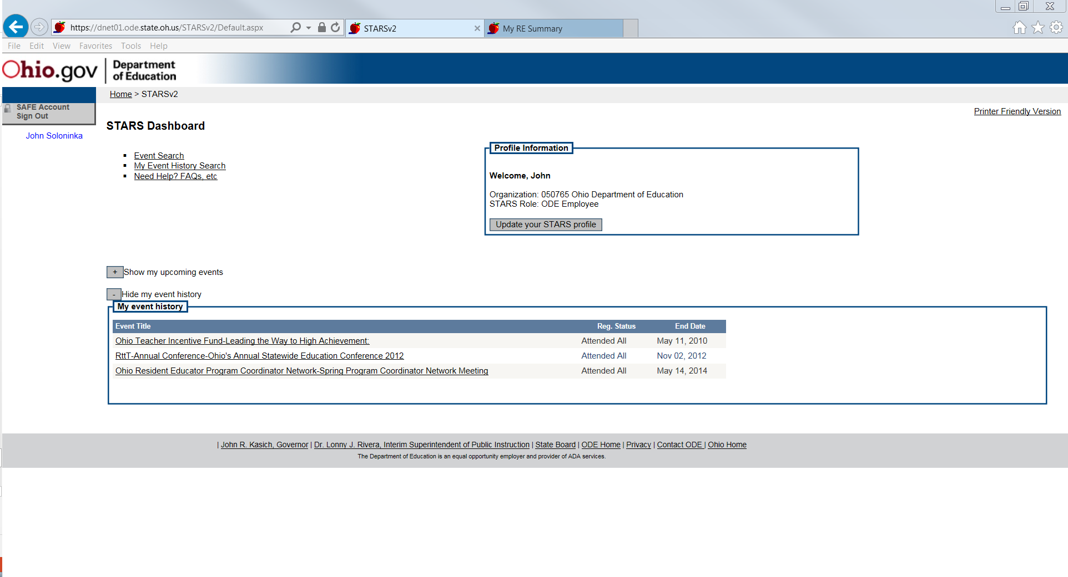
RE Mentor Trainings
ODE Stars Account www.education.ohio.gov

Slide 21
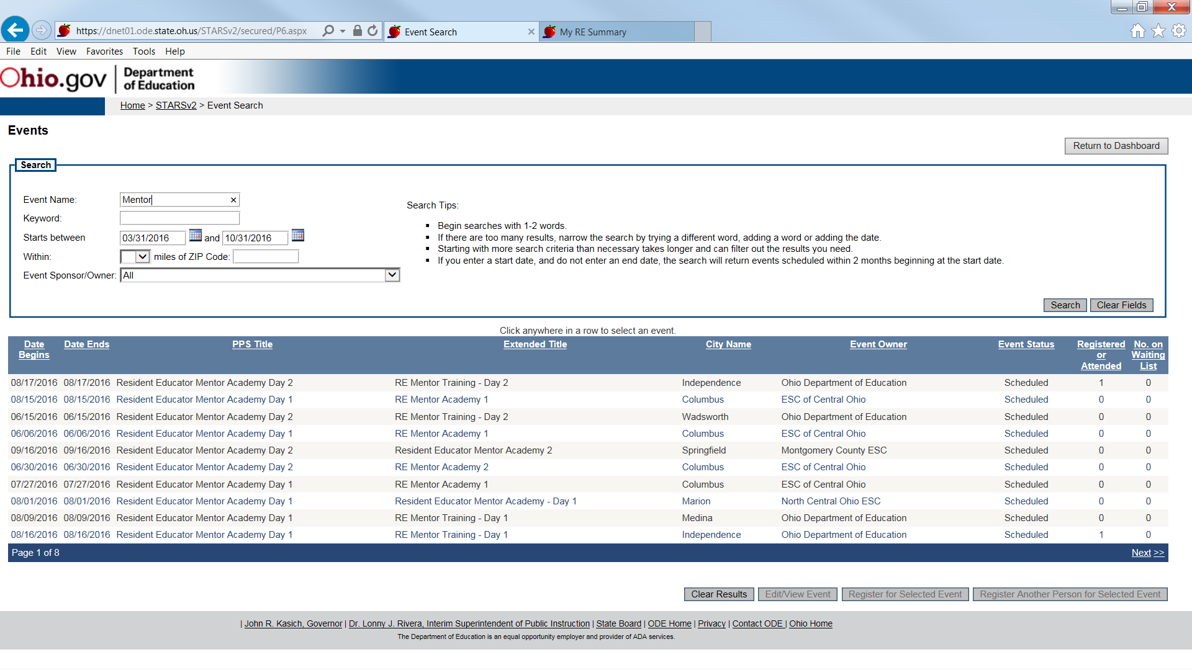
RE Mentor Trainings ($85 / day)
ODE Stars Account www.education.ohio.gov

Slide 22





Social Media
Ohio Families and Education
Ohio Teachers’ Homeroom
ohio-department-of-education
storify.com/ohioEdDept
@OHEducation
OhioEdDept

