Slide 1
Does working in collaborative groups during vocabulary instruction improve students’ comprehension of vocabulary words?
Katharina Cerny
MUST Intern

Slide 2
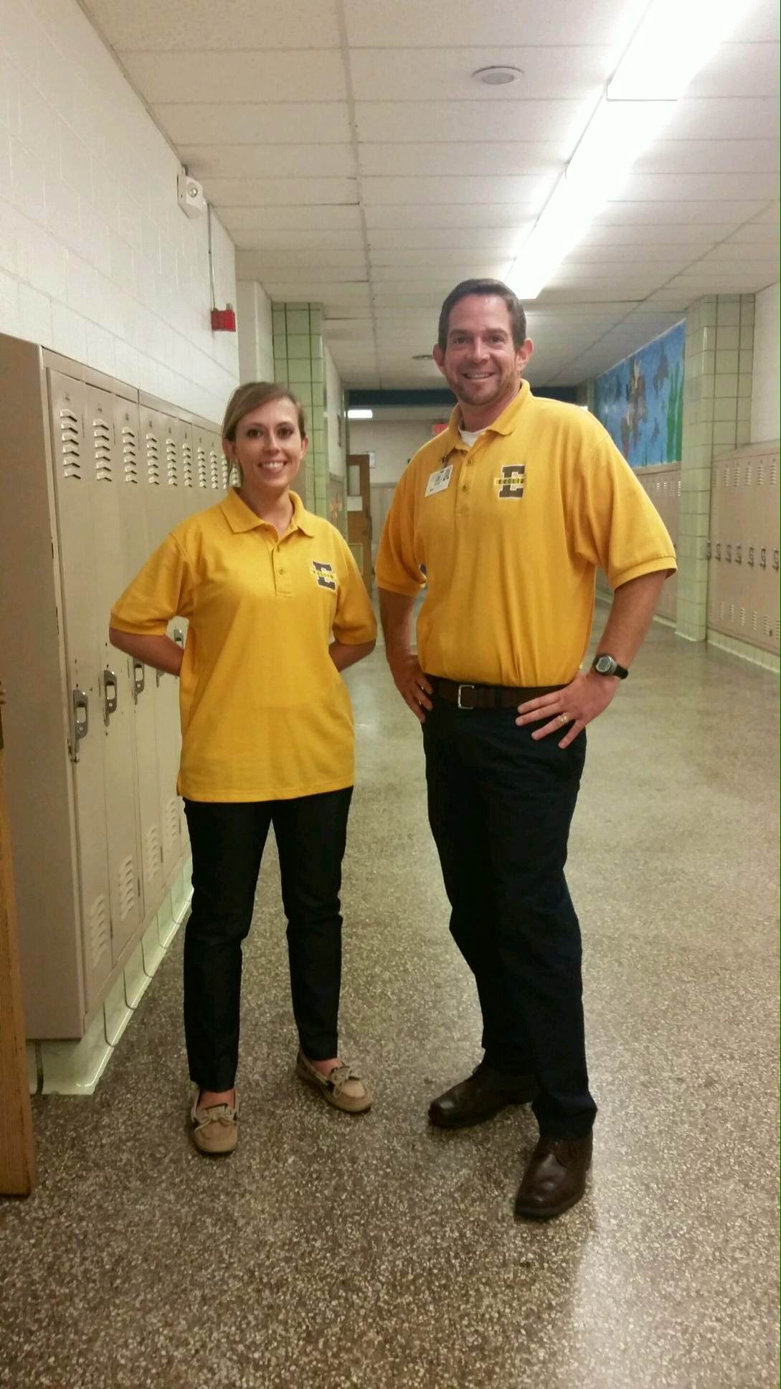
Katharina ‘Katie’ Cerny
Cleveland born and raised
Daughter of teacher/principal
Attended Holy Name High School (‘10), University of Dayton (‘14)
English major
Studied English literature in Italy for four months
Selected as sole Literacy Graduate Assistant at Cleveland State University

Slide 3
Abstract
Collaborative vs. Traditional
Collaborative/Cooperative
Cooperative learning is a specific kind of collaborative learning
To see if students retain vocabulary words and definitions better in cooperative think-pair-share groups in comparison to traditional teacher led lessons.

Slide 4
Literature Review
According to a study by Sasan Baleghizadeh (2010), participants in an experimental group followed the think-pair-share technique while the control group did the word building task individually. The experimental group achieved significantly higher scores than the controlled group.
The result of the t-test indicated that the mean score of the experimental group (12.30) is significantly different from the mean of the control group, t (25) ¼ –8.20, P ¼ .001. This indicates that the students who completed the task collaboratively through the structured pair-work design of Think-Pair-Share produced more accurate answers than those who worked individually.

Slide 5
Literature Review
Harmer (2001) states many advantages of pair work: recognizes “two heads are better than one,” increases speaking time students get during a class period, and promotes learner autonomy.
Johnson and Johnson (1991) said cooperative learning has four defining characteristics: positive interdependence, individual accountability, cooperation, and evaluation.

Slide 6
Methods
Survey (Pre and Post Test)
Vocabulary Worksheet
Think-Pair-Share
Paired by high-low ability
Vocabulary Test

Slide 7
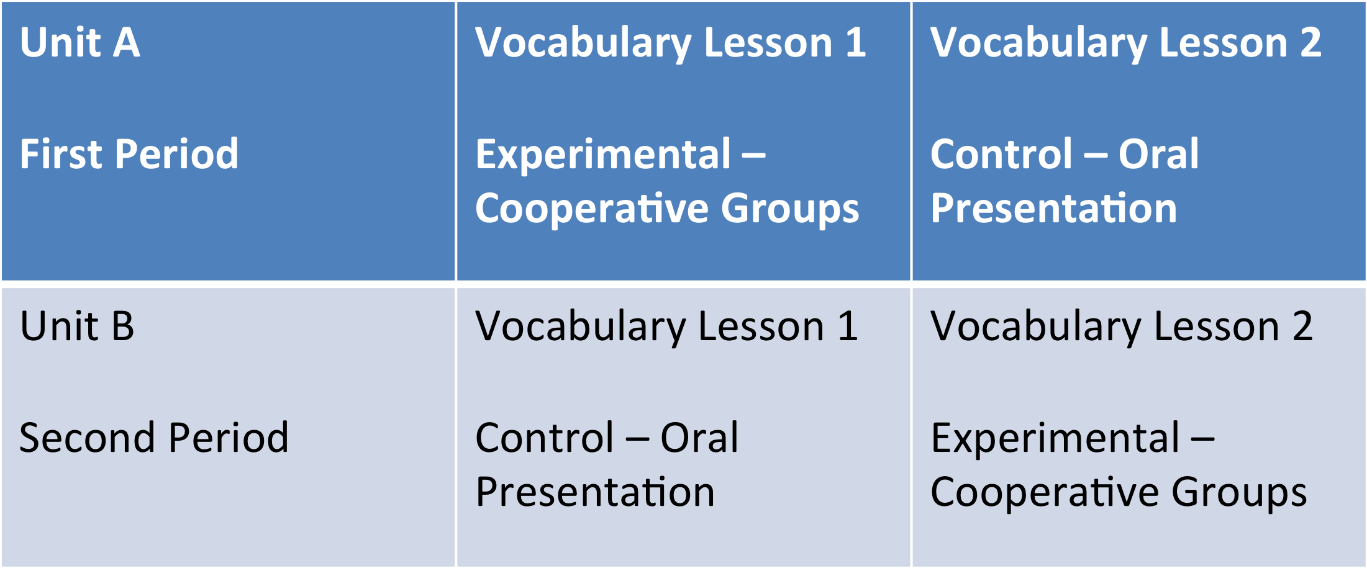
Methods

Slide 8
Limitations
Attendance is unpredictable
Having the same students present during each vocabulary lesson
Students willingness to communicate with their partner and not their friends

Slide 9
Findings
Survey
Ranking how comfortable my students are in the following situations (1 = not at all comfortable &
5 = very comfortable)
Working Independently – Averaged 4.1
Working in Groups – Averaged 3.5

Slide 10
Conclusion
By the end of the third
quarter, students’ ability
to use vocabulary words
will increase due to the
think-pair-share
technique.
Thank you

Slide 11
References
Baleghizadeh, S. (2010). The effect of pair work on a word- building task. ELT Journal: English Language Teachers Journal, 64(4), 405-413. doi:10.1093/elt/ccp097
Harmer, J. (2001). The Practice of English Language Teaching (Third edition). Harlow, UK: Longman.
Johnson, D. W. and R. T. Johnson. (1991). Learning Together and Alone (Third edition). Englewood Cliffs, NJ: Allyn & Bacon.

