Slide 1
Next Gen Teacher Prep: Aligning Training and Practice for the 21st Century Classroom
March 20, 2014
Dr. Allison Powell
Vice President, State and District Services/New Learning Models
International Association for K-12 Online Learning

Slide 2
iNACOL
iNACOL is the premier K-12 nonprofit in blended, online, and competency-based learning
Provides leadership, advocacy, research, training, and networking with experts in K-12 online learning.
  4700+ members in K-12 online and blended learning in over 50 countries
  Annual conference – iNACOL Blended and Online Learning Symposium – Palm Springs, CA on November 4-7, 2014
“Ensure every student has access a world class education” regardless of geography, income or background.
Our strategic areas of focus in online and blended learning:
  Policy
  Quality
  New Learning Models

Slide 3
iNACOL Partners & Members
Blended
Schools
Philanthropy/Foundations
3,361 Teachers & Educators
Parents
Charter Schools
Think Tanks
Policy Makers
International Programs
State Virtual Schools
Colleges & Universities
Non-profit/
Associate
OER
TA Providers
Full-time Online Schools
Public School Districts
Next Generation Learning Partners
Online Content Providers
Regional Education Agencies
Tech Tools Providers
Part-time Online Programs
CMOs/EMOs
Tutoring/Services
State Departments of Education
Private & Independent Schools
Researchers & Evaluators

Slide 4
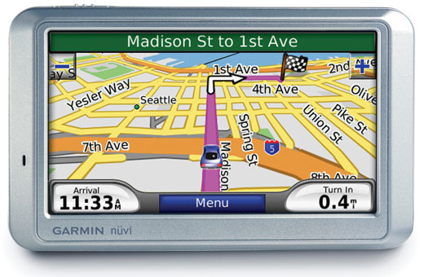
GPS
Time to Destination
Notes:
Today, with a GPS, it is almost impossible to get lost. The GPS knows Multiple Ways to YOUR destination
You have access to information on the routes, speed of travel, the time to destination, and places of interest along the way to explore.
Imagine if today’s learning environments were re-imagined to work more akin to the experience of using a gPS when you are driving.
Just as a car’s GPS system provides an immediate alert when a wrong turn is made or the driver gets stopped in a traffic jam, a learning system can provide immediate feedback to keep a student aware of the pacing and progress toward their learning goals — and advise them when they need help.
Effective blended learning environments provide this gPS for students, allowing them to navigate with flexibility along individual pathways for truly personalized learning.
A next generation education system would offer each student their own gPS-like dashboard for learning so that each student would know if they were on track toward their destination — graduation, college and career-readiness — every moment of every day and every point along the way.
You’d no longer have to wait until the end of a grading period or school year to take a summative assessment for accountability to show whether you are on or off-track. With a gPS, the moment a student makes a wrong turn, the system would help let the student know to turn around, to seek help and exactly where to find resources to get back on their route toward success and graduation.
Blended learning offers a vehicle for optimizing the instructional design toward personalization through transparent data dashboards and enhancing a student’s choice of path. This flexibility allows students to access multiple resources and a variety of content (with reviews and recommendations), but provides a clear profile of how far they have traveled along their pathway and the work still needed to continue along the pathway if they are to achieve success.
Not every student’s learning happens along a straight line. Side trips — peaked by interests that contribute to the broader acquisition of an individual’s knowledge and skills — can bring joy to the journey.
The blended learning journey is supported by people harnessing advanced, adaptive technologies that provide immediate feedback on time to destination, re-routing or help in order to get back on track, and opportunities to dive into areas of unique interests for deeper learning along the way. The journey is not necessarily linear, and a student is able take multiple pathways to achieve their learning goals and explore based on individual interests — all while co- piloting with educators and receiving regular feedback on progress so they don’t get lost.
A GPS for learning is an apt analogy to demonstrate how blended and online learning environments can be a vehicle for personalized learning through use of a customized dashboard display showing real-time information and offering tools to support optimized pathways along a personalized learning journey toward graduation and student success.

Slide 5
Does every student have access to a world-class education?

Slide 6
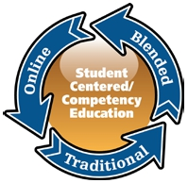

Slide 7
New Solutions through Online Learning
40% of US high schools do not offer AP courses
  75% of districts use online learning to offer Advanced Placement or college-level courses.
Teacher Shortages
  40% of public school districts in America today say they need online learning resources because certified teachers are not available for traditional face-to-face instruction.
More than 50% need online learning to reduce student scheduling conflicts to graduate on time.
60% of school districts say they need online learning for credit recovery.

Slide 8










Providing Opportunities to All Students
Traditional Public/Private
Accelerated Students
Credit Recovery
Medically Fragile
Need to work and/or support family
Rural Students
Home Schoolers
Special Education and ELL
Aspiring athletes and performers

Slide 9
U.S. Online Learning Facts
K-12 online learning enrollments growing 30% annually (50,000 in 2000; 500,000 enrollments in 2005; 1.8 million in 2010).
82% of school districts had one or more students in a fully-online or blended course
More universities are offering K-12 courses online
  Indiana U, Univ of Montana, Nebraska; Stanford, JHU, Northwestern programs for gifted
Over 50% of employers use e-learning for training

Slide 10
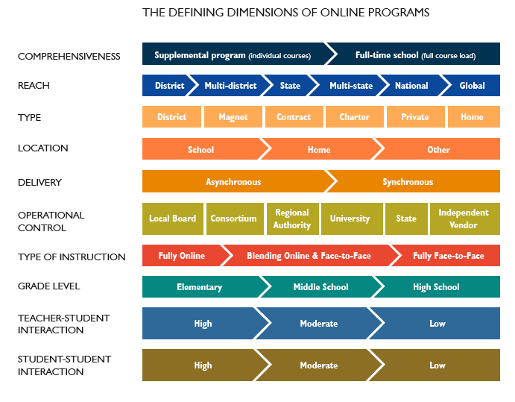

Slide 11
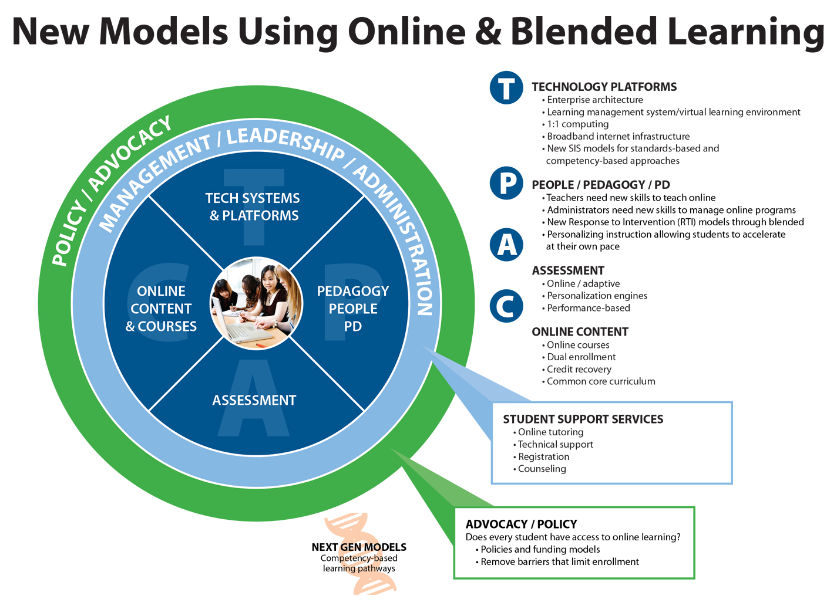
Source: Susan Patrick, iNACOL

Slide 12
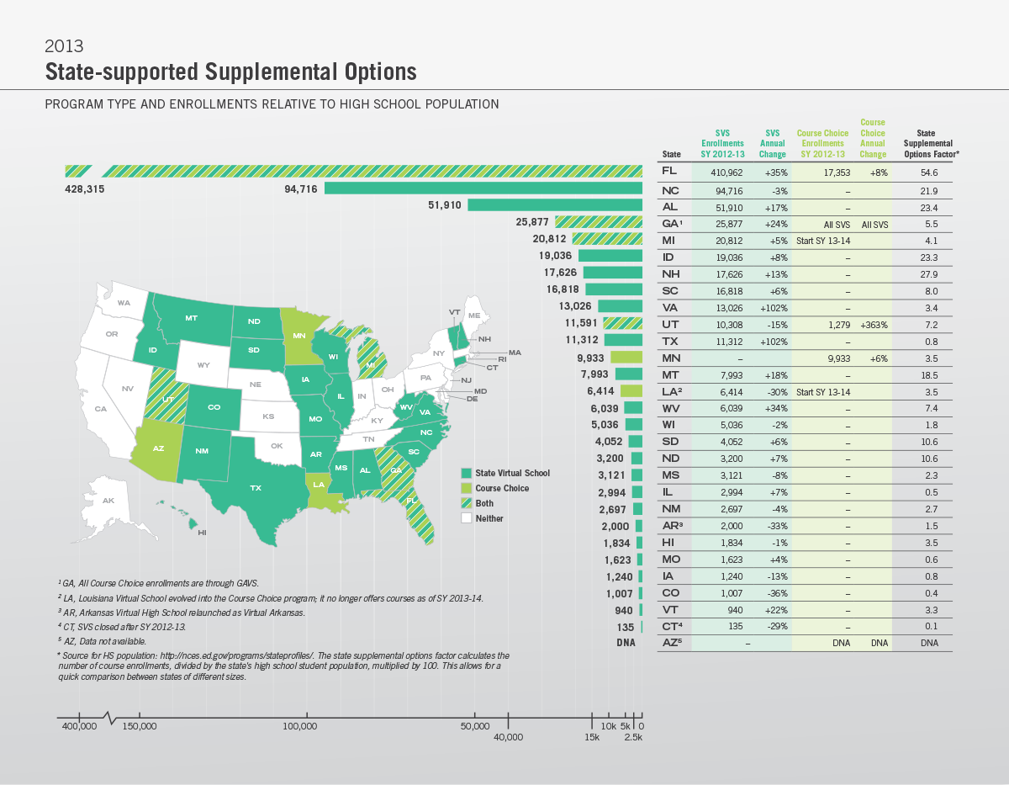
State Supported Supplemental Programs
Notes:
29 states
620,000 course enrollments in state virtual schools
16% annual increase (19% last year)
FLVS is (still) about 50% of the SVS enrollments across the country

Slide 13
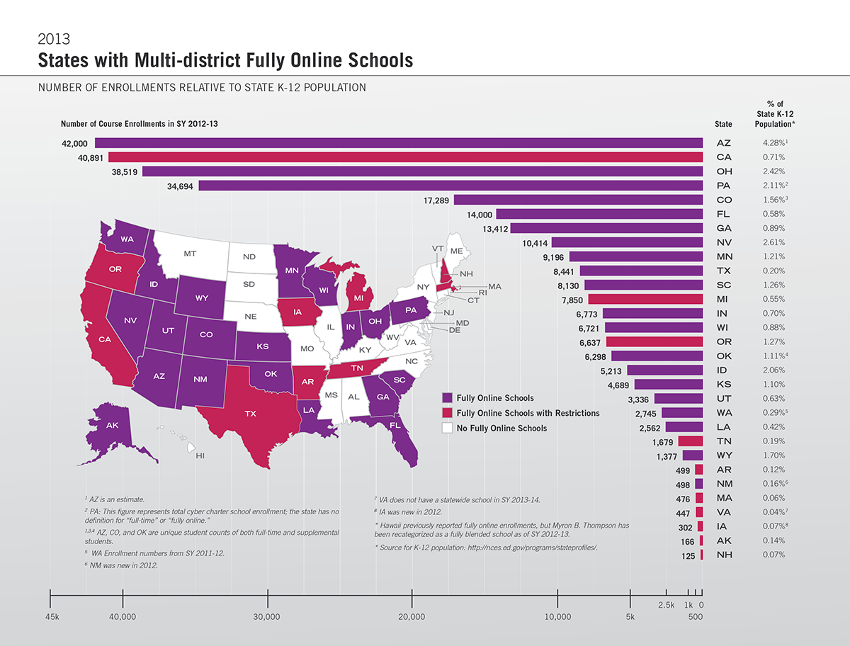
Notes:
Available in 30 states and Washington DC
Estimated 325,000 full-time online students
States with established online schools growing at ~15% annually (with outliers)

Slide 14
Single District Programs
“The total number of students taking part in all of these programs is unknown, but is likely several million, or slightly more than 5% of the total K-12 student population across the United States. We stress, however, that we estimate this by triangulating from close to a dozen sources. No single source is comprehensive.”

Slide 15
State Online Learning Trends & Examples
Alabama, Arkansas, Florida, Michigan, North Carolina, and Virginia:
  Online learning HS graduation requirement
Utah
  Open Educational Resources (Open High School of Utah)
Montana: state virtual school
  Managed by the University of Montana’s College of Education

Slide 16
State Online Learning Trends & Examples
California, Texas, Virginia, Washington, Kentucky
  Course quality – review all online courses against iNACOL online course standards
Student Choice
  Allow students to choose courses from multiple providers (Utah, Louisiana, Florida, Arizona, Georgia, Michigan, Minnesota)
  Funding follows student (FL, UT, MN, AZ)
Shift to Performance-based Funding Models
  Utah, Louisiana, Florida, New Hampshire

Slide 17
Global Perspective

Slide 18
World Future Society
Top 10 breakthroughs transforming life over the next 20-30 years
Best forecast data ever assembled
Alternative energy
Desalination of water
Precision farming
Biometrics
Quantum computers
Entertainment on demand
Global access
Virtual education or distance learning
Nanotechnology
Smart Robots

Slide 19
Survey Findings
Almost 60 percent of the surveyed countries reported government funding for blended or online programs at the primary and secondary levels.
Seventy-two percent of the surveyed countries reported that their online and blended classroom teachers participated in professional development for online teaching.
Universities and colleges were reported as the primary source of training for educators, followed by regional centers and local schools.

Slide 20
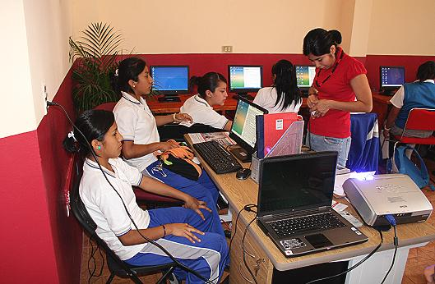
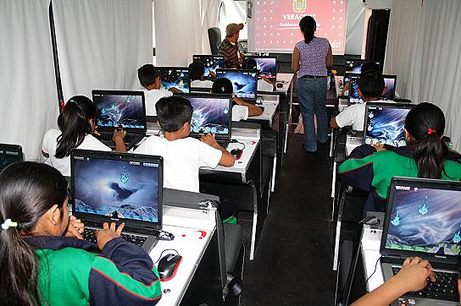
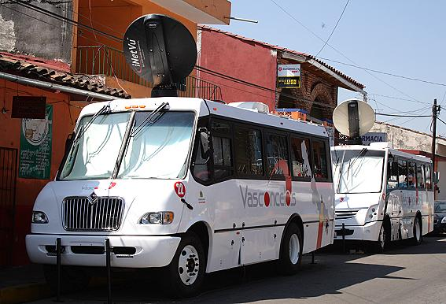
Mexico
K-12 Digital Content, Laptop for Every Teacher, Pre-service methods using engaging digital content, new strategies

Slide 21
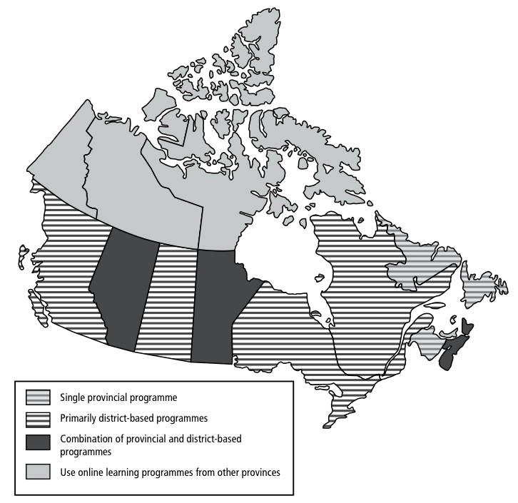
iNACOL Canada Study
All 13 Provinces and Territories offer K-12 online learning

Slide 22
New Zealand
Professional Development – ICT PD
Teacher Laptop Program
National Broadband Initiative
Virtual Learning Network

Slide 23
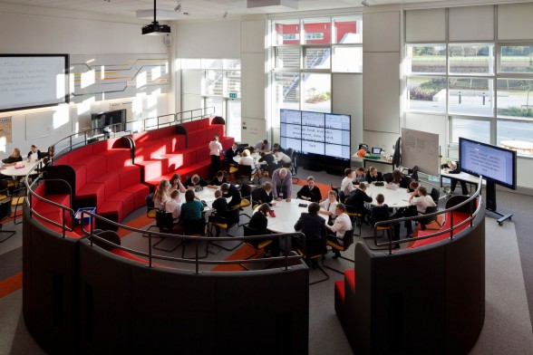

European Union
EU:
  EU E-Learning Action Plan
  IB Diploma Programme
  Online (125 countries)
  New Line Learning Schools
UK: E-Learning Exports - 29 billion pounds annually; deal with China
  Education as an export
Notes:
In the EU this fall, the International Baccalaureate program started an IB diploma programme online. The IB developed gold-standard online courses, trained master teachers to teach online and will offer the IB program to students in 125 countries.

Slide 24



Turkey, the Middle East
& Arab Spring
Turkey: online courses
Arab Bureau of Education for the Gulf States

Slide 25


India
Size
  1 billion+, 70% rural population
  Need 200,000 more schools
Internet Accessibility
  2007-08 - 42 million users (3.7%)
Online Learning
  Universal access for K-12 in 10 yrs
  Shortage of good teachers
  “Leverage teachers using technology to bring to scale”
  Educomp digitizing learning resources for K-12 Education

Slide 26
China
Population - 1.3 billion people
    Digitized K-12 curriculum
    Training Master Teachers to teach online
    China’s first online school was created in 1996; today it has expanded to more than 200 online schools with enrollments exceeding 600,000 students.
    With online learning: increase educational opportunities to 100 million new students
Notes:
China is centering their education strategy using online learning to expand access as a new delivery model. Three years ago, CHINA digitized their entire K-12 academic curriculum. They are training master teachers to teach online. China is working to move all exams online and provide test prep online. In the next 10 years, the Chinese Ministry of Education plans to reach 100 million more students through online learning.

Slide 27
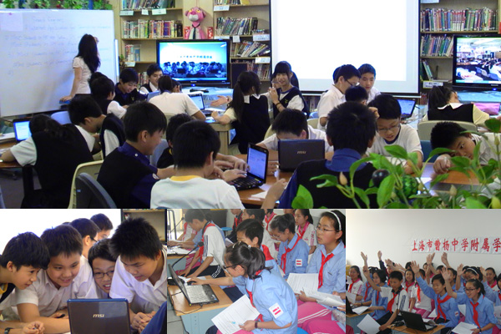
Hong Kong
  Blended learning for Continuity of Learning
  National Online Repository of Content
  Internet access at home for families to be used for learning

Slide 28


South Korea
National Virtual School
Switch to digital content from textbooks

Slide 29

Singapore
Singapore: 100% of Secondary schools use online learning
All teachers trained to teach online
Blended Learning Environments
E-Learning Weeks

Slide 30
Trends in Education: Next Generation Models of Online and Blended Learning
Notes:
Personalization
Online learning
Blended learning
Competency-based approaches
Open Educational Resources
Mobile learning

Slide 31
Personalized Learning 4 Attributes
(From Scott Benson, BMGF)
Four essential attributes for a personalized learning model:
  Learner Profiles: Captures individual skills, gaps, strengths, weaknesses, interests & aspirations of each student.
  Personal Learning Paths: Each student has learning goals & objectives. Learning experiences are diverse and matched to the individual needs of students.
  Flexible Learning Environment: Multiple instructional delivery approaches that continuously optimize available resources in support of student learning.
  Individual Mastery: Continually assesses student progress against clearly defined standards & goals. Students advance based on demonstrated mastery.
Notes:
Personalized learning is an instructional strategy.
Compare these essential attributes to what most traditional one-size-fits-all classroom environments look like: learner profiles with precise knowledge and skills, students with personal learning paths versus a lecture-based learning experience; flexible learning environments with a variety of modes, resources and modalities (e.g. connectivism, as illustrated in Figure 1) versus one approach for all students at the exact same pace using a single textbook. Today, with these contrasts, the vast majority of traditional classrooms in the K-12 education system are far from realizing the promise of personalized learning. However, this is where the shift to blended learning instructional models can begin to incorporate the essential elements for personalized learning — providing a roadmap and solution as a method or modality for delivery — and a means to transform education to student-centric learning. Realizing this transformation requires highly personalized, blended learning environments designed and built upon competency education.
Personalized learning is tailoring learning for each student’s strengths, needs and interests — including enabling student voice and choice in what, how, when and where they learn — to provide flexibility and supports to ensure mastery of the highest standards possible.

Slide 32


Blended learning
A formal education program in which a student learns at least in part through online learning, with some element of student control over time, place, path and/or pace
and
at least in part in a supervised brick-and-mortar location away from home, and the modalities along each student’s learning path within a course or subject are connected to provide an integrated learning experience.
(Horn & Staker, 2013)
Notes:
a formal education program in which a student learns at least in part through online learning, with some element of student control over time, place, path, and/or pace, at least in part in a supervised brick-and-mortar location away from home, and the modalities along each student’s learning path within a course or subject are connected to provide an integrated learning experience (Horn & Staker, 2013).

Slide 33
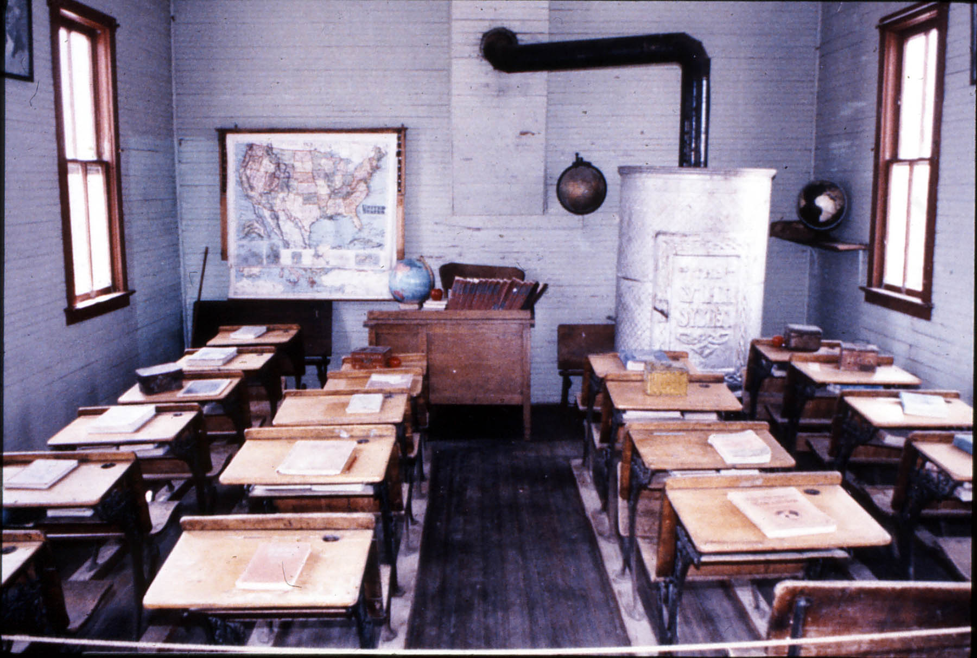
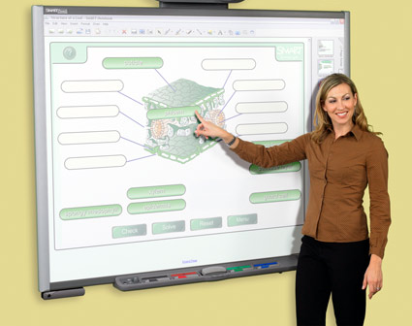








Tech-rich = blended

Slide 34






Emerging models of blended learning
Rotation
Flex
A La Carte Model
Enriched Virtual
Station rotation
Lab rotation
Flipped Classroom
Individual rotation
Online platform with F2F support and fluid schedules
Students attend physical school & take 1 or more courses online
Students learn sometimes at a physical school, other times remotely

Slide 35
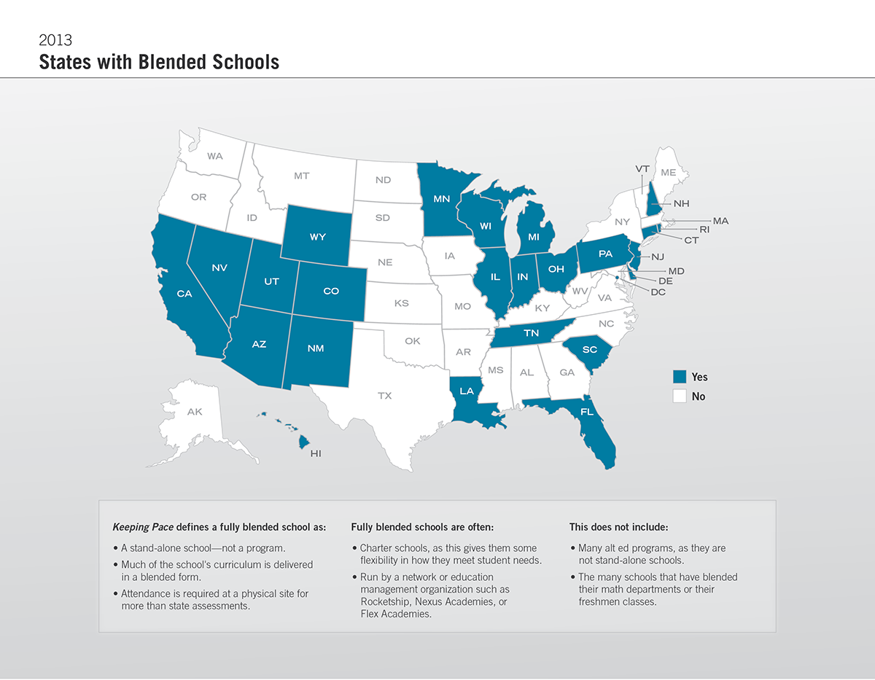
Notes:
24 and Washington DC

Slide 36
Competency Education:
5-part Definition
Students advance upon mastery.
Competencies include explicit, measurable, transferable learning objectives that empower students.
Assessment is meaningful and a positive learning experience for students.
Students receive timely, differentiated support based on their individual learning needs.
Learning outcomes emphasize competencies that include application and creation of knowledge, along with the development of important skills and dispositions
Notes:
In a competency-based education system, students understand learning objectives and also know what they must “know and show” to be proficient. If a student does not demonstrate adequate proficiency to advance, they must be
provided with supports and interventions that help them fill the gaps in their knowledge and skills.
When we think about the traditional “time-based system”, students essentially have variable amounts of learning
in fixed amounts of time — quite simply allowing students to have varying levels of gaps as they move through the system with passing grades. For example, in a time-based system, even a “B” average in a course assumes the student may be missing 15-20% of the content knowledge. Students are passed on with “C”s and “D”s, unprepared for the next course.

Slide 37



From Inputs… iNACOL National Quality Standards
Online Courses
Online Teaching
Online Programs
www.inacol.org
Notes:
This is an area where SREB and iNACOL, working with many member states, have been very active.
SREB developed the Standards for Quality Online Teaching, (2006) which defines the qualifications, standards and indicators of a quality online teacher…Online Teaching Evaluation Guidelines developed standards checklist.
ADVANCE: iNACOL National Standards for Quality Online Teaching as a comprehensive set of criteria combining SREB Standards with 21st Century Skills criteria…
Speak Up Survey: Teachers see professional development as one of the primary barriers…Good news: 1/3 of teachers have taken online PD course (57% increase from 2007) But much, much more is needed!
Working with member states, SREB developed the nation’s first (ADVANCE) Guidelines for Professional Development of Online Teachers, which define the qualifications of a quality online teacher and the standards needed for academic preparation, content knowledge, online skills and delivery.
The guidelines give state virtual schools a valuable tool to:
develop and provide professional development programs and support for their online teachers; and
assess the quality of professional development programs, products and services available from third-party providers.

Slide 38
Myths and Misconceptions About Online Teachers
Online schools and regular school counselors can handle the few participating students without leadership support.
Any regular classroom teacher is already qualified to teach online.
Any highly qualified face-to-face classroom teacher is ready to teach a quality online course that has previously been prepared or purchased. Some say those who teach a section that is already online don’t really teach at all!
Online schooling will fit with regular school routines and practices.
The technology coordinator and counselor will provide any professional development necessary.
Newly qualified teachers who learn about online schooling in their pre-service programs will be ready to teach online when they graduate.

Slide 39
Professional Development Topics for All Roles
Technical skills
Online learning pedagogy
State and national standards including content standards
Serving students
Curriculum
Professionalism and leadership

Slide 40
Online Teachers…
  Require different pedagogy, communication, and pacing to be successful. Synchronous technologies, including videoconferencing, change the nature of communication between the teacher and students more than if they were physically in the same classroom. Anyone who is working with virtual schooling needs to understand and experience these differences.

Slide 41
Role of Online Teacher
Facilitate and build an online community of learners
Engage learners in a virtual environment through reflective and hands-on activities
Analyze data to assist in individualizing instruction
Personalize the learning through online discussion and group projects
Differentiate instruction (i.e. learning styles, adaptive/assistive technologies, pacing, supplemental activities and remediation.)
Develop and deliver asynchronous and synchronous lessons that use appropriate and effective multimedia design elements
Student academic integrity issues (plagiarism and the safe and legal use of online resources)

Slide 42
Online Teachers and PD
73% of online teachers have six or more years of teaching experience
22% of brand new online teachers report receiving no training. That percentage decreased dramatically within the first five years (12%)
22% of online teachers received less than 10 hours of training to meet short-term needs
46% received 45+ hours of training
(Going Virtual, 2010)

Slide 43
Online Teachers and PD
94% of teachers receive PD from their school or organization, only 30% from universities
Only 12% of brand new online teachers report receiving college or university training, compared to 43% of teachers with 6-10 years experience
Most common type of training
  Ongoing training sessions (81%)
  Workshops (77%)
  (Going Virtual, 2010)

Slide 44
Preferred Professional Development
Most preferred form of PD is fully online facilitated (53%), and in workshop format (49%)
Graduate courses are most appealing to teachers with 0-10 years experience and least preferred by those with over 10 years of experience
(Going Virtual, 2010)

Slide 45
PD Topics Most Wanted/Covered
86% have received training in the field online teaching and learning, while 16% say they need this
Psychology of online learning (cyberbulling) was the area where most wanted training
Meeting the needs of students with disabilities in the online classroom as a facilitation strategy is high need
Over 90% have received technology training (LMS and Communication technologies)
Want training in design tools and social networking
58% design none of the learning activities in their online course
43% want training on instructional design principles for online lessons
85% have received training in various aspects of digital etiquette, behavior and assessment concepts
(Going Virtual, 2010)

Slide 46
Basic PD Should Include
How to provide appropriate communications
Providing appropriate and timely feedback
How to facilitate discussions
Facilitation of teamwork and multimedia projects
Adaption of curriculum and materials
Adaptation of online tools to support effective instruction
NEA Guide to Online Teaching

Slide 47
Support For Online Teachers
Technology Infrastructure
  Networks and bandwidth
  Consistent Internet access
  Computers and Internet access at home
  Hardware and software tools to access content
Technical and Administrative Support
  24/7 technical support
  Grading and registration system for teachers and admin, also available to students and parents
  Student handbook and policies
Educational Support
  Release Time
  Master teacher mentoring and peer coaching
  Formative evaluation
  Continuous professional development
  NEA Guide to Online Teaching

Slide 48
Administrator Development
Lack of PD for administrators
Need to know what to look for in evaluating teachers
Need to understand how technology works to get into the courses
How to support online teachers
Requires administrators and policy makers that can make wise decisions about resource
Allocation and to gather and analyze data that cross traditional categories and sectors.

Slide 49
PD for Administrators
Administrators could benefit from training similar to that required by the teachers and Online site facilitator. (Abbreviated form)
  Details of online learning not as important, a comprehensive understanding and overview is critical.
Depth of professional development should be greater for administrators of virtual schools.
Creation of effective PD for administrators is urgent
  start at pre-service and ending with leaders able to support the PD of other administrators

Slide 50
Supporting and Evaluating Online Teachers
Criteria highlight good teaching practice and skills and methods
  Academic credentials
  Information technology skills
  Interactive and collaborative strategies
  Online classroom management and communication skills
  Legal and ethical issues in online learning
  Experience in online learning

Slide 51
Trends in Pre-Service Teacher Training
United States
  UCF, FLVS partnership for student teaching
  Michigan State and Michigan Virtual School
Mexico
  all pre-service teachers trained to use digital content, given laptops, all content is digitized
Singapore
  teachers trained to teach in blended environments (since 2005, SARS virus pandemic)
International Baccalaureate (IB) program
  Master teachers to teach online and offering “gold standard” IB courses online

Slide 52
Trends in Online Teacher PD
Certificate programs in US
  Boise State University
  New Mexico State University
State Departments of Education
  Georgia and Idaho - endorsements
Non-profit organizations
  EDC, Ed Tech Leaders Online
  Virtual High School, Inc.

Slide 53
Trends in Online Teacher PD
Regional Groups
  Offering courses
For-profit Companies
  Focused mostly on product rather than pedagogy
Online Schools
  Still main provider of teacher PD, must develop on their own
  Inconsistencies in training outcomes, must expend additional resources

Slide 54
Key Questions
What supports are required for Colleges of Education to redefine teacher education by adopting standards and preparing all new teachers for online and blended teaching and other professional opportunities available in the field of K-12 online learning ?
What emergent forms of teacher education are evolving as a result of the shift toward school-based, blended and online training, and how can Colleges of Education partner with organizations to enhance these efforts? In other words, how can Colleges of Education step outside the box to rethink quality teacher education, and support it new ways?
With rapid advances in technology continuing at an exponential rate, how can we redefine teacher education, leveraging the capabilities of the technology itself, such as developing innovative communities of practice, shared inquiry, and global networked professional development opportunities?
(Adapted from Going Virtual 2010)

Slide 55
Project Tomorrow Survey (2009)
Benefits of taking a class online?
  According to students:
    51% said it allows them to work at their own pace
    49% to earn college credit
    44% said it allows them to take a class not offered on campus
    35% said it was to get extra help
    19% said they took online courses to get more attention from teachers

Slide 56
How Students Learn
Notes:
Education Evolving - Minnesota

Slide 57
Thank you!
Contact information:
Allison Powell: apowell@inacol.org
www.inacol.org
CompetencyWorks.org
OnlineProgramHowTo.org
K12onlinersearch.org

