Slide 1

Assessment & Support System
Fall 2019 OCTEO Conference
Jerry Bush
Jerry.Bush@pearson.com
615-417-2416
Kellie Crawford
Kellie.Crawford@pearson.com
304-549-4869

Slide 2

edTPA Updates
edTPA Today
Updates and Announcements
New Resources
Candidate Performance Data
System of Support

Slide 3




Who is Involved?

Slide 4
edTPA Today
Over 870 participating education preparation programs
Presence in over 44 states
20 states with edTPA related policy
More than 10,660 members included in the edTPA Online Community

Slide 5
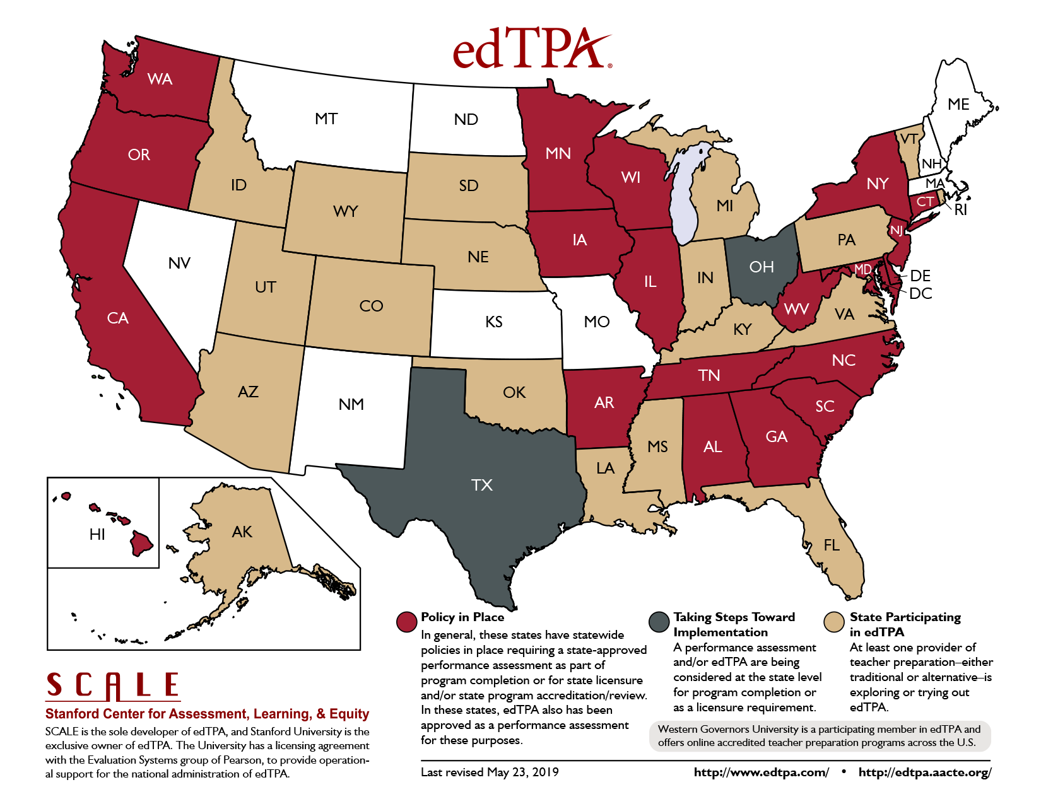
Internal and Confidential

Slide 6
28 Subject-Specific Areas
Elementary
  Elementary Literacy
  Elementary Mathematics
  Elementary Education: Literacy with Mathematics Task 4
  Elementary Education: Mathematics with Literacy Task 4
Middle Childhood
  English-Language Arts
  History/Social Studies
  Mathematics
  Science
Secondary
  English-Language Arts
  History/Social Studies
  Mathematics
  Science
Agricultural Education
Business Education
Classical Languages
Early Childhood Education
Educational Technology Specialist
Technology and Engineering
English as an Additional Language
Family & Consumer Sciences
Health Education
K-12 Performing Arts
Physical Education
Library Specialist
Literacy Specialist
Special Education
Visual Arts
World Language

Slide 7
Updates and Announcements

Slide 8

SCALE’s Annual Teacher Performance Assessment Conference
Preparing the Workforce for Equitable
Teaching and Learning
March 26-28, 2020
Austin, TX
A call for proposals is open through November 4th. More information is available at https://tpaconference.com/
Notes:
8

Slide 9
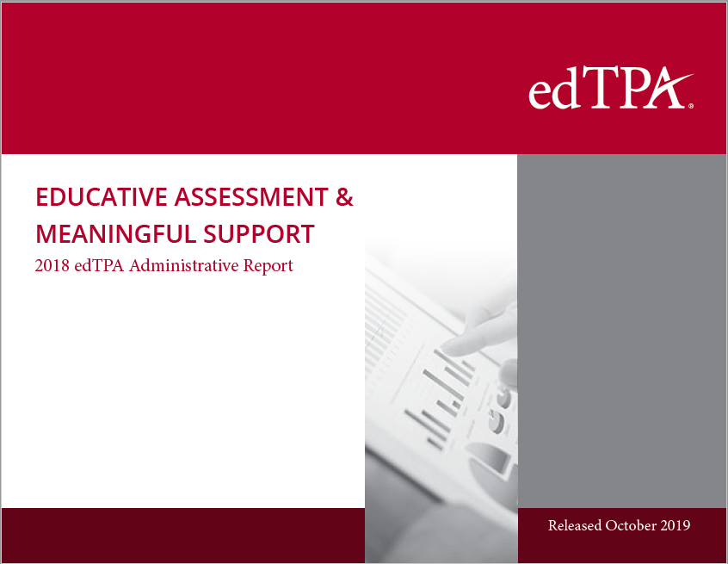
2018 Administrative Report

Slide 10
2018 Administrative Report
Reliability and Validity Evidence
Inter-rater Agreement
Internal Consistency
Internal Structure
Candidate Performance
Overall Scores
Task and Rubric Scores
Performance by Content Field
Performance by Consequential Use
Modeled Candidate Passing Rates
Performance By Demographic Subgroups

Slide 11

School Librarian/Library Specialist Handbook
Based on input from a national panel of library educators and consistent with the recently released National School Library Standards (AASL 2018). School Librarian/Library Specialist handbook has been updated and available for preview in the Resource Library.
The handbook is not intended for consequential use by candidates in your program until Fall 2020.
Notes:
SCALE is pleased to announce the release of an updated version of the Library Specialist handbook for edTPA.
The new version of the handbook is called “School Librarian/Library Specialist”, but is not intended for consequential use by candidates in your program until Fall 2020. We are offering the revised version a year early so that programs can examine the updates and plan for any potential program changes.
Please continue to use the current “Library Specialist” handbooks and templates until Fall 2020 for both National and Washington.
The handbooks below will replace the current Library Specialist handbooks (National and Washington) beginning with the 2020-2021 program year. At that time, the templates and other candidate support resources for the new handbooks will be released.
The changes to the handbook are based on input from a national panel of library educators and consistent with the recently released National School Library Standards (AASL 2018). The framing for the learning segment and the subject specific rubric foci reflect the Standards and expectations for best practices for school librarians and Library Specialists. In addition, the academic language emphasis in edTPA has been revised to make explicit connections to the Standards, competencies and learner outcomes linked here.
SCALE will be updating related resource materials (Understanding Rubric Level Progressions, Making Good Choices, Academic Language handout) during the 2019-20 academic year and working closely with Pearson to modify any scoring training materials. Please watch for additional announcements regarding these materials.

Slide 12

Career-Technical Education Handbook
The development of the Career-Technical Education handbook is currently in the field test stage. For more information on the handbook or to participate in development activities, please contact Jerry Bush.
The handbook is scheduled for operational use for Fall 2020.

Slide 13
New Resources

Slide 14

edTPA EPP Implementation Guide:
Effectively Implementing edTPA for Educator Preparation Programs
Provides step-by-step strategies for supporting candidates, P-12 partners, and other users
Tested examples for successful implementation
Detailed guidance on getting started with edTPA
Developing an inquiry stance towards the process of completing the assessment analyzing the impact and value of edTPA
Notes:
NEW RESOURCE AVAILABLE
EPP Implementation Guide: Effectively Implementing edTPA for Educator Preparation Programs
Designed for edTPA Coordinators, this resource provides step-by-step strategies for supporting candidates, P-12 partners, and other assessment users, along with tested examples for successfully implementing edTPA. The resource provides detailed guidance on everything from getting started with edTPA, planning for implementation and instruction, and developing an inquiry stance towards the process of completing the assessment and analyzing its impact and value.
Because this information is highly relevant to all EPP stakeholders, edTPA coordinators are encouraged to use this implementation guide as a reference when collaborating with faculty/instructors, supervisors, and staff to embed edTPA within their program. Please share with other stakeholders within your preparation context and help spread the word about this key resource!

Slide 15
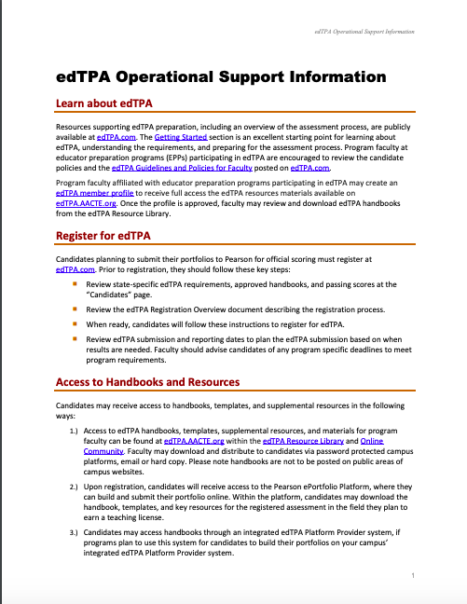
edTPA Operational Support Guide
edTPA Registration
Accessing Resources and Materials
edTPA ePortfolio
Preparing and Submitting the portfolio
Requesting Alternative to Video
Score Reporting
Candidate/Faculty Support
Voucher

Slide 16
Candidate Performance Data

Slide 17
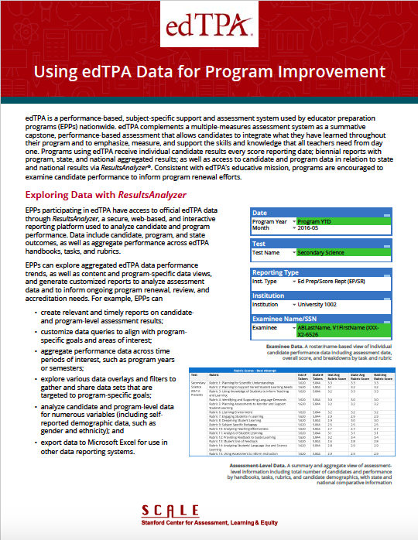
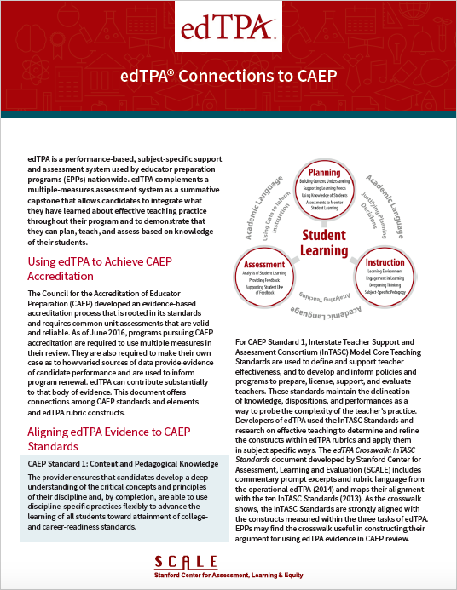
Using edTPA Data
Notes:
Will most likely want to move this to the end to mention its availability

Slide 18
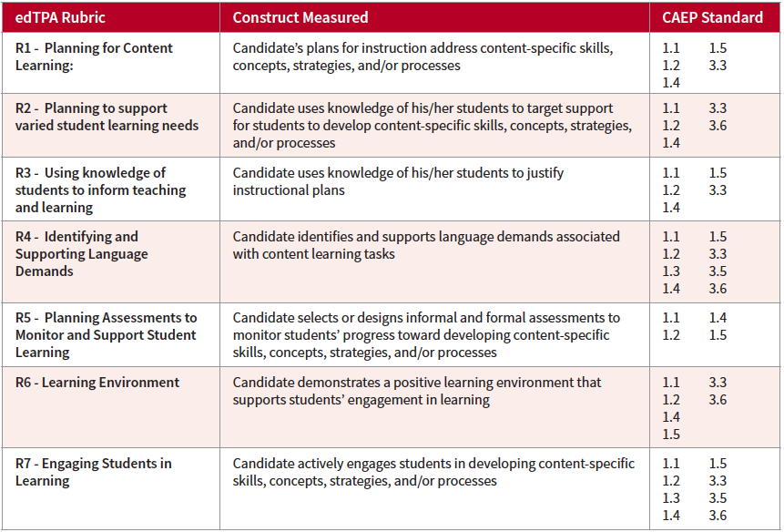
Connections to CAEP

Slide 19
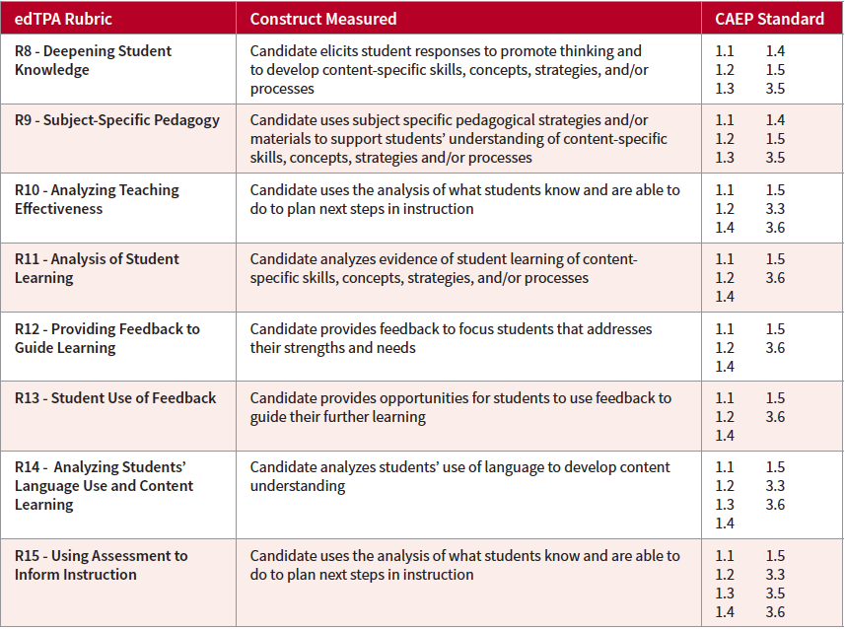
Connections to CAEP

Slide 20
Ohio vs. National Data
July 1, 2018 – June 30, 2019
13 Rubric Handbooks
 | N | Mean
Ohio | 52 | 35.5
National | 1,108 | 35.2
15 Rubric Handbooks
 | N | Mean
Ohio | 3,311 | 43.0
National | 41,538 | 43.8
18 Rubric Handbooks
 | N | Mean
Ohio | N/A | N/A
National | 11,696 | 51.9

Slide 21
Handbook Means – Ohio & National

Slide 22
Ohio and National Task Means
Early Childhood

Slide 23
Ohio and National Rubric Means Early Childhood

Slide 24
Ohio Early Childhood
Rubric Distribution
Rubric | 1.0 | 1.5 | 2.0 | 2.5 | 3.0 | 3.5 | 4.0 | 5.0
R6 | 2 | - | 28 | 1 | 1,121 | 6 | 83 | -
R7 | 5 | - | 181 | 9 | 880 | 9 | 157 | -
R9 | 227 | 6 | 479 | 17 | 500 | 1 | 11 | -
R13 | 137 | 2 | 519 | 18 | 498 | 1 | 48 | 1

Slide 25

Support & Assessment System
More than 175 support resources
Developed by SCALE with EPP input
Downloaded 1.3 million times
Resource Library at http://edtpa.aacte.org

Slide 26
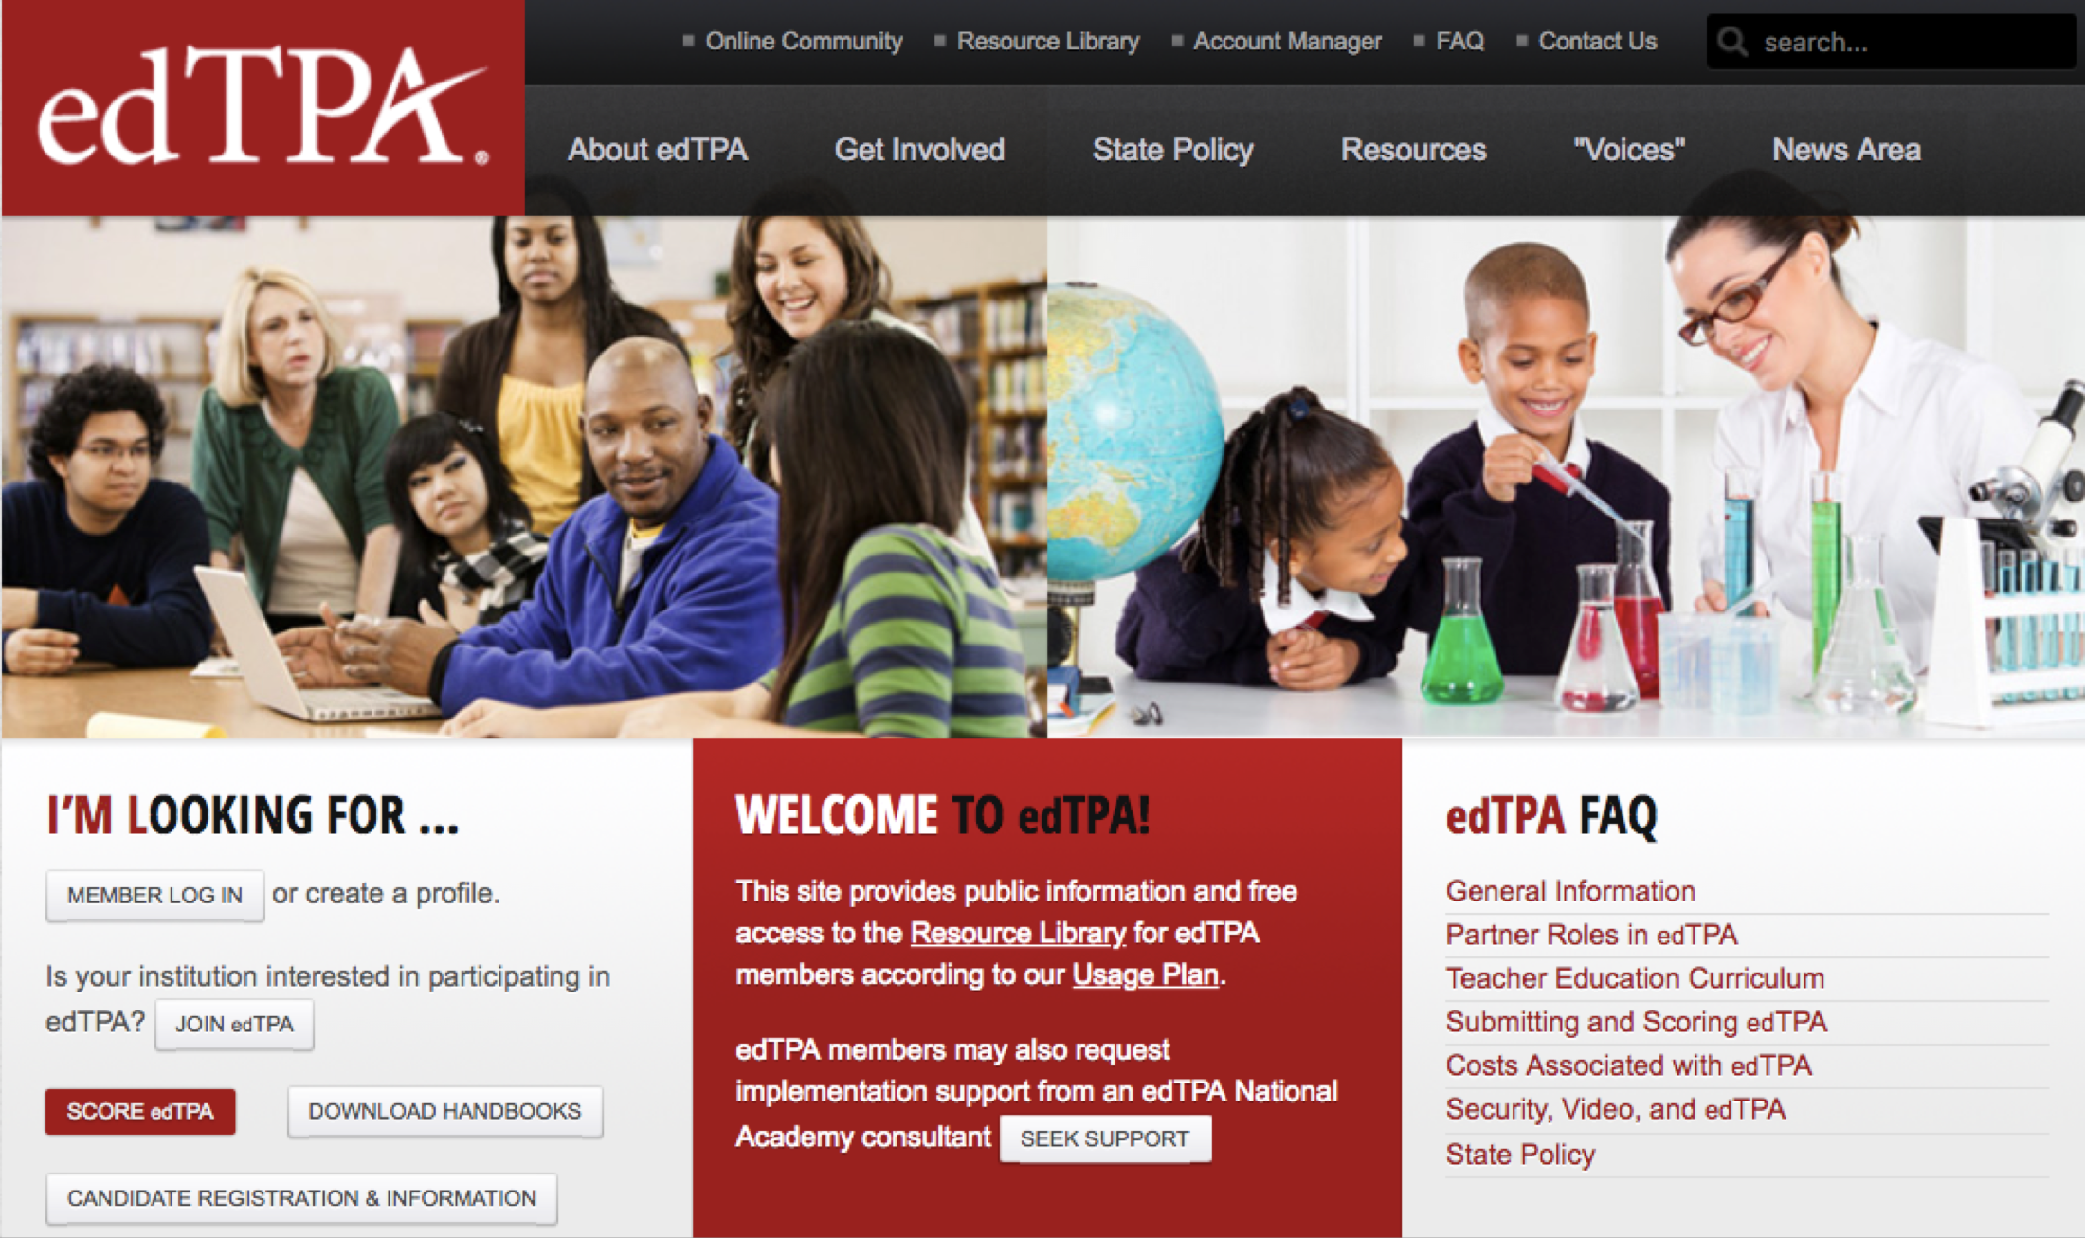
How do I get started?
edTPA.AACTE.org

Slide 27
Getting Started - edTPA 101
Onsite or Virtual
edTPA coordinators, faculty, supervisors and P-12 partners
Participants will:
  learn about the robust support system in place for EPPs and the process of scoring and data reporting
  have access to content-specific handbooks and engage in a 'walk-through' to gain an understanding of the structure of the handbook
  identify what candidates provide as evidence for each of the edTPA tasks and rubrics
  review several supplemental resources and materials to support their work
For more information:
Kellie Crawford at kellie.crawford@pearson.com or 304-549-4869

Slide 28

edTPA SUPPORT and Assessment Program: National Academy
SCALE trained and endorsed EPP leaders
Experts on edTPA implementation
Lead workshops at local or regional events
Use the “seek support” button at http://edtpa.aacte.org

Slide 29

Regional edTPA Workshops
Topic include but are not limited to:
edTPA Handbook and Rubric Deep Dive
Academic Language
Candidate Support
Curriculum Inquiry
Local Evaluation Training
edTPA Data for Program Review and Accreditation

Slide 30

Questions?
Copyright © 2019 Pearson Education, Inc. or its affiliate(s). All rights reserved.
Evaluation Systems, Pearson, P.O. Box 226, Amherst, MA 01004

Slide 31
Additional Sources of Information
edTPA.aacte.org
edTPA.com

Slide 32
edTPA Resource Library & Online Community edTPA.AACTE.org
EdReports
es-raproductsupport@pearson.com
Educator Preparation Program Support
edTPAEPPSupport@pearson.com
Kellie Crawford Kellie.Crawford@pearson.com 304-549-4869
Jerry Bush
Jerry.Bush@pearson.com
615-417-2416

