Slide 1
Supporting Preservice Teachers Through the Process of Dual Advising
and Mentoring
Mount Vernon Nazarene University
Fall 2019

Slide 2
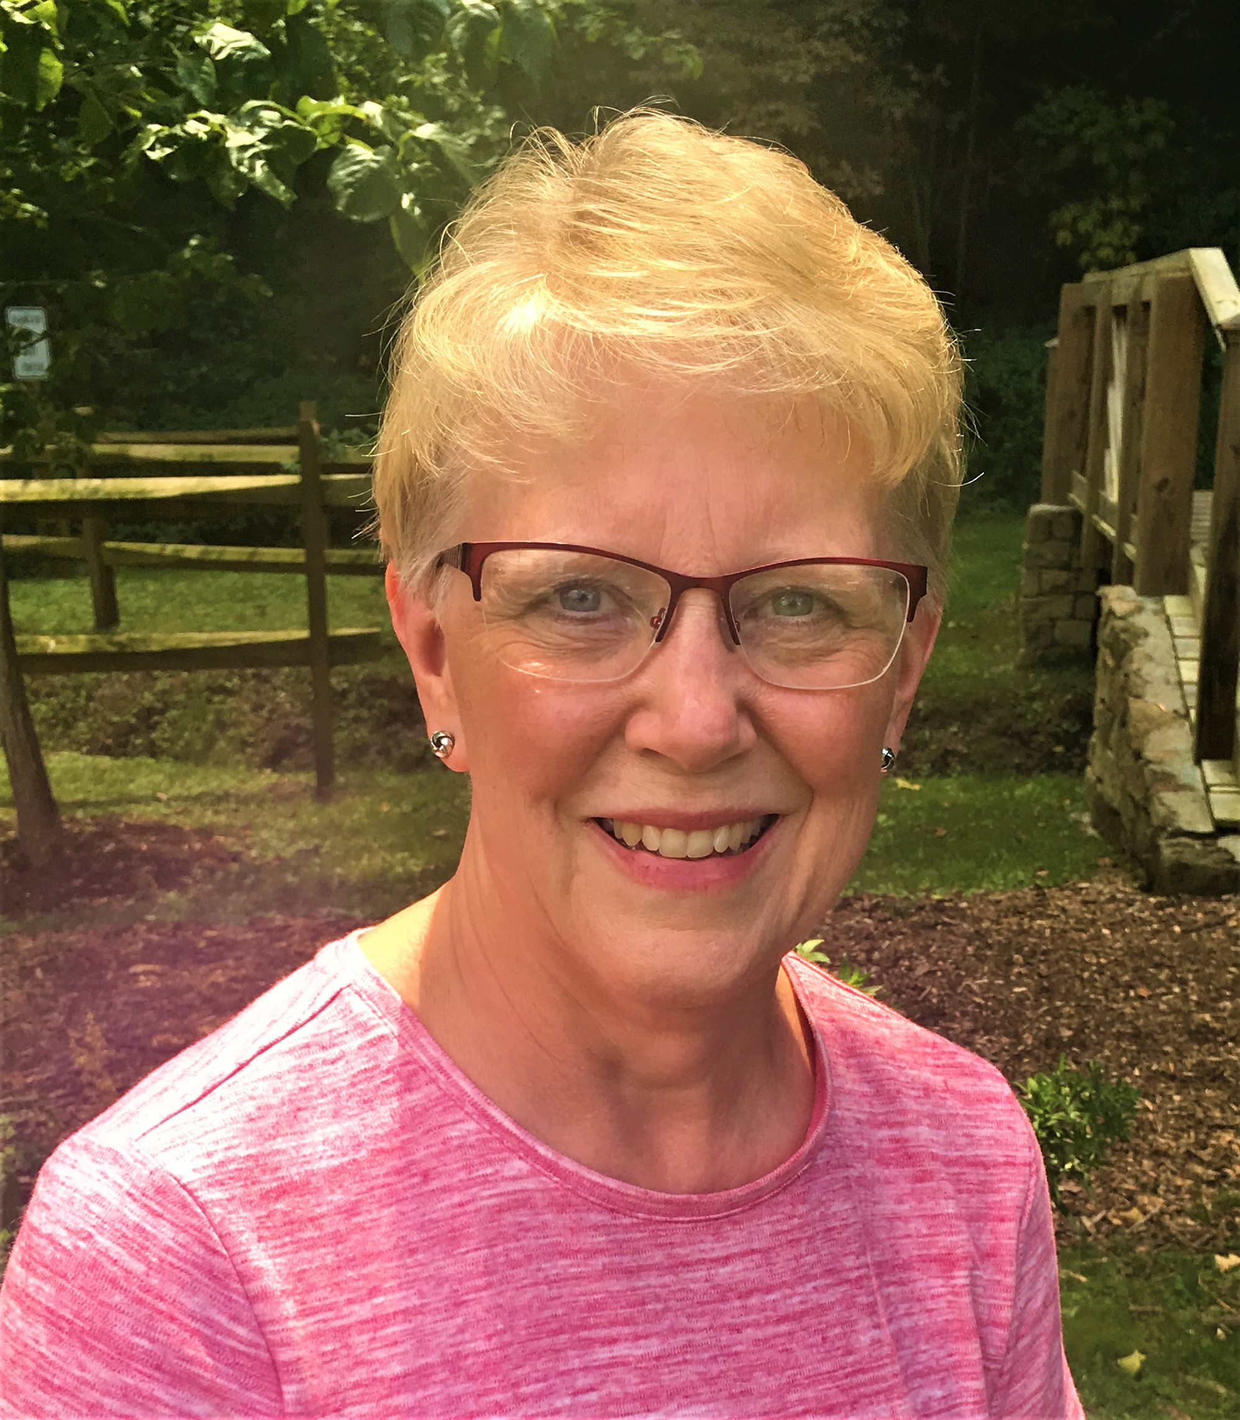
Kenna Williams
Undergraduate Education Coordinator
Mount Vernon Nazarene University
800 Martinsburg Road
Mount Vernon, OH 43050
kenna.williams@mvnu.edu
740-397-9000 ext. 3400

Slide 3
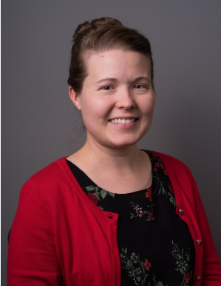
Krishana White, Ed.D.
Assistant Professor of Education
Assistant CAEP Coordinator
Mount Vernon Nazarene University
800 Martinsburg Road
Mount Vernon, OH 43050
kwhite@mvnu.edu
(740) 397-9000 ext. 3407

Slide 4

Notes:
Kenna. We know advising students is a huge job. Students have lots of questions, concerns, and needs that we do our best to meet. We all desire to implement a strong model for the betterment of our students and our programs.

Slide 5

a work in process
Notes:
Krishana. So today, we are going to share our journey to the dual advisorship model with the hopes of giving you new ideas, insight, and/or tools you can use to help strengthen your advising process. At the end, we have built in time for sharing so that we can all reflect on our current advising practices and then hear about practices we are doing at our different locations.

Slide 6
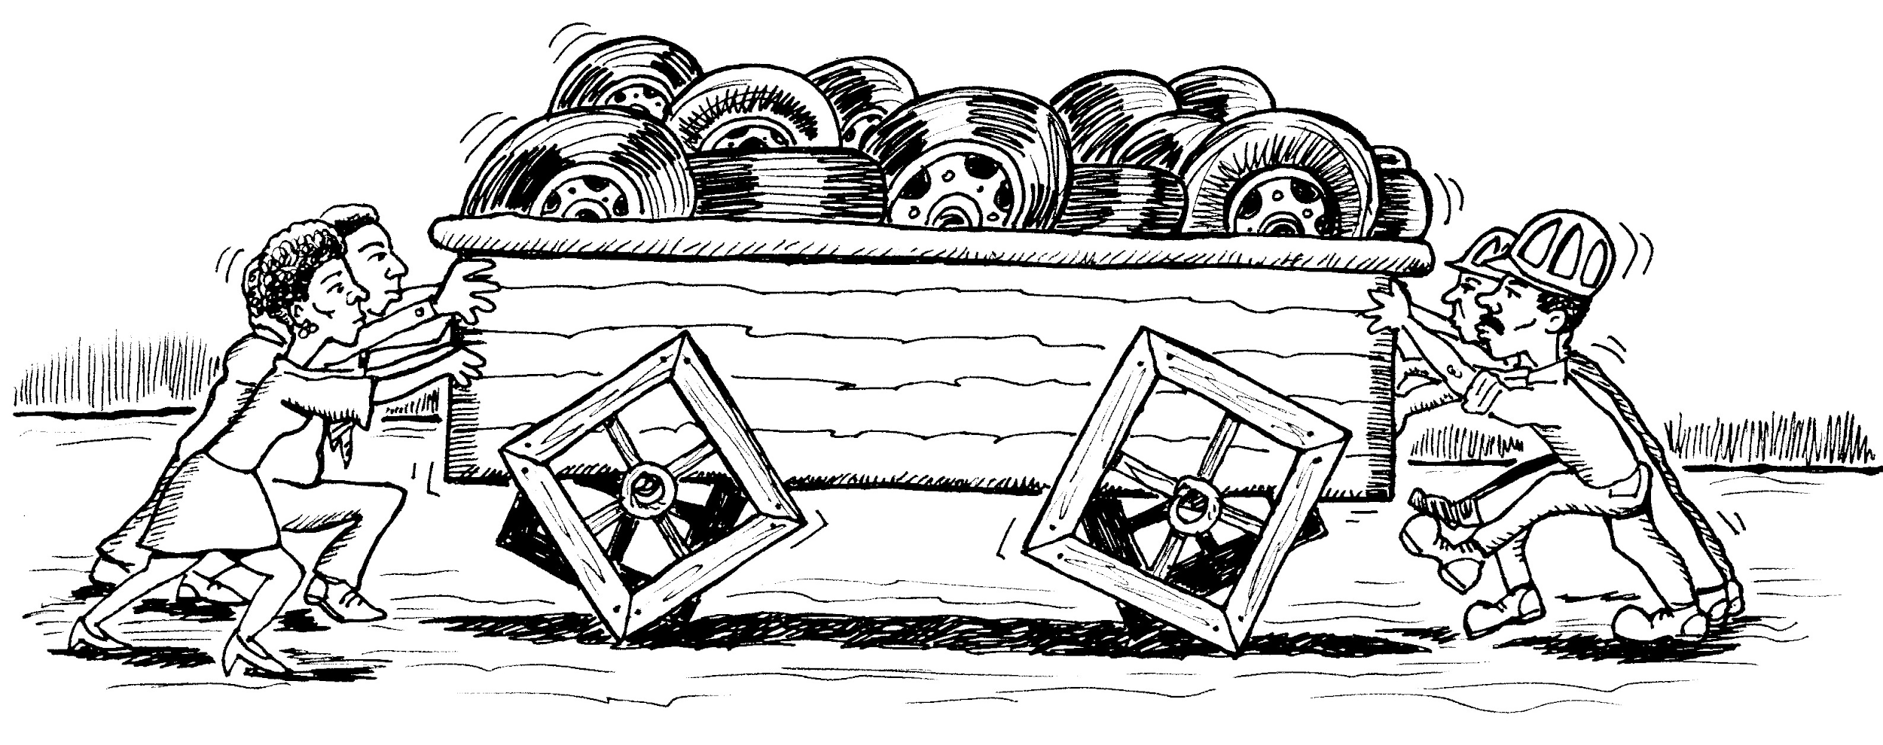
Initial Issues
Time Efficiency Double work
Communication breakdown Relational mentorship
Faculty & Staff cuts Centralized scheduling
Scheduling errors Financial efficiency
Notes:
Kenna. Double work - multiple professors encountering same issues and wasting time researching not knowing someone else resolved.
Faculty advisors not able to mentor bc time used on schedules instead of student.

Slide 7

CAEP Standard 3.4
The provider creates criteria for program progression and monitors candidates’ advancement from admissions through completion....
Notes:
Krishana. We also recognized this as an accreditation issue. Advising and retention of appropriate teacher candidates is a shared concern across universities as it relates to CAEP Standard 3.4 The provider creates criteria for program progression and monitors candidates’ advancement from admissions through completion....

Slide 8
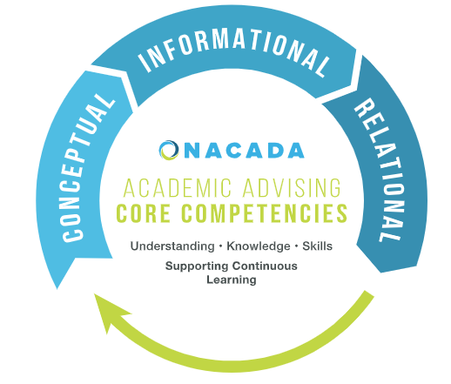
Notes:
Kenna.
We reflect on our process regularly to make changes, tweaks, and overall improvements.
The Conceptual component provides the context for the delivery of academic advising. It covers the ideas
and theories that advisors must understand to effectively advise their students.
• The Informational component provides the substance of academic advising. It covers the knowledge advisors
must gain to be able to guide the students at their institution.
• The Relational component provides the skills that enable academic advisors to convey the concepts and
information from the other two components to their advisees
Image Source: https://nacada.ksu.edu/Portals/0/Resources/documents/Core%20Competencies%20BASIC%20Flyer%20%28update%205-10-17%29.pdf

Slide 9

INITIAL DUAL ADVISING
MODEL
Primarily focused on schedules
Heavy on appreciative advising
Instituted a required, in-person meeting with faculty mentor
Notes:
Kenna. Appreciative Advising p. 85-88 - dreaming with students; help them get comfortable with their program; designing goals.
The bumpy part was the relationship with the faculty mentor.

Slide 10
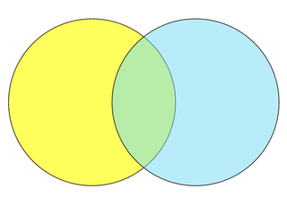
Undergraduate Education Coordinator
BOTH
Professional Mentor
What does it mean to be a professional as a student?
What does it mean to be a professional as an educator?
Honors?
Minors?
Athletics?
Music?
For credit?
Program Questions
Travel classes?
Endorsement?
Have time?
CCP
Transfer Students
Course sequence
Meet gate requirements
Tracking standardized
assessments
Final audit for licensure
Notes:
Kenna & Krishana
Dream - Honors program? Endorsement? Minors? Athletics? Music, for credit or not, time? Travel Classes
Program questions
The undergraduate education coordinator ensures preservice teachers take the correct course sequence and monitor each preservice teacher’s progression through program gates, the milestones required for successful movement from program admittance all the way through to licensure application.
The professional mentor is a full-time education faculty member who establishes a relationship focusing on our unit’s conceptual framework of compassion, competence, and commitment as a profession.
Krishana. Classroom situations. Pros and Cons MCE/ELIS. Mock interviewing.

Slide 11


Undergraduate Education Coordinator
Professional
Mentor
standardized
personalized
Notes:
Kenna & Krishana
In a nutshell,
Kenna - Standardized scripted protocol for study tips, gates progressions, licensure application, etc...
Krishana - personal application, tailoring standardized info into a personalized approach. Because I have fewer students than Kenna. She sees all our MCE and P-5/IS students.

Slide 12

together
We build the core of our department’s conceptual framework.

Slide 13

Professional education, cumulative, and major GPA
Field placement issues
Difficulties in classes
Praxis Core Tests
Counsel out of the program
Notes:
Krishana & Kenna.
Kenna - shares all that is being tracked for each student
Krishana - how issues can come back into the classroom setting
Management, presenting, planning, professionalism (punctuality, communication),
Reminders, follow-ups (each other & students)

Slide 14

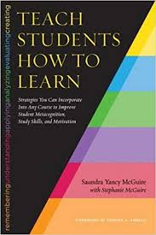
ENHANCED MODEL
New Student Institute
Individualized faculty member meetings
Dr. McGuire’s Work- study location, strategies for working with lower ACT population
Providing four year plan earlier
Notes:
Krishana
Kenna final bullet
Consistently Tweaking
Shifting to a more Proactive approach(used to be called intrusive advising). (p. 137)
Counseling out of the program; avoidance behaviors; delayed in the program
Appreciative Advising p. 85-88 - dreaming with students; help them get comfortable with their program; design goals.
NSI - this year’s freshmen class, lower ACT, and mentorship improvements.
Individualized faculty member meetings - contact info other than just email (REMIND),,
Dr. McGuire’s Work- study location, (CHECK FOR DEPT PPT), introductions to advisor already done
Kenna - doing four year plan earlier - FA freshmen instead of SP;

Slide 15
Byproducts & Anticipated Outcomes
stronger relationships
retention
two voices & moral support
course & field work
schedule & program requirements
nurturing new freshmen
Notes:
Kenna & Krishana
Hopefully, retention
candidates hear hard news from two voices and receive moral support as well as come at it from multiple perspectives
Coursework & classroom prep
black and white schedule mathing out of time and program requirements
nurturing new freshmen - - they are more willing to ask questions, guidance, advice = better prepared

Slide 16

What is a way you see dual advisorship being advantageous to your program?
What are things your program has done that are successful for advising?
Notes:
Q & A slide with talking point questions to get them thinking about starting up in their own setting - what is a way you see this being advantageous to your program? What are things your program has done that are successful for advising?

Slide 17
References
CAEP: Council for the Accreditation of Educator Preparation. (2015). Standard 3: Candidate quality, recruitment, and selectivity. Retrieved from http://caepnet.org/standards/standard-3
Drake, J. K., Jordan, P., & Miller, M. A., (Eds.). (2013). Academic advising approaches: Strategies that teach students to make the most of college. San Francisco, CA: Jossey-Bass.
McGuire, S. Y. (2015). Teach students how to learn: Strategies you can incorporate into any course to improve student metacognition, study skills, and motivation. Sterling, VA: Stylus Publishing, LLC.
NACADA: The Global Community for Academic Advising. (2017a). NACADA academic advising core competencies model. Retrieved from https://www.nacada.ksu.edu/Resources/Pillars/CoreCompetencies.aspx
NACADA: The Global Community for Academic Advising. (2017b). NACADA core values of academic advising. Retrieved from https://www.nacada.ksu.edu/Resources/Pillars/CoreValues.aspx

