Slide 1
Jessica Mercerhill, PhD
Senior Director, Educator Preparation
Fall 2019 Update to OCTEO

Slide 2
Agenda
New Associate Vice-Chancellor for P-16 Initiatives
Program/Data
  Fall Surveys
  Program Reviews
Standards Developments and Revisions
Partnership Projects with ODE
  Human Resource Capital Management website
  Diversifying the Educator Pipeline
Performance-Based Assessment and APK

Slide 3
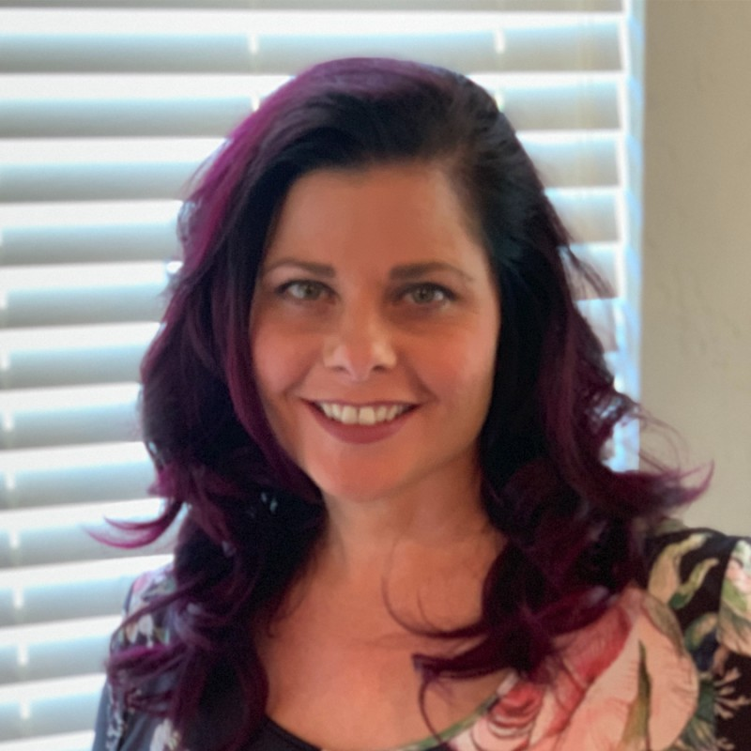
Associate Vice Chancellor for P-16 Initiatives
Introducing
Dr. Krista Maxson!

Slide 4
Program/Data
Fall Surveys: Pre-Service, Principal Intern, Principal Mentor
  Distribution histories will be sent week of Nov 4
  Reminder emails will automatically send Oct 30 and Dec 2
  Survey closes Dec 9.
Please note:
  Links cannot be used by multiple people.
  Institutions cannot send links to students
  Reach out to your mentor teacher and principal mentor partners and ask them to look for and respond to the survey
    From: Ohio Department of Higher Education <noreply@qemailserver.com>

Slide 5
Programs/Data
Fall Program Review Submissions
  Submitted Oct 15
  Limited state reviews
    Will be reviewed by Nov 15
  Full state reviews
    Consultants identified, contracts under development
  After review is complete: public posting (10 business days), legal council review, Chancellor signature

Slide 6
New Online Program Review System Coming!
EDvera curriculum workflow system
Anticipated late January, 2020
Spring Submission
  March 15 deadline
  Forms available online now – please download the most recent version (Don’t just reuse forms from previous submission!)
  Current forms will be uploaded into new system by institution users

Slide 7
Standards Development and Revisions
Adapted Physical Education Endorsement
  New standards pending Chancellor authorization
Computer Science Endorsement (new)
  ISTE standards for computer science educators
  Endorsement still pending state approval
  Proposals may be submitted on rolling basis

Slide 8
Standards Development and Revisions con’t
In committee now:
  Theater/Drama Endorsement (new)
  Middle Childhood Generalist
  Reading in Content Area 3 credit requirement
Media Arts Endorsement (new pending state approval)
  still not enough faculty volunteers

Slide 9
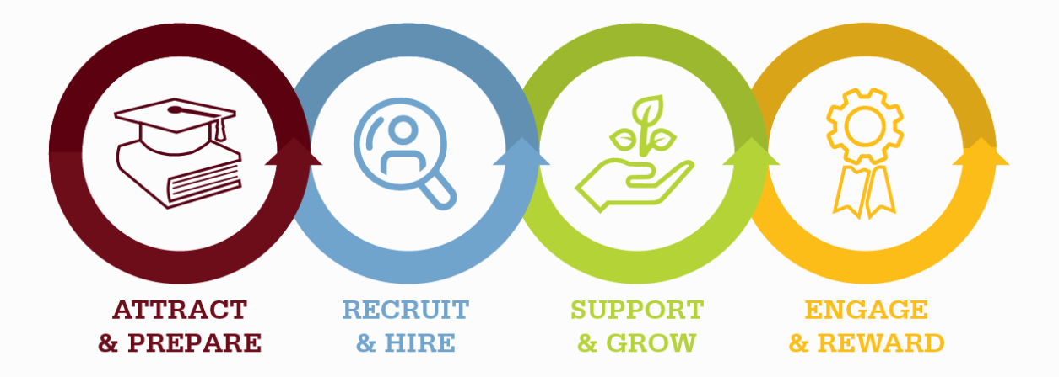

Partnership Projects with ODE
Human Capital Resource Center
Resources to Attract, Hire, and Support the Excellent Educators

Slide 10




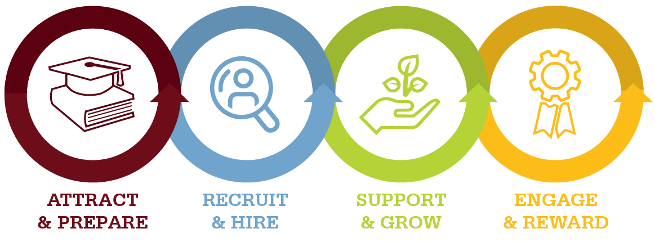
Human Capital Resource Center
1. Exploring Careers in Education
Illuminate a path to pursuing a career in education.
2. Educator Recruitment
Discover strategies to help improve and increase applicant pools.
3. Professional Conduct
Find tools to help navigate difficult waters and support ethical decision making.
4. Mentoring
Discover how to create intentional, integrated support systems to advance practice.
5. Educator Recognition
Explore opportunities that celebrate educators who go above and beyond and engage them as ambassadors for the profession.
www.ohiohcrc.org
Notes:
Five phase one projects were completed.
Exploring careers in education outlines the different types of careers in the education field beginning with have a high school diploma and beyond. This portion helps human capital leaders work with candidates on exploring the education profession and the various roles within it.
Educator recruitment offers new tools to help districts and schools with proactive recruiting.
Professional conduct offers guides to help work with educators on navigating the difficult waters and to help educators make better choices that often get them into trouble.
Mentoring – offers many tools to support a mentoring program for any educator regardless of their role or years of experience
Educator recognition – highlights ways to recognize and celebrate our educators.
In the next phase of work we will address – onboarding, Employer branding, compensation. Please visit the website to find various resources and tools.

Slide 11
Diversifying the Education Profession Taskforce
Three meetings that Center on Great Teachers & Leaders at AIR facilitated in partnership with Cheryl Krohn and Jessica Mercerhill
Examined Root Causes for the lack of diversity in our current workforce, including in Ed Prep
Identified priority recommendations to present to Superintendent DeMaria and Chancellor Gardner
Final recommendations are complete and will be released in next few week

Slide 12
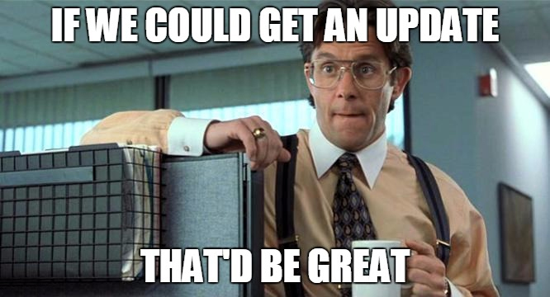
Performance-Based Assessment in place of APK
Recommendation in review by State Board Subcommittee on Teaching, Leading, and Learning
NOT for requirement but option

Slide 13

Question and Answer time!

