Slide 1
Supporting Student Satisfaction: An Audio Method to Address the Trauma of Feedback
Vince Laverick, Ed.D.
Lourdes University

Slide 2
Types of feedback used
What types do you use in your setting?

Slide 3
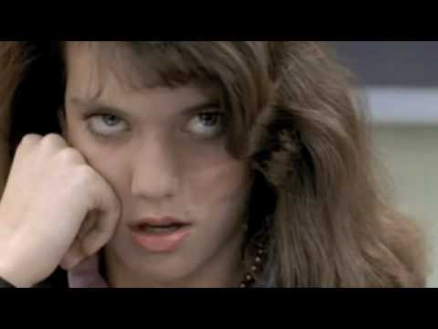

Slide 4


Slide 5
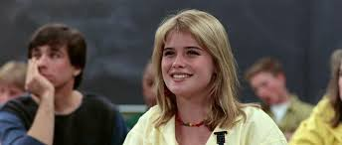

Slide 6
Part of a Group
Cheri Hampton-Farmer, Ph.D.
  Chair- Dept. of Communication
Robert Postic, Ph.D.
  Chair- Dept. of Behavioral Sciences

Slide 7
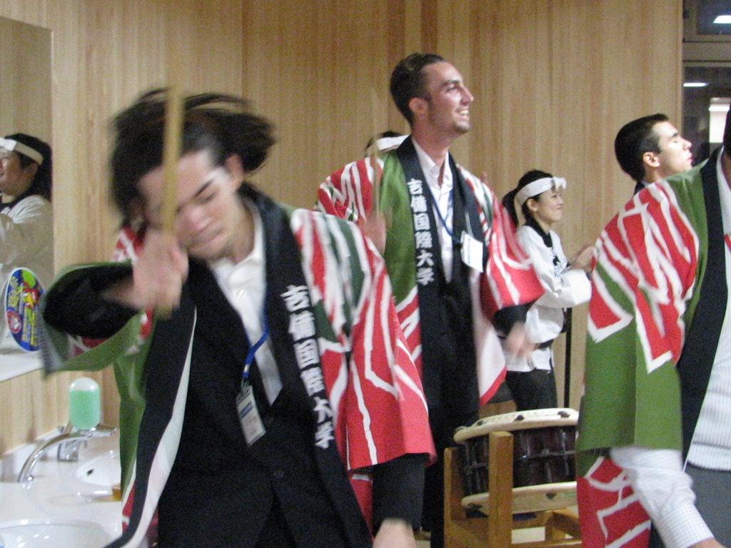
Need
Inconsistencies across courses
Students not accessing feedback

Slide 8
Goals
Identify feedback preferences
Measure satisfaction levels
Reduce communication anxiety

Slide 9

New feedback method
Audio feedback

Slide 10
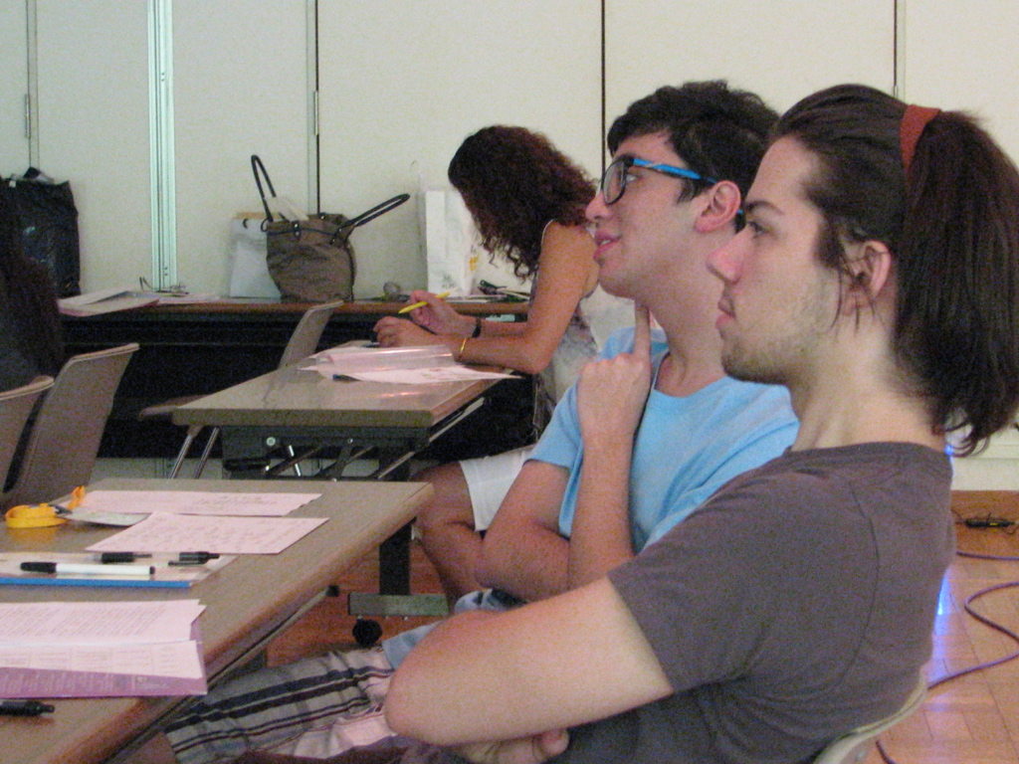
Plan
Systematize feedback instruments
Initiate audio feedback
Measure satisfaction

Slide 11
Context
Required course - 600 yearly
Average class size - 20
Instructors –
  2-3 FT 6-10 PT
Timing of survey
  FA16 & SP17 Week 13-15

Slide 12
Research Design
Theoretical Design
  Metacognition- Bransford (2000)
  Communication Anxiety- Brodie (2010)
  Feedback- Buckely (2012)
Notes:
Bransford (2000)- 3 items for metacognition: preconceived notions, base of knowledge, progress toward a goal
Brodie (2010)- delineates types of speech anxiety and possible methods to address them
Buckely (2012)- students receiving recorded audio feedback preferred it to written feedback

Slide 13
Research Design
Methodology- quantitative
Pilot Study
Survey
Notes:
Methodology- quantitative
Pilot Study- used a survey at the end of the semester conducted in Introductory speech course. Survey had 42 questions.
Survey was completed by 242 students in the face to face sections. Purposefully, did not include online course option
Over a 95% completion rate.

Slide 14
Research Question
RQ: To what extent does audio/oral feedback impact satisfaction?

Slide 15

Findings

Slide 16
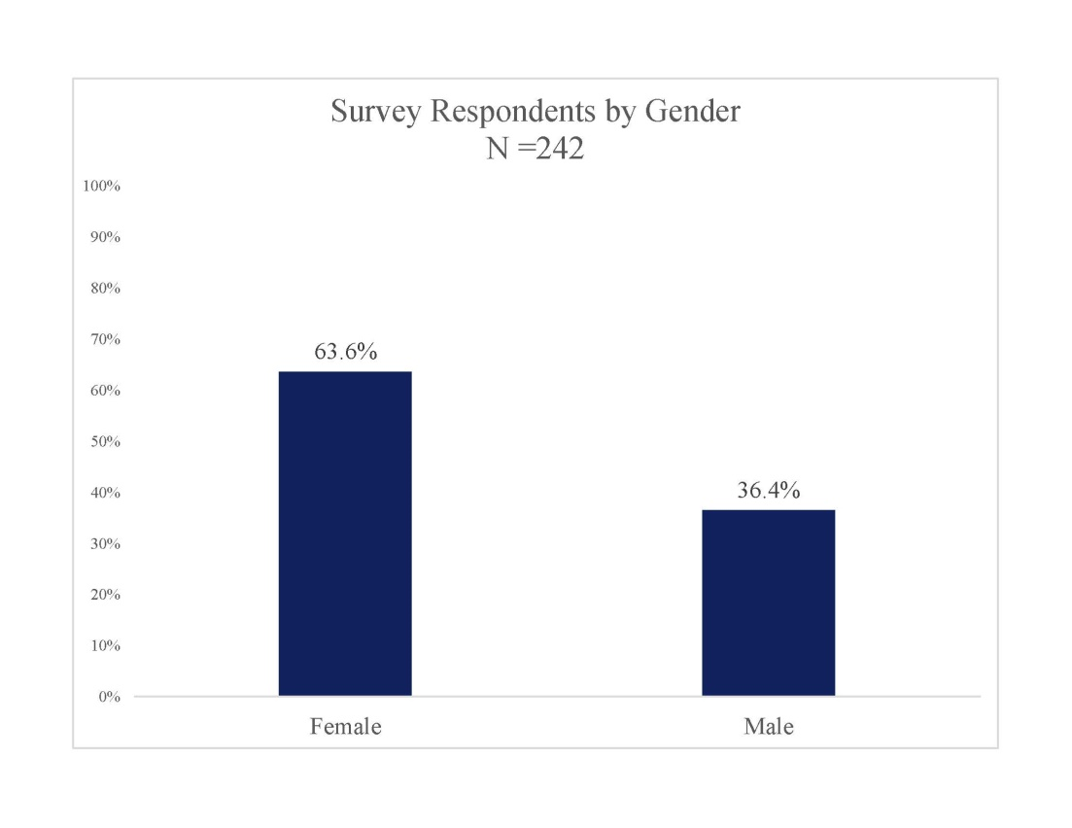

Slide 17
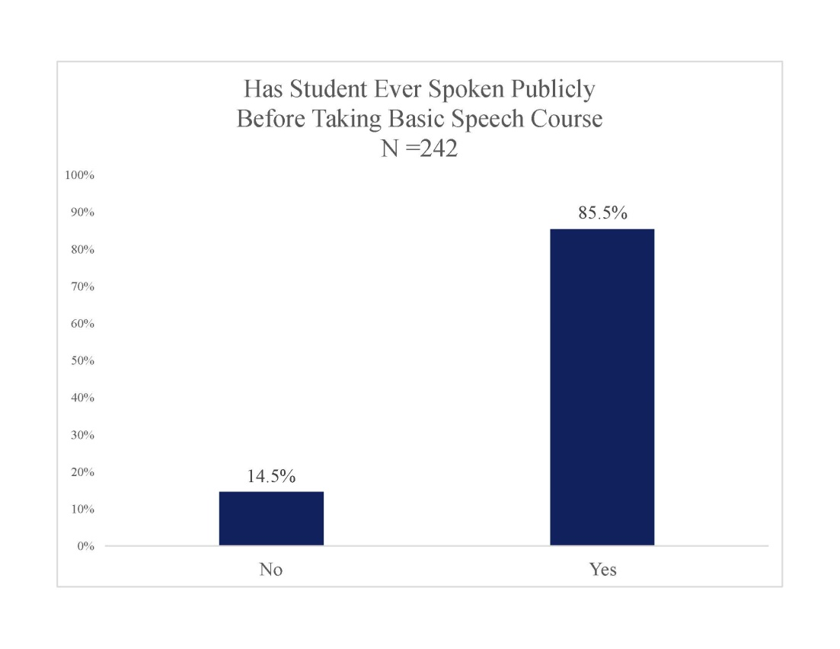

Slide 18
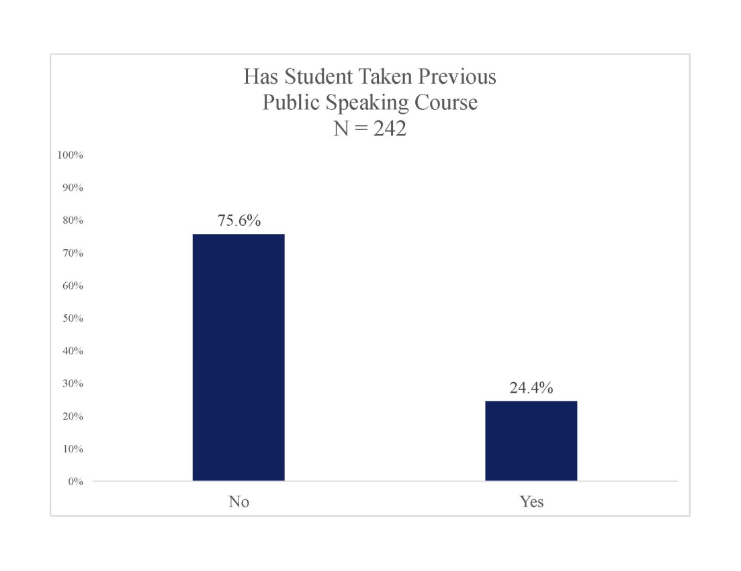

Slide 19
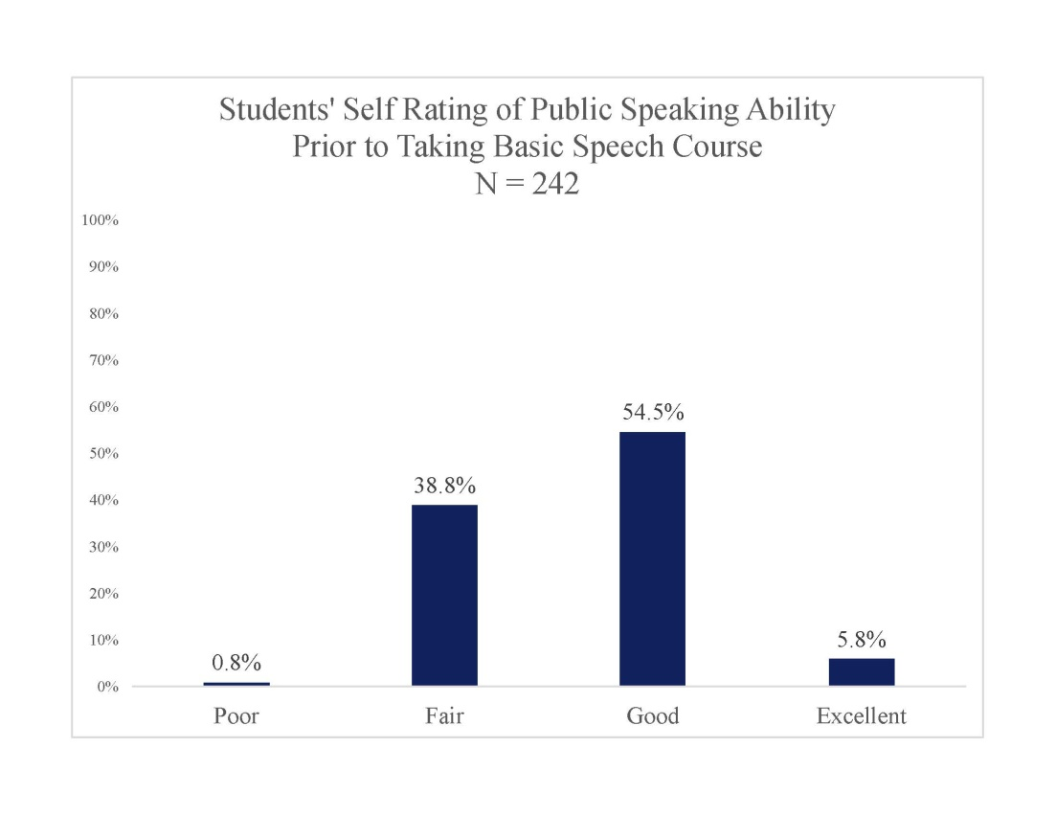

Slide 20
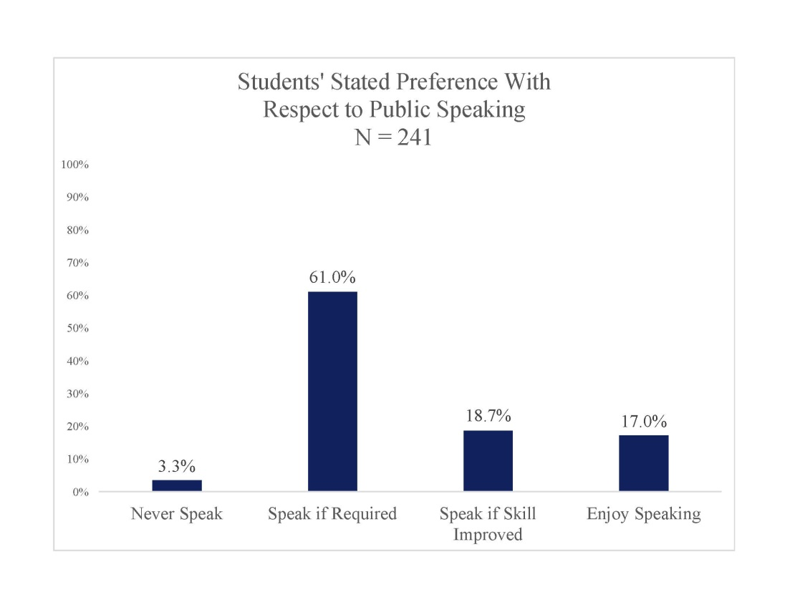

Slide 21
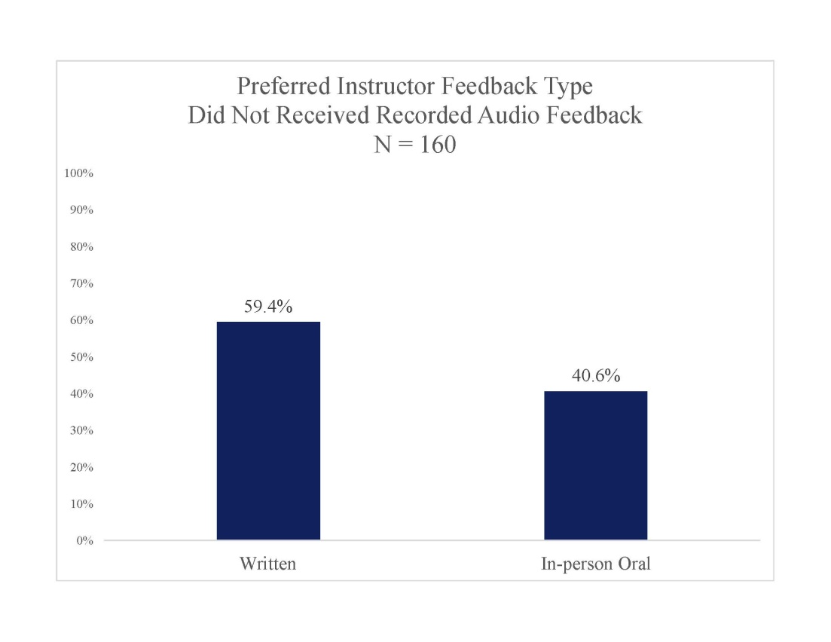

Slide 22
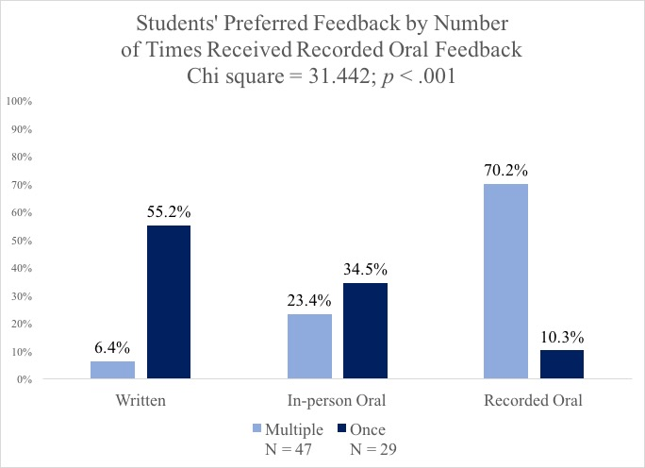

Slide 23
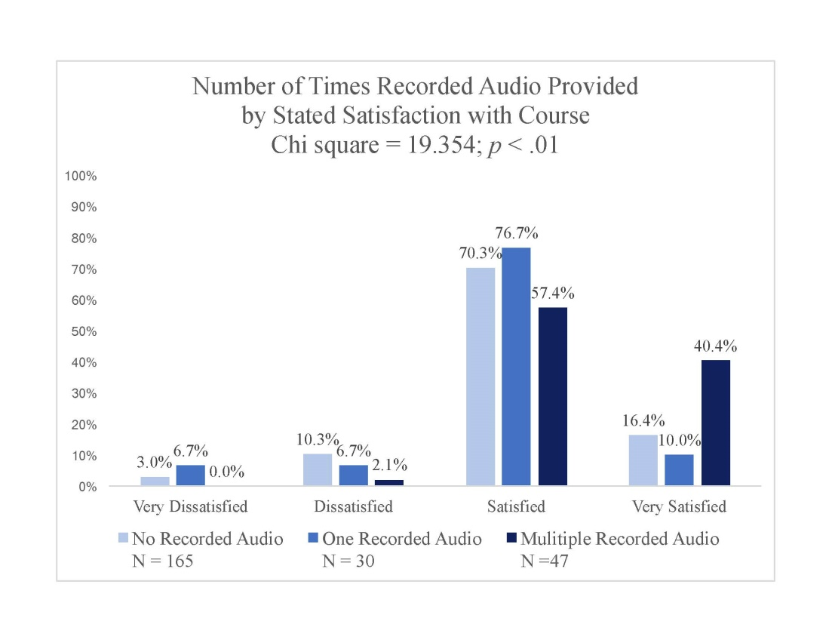

Slide 24
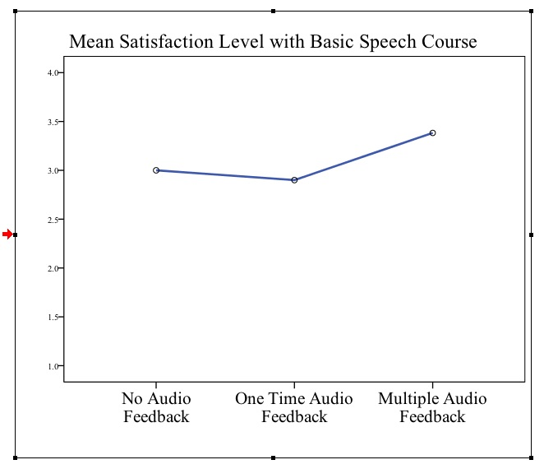

Slide 25
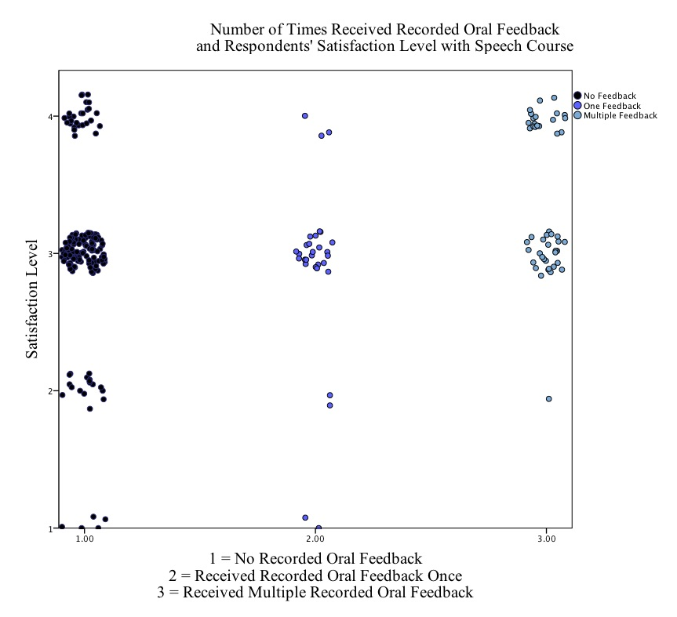

Slide 26
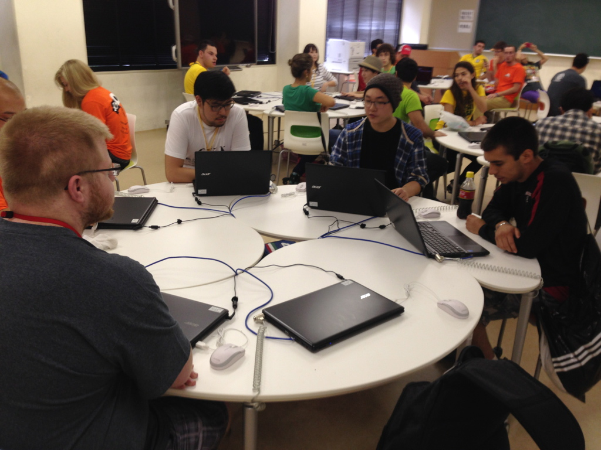
Implications
Feedback preferences
Consistent feedback method

Slide 27
Anecdotal Comments
Novelty
Personal
Tone
Easier to understand

Slide 28
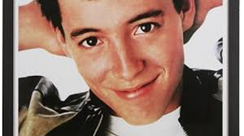
Connection to Education
Feedback on lessons
Tone
Model effective student feedback

Slide 29
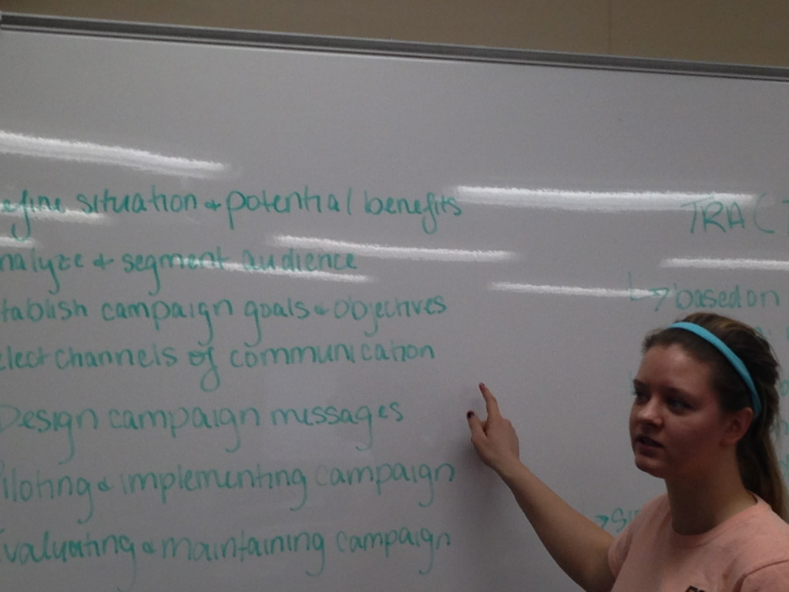
Future Research and Questions

Slide 30
Questions Later?
Vince Laverick, Ed.D.
Lourdes University
419.824.3840
vlaverick@lourdes.edu

Slide 31
References
Bransford, J.D. (2000). How people learn: Brain, mind, and school. Washington, D.C. National Academy Press.
Bodie, G. D. (2010). A Racing Heart, Rattling Knees, and Ruminative Thoughts: Defining, Explaining, and Treating Public Speaking Anxiety. Communication Education, 59(1), 70-105.
Buckely, P. (2012). Can the effectiveness of different forms of feedback be measured? Retention and student preference for written and verbal feedback in level 4 bioscience students. Journal of Biological Education, 46(4), 242-246.

