Slide 1
Valid and Reliable (V&R) Instruments for Educator Preparation Programs (VARI-EPP) Endeavoring to Persevere: VARI-EPP Panel Discussion OCTEO
Thursday, October 27, 2:45 – 3:45 PM
VARI-EPP Coordination Team: Erica Brownstein, Carolyn Kaplan, and Xiangquan (James) Yao (Ohio State)
VARI-EPP Collaborators: Lisa Baylor (Walsh), Sue Corbin (Notre Dame), Anne Price (Cleveland State)

Slide 2
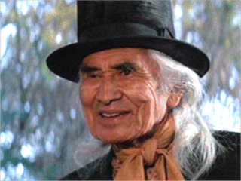
Pop Quiz!
Can you identify the origin of the title of our presentation?
Chief Dan George as Lone Waite in The Outlaw Josey Wales (1976)
Note: It has been attributed to others, too, but we’re sticking with Lone Waite

Slide 3
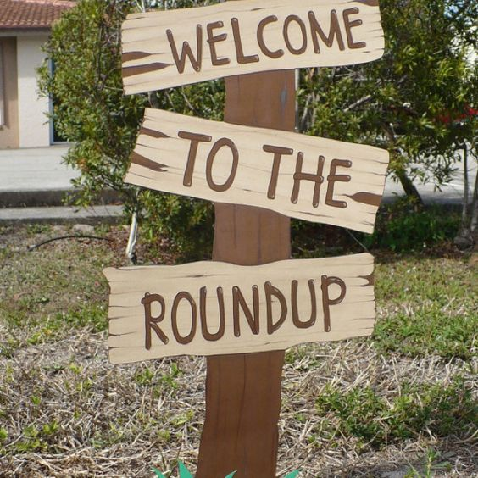
Endeavoring to. . . Pre-Assess
Please stand up if:
Your institution participated in the VARI-EPP Project last year
Your institution is participating in the VARI-EPP Project this year for the first time
Your institution has not yet participated and you are curious to learn more
Notes:
Image Source: https://s-media-cache-ak0.pinimg.com/564x/22/a2/01/22a2014e50d3c0d2ac3ea2464cade1c4.jpg

Slide 4
Endeavoring to. . . Assess
Candidate Preservice Assessment of Student Teaching (CPAST) Form
A formative and summative assessment during the student teaching practicum.
The rubric has two subscales: (1) Pedagogy and (2) Dispositions with detailed descriptors of observable, measurable behaviors, to guide scoring decisions.
An additional “Look Fors” resource provides elaborates on the qualities and behaviors for a given level of performance.
A self-paced, 90-minute training module for users of the form.

Slide 5
Endeavoring to. . .
Address All P-12 Contexts and Licensures
CPAST Form
License Area | # of Student Teachers | Percentage
Early Childhood Education | 465 | 38.7%
Middle Childhood Education | 202 | 16.8%
Special Education | 168 | 14.0%
AYA/Secondary English Lang. Art | 99 | 8.2%
AYA/Social Studies Education | 92 | 7.6%
AYA/Secondary Math Education | 70 | 5.8%
AYA/Secondary Science Education | 50 | 4.2%
Music Education | 39 | 3.2%
Foreign Language | 29 | 2.4%
Physical Education | 14 | 1.2%
Art Education | 2 | 0.2%
TESOL | 1 | 0.1%
Family and Consumer Science Education | 1 | 0.1%
Undisclosed | 4 | 0.3%
Data from
2015-2016
Placement Type | # of Student Teachers | % of Student Teachers
Urban | 447 | 37.2%
Suburban | 542 | 45.1%
Rural | 299 | 24.9%
Missing | 95 | 7.9%
N = 1383 (due to multiple placements)
Notes:
Urban Public: Akron, CSU, OSU, Wright, Youngstown, Toledo
Urban Private: CCU, Dayton, Findlay, Malone, Mt. Union
Suburban Public: Kent, OU
Suburban Private: BW, JCU, Lake Erie, Notre Dame, Walsh, Wesleyan
Rural Private: Cedarville, Lourdes, ONU, Marietta

Slide 6
Endeavoring to Show. . . Validity and Reliability (2015-2016 Data Analysis)
Content Validity
Construct Validity
Confirmatory factor analysis (CFA) confirmed our theoretical assumption of a two-factor model (i.e. pedagogy and disposition)
Test-retest Reliability
Pedagogy & Disposition significantly correlated at midterm and final
Concurrent Validity (OAE and edTPA) Results
No significant correlation between CPAST Form and OAE
No significant correlation between CPAST Form Disposition Rows and edTPA
Significant correlation between CPAST Form Pedagogy Rows and edTPA
IRR
Good, but can do better…

Slide 7
Mean Scores: Student Teachers’ Performance
Pedagogy and Dispositions means from all institutions 2015-2016 (n =1203*)
Participants received midterm and final scores (pedagogy & disposition) for Spring 2016
These are the data required for CAEP reporting (i.e., comparisons)
 | Pedagogy | Dispositions
Midterm | 2.05 | 2.32
Summative | 2.45 | 2.64
3 = Exceeds Expectations
2 = Meets Expectations
1 = Emerging
0 = Does Not Meet Expectations
* Some scores were not included because training of evidence completion was not attained

Slide 8
Mean Scores: Student Teachers’ Performance
Pedagogy Rows
Dispositions Rows

Slide 9
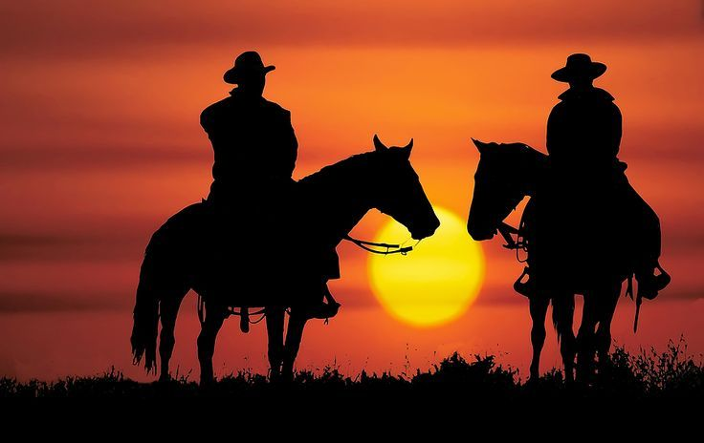
Endeavoring to. . . Look to the Future
Fall data collection will be via spreadsheet
Spring data collection will be via an online system
MOU is only necessary for institutions NOT under IRB
MOU necessary for all institutions next year
Will share for review when available
IRR
~75 candidates to participate
Interested? Let us know!
Will contact based on previous survey
Training available December 5
CPAST Training 4.0
Cooperating Teacher Training
SPA Alignment Project for CPAST form
Any other Pre-CPAST Form examples to share?
Any more Math SPA participants?
Notes:
Image Source: https://s-media-cache-ak0.pinimg.com/736x/7d/6d/c6/7d6dc67acc786f22e164a6dc6ccfb96d.jpg

Slide 10
Endeavoring to. . . Collaborate Across the State
Institutions Providing Data 2015-2016
Institutions Participating in Collaboration Study
Institution Type | # of Institutions | # of Student Teachers
Urban - Public | 6 | 481
Suburban - Public | 2 | 359
Rural - Public | 0 | 0
Urban - Private | 5 | 208
Suburban - Private | 6 | 85
Rural - Private | 4 | 70
Total | 23 | 1203
Institution Type | # of Institutions
Urban - Public | 4
Suburban - Public | 1
Rural - Public | 0
Urban - Private | 3
Suburban - Private | 5
Rural - Private | 3
Total | 16
Notes:
Urban Public: Akron, CSU, OSU, Wright, Youngstown, Toledo
Urban Private: CCU, Dayton, Findlay, Malone, Mt. Union
Suburban Public: Kent, OU
Suburban Private: BW, JCU, Lake Erie, Notre Dame, Walsh, Wesleyan
Rural Private: Cedarville, Lourdes, ONU, Marietta

Slide 11
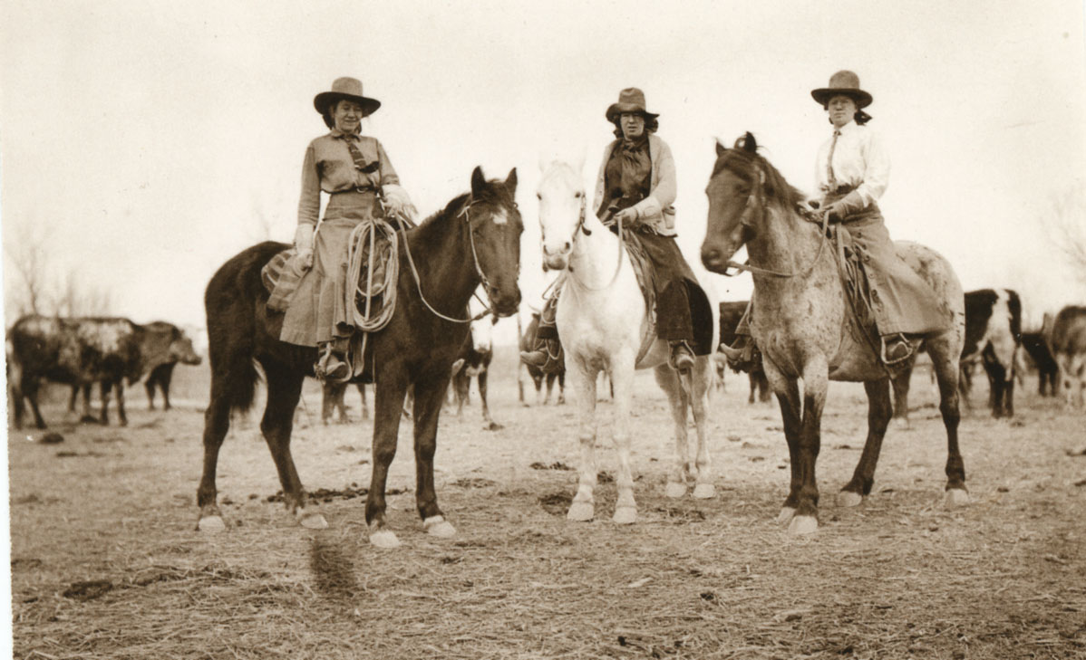
Endeavoring to. . . Collaborate Across the State
Participants:
Lisa Baylor, Walsh University
Sue Corbin, Notre Dame College
Anne Price, Cleveland State University
Please describe your context:
Number of candidates assessed with CPAST
Number of programs/supervisors participating
How supervisors were trained
Anything else you would like to share
Notes:
Image Source: http://3.bp.blogspot.com/-AbusPP7SL_c/VWd689BtKXI/AAAAAAAAGCQ/sj5UPOcC8eg/s1600/cowgirls-from-past.jpg

Slide 12
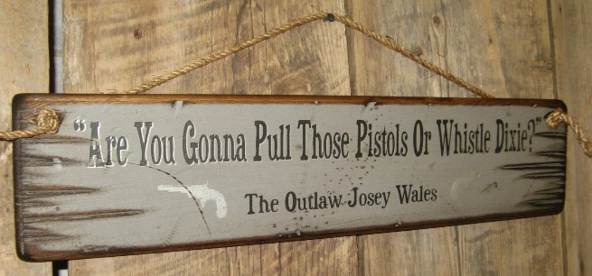
Endeavoring to. . . Participate
What was your program's motivation for participating in the VARI-EPP Project?
Notes:
Image Source: https://img0.etsystatic.com/029/0/7840266/il_fullxfull.621720728_7rs6.jpg

Slide 13
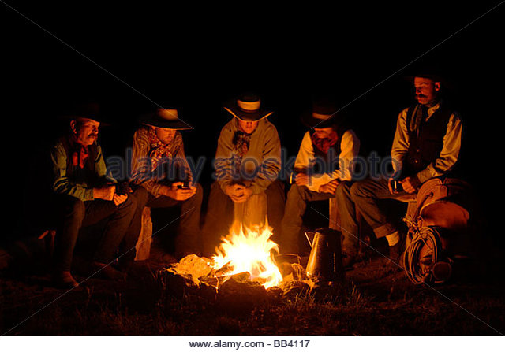
Endeavoring to. . . Maximize the Experience
How was participating in the VARI-EPP project a benefit for your program?
Notes:
Image Source: http://l7.alamy.com/zooms/bed502fb708946baa5c1667ce06039fc/usa-oregon-seneca-ponderosa-ranch-five-cowboys-sitting-around-a-nighttime-bb4117.jpg

Slide 14
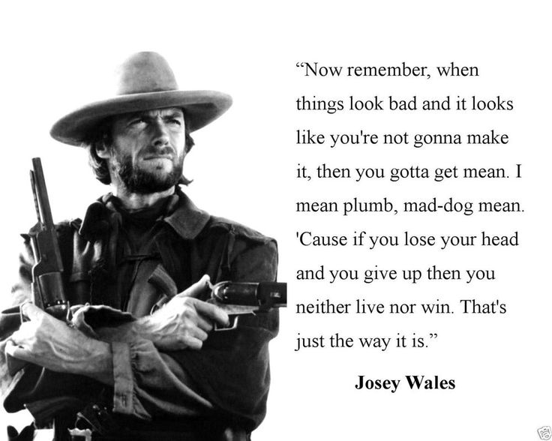
Endeavoring to. . . Understand and Overcome Challenges
How was it a challenge for your program?
Notes:
Image: https://www.pinterest.com/explore/outlaw-josey-wales-quotes/

Slide 15
Research Question | Summary of Findings
What were EPP’s motivations for participating in a statewide collaborative effort to develop valid and reliable assessment instruments for educator preparation? | Need for a revised student teaching assessment instrument Need to meet accreditation requirements (i.e., for valid and reliable assessment instruments) Availability of resources in collaboration
What are the benefits and challenges encountered by EPPs when engaging in a multi-university collaborative effort? | Benefits: Identical form used across multiple EPPs Positive impact of CPAST Form on individual EPPs Challenge: Communication with cooperating teachers
What is the learning that occurred across institutions as a result of participating in the statewide collaboration? | How supervisors and candidates used the CPAST Form to score performance

Slide 16
Questions?
Notes:
Image Source: http://whoapodcast.com/wp-content/uploads/2015/01/Cowboy-qa-banner2.jpg

Slide 17
Thank you for your time!
If you have any questions AT ANY TIME, feel free to contact:
Name | Email | Phone | Topic
Erica Brownstein | Brownstein.2@osu.edu | (614) 292-1414 | “Big Picture” project questions, rubric questions
Carolyn Kaplan | Kaplan.169@osu.edu | (614) 292-5044 | Training, Timeline, IRR Participants
Xiangquan (James) Yao | Yao.298@osu.edu | (614) 292-5044 | Data Collection

