Slide 1
Social Justice Colloquia as a Key Component of Transformative Teacher Education
Todd S. Hawley
Lisa A. Borgerding
Kent State University

Slide 2
Evolution of Social Justice Colloquia
Troubled By:
Definitions of SJ
Desire to take ACTION
Desire to share SJ commit-ments more formally with students
ADED Faculty started discussing how SJ emerges in our separate courses, desired more formal discussions, & decided to start readings
ADED Faculty started discussing SJ articles at regular meetings
Developed a subcommittee to imagine how SJ could be emphasized in Senior year
Developed the ADED Colloquia in Fall 2012
Colloquia have recurred every fall 2012-2015 with evolving topics

Slide 3
Topics & Structure
Topics
Structure
4 1-hour sessions (2 consecutive sessions on two Fall Fridays)
Interdisciplinary grouping (math, social studies, language arts, & science)
Groups of about 24-30
Led by an ADED faculty member
Fall follow-up in Practicum seminars
Some years, spring follow-up in Inquiry seminars
LGBTQ
Culturally-Relevant Pedagogy
Race
Poverty
Students’ Considered “At Risk”
Service Learning

Slide 4
Instructions for Students
If we believe in a social constructivist view of learning, we, as teachers need to have awareness about social issues as we shape our pedagogical practices and interactions with students, parents, and colleagues. On Friday, September 6th and Friday, September 20th, from 8:00-10:00am, you will participate in discussions around social issues in schools. These discussions will be interdisciplinary, meaning you will be talking with faculty and secondary pre-service teachers in various disciplines (English, math, science, and social studies). These discussions will be led by an ADED faculty member who is an expert in the topic being discussed. Attendance and active participation is mandatory. A two-page reflection paper about this experience is due electronically on Friday, September 27^{th.}

Slide 5
Student Reflection assignment
Reflection format: 3-2-1 Response
3—Describe 3 things you learned during the colloquium that INTRIGUED, SURPRISED, or ENLIGHTENED you.
2—Describe 2 things that challenged your thinking in some way, perhaps in ways you found slightly uncomfortable or stretching.
1—Synthesize what you gained through these sessions into one image—a simile or metaphor—that represents what you will take away from this experience. Tie what you have learned to your practicum experience, in essence, answering the question, "How will what I’ve learned from this colloquium make me a better teacher.”
An example of an image: “What I have learned about myself as a teacher through the social justice colloquium is that a teacher is like a chambered nautilus. As she grows in teaching experiences, her understanding about students grows, adding a new chamber onto her shell, expanding her living space to make room for new knowledge.”

Slide 6
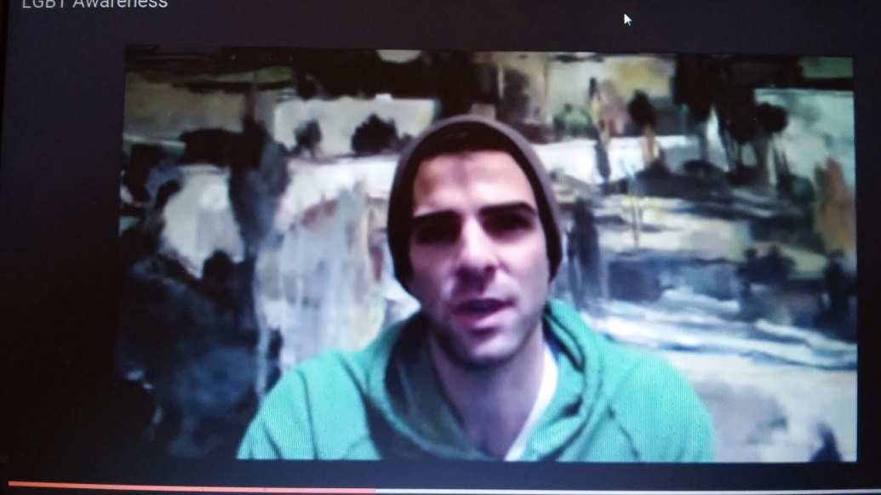
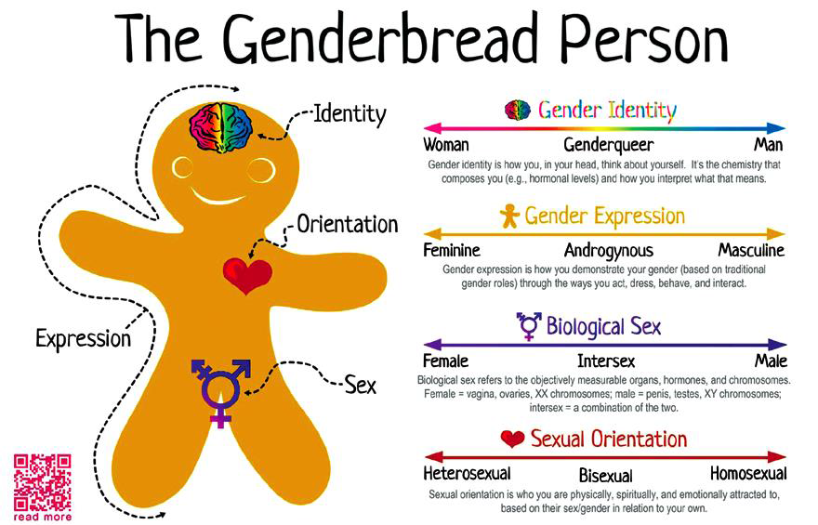
Classes: LGBTQ
Provides background on gender identity, gender expression, biological sex, and sexual orientation
Addresses how LGBTQ issues arise in classrooms, extracurriculars, and policies

Slide 7
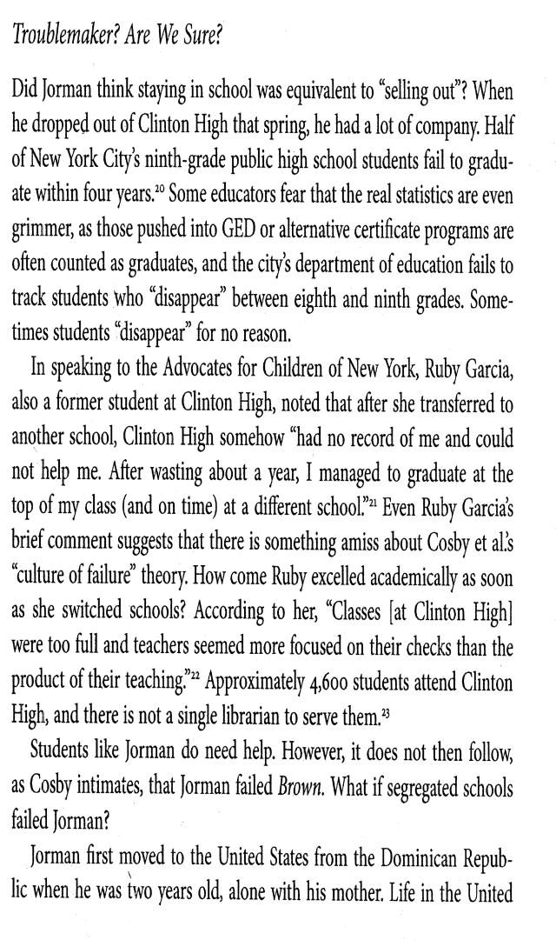
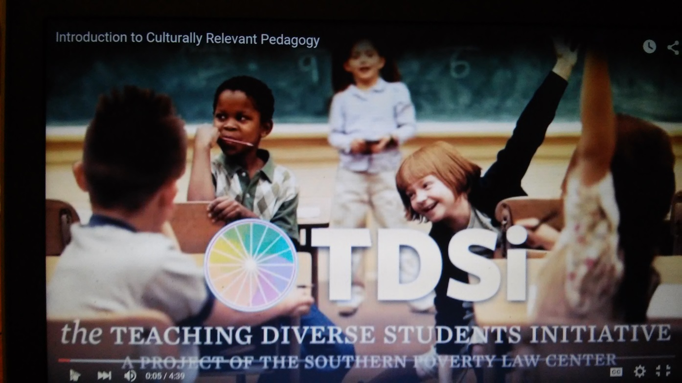
Classes: Students Considered “At Risk”
Untangles the codes embedded in the term “at risk”
Invites students to consider their own preconceptions about who is “at risk”

Slide 8
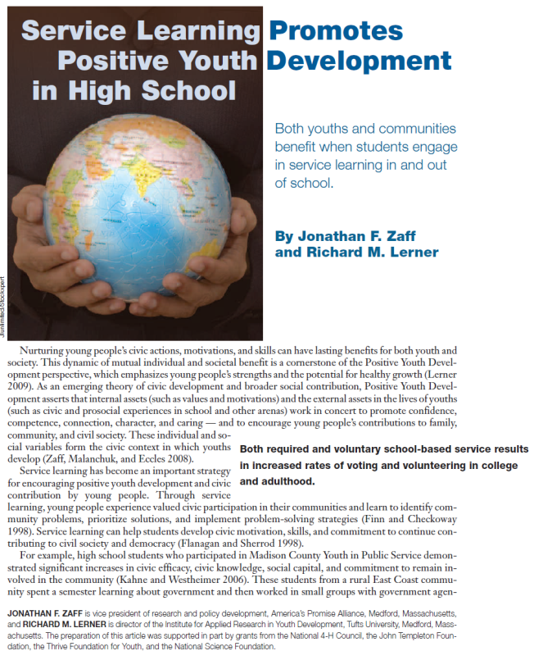
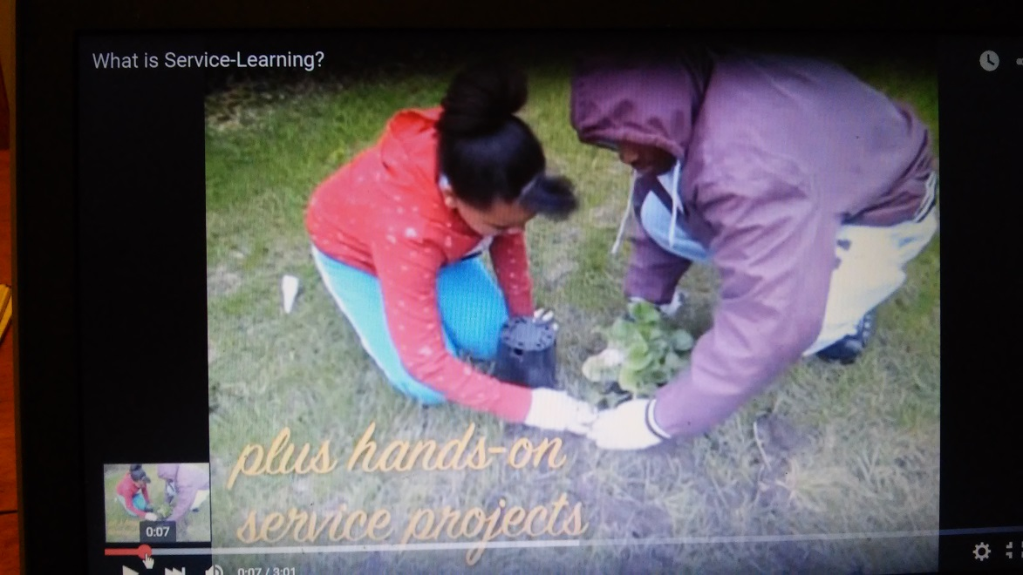
Classes: Service Learning
Explores the elements of service-learning
Identifies exemplary service-learning class-based and school-based programs
Discusses equity and access to service-learning opportunities

Slide 9
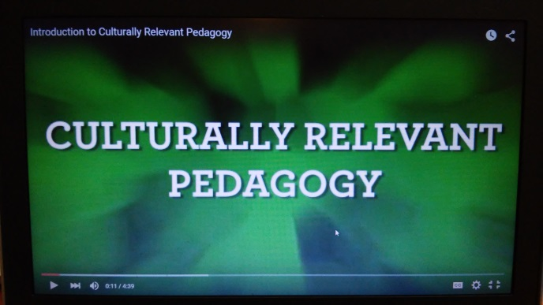
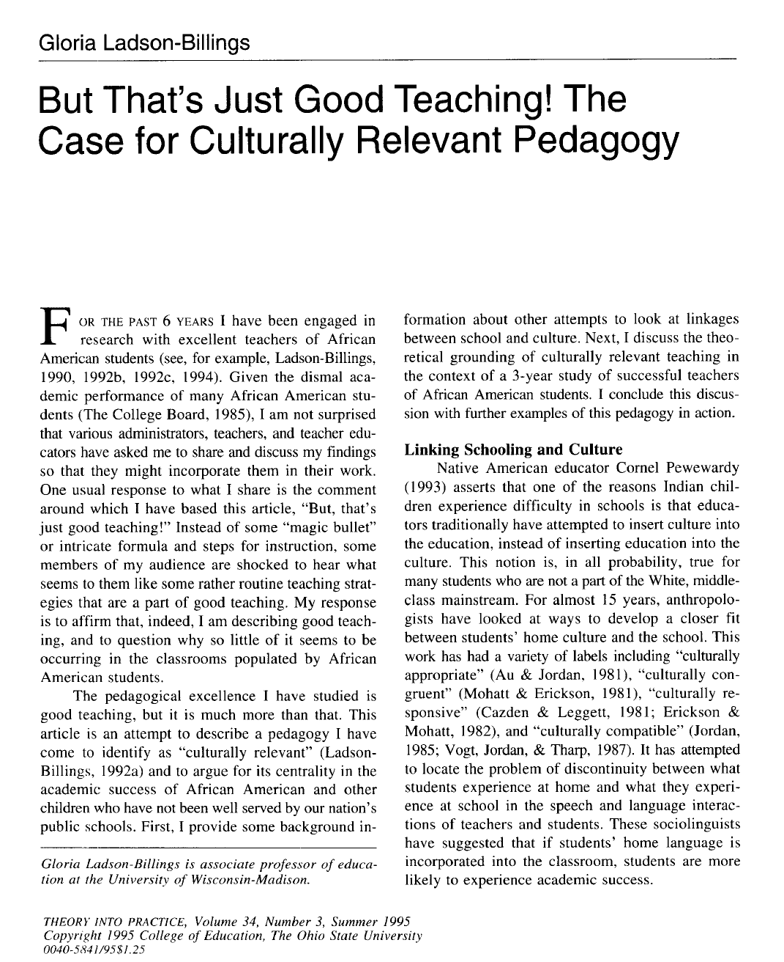
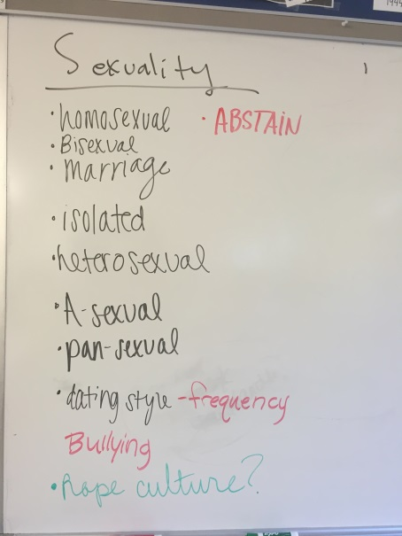
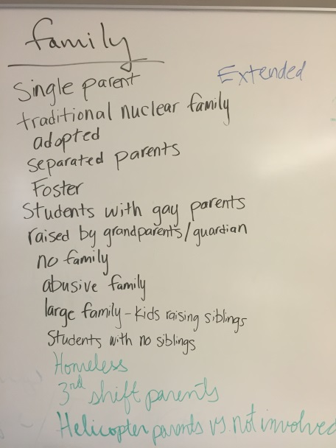
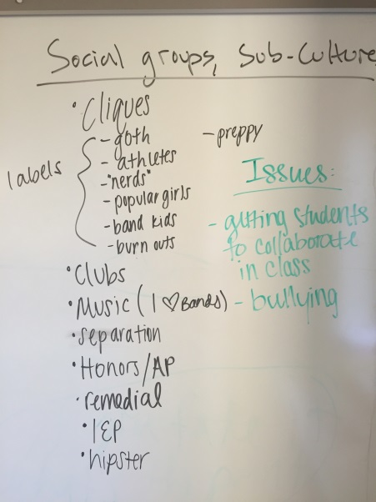
Classes: Culturally-Relevant Pedagogy
Provide background on CRP/CRT
Invite students to generate examples of 10 different “realms of culture”
Exploring home contexts as a way to identify different aspects of culture

Slide 10
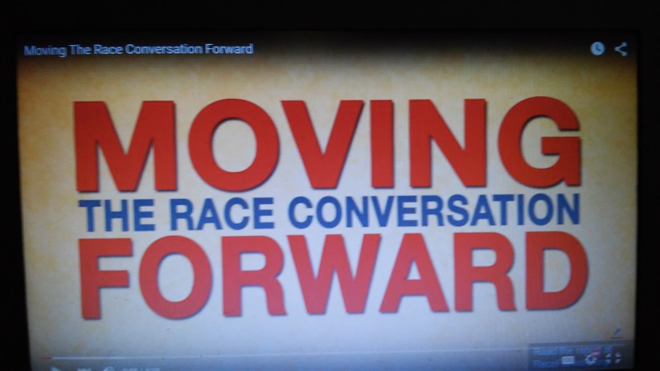
Classes: Race
Explores race in the media and makes the argument that race is pervasive and always implicitly a part of all education
Opens up discussion about how the majority of U.S. teachers are white women for an increasingly racially/ethnically diverse student body
Discusses how teachers can diversity the curriculum and honor all students’ funds of knowledge

Slide 11
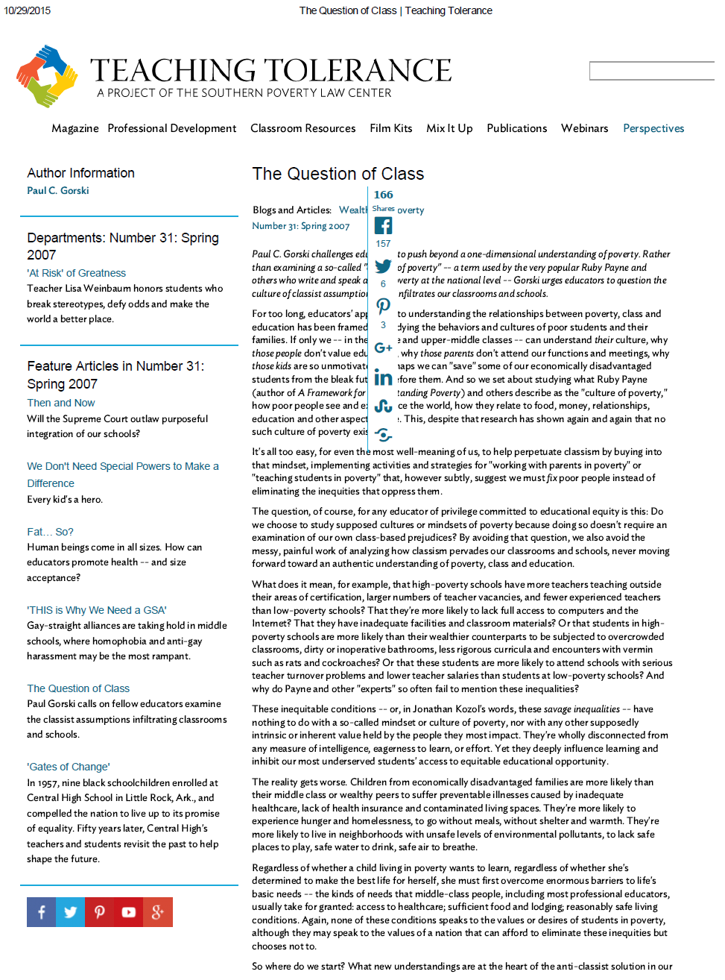
Classes: Poverty
Highlights connections between poverty and education in America.
Explores teacher candidates’ definitions of poverty and conceptions of how poverty might influence their field and student teaching experiences.
Engage teacher candidates in deliberative discussions framed around Gorski’s article – The Question of Class- and his challenge for educators to transform their consciousness and practices in the classroom.

Slide 12
Student Feedback
LGBTQ: “The first session I attended was the LGBT meeting, and I learned something I had not previously known about school clubs. I had heard about the federal Equal Access Act in terms of religious non-curricular clubs, but not in terms of students starting Gay/Straight Alliances. This allowed me to gain a better understanding of how far some schools may go to avoid any open discussions of sexual orientation, gender identity, and gender expression. For example, to hear the example of schools eliminating all non-curricular groups to avoid having a GSA was truly alarming.”
CRP: “Another time where I was challenged was during the culturally relevant pedagogy session. Two peers gave opposite answers on the role of teachers, one suggested that if we know a kid has a rough situation going on we could be more lenient and another suggested that as teachers it is our job to make students motivated. I found that I was uncomfortable by the usage of “making” students be motivated as it seemed negative, but I also did not like letting students automatically get a pass.”
Overall: “The colloquiums were to me like food is to a dog. This is because I am very interested in getting my hands on knowledge, and the colloquiums allowed me to do so. These colloquiums will allow me to address certain situations in a better way. This will in turn allow me to be the best teacher possible.”
At-Risk: “I found that was uncomfortable during the students considered “at-risk” meeting. Based on relative personal beliefs, and previous information learned in class, I found it very hard to reach the conclusion that “African American males, who are poor” was a final answer for “at-risk” youth. I understand that it is important to recognize individuals who are often incorrectly identified in order to “change the pattern,” but narrowing the definition was tough. I was comfortable discussing this, it was just difficult to recognize these issues from a viewpoint opposite of my “base conclusions on evidence, it could be anyone” personal stance.”
Positive evaluations for colloquia.
Students liked opportunity to talk with students in other programs
Also moments of discomfort

Slide 13
Evolution of Social Justice Colloquia
How these SJ Colloquia have impacted our program since 2012:
Developed a new Introduction to Social Justice in Secondary Education course
Infused new field experiences (detention center, ESL placements, magnet schools, etc.) in junior methods courses
Included SJ elements in seniors’ spring portfolio exhibition
Collaborating as a faculty to conduct research about ADED students’ cultural diversity awareness
Troubled By:
Definitions of SJ
Desire to take ACTION
Desire to share SJ commit-ments more formally with students
ADED Faculty started discussing how SJ emerges in our separate courses, desired more formal discussions, & decided to start readings
ADED Faculty started discussing SJ articles at regular meetings
Developed a subcommittee to imagine how SJ could be emphasized in Senior year
Developed the ADED Colloquia in Fall 2012
Colloquia have recurred every fall 2012-2015 with evolving topics

Slide 14
Discussion Questions
4 Groups:
  LGBTQ, Culturally-relevant pedagogy, race, poverty
Questions:
  How does this social justice topic manifest in teacher education coursework, field experience, and student teaching?
  What challenges and possibilities exist for discussing this topic with preservice teachers?

Slide 15
Further Discussion
In what ways can social justice commitments be manifested in teacher education programs?
  What are programs doing?
  What more can be done?
What challenges and possibilities exist for furthering these commitments?

Slide 16
Questions?
Todd Hawley thawley1@kent.edu
Lisa Borgerding ldonnell@kent.edu

