Slide 1
Ohio Education Research Center: Informing Innovation
Jill L Lindsey, Ph.D.
Director of Operations & Research
Ohio Education Research Center
The Ohio State University
Professor & Chair Leadership Studies
Wright State University
Making Research Work for Education

Slide 2











Overview
A statewide network of researchers
addressing critical issues of education and workforce
policy and practice.
Notes:
OERC is a collaboration of seven universities and four research organizations across Ohio.
OERC develops and implements a statewide, preschool-through-workforce research agenda to address critical issues of education and workforce policy and practice.

Slide 3
Primary Objectives
BUILD AND MAINTAIN LONGITUDINAL DATA ARCHIVE
TIMELY, QUALITY EVALUATIONS AND RESEARCH PRODUCTS
BRIDGE NEEDS, RESEARCH, PRACTICE, AND POLICY
LINK TO RESOURCES
Notes:
evaluation & research products for state, federal and private agencies as well as other policy informing organizations;
data base that includes restricted administrative records in a secure environment, while also increasing researcher access to data;
a bridge to education practitioners, researchers and policymakers translating the needs of practitioners into the research agenda and research into actionable practice improving policy at all levels of education
Bring together diverse resources on education throughout the state to improve access to high quality knowledge

Slide 4
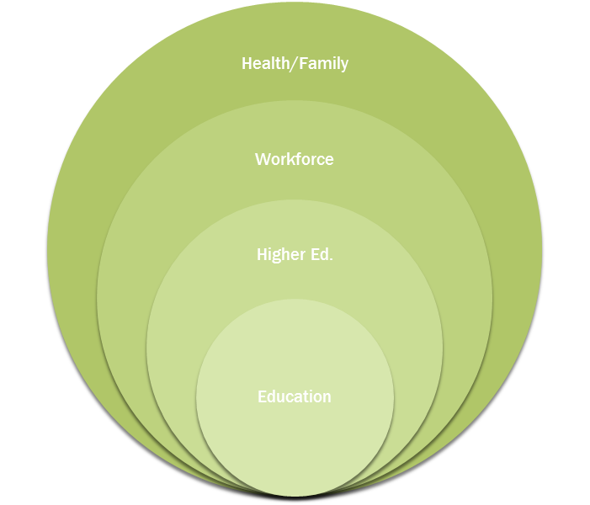
Ohio Longitudinal Data Archive
Comprehensive data (e.g. major state data sources)
System linkages (e.g. early childhood data to K-12, teachers to students)
Testing and outcome data (e.g. student and teacher level effectiveness)

Slide 5
INVESTIGATE THEORY OF ACTION
STANDARDS & GUIDANCE
LAWS & POLICIES
ALTERED PRACTICE
STUDENT PERFORMANCE IMPROVES

Slide 6
changes or INNOVATIONS?
FUNDING & PERFORMANCE PAY
STUDENT IMPACT MEASURES
STANDARDIZED TESTING
READING GUARANTEE
ACCOUNTABILITY
COLLEGE/CAREER READINESS
STANDARDS

Slide 7
BRIDGING NEEDS
Practical Research
  Relevant to current problems of practice
Connected to current policy issues
  Provide evidence/evaluate policies
Build relationships with education stakeholders
  Practitioners in K-16 and policy leaders

Slide 8




Resources
Visit OERC’s website (oerc.osu.edu)for access to:
  Research Reports & Briefs
  Data Visualizations
  Monthly E-Newsletter
  Events
Connect with OERC on Social Media:

Slide 9
RECENT & CURRENT
INNOVATIVE PROJECTS
STUDENT SUCCESS DASHBOARD
STUDENT GROWTH MEASURES: A STUDY OF POLICY AND PRACTICE
HIGHER EDUCATION OUTCOMES DASHBOARD

Slide 10
Primary Objectives
Student Success Dashboard
Districts must implement a research based method of identifying students at risk of dropping out and provide focused counseling to those students.
OERC Pilot with six districts beginning in November 2015
Will be available in 2016 to all districts across Ohio
No charge/Free

Slide 11
Primary Objectives
Student Success Dashboard
Calculates student’s risk of:
  dropping out
  repeating a grade
  not graduating on time.
Administrators, Principals, Counselors and Teachers may view their students’:
  Risk factors;
  Prior academic achievement on state tests;
  Prior discipline and attendance records; and
  History of school’s attended (mobility).

Slide 12
Primary Objectives
LINKS to web RESOURCE center
Research related to risks and interventions
Best practices for getting students back on track
Support and guidance for completing Student Success Plans

Slide 13
Primary Objectives
Student Growth Measures: A study of Policy & Practice
Two year study examining use of Student Growth Measures (SGMs) in OTES & OPES.
Law required SGM’s comprise 50% of teachers’ evaluations.
Several SGM measurement types available:
  Teacher-level Value-Added data (OAA)
  Vendor-developed assessments approved by ODE
  Locally determined measures (e.g. Student Learning Objectives)

Slide 14
Primary Objectives
Student Growth Measures: A study of Policy & Practice
Key Findings
1% of teachers and principals rated as Ineffective.
Teachers in the Big 8 are more likely to be rated as Ineffective or Developing compared to colleagues in other districts (19% vs. 8%).
More variability in teacher ratings using new SGM evaluation model.

Slide 15
Primary Objectives
Student Growth Measures: A study of Policy & Practice
Key Findings Continued
Teacher evaluations using SLO’s and/or Shared Attribution measures had higher ratings on the SGM component than those using value-added or approved vendor assessments.
Concerns over fairness issues by some teachers and administrators.

Slide 16
Higher education outcomes dashboard
Query to display:
  Outcomes for 2003-2006 entering cohorts to any Ohio public university, college, or community/technical school
  Outcomes are defined as 1 and 6 years following graduation from school
  Outcomes are: (1) employment in Ohio and (2) Median earnings from work (adjusted for 2010 dollars)
Limitations
  Only programs with 10 or more graduates in a year/program cell show up
  Only employment in Ohio

Slide 17
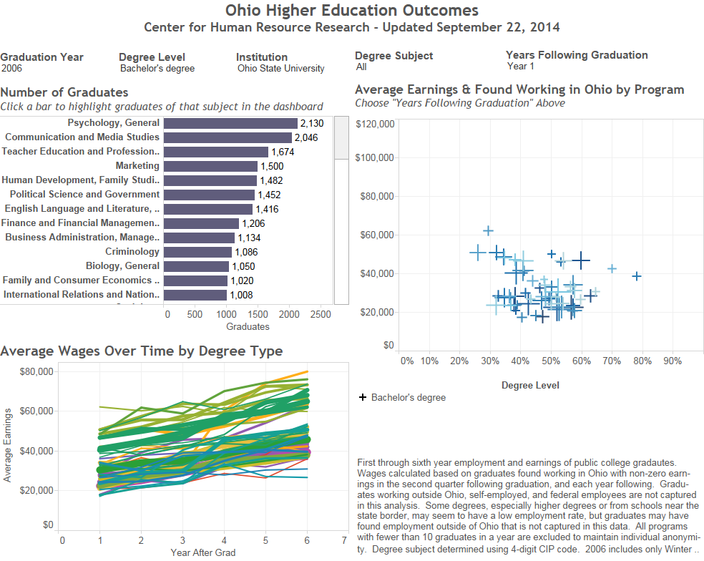
Ohio Higher Education outcomes DASHBOARD

Slide 18
Uses of this dashboard
Help students understand the relative employment financial payoffs in Ohio of specific degrees
Show the employment rate in Ohio over time for different programs
Illustrate how both employment and payoff can change

Slide 19
To access
http://tinyurl.com/mv7whjq
OR
https://public.tableausoftware.com/profile/kharlow#!/vizhome/LongitudinalHEIOutcomes092414/Dashboard

Slide 20
EXAMPLES OF Other OERC Reports
Ohio’s Race to the Top Benchmark Progress Study
Implementation of the “Collaboration on Economic Success in Appalachia” High School-Higher Education Alignment Project
Ohio Network for Educational Transformation Evaluation Report
Ohio’s Race to the Top Dropout Tracking Report
Ohio STEM School Impact Study

Slide 21



Website
www.oerc.osu.edu

Slide 22

Informing innovation
YOU
are vital
partners in this
dynamic process
Notes:
SCHOOLS OPEN DOORS,
HIGHLIGHT EXAMPLARS- GREAT THINGS
SHARE TO IMPROVE PRACTICE
Feedback to INFLUENCE POLICY

Slide 23
get involved in INNOVATION
Next 24 hours
Check out the OERC Website Resources and Reports
Next week
Next month
Attend OERC Annual Conference Friday, November 6th
Identify exemplary practices the OERC could investigate
Engage in online dialogue about education in Ohio
Join the OERC Researcher Network

Slide 24
Thank You
Dr. Jill Lindsey
(937) 775-3298
Jill.Lindsey@wright.edu
Dr. Joshua Hawley
(614) 247-8140
Hawley.32@osu.edu
Ms. Kristen Kubitza
(614) 634-1847
Kubitza.2@osu.edu

Slide 25
Website
www.oerc.osu.edu

