Slide 1
Becoming a teacher leader through inquiry-based learning
Laurie Katz (katz.1242osu.edu)
Michele Sanderson (sanderson.25@osu.edu
The Ohio State University
Notes:
Inquiry-based learning is primarily a pedagogical method, developed during the discovery learning movement of the 1960s as a response to traditional forms of instruction - where people were required to memorize information from instructional materials.^{[4]} The philosophy of inquiry based learning finds its antecedents in constructivist learning theories, such as the work of Piaget, Dewey, Vygotsky, and Freire among others & can be considered a constructivist philosophy.
Some of the characteristics involve:
developing questions, making observations, doing research to obtain supporting evidence to answer the questions, explaining the evidence collected, connecting the explanation to the knowledge obtained from the investigative process
Benefits: prepares early childhood educators to be leaders for today’s and tomorrows children…They will need to be prepared to collect, synthesize, and analyze information; they will need to be prepared to work cooperatively with others to respond to changing social, economic, and global conditions. They will also be using technology to communicate their ideas, thoughts and final products.
develop critical thinkers & problem solvers
Michele will discuss how she uses inquiry-based learning as the first course preservice ECEs & I will discuss how I’ve used IBL at the end of their program with a culminating (capstone) project.

Slide 2
A Tree of Questions

Slide 3
With a focus on learning. . . .
Inquiry based learning as part of early childhood pedagogy
Outcomes for our interns & ourselves
Framework of a tree,
- promoted efficacy in the learning process through inquiry
- Essential questions: Who am I becoming as a teacher, and what is learning?
- Directed the instructor with ongoing intern questions, providing shape to our inquiry
Inquiry notebook connected field to classroom & kept the focus on questions
Interns
actively engaged in inquiry that made them think differently about learning and teaching
perceived themselves as learners & took a leadership role in their own educational experience
Instructors
relinquished control, focusing on student questions/learning;
covered course content but in a richer, deeper, more authentic way

Slide 4
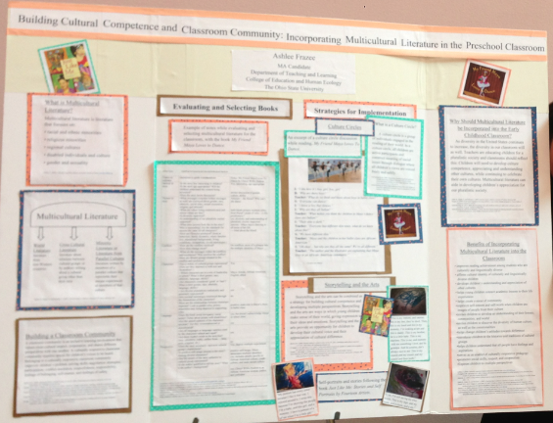
How to Build Cultural Competence & Classroom Community by Incorporating Multicultural Literature in a Preschool Classroom?
Evaluating and Selecting Books
Strategies for Implementation
“ I learned how to synthesize my ideas …”
“My poster project helped me realize I am able to take my knowledge and experience as a teacher and student and share it with others…..”
“ I developed a strong understanding of multicultural children’s literature and feel comfortable educating fellow teachers and others how to select quality multicultural literature and ways it can be used in the classroom
Notes:
Towards the end of their preservice program, I have them focus on a topic of their choice by posing a question that they research. Usually, they submit it to their advisor/second reader in the form of a paper and then present it to them in the form of a poster, powerpoint. I’ve changed it a little and suggest to them that they use their project & submit it as a proposal to a conference (OAEYC) as a poster session. In the past 2 years, I’ve had about 12 students present – predominantly masters preservice early childhood educators. I’ve selected 2 posters and interviewed the students regarding components of teacher leaders.
Responses from interview demonstrated- Skills of collaboration, action research, reflective practice, inquiry, peer mentoring

Slide 5
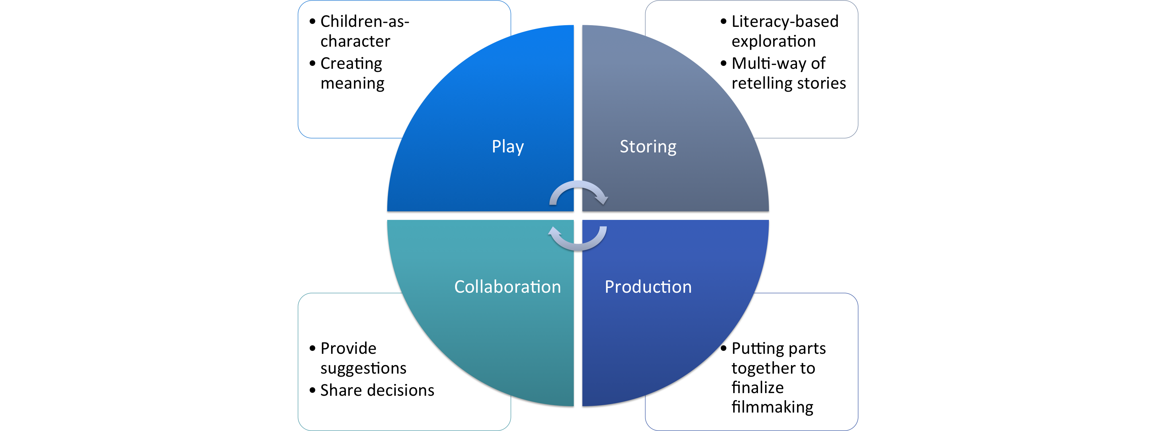
Monkey King
How to integrate pop culture in early literacy development?
The Literacy Playshop Model by Wohlwend
“Being part of the poster session at OAEYC felt very challenging at first, but when I starting planning the content and design….. It started to feel like a thoughtful journey that I could share my interest & ideas with people in early childhood education”
“I can help others use pop culture as a tool to teach literacy by (1) building an inclusive classroom, and (2) choosing materials, & activities to implement in a curriculum….”
Play
Children-as-character
Literacy-based exploration
Production
Putting parts together to finalize filmmaking
Collaboration
Provide suggestions
Storing
Creating meaning
Multi-way of retelling stories
Share decisions
Play
Children-as-character
Literacy-based exploration
Production
Putting parts together to finalize filmmaking
Collaboration
Provide suggestions
Storing
Creating meaning
Multi-way of retelling stories
Share decisions
Notes:
The act of being part of a conference – professional affiliation, validates their knowledge that they have critical skills to offer not only young children but fellow early childhood educators.

