Slide 1
OCTEO Conference
ODE Update ∙ October 18, 2013

Slide 2
Overview
RESA (Resident Educator Summative Assessment)
OAE (Ohio Assessments for Educators)
Tools for Teachers
CORE (Connected Ohio Records for Educators) On-line Licensure Application
2013 Teacher Supply and Demand Study

Slide 3
RESA
RESA Handbook will be available on the ODE RE website by the first of November
Eligible REs in their third year of the program may be registered for the assessment by their program coordinator
For more information: www.education.ohio.gov
Search: Resident Educator Program

Slide 4
Educator Licensure Testing Requirements
Educator Licensure Testing (OAE, Praxis II and ACTFL/LTI) requirements for each licensure area are available on the ODE website
Licensure testing chart is updated bi-annually in January and July

Slide 5

Educator Licensure Testing Requirements
www.education.ohio.gov
Search: Educator Licensure Examinations

Slide 6
Ohio Assessments for Educators
www.oh.nesinc.com
Additional OAE Tests to be updated in January 2014
Praxis II Health Education will be reviewed this coming spring
ACTFL/LTI OPI and WPT will continue

Slide 7
Ohio Assessments for Educators
OAE | Ohio’s Credential
Chemistry | AYA Physical Sciences: Chemistry and dual science licensure
Computer Information Science | MA Computer Information Science
Earth and Space Science | AYA Earth Sciences And dual science licensure
English to Speakers of Other Languages | MA TESOL Endorsement TESOL
Integrated Science | AYA Integrated Science
Marketing | CTE Marketing
Physics | AYA Physical Sciences: Physics and dual science licensure
Prekindergarten (subtest I) and (subtest II) | Endorsement: Prekindergarten Associate Prekindergarten
School Counselor | PPS School Counselor
School Library Media Specialist | MA Library Media
Theater | MA Drama Theater

Slide 8
Educator Licensure Testing
Disclaimer: Educator Licensure tests and qualifying scores listed in the ODE charts and on the ODE website are subject to change by the State Board of Education of Ohio.

Slide 9

Faculty Resources
www.oh.nesinc.com/faculty.asp
Support Materials for Faculty
Notes:
OAE include tools, strategies, and support materials to help faculty prepare their candidates for testing.

Slide 10
Assessment Frameworks
Provide the structure of the assessment, the major domains of knowledge and skills, and the assessment competencies that describe the content covered by the assessments.

Slide 11
Alignment Studies
Provide information about the alignment between the knowledge and skills addressed by the OAE and the national and/or Ohio educational standards relevant to that field.

Slide 12

Data Analysis Tool
ResultsAnalyzer
Institutions will view assessment data reports and be able to analyze the performance of their candidates
Notes:
Institutions will be able to view and analyze the performance of their candidates—individually or in aggregate—by using ResultsAnalyzer™, a data analysis tool provided for the program.
The ResultsAnalyzer™ tool will allow users to access candidate, assessment data, giving them the capability to: Export data to Microsoft® Excel or other report software; and print graphics and Analyze candidate and institution data for numerous variables (including self-reported data such as gender and ethnicity)

Slide 13

education.ohio.gov/Topics/Teaching/Tools-for-Teachers
Licensure
Scholarships
Professional development
Recognition programs
Classroom resources
Notes:
Tools for Teachers is an updated monthly webpage for teachers that provides timely announcements and information on licensure, scholarships, professional development and study opportunities, award and recognition programs, and links to classroom resources and tools.

Slide 14
CORE/My Educator Profile
On-line Licensure Application
Pay by Credit Card
IHEs to Enroll Electronic Signatures
(614) 466-3593 ODE Office of Educator Licensure

Slide 15
Teacher Supply-Demand Study
Joshua D. Hawley
Ohio State University

Slide 16

Creating and Building Partnerships
The Ohio Education Research Center is a network of Ohio-based researchers and research institutions, that develops and implements a statewide, preschool-through-workforce research agenda to address critical issues of education practice and policy.

Slide 17
Teacher Supply-Demand Study
Conducted by the OERC for the ODE Center for the Teaching Profession
Previous SD studies for ODE were conducted in 2003 & 2007

Slide 18
Demand For Teachers
The economic recession that began in 2008 has reduced the need for teachers overall.
  700 fewer teachers per year in the coming years mainly due to declining birth rates during the economic recession.
  The effect of lower fertility would be reversed if schools resume the recession-interrupted trend toward lower pupil/teacher ratios

Slide 19
Projected Enrollments and Teacher Counts

Slide 20
Retirement Changes
Retirement rule changes have already resulted in major declines in teacher stocks.
  Approximately 6,000 teachers retire every year.
  Pension changes have provided incentives to retire sooner, which teachers have done over the past three years.
  Those most likely to retire between now and July 2015 are individuals who will attain 35 years of service by that date.

Slide 21
New Teacher Supply
Number of education degrees peaked at 14K annually in 2004-5. Loss since 2004 is primarily in undergraduate degrees
The Number of schools offering education degrees has continued to increase (91)
Over a quarter of all new teachers licensed in Ohio in 2012 were in early childhood or prekindergarten through 3rd grade

Slide 22
Teaching Field (2011 License Issued)

Slide 23
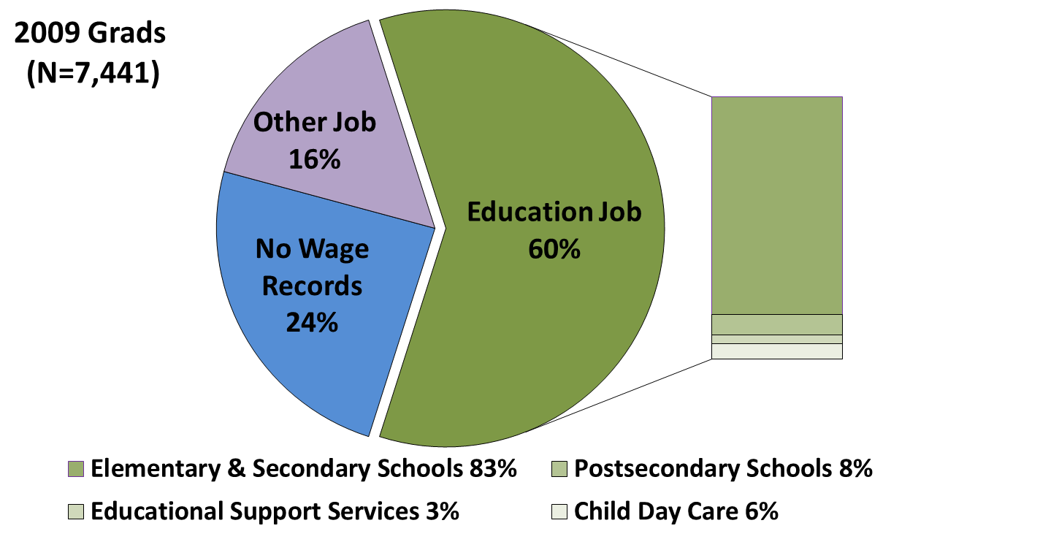
What are the employment outcomes for Ohio’s Education graduates?

Slide 24
Other Issues Report Deals with
Administrator retirement projections, pay and supply-demand differences
Compensation for teachers over time and by type, location and size of district
Employment by education degrees
Demand by field of study
Projections for community and private schools

Slide 25
Questions
Joshua D. Hawley
Ohio Education Research Center
Hawley.32@osu.edu
614-247-8140
Oerc.osu.edu

Slide 26





Social Media
Ohio Families and Education
Ohio Teachers’ Homeroom
ohio-department-of-education
storify.com/ohioEdDept
@OHEducation
OhioEdDept

