Slide 1
OCTEO Conference
Praxis Core Academic Skills for Educators
Tests
Kathy Pruner
Client Relations Director
Kevin Cureton
Director for Assessment Development
October 8, 2013

Slide 2
Today’s Session
Comparing the New Core Tests with Praxis I Tests
Update on Praxis Testing – New Score Reporting, Test Centers Expansion and Test Dates
Resources for You and Your Students

Slide 3

Background on ETS
Non-profit organization, founded in 1947
  ACE, Carnegie Foundation and College Entrance Examination Board
Mission: advance quality and equity in education for all people worldwide
ETS develops, administers, and scores
  50+ million assessments
  180+ countries
  9,000+ locations worldwide

Slide 4
Background on ETS
3,178 employees (+ 2,500 Prometric™ employees)
1,100+ have training and expertise in education, psychology, statistics, psychometrics, computer sciences, sociology and the humanities
863 advanced degrees, 383 doctorates
One of the world’s largest educational research organizations

Slide 5
Core Academic Skills for Educators Tests:
Reading, Writing and Mathematics

Slide 6
Core Academic Skills for Educators
Regenerated Praxis I® Pre-Professional Skills Tests (PPST®)
Measure academic skills in Reading, Writing, and Mathematics that are needed to successfully prepare for a career in education
Delivered on computer only (except for ADA accommodations)
Delivered as three separate assessments:
  Reading 85 minutes (vs. 75 minutes for PPST Reading)
  Writing 100 minutes (vs. 68 minutes for PPST Writing)
  Mathematics 85 minutes (vs. 75 minutes for PPST Mathematics)
  Combined Test 4½ hours
  First administration October 2013

Slide 7
Core Test Fees
$135 for the combined test
$125 for two tests taken at the same time
$85 for a single test
Same fees as PPST

Slide 8
Core Academic Skills for Educators
Status of the test
Multi-state standard setting | January 2013
Study Companion available | July 2013
Interactive practice tests available | September 2013
First administration | October 2013
Final administration of the Praxis I® Pre-Professional Skills Tests is slated for August 2014

Slide 9
Core Academic Skills for Educators
What are the skills assessed?
Skills in Reading, Writing, and Mathematics, drawn from the College and Career Readiness Standards of the Common Core and identified as important for a career in education
Weighting and priority of test content is based on the importance of that content (those skills) to success —learning and achievement — within an educator preparation program
Important:
“Success” is defined as more than
merely getting through the program

Slide 10
Big Picture: What is different from PPST?
The tests were designed from the ground up to align with the Common Core State Standards.
Teacher candidates are being assessed on the same range of career and college readiness skills they are looking to help students achieve.

Slide 11
Big Picture: What is different from PPST?
Reading: Added assessment of integrating content from multiple texts and texts with diverse formats.
Mathematics: More rigorous coverage including assessment of CCSS content that is not included in the PPST.
Writing: Assesses the ability to write informational/explanatory texts AND to write an argument. More of the candidate’s score comes from productive writing skills (writing and revision), and selected response questions include coverage of research skills.

Slide 12
Big Picture: What is different from PPST?
Scores will be reported on the 100-200 Praxis score scale, as opposed to the 150-190 PPST scale.
Because the tests measure additional content, and are designed to be more rigorous, scores on the new tests cannot be compared with scores on the PPST.
Standard setting studies established recommended passing scores on the new score scale.

Slide 13
Core Academic Skills for Educators
Reading (5712)
I. Key Ideas and Details | 17-22 SR* | 35%
II. Craft, Structure, and Language Skills | 14-19 SR* | 30%
III. Integration of Knowledge and Ideas | 17-22 SR* | 35%
*Selected Response (SR) questions include traditional multiple-choice questions as well as innovative items such as multiple-selection multiple-choice.

Slide 14
Comparing Praxis Core Reading with PPST
 | PPST Reading | Core Reading
Number of questions | 46 multiple-choice questions (5710) 40 multiple-choice questions (0710) | 56 selected-response questions
Time | 75 minutes (5710) 60 minutes (0710) | 85 minutes
Delivery Method | Computer-delivered (5710) Paper-delivered (0710) | Computer-delivered
Types of passages | Long passages (approx. 200 words) with 4-7 questions Short passages (approx. 100 words) with 2 or 3 questions Brief statements with 1 question | Paired passages totaling approx. 200 words with 4-7 questions Long passages (approx. 200 words) with 4-7 questions Short passages (approx. 100 words) with 2 or 3 questions Brief statements with 1 question

Slide 15
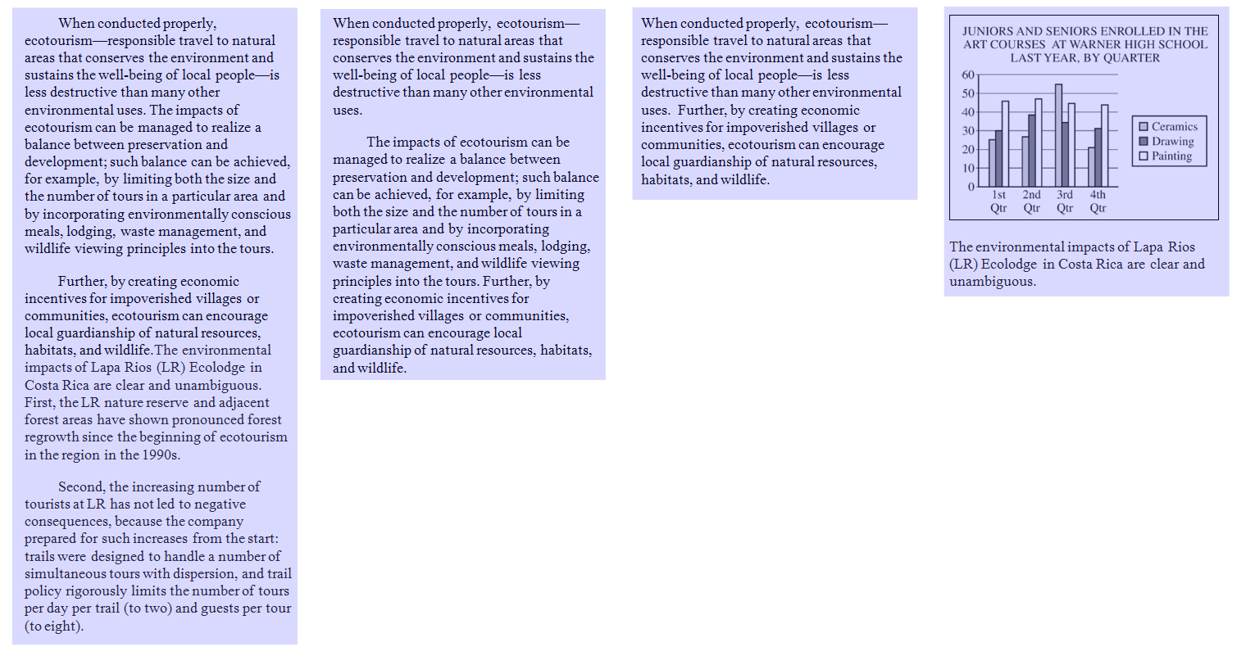
Reading
What is carried over from PPST?
Including graphical texts.
Candidate is presented with a variety of texts of different lengths from a variety of disciplines.

Slide 16
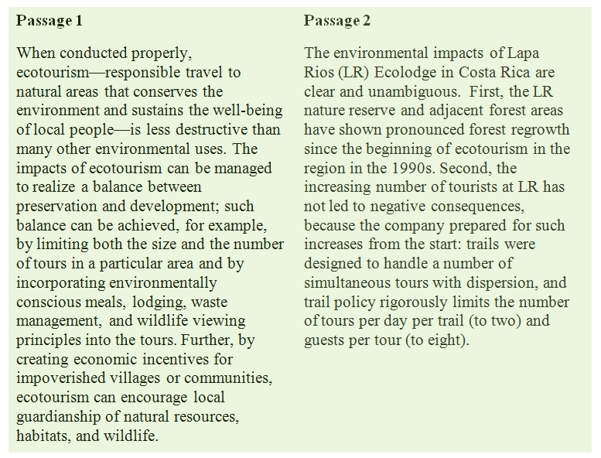
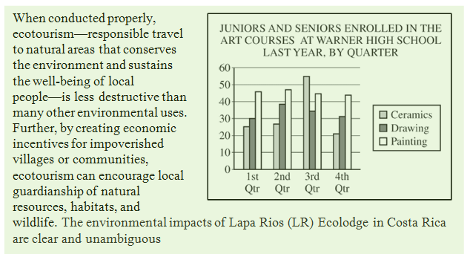
Reading
What’s new?
The regenerated academic skills test adds texts used to assess integration of content between multiple texts.
Including graphical texts.

Slide 17
Reading
New question types get at standards not covered by PPST
CCSS College and Career Readiness Anchor Standards for Reading
Integration of Knowledge and Ideas
7. Integrate and evaluate content presented in diverse media and formats, including visually and quantitatively, as well as in words.
9. Analyze how two or more texts address similar themes or topics in order to build knowledge or to compare the approaches the authors take.

Slide 18
Core Academic Skills for Educators
Mathematics (5732)
I. Number and Quantity | 17 (SR and NE)* | 30%
II. Algebra and Functions | 17 (SR and NE)* | 30%
III. Geometry | 11 (SR and NE)* | 20%
IV. Statistics and Probability | 11 (SR and NE)* | 20%
*Selected Response (SR) questions include traditional multiple-choice questions as well as innovative items such as multiple-selection multiple-choice.
*Numeric Entry (NE) questions require candidates to enter an answer rather than selecting from among answer choices.

Slide 19
Comparing Praxis Core Math with PPST
 | PPST Mathematics | Core Mathematics
Number of questions | 46 multiple-choice questions (5730) 40 multiple-choice questions (0730) | 56 selected-response questions
Time | 75 minutes (5730) 60 minutes (0730) | 85 minutes
Delivery Method | Computer-delivered (5730) Paper-delivered (0730) | Computer-delivered
Question Types - | Single-selection multiple-choice questions | Selected-response and numeric entry questions, including Single-selection multiple-choice questions Multiple-selection multiple-choice questions Numeric entry questions

Slide 20
Mathematics
What is carried over from PPST?
I. Number and Operations
Order
Equivalence
Numeration and Place Value
Number Properties
Operation Properties
Computation
Estimation
Ratio, Proportion, and Percent
Numerical Reasoning
II. Algebra
Equations and Inequalities
Algorithmic Thinking
Patterns
Algebraic Representation
Algebraic Reasoning
III. Geometry and Measurement
Geometric Properties
The xy-Coordinate Plane
Geometric Reasoning
Systems of Measurement\
Measurement
IV. Data Analysis and Probability
Data Interpretation
Data representation
Trends and Inferences
Measures of Center and Spread
Probability
The Core Mathematics test includes topics covered in PPST.

Slide 21
Mathematics
What’s new?
I. Number and Quantity
The Real Number System
Work with radicals and integer exponents
II. Algebra and Functions
Reasoning with Equations and Inequalities
Understand solving equations as a process of reasoning and explain the reasoning
Building Functions
Interpreting Functions
Building Functions
III. Geometry
Modeling with Geometry
Apply geometric concepts in modeling situations
IV. Statistics and Probability
Basic Statistics and Probability
Develop understanding of statistical variability
Use random sampling to draw inferences about a population
Investigate patterns of association in bivariate data
Interpreting Categorical and Quantitative Data
Interpret linear models
The Core Mathematics test adds coverage of CCSS mathematics content not included in PPST.

Slide 22
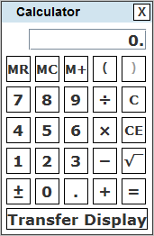
Mathematics
What’s new?
Onscreen calculator added.
Test is meant to assess mathematical reasoning, not computation.
Calculator reduces the chance of simple arithmetic error.

Slide 23
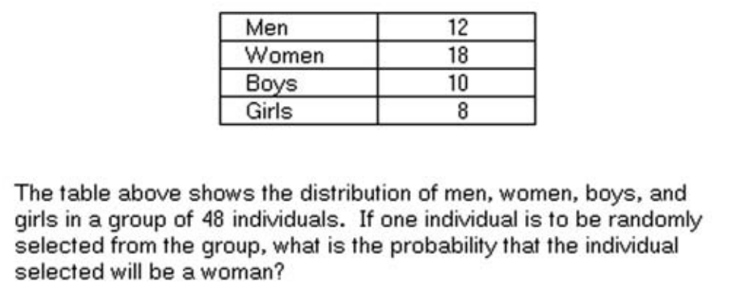

Mathematics
What’s new?
Innovative Item Types – Numeric entry and Multiple Selection responses added
Which of the following are valid ways to find 125 percent of a number?
Select all that apply.
Multiply the number by 1.25.
Divide the number by 4 and multiply the result by 5.
Divide the number by 4 and add the result to the number.
Multiply the number by 0.25 and multiply the result by 4.

Slide 24
Core Academic Skills for Educators
Writing (5722)
I. Text Types, Purposes, and Production A. Text Production: Writing Arguments B. Text Production: Writing Informative/Explanatory Texts C. Text Production: Revision | 6-12 SR* 2 CR | 60%
II. Language and Research Skills for Writing A. Language Skills B. Research Skills | 28-34 SR* | 40%
*Selected Response (SR) questions include traditional multiple-choice questions as well as innovative items such as multiple-selection multiple-choice.

Slide 25
Comparing Praxis Core Writing with PPST
 | PPST Writing | Core Writing
Number of questions | 44 multiple-choice questions (5720) 40 multiple-choice questions (0720) 1 constructed-response question (both 5710 and 0710) | 40 selected-response questions 2 constructed response questions
Time | 68 minutes (5720) – 38 minutes for the multiple-choice section and 30 minutes for the constructed-response section 60 minutes (0720) – Two 30-minute sections | 100 minutes (40 minutes for the selected-response section and two 30-minute constructed-response sections)
Question Types | Single-selection multiple-choice questions: Usage Sentence Correction Constructed-response question: Argumentative Essay | Selected-response questions: Usage Sentence Correction Revision in Context Research Skills CR questions: Argumentative Essay Informative/Explanatory Essay

Slide 26
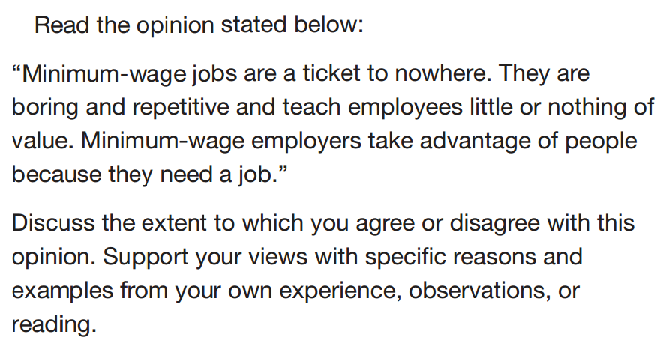
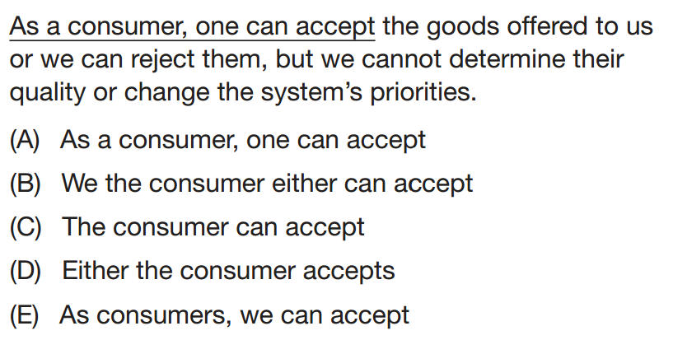
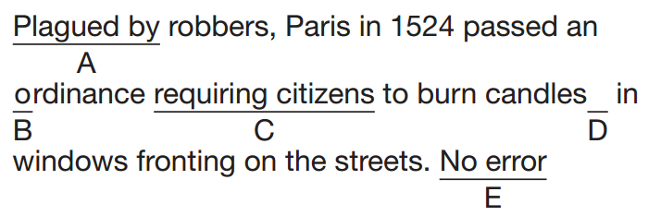
Writing
What is carried over from PPST?
Argumentative essay
Assesses CCR Standards
Writing 1, 4
Language 1, 2, 3
Sentence Correction
Language 1, 2, 3
Usage
Language 1, 2

Slide 27
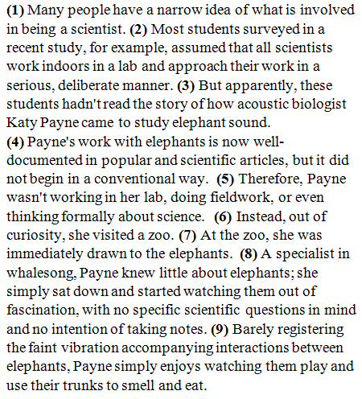
Writing
What’s New?
Informational/Explanatory Essay
Writing 2, 4, 7, 8, 9
Language 1, 2, 3
Revision in Context Set
Writing 5
Language 3
Research Questions
Writing 8
Which is the main purpose of reviewing the
references in a research article when one writes an academic paper?
(A) To check that the authors did their own research
(B) To identify additional relevant sources
(C) To learn how to write citations correctly
(D) To verify that the authors did not cite themselves
(E) To avoid reading other sources on the same topic
In context, which revision to sentence 9 is most needed?
(A) Insert “Although” at the beginning of the sentence.
(B) Change “accompanying” to “that accompanied”.
(C) Change “enjoys” to “enjoyed”.*
(D) Change “watching” to “to watch”.
(E) Change “to smell and eat” to “for smelling and eating”.
Assignment:
… Read the two passages carefully and then write an essay in which you identify the most important concerns regarding the issue and explain why they are important. Your essay must draw on information from BOTH of the sources. In addition, you may draw on your own experience, observations, or reading. Be sure to CITE the sources whether you are paraphrasing or directly quoting.

Slide 28
Core Academic Skills for Educators
Writing
Usage
Argumentative essay
Sentence Correction
Which is the main purpose of reviewing the
references in a research article when one writes an academic paper?
(A) To check that the authors did their own research
(B) To identify additional relevant sources
(C) To learn how to write citations correctly
(D) To verify that the authors did not cite themselves
(E) To avoid reading other sources on the same topic
In context, which revision to sentence 9 is most needed?
(A) Insert “Although” at the beginning of the sentence.
(B) Change “accompanying” to “that accompanied”.
(C) Change “enjoys” to “enjoyed”.*
(D) Change “watching” to “to watch”.
(E) Change “to smell and eat” to “for smelling and eating”.
Research Questions
Informational/ Explanatory Essay
Assignment:
… Read the two passages carefully and then write an essay in which you identify the most important concerns regarding the issue and explain why they are important. Your essay must draw on information from BOTH of the sources. In addition, you may draw on your own experience, observations, or reading. Be sure to CITE the sources whether you are paraphrasing or directly quoting.
Revision in Context Set

Slide 29
Core Test Adoption by Ohio Programs
Ohio universities will need to prepare for the retirement of Praxis I testing to occur in August 2014
Review of test content and adoption of new Core tests
Setting a score requirement for each test will be important

Slide 30
Recommendations from National Standard-Setting Panels
Reading – the recommendation was a score of 156 on a 100-200 scale
ETS recommends staying within +/- 2 SEM’s (standard error of measure) of the RSV:
          -2 SEMs 25 140
          -1 SEM 28 148
          RSV 31 156
          +1 SEM 35 166
          + 2 SEMs 38 174

Slide 31
Recommendations from National Standard-Setting Panels
Writing – the recommendation was a score of 162 on a 100-200 scale
ETS recommends staying within +/- 2 SEM’s (standard error of measure) of the RSV:
          -2 SEMs 37 150
          -1 SEM 41 158
          RSV 44 162
          +1 SEM 48 170
          + 2 SEMs 52 176

Slide 32
Recommendations from National Standard-Setting Panels
Mathematics - the recommendation was a score of 150 on a 100-200 scale
ETS recommends staying within +/- 2 SEM’s (standard error of measure) of the RSV:
          -2 SEMs 22 132
          -1 SEM 26 142
          RSV 29 150
          +1 SEM 33 162
          + 2 SEMs 37 172

Slide 33
Update on Praxis Testing

Slide 34
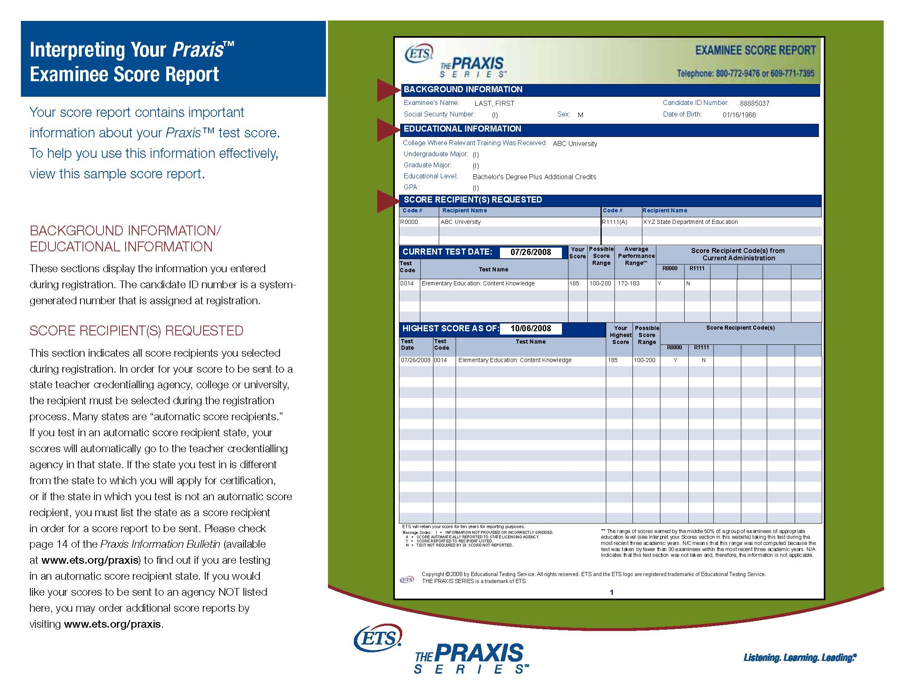
New Score Reporting Service Has Begun!
Scores retrieved now via
  Client Services portal in the ETS Data Manager or by
  Web-to-web interface with ETS server
Data Updated Weekly
  To start, data from September 2012 to date
  Moving to two years of candidate data availability
How can you use the new system?

Slide 35
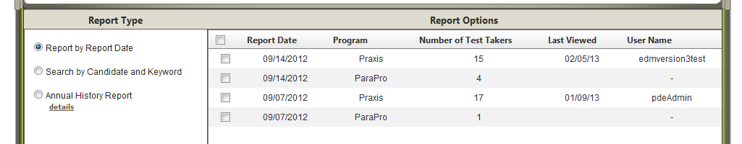
ETS Data Manager: Pulling Test Taker Score Reports By Report Date
Retrieve data by specific report date and testing program (Praxis)

Slide 36
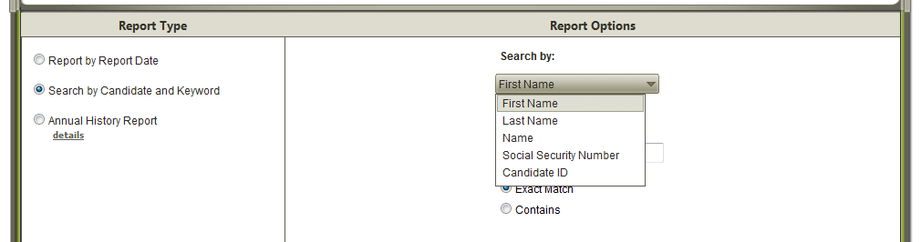
ETS Data Manager: Pulling Test Taker Score Reports By Candidate and Keyword
Search by first name, last name, Social Security Number or candidate ID #

Slide 37
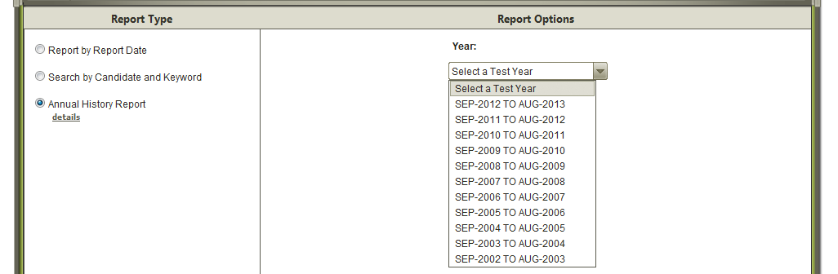
ETS Data Manager: Creating Annual Reports of Score
Create a report containing candidates that reported to your institution within a selected year.

Slide 38

Test Centers for Ohio Candidates

Slide 39
Computer-based Test Sites in Development - Applications
Mansfield, North Central State College – NEW! - selecting test dates
Chauncey - Athen-Meigs Educational Service Center
St. Clairsville - Belmont College
Lancaster - Ohio University – Lancaster
Akron – University of Akron
Toronto – Toronto City Schools
Celina - Wright State University, Lake Campus

Slide 40
Computer-based Test Sites in Development - Recruitment
New Concord, Muskingum University – ready to move forward
Lima – Ohio State University at Lima
Lima – University of Northwest Ohio
Cambridge - Zane State College - Cambridge

Slide 41
Computer-Based Testing Windows 2013-2014
Two week testing windows for Core tests
  10/7/2013 – 11/2/2013 – now four weeks!
  12/9/2013 – 12/21/2013
  1/13/2014 – 1/25/2014
  2/3/2014 – 2/15/2014
  4/7/2014 – 4/19/2014
  5/12/2014 – 5/24/2014
  6/16/2014 – 6/21/2014 (one week window)
  7/14/2014 – 7/26/2014
  8/4/2014 – 8/16/2014
Students can register for a computer-delivered test up to 3 days before without paying a late fee.
Note: Core tests will be administered on a continuous basis in the near future

Slide 42
Resources for Your Students

Slide 43

Free Test Prep
Comprehensive Praxis Study Companion
  Test at a Glance (TAAG)
  Reducing Test Anxiety
  Study Plan document
Pre-Recorded Webinars - “on-demand” webinar modeled after “live” webinars
  Assists those who are not able to attend “live” webinars due to class, work, or time zone conflicts
Live one-hour webinars: all start at 1 PM ET
  Thursday, October 24
  Wednesday, November 20

Slide 44
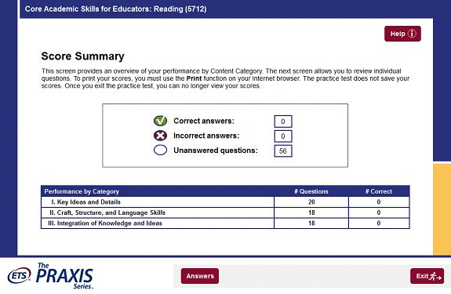
Interactive Practice Tests for Core
$17.95

Slide 45
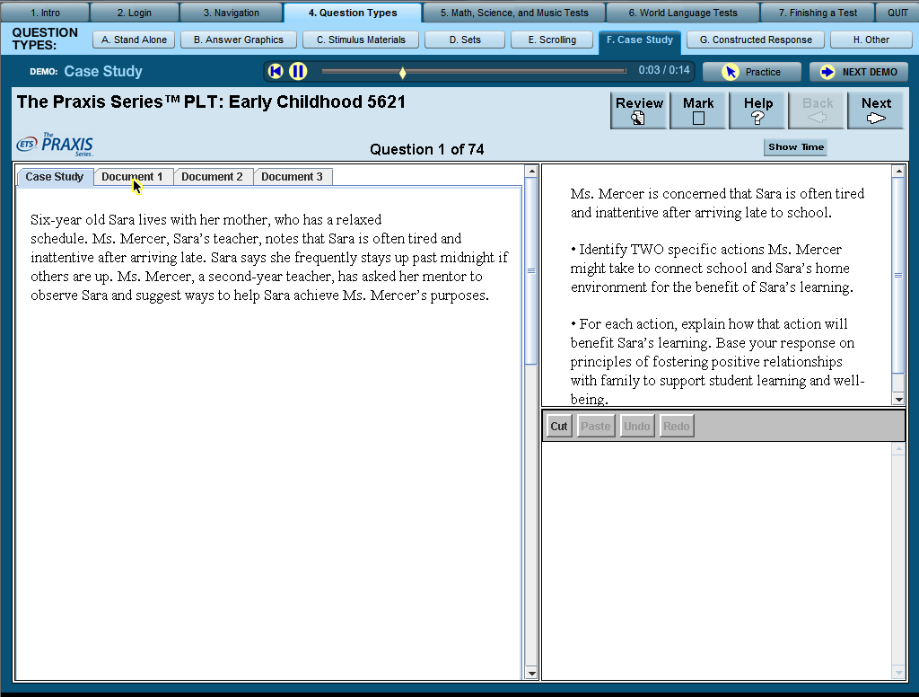
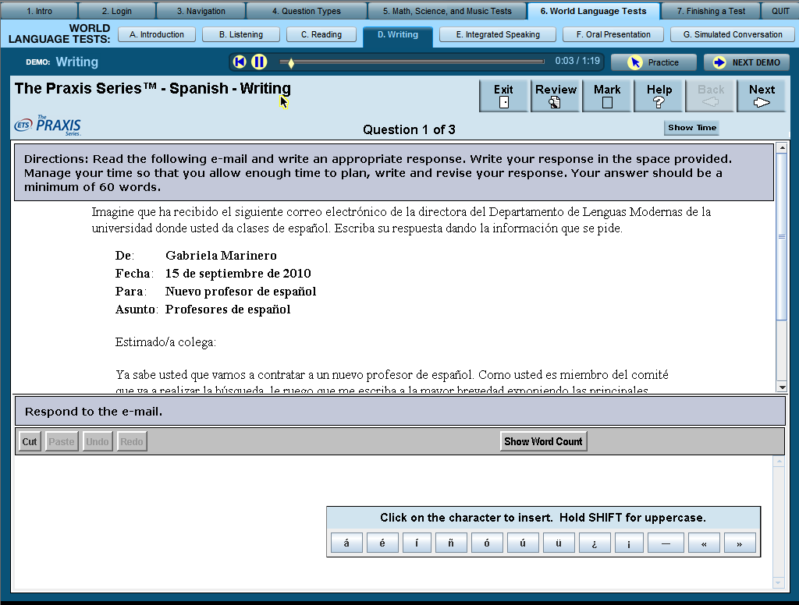
Computer-Delivered Testing Demonstration www.ets.org/praxis/computertestingdemo
Notes:
Enables candidates to familiarize themselves with testing experience prior to test day
Try out navigational features of the test
Experience different formats and types of questions
Multiple choice, questions that scroll, case questions, etc.
Including World Languages

Slide 46
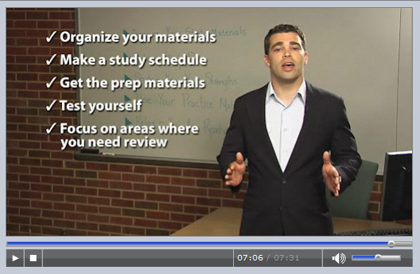
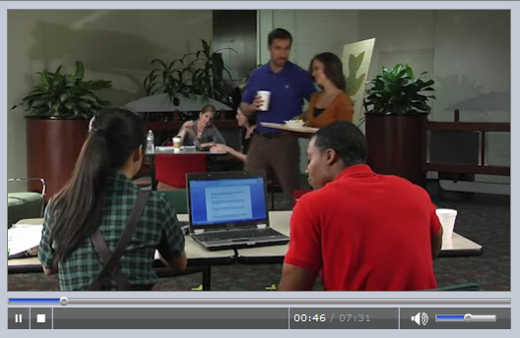
Strategies for Success Video www.ets.org/praxis/strategiesforsuccess
Notes:
Get study preparation guidance including
How to approach taking the test
Putting together a plan
Learn about test anxiety

Slide 47
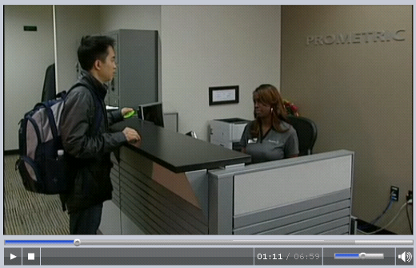
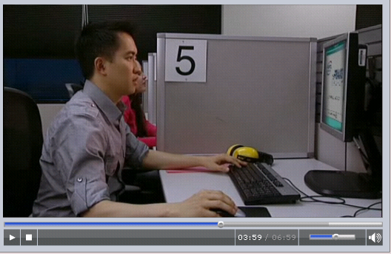
“What to Expect on Testing Day” Video www.ets.org/praxis/testday

Slide 48
Resources for You

Slide 49
Institutional Section of Praxis Website
Test Information
Preparing Teacher Candidates
  Test Preparation Materials
Scores and score reporting services
Services and Tools
  ETS Data Manager for the Praxis Series
    Quick and custom reports
    Real time data of student performance
Research
  Trends in education, teacher performance, student learning outcomes, teacher quality and other related topics
  http://www.ets.org/praxis/institutions

Slide 50
Important Support Links
Institutional support: Denee West
  Phone: (866) 243-4088
  Email: TeachingandLearning@ETS.ORG
Praxis Connections Newsletter - sign up: http://www.pages03.net/ets/PraxisMailingList/IHEOptIn/
ETS Data Manager for The Praxis Series™
  http://www.ets.org/praxis/institutions/services_tools/data_manager/
Teaching Reading: Elementary Education test
  qualifier for Third Grade Reading Guarantee http://www.ets.org/praxis/prepare/materials/5203

Slide 51
Thank You for Your Time!
We are here to support you:
Kathy Pruner kpruner@ets.org 609-683-2694
Kevin Cureton kcureton@ets.org 609-683-2844

Slide 52
Comparing Praxis Core Reading with PPST
 | PPST Reading 5710/0710 | Core Reading
Number of questions | 46 multiple-choice questions (5710) 40 multiple-choice questions (0710) | 56 selected-response questions
Time | 75 minutes (5710) 60 minutes (0710) | 85 minutes
Delivery Method | Computer-delivered (5710) Paper-delivered (0710) | Computer-delivered
Types of passages | Long passages (approx. 200 words) with 4-7 questions Short passages (approx. 100 words) with 2 or 3 questions Brief statements with 1 question | Paired passages totaling approx. 200 words with 4-7 questions Long passages (approx. 200 words) with 4-7 questions Short passages (approx. 100 words) with 2 or 3 questions Brief statements with 1 question

