Slide 1

Ohio Department of Education
OCTEO Conference
October 25, 2012
www.education.ohio.gov

Slide 2
Title II Report
The Title II timeline:
IHEs resolve data issues with ETS
Resolution Period 2/28 – 3/13/2013
2. ETS Delivers Report to Westat 3/30/2013
IHEs submit institutional reports to Westat February
The Title II website address is:
https://title2.ed.gov/Title2IPRC/default.aspx

Slide 3

ODE CORE CE-Public
My Educator Profile
- Pilot Testing Fall 2012
- Operational by January 2013
Educators will be able to apply and pay licensure fees online
IHEs will be able to review and electronically sign initial licensure requests online

Slide 4

Provisional Licensure
- Amending OAC 3301-24-05
Sun setting provisional teaching, principal and school counselor licenses

Slide 5
Initial Educator Licensure Testing Requirements
Educator Licensure Testing (Praxis II and ACTFL/LTI) requirements are available on the ODE website
This Educator Licensure Testing Chart will be updated in January
www.education.ohio.gov
search: Educator Licensure Examinations

Slide 6
Initial Educator Licensure Testing Requirements Update:
PEARSON / Evaluation Systems
Validation of tests/assessments
Tests are all computer based
Tests to be proposed to SBOE in Spring 2013 and available starting September 1, 2013
ACTFL/LTI OPI and WPT tests will continue

Slide 7
Teacher Testing Requirements Update:
PEARSON / Evaluation Systems
Validation of tests/assessments
Tests to be proposed to SBOE in Spring 2015 and available starting September 1, 2015
ACTFL/LTI tests will continue

Slide 8
Educator Licensure Testing
Disclaimer: Educator Licensure tests and qualifying scores listed in the ODE charts and on the ODE website are subject to change
by the Ohio State Board of Education.

Slide 9

Race to the Top
Annual Statewide Education Conference, Columbus November 1-2
IHE faculty and staff are invited to attend with their LEA partners (Free)

Slide 10
Race to the Top
TeachOhio
15 ESCs are working with LEAs in their service areas
assist teachers holding supplemental or alternative teaching licenses move to full licensure or add a licensure area
assist teachers with their HQT status
facilitate a regional teacher supply strategy

Slide 11
Race to the Top
TeachOhio
Athens-Meigs ESC
ESC of Central Ohio
Clark County ESC
Cuyahoga County ESC
East Central Ohio ESC
Gallia Vinton ESC
Hamilton County ESC
Lorain County ESC
Mahoning County ESC
Mid-Ohio ESC
Montgomery Count ESC
Muskingum Valley ESC
Ohio Valley ESC
Summit and Medina Counties ESC
Tri County ESC

Slide 12


Teacher Evaluation System in Ohio
(OTES)
Definition of Teacher Effectiveness:
Students
Content
Assessment
Instruction
Learning environment
Collaborate and Communicate
Professionalism
http://esb.ode.state.oh.us/

Slide 13

Teacher Evaluation System in Ohio
(OTES)

Slide 14

Teacher Evaluation System in Ohio
(OTES)
Teacher Performance Evaluation Rubric- Levels of Performance:
Accomplished
Developing
Proficient
Ineffective
ORC 3319.112 http://codes.ohio.gov/orc/3319.112

Slide 15
Teacher Evaluation System in Ohio
(OTES)

Slide 16
Principal Evaluation System in Ohio
(OPES)
Definition of Principal Effectiveness:
Continuous Improvement
Instruction
School Operations, Resources and Learning Environment
Collaboration
Parent and Community Engagement

Slide 17
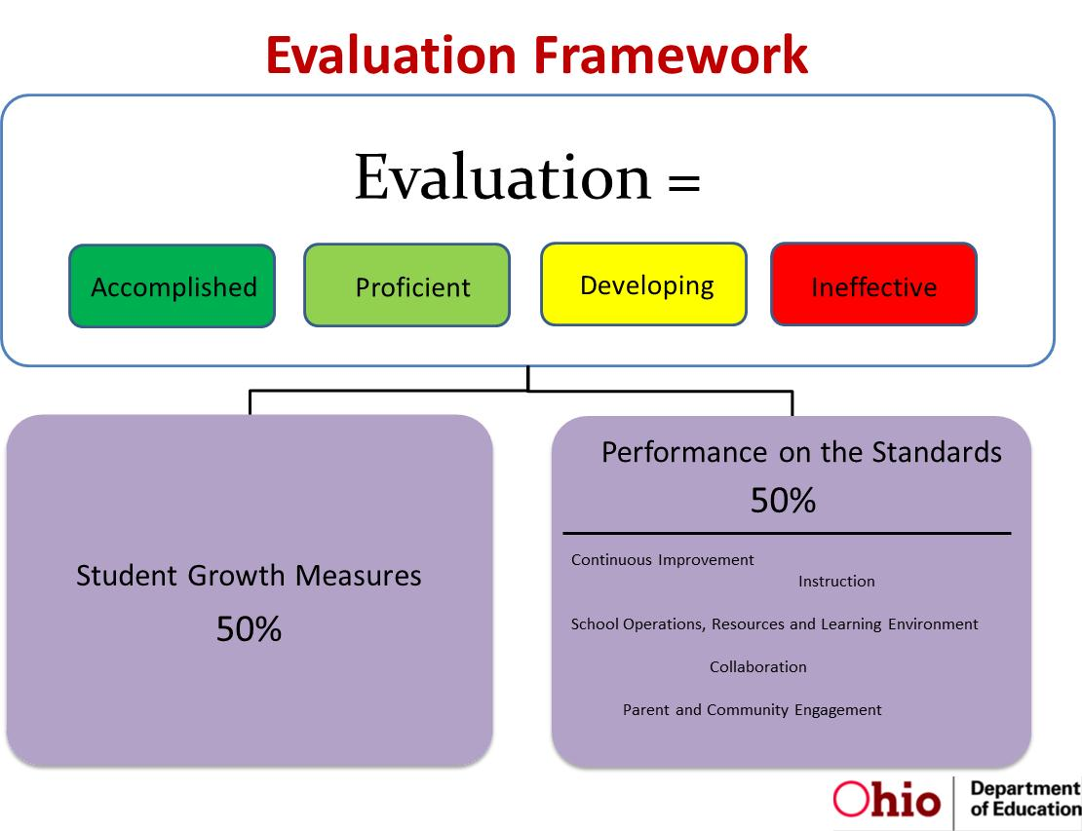
Principal Evaluation System in Ohio
(OPES)

Slide 18

We Moved - New Website Address: http://toolsforteachersohio.wordpress.com/
Tools for Teachers is an updated monthly webpage for teachers that provides timely announcements and information on licensure, scholarships, professional development and study opportunities, award and recognition programs, and links to classroom resources and tools.

Slide 19
Contact Information
John W. Soloninka
ODE Center for the Teaching Profession
Office: (614) 387-0161
Email: John.Soloninka@education.ohio.gov
Toll Free: (877) 644-6338

