Slide 1

Preparing Pre-Service Teachers for a Whole New World: Maximizing the Benefit of TPA in an Ohio School of Education
OCTEO Fall 2012
Dr. Debra Gallagher
Ohio Northern University

Slide 2

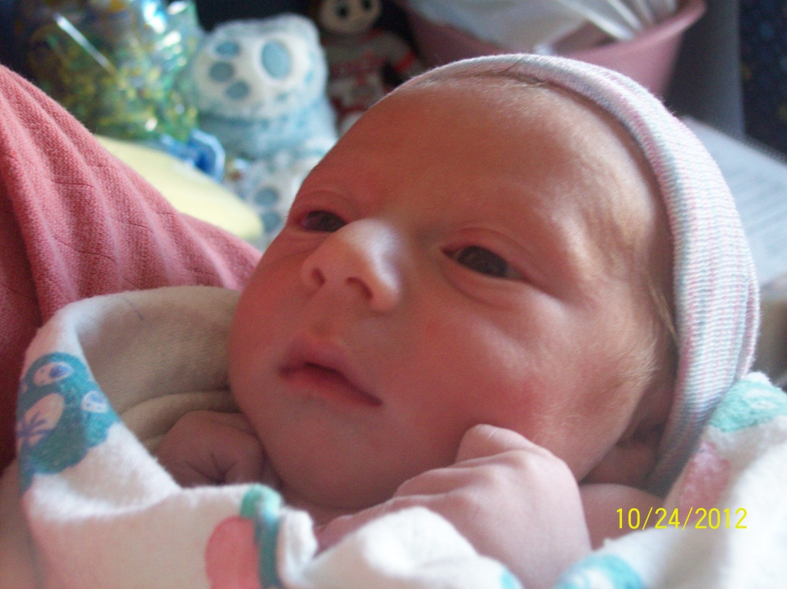
Who will teach them?

Slide 3
Ohio Northern University
Approximately 3.600 students
Education Department is in the Getty College of Arts and Sciences
400 Education Students
9 Education Faculty
35 Student teacher 2012-13
Areas of Study
  AYA Math, Science, Social Studies, Engineering Education
  Middle Childhood
  Early Childhood
  MA-Music, PE/Health, Technology, Art

Slide 4
Goals of this session
Share the benefits of implementing the TPA with our students
Discuss issues such as faculty support
Discuss the Software solution for ONU
Gain input from others about what is working at various universities.

Slide 5
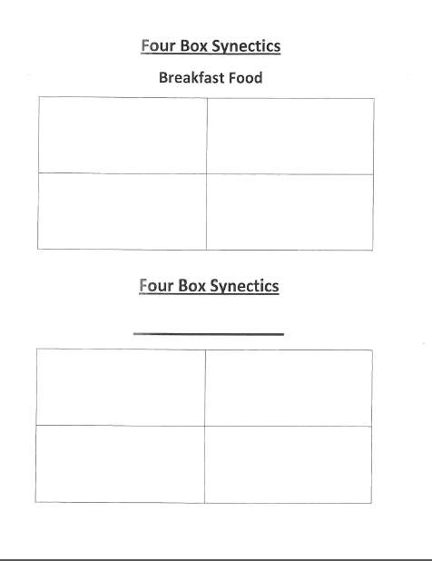

Slide 6
The Beginning…
Our director came back from a meeting much like OCTEO and told us about this new assessment coming to higher education-TPA
We unanimously agreed as a faculty to begin in the pilot stages as soon as possible.

Slide 7
ONU Meets TPA
Timeline
  Spring 2011-Pilot-Planning section of TPA with 4 students, 2 LA and 2 Math, 4 faculty
  Fall 2011-Pilot-Entire TPA with 2 students, 2 faculty
  Spring 2012-All students completed the TPA
  Spring 2012-One faculty member became a scorer for TPA (two others have applied and are waiting)
  Fall 2012- All students completing TPA

Slide 8
Reviewing TPA
Spring 2011-Four faculty members each reviewed the Planning section of the TPA for the teacher candidate they were supervising
Fall 2011-Two faculty members provided a timeline to the teacher candidates for the completion of TPA
All documents were submitted as a hard copy and reviewed by faculty

Slide 9

Dr. Gillham

Slide 10
Faculty Support
All faculty were eager to be involved so that we could work together to improve our program
Three applied to be scorers-1 has scored to date
All faculty are on TaskStream for students to request feedback

Slide 11
Timeline to submit work
Segment | Need to do | Write | Due dates
Planning | Context for Learning template |  | 9/23/11
Planning | Select a learning segment, 3-5 days Identify central focus, content standards, objectives |  | 9/28/11
Planning | Consider academic language critical to understanding and determine how you will teach it Write lesson plan for each lesson-include all instructional materials and assessments |  | 10/7/11
Planning |  | Planning Commentary template | 10/7/11

Slide 12
Choosing an Electronic System
Education department has been using an electronic system for assessment data for a number of years
University was moving toward adoption of electronic system for all students to portfolios
After an in-depth review of a number of systems, ONU selected TaskStream to manage the numerous assessments

Slide 13
Why TaskStream for the University?
The fee structure was viewed as a PLUS because it was economical and it aligned with the various programs
Consultants from QUICKLY return your call.
Can meet the needs of gen ed plus much more.
Students in education licensure program use it in two ways but pay only one price
Works in our Banner system

Slide 14
ONU, TPA, and TaskStream
Spring 2012
  All teacher candidates used TaskStream as the management platform for working and submitting TPA to Pearson
Fall 2012
  Teacher candidates are all using TaskStream and will submit to Pearson on October 31

Slide 15
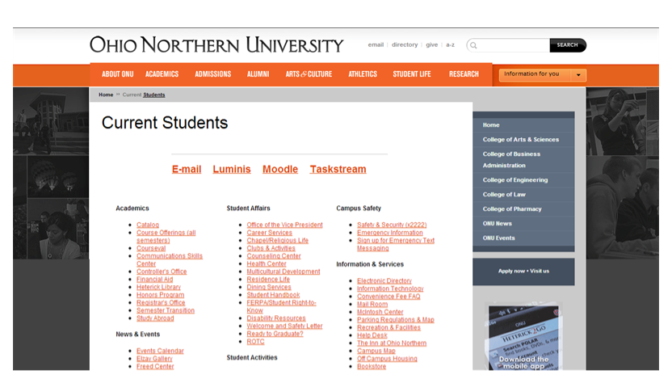
Students log in to TaskStream

Slide 16
Advantages of TaskStream for TPA
Everything completed and stored in one place
Handbooks and rubrics are available at a click
Easy for teacher candidates to request feedback from any faculty member
Students can contact TaskStream directly and get timely answers to their questions.
Notes:
Emphasize these are advantages FOR students

Slide 17
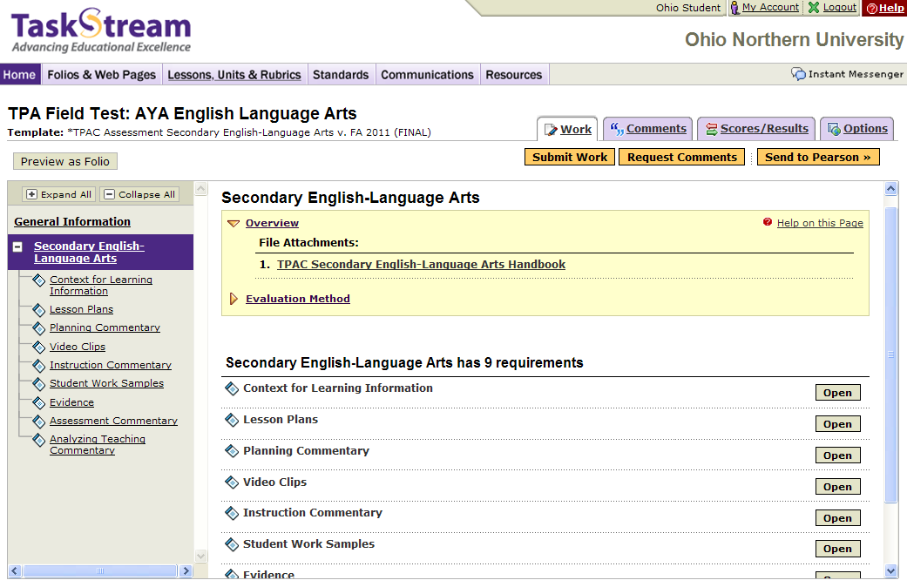
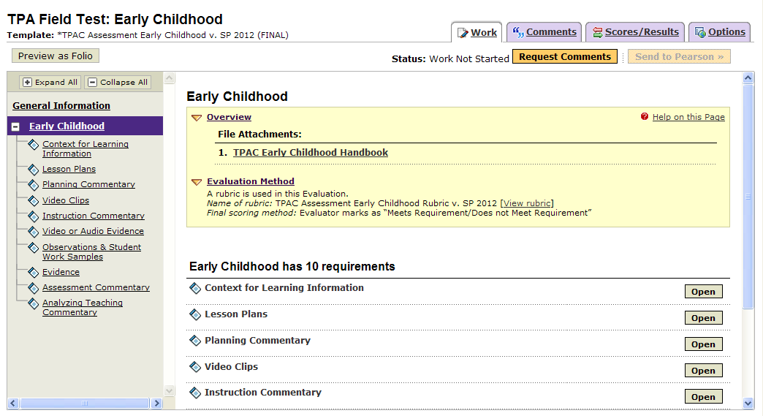
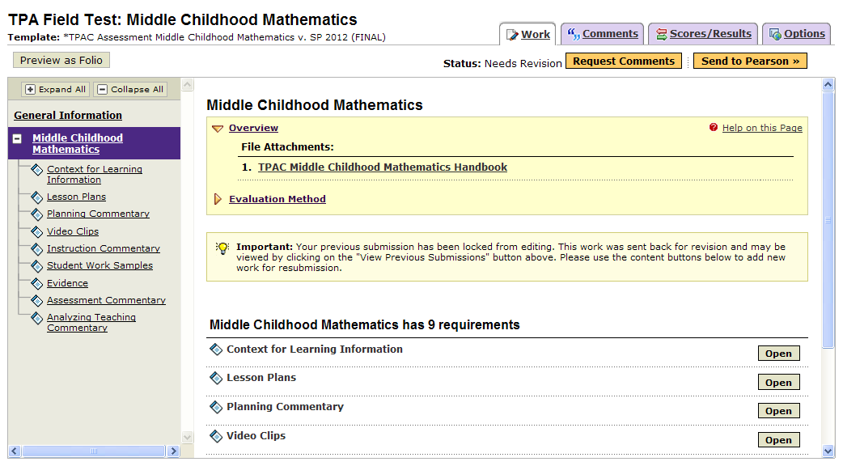
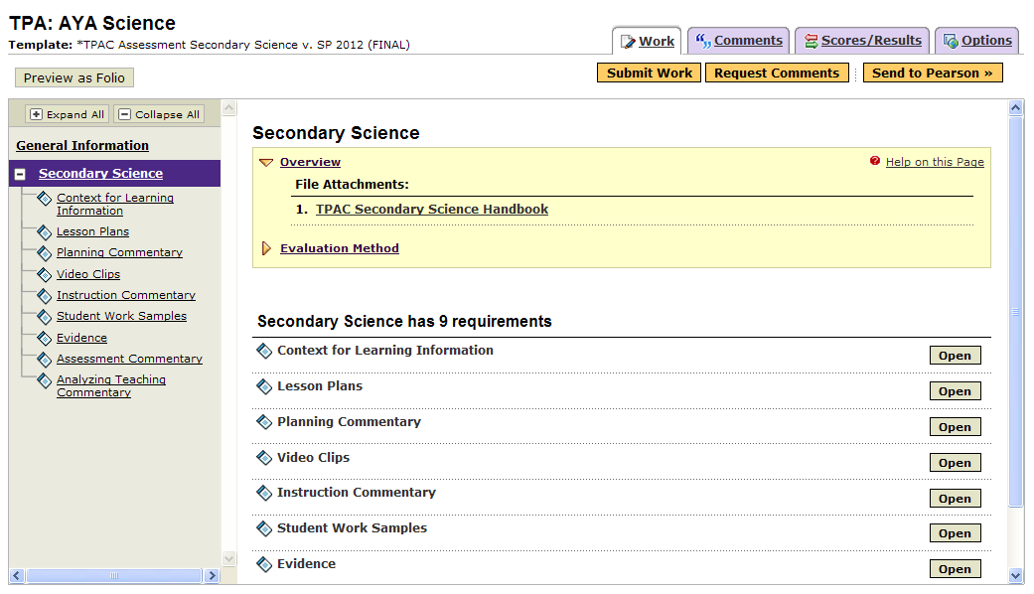
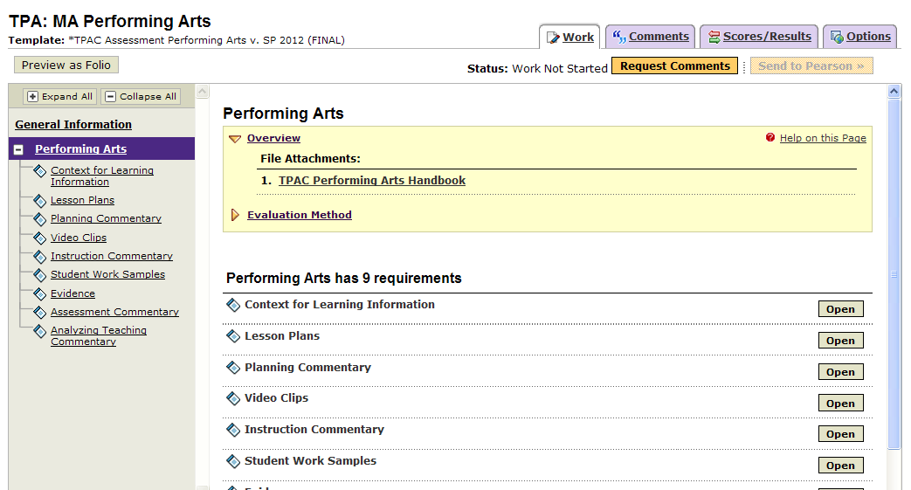
TPA Templates

Slide 18
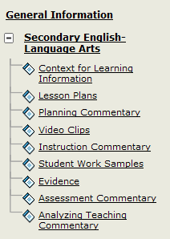
TPA Template:
Secondary English- Language Arts

Slide 19
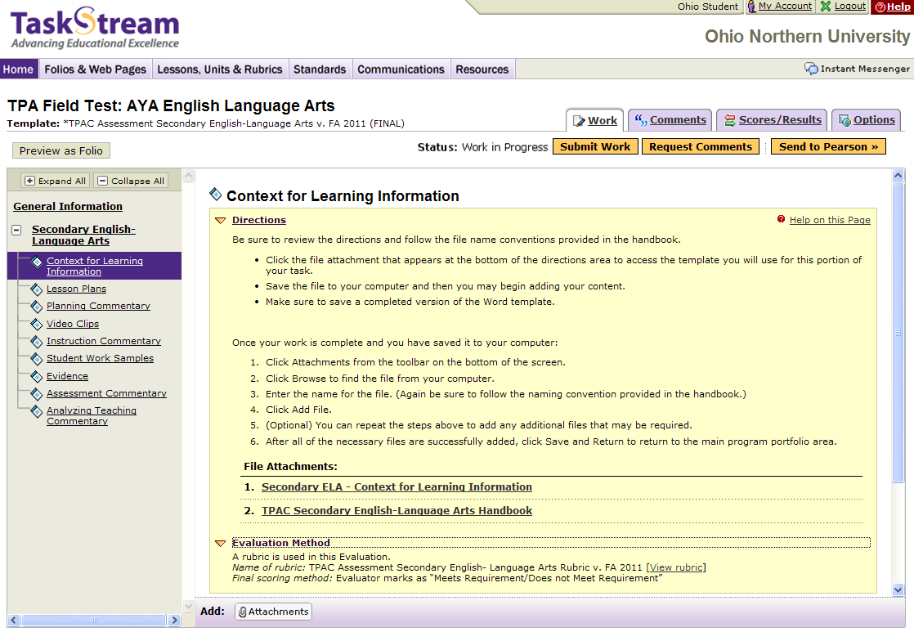
Assignment

Slide 20
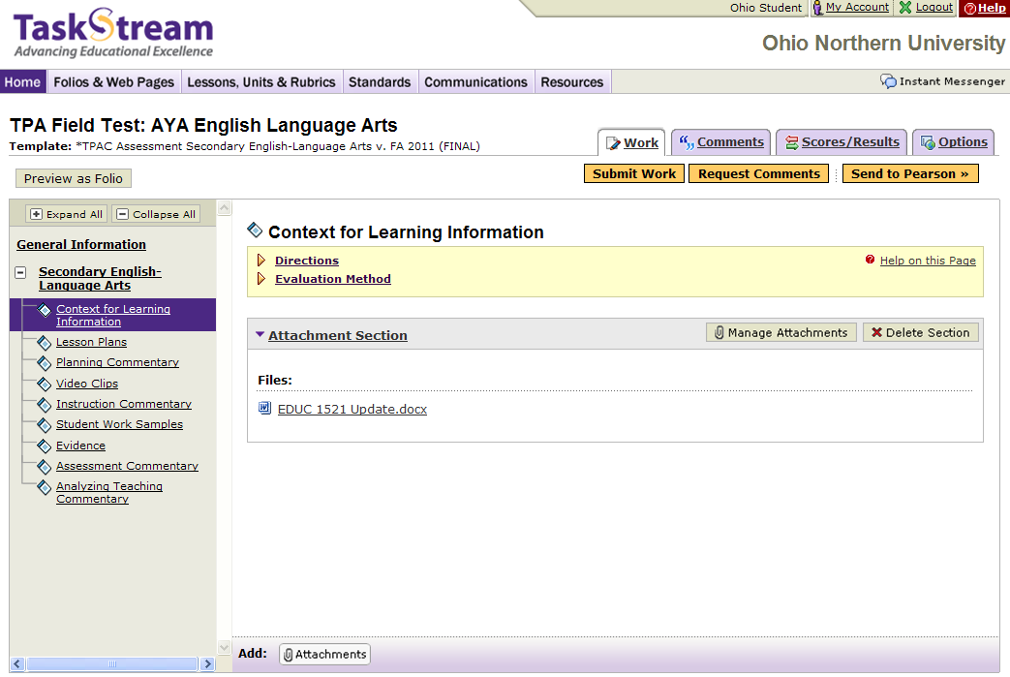
Requesting Feedback

Slide 21
Requesting Feedback

Slide 22
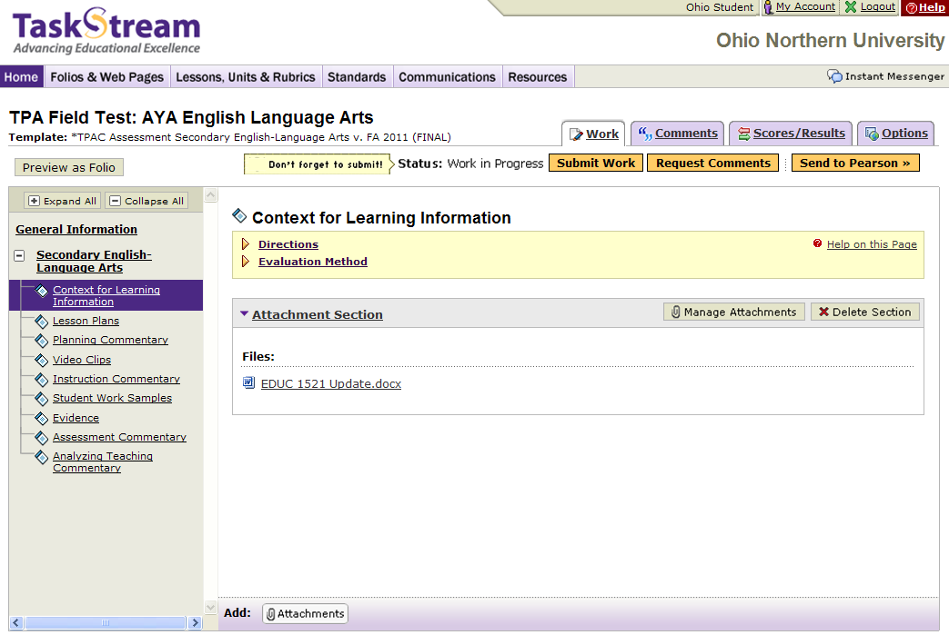
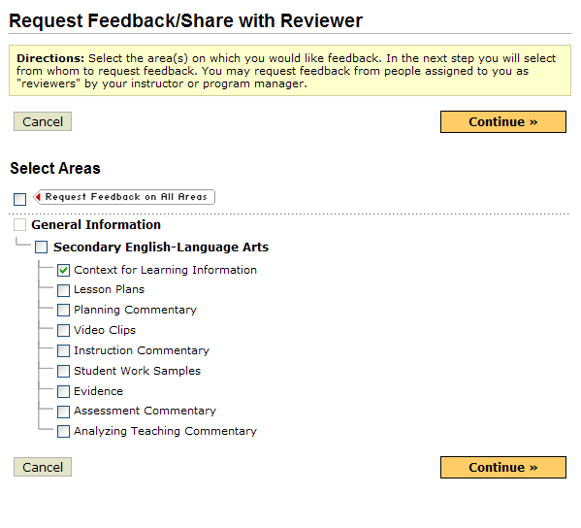
Requesting Feedback

Slide 23
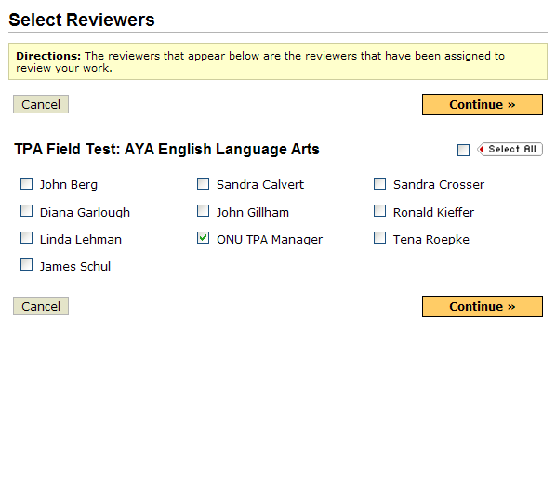
Requesting Feedback

Slide 24
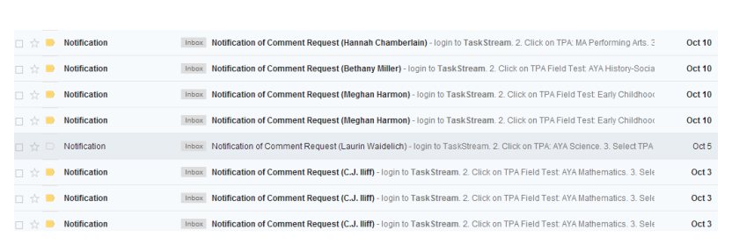
Feedback

Slide 25
Where are we going from here?
Reviewing results from last submission to see gaps in our curriculum
Finding ways to use TaskStream more effectively for our students and faculty

Slide 26
Questions for Audience
What are some challenges you have had implementing TPA?
How and what type of feedback are you providing for your teacher candidates?
How are you using the data from the field test in your program?

Slide 27
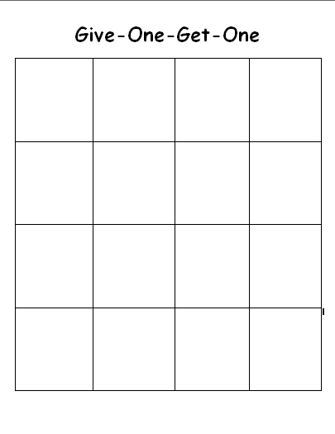

Slide 28
Thank You!

