Slide 1
Pioneer Reflections from Ohio’s 2010-2011 Journey: Pilot Year Insights from Leg (Phase)I and Leg II Travelers
Travelers: Donna Hanby (WSU)
Katie-Kinnucan-Welsch (UD)
Iris Johnson (MU)
Theresa Dorn (WSU)
Mary Ellen Carpenter (Sugarcreek/WSU)
OCTEO Fall Conference ~ September 26, 2011

Slide 2
2010-2011
Today’s Overview:
Survey Insights – Phase II IHEs
  Teacher Candidates
  Faculty ‘Shepherds’
Annual Reports from TPA Contacts (Phases I & II)
Spring 2011 Portfolio Reflections – Phase I IHEs
Panel Discussion – Lessons Learned from Leg I and II Trail Blazers
Sharing your Leg of the Ohio TPA trail

Slide 3
Teacher Candidate Survey
N-93 from Phase II IHEs
59% State Institutions and 41% Private
Tasks Completed:
  Task 1: Planning Instruction and Assessment – 86%
  Task 2: Instructing & Engaging Students in Learning – 34%
  Task 3: Assessing Student Learning – 59%
  Task 4: Final Retrospective Reflection – 32%

Slide 4
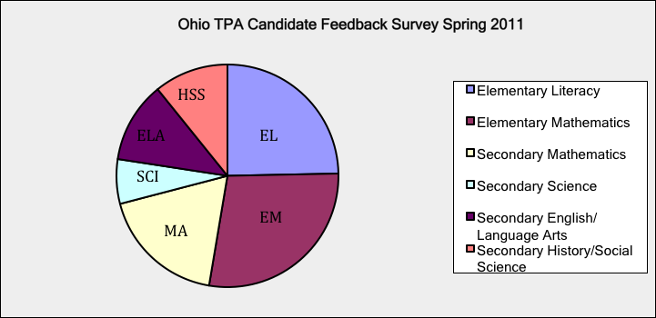
Teacher Candidate Survey Results…
EL-25% EM-28% MA-18% SCI-6% ELA-12% HSS-11%

Slide 5
Q3. Reflecting upon your experience with the TPA task(s) and content area assessment you implemented, what were some noted positives and negatives about the 3-5 day experience during your clinical experience/student teaching?
Theme | % of Respondents
Positive: | 96%
Self-awareness/Professional Development | 53%
Focus on Student Learning | 37%
Appropriate Time Line | 6%
Negative – Restricted Time Line | 2%

Slide 6
Q4. Related to question #3, what were some of the challenges you experienced during the 3-5 day experience?
Themes:
Student Factors (e.g., absenteeism, not completing tasks, ability) – 34%
Meeting TPA Requirements (e.g., 3-5 day timeline, videotaping, reflections, lesson planning) – 44%

Slide 7
Q5. What supports were beneficial to your success in completing the task(s)?
Theme | % of RespondentsT
TPA Materials (e.g, rubric, glossary, checklist) | 15%
Supervisor, Cooperating Teacher, Peers | 56%
Prior Teaching Experience | 3%

Slide 8
Q6. What supports might have been helpful during the preparation, teaching, and follow up of the task(s)?
Theme | % of Respondents
More clearly defined requirements or examples of completed samples | 31%
More time to complete tasks | 8%
More preparation of supervisors, cooperating teachers, candidates etc. | 26%

Slide 9
Q7. Did you feel the process was educational?
Please explain.
Yes – 63% No – 14% Undecided – 23%
“Yes, because I was analyzing student learning and developing lessons that met the needs of each individual student. It helped me develop lessons that were within the students’ ability level, but pushed them to think more in depth.”
“The process was very educational. My cooperating teacher read over my task and commented that it was great to have student teachers do this assessment. I learned a lot about myself and my planning and how I can reflect on it and continue to grow.”
“This process was very educational because it forces the student to truly look at everything that they are doing and evaluating their progress and to analyze each piece.”
“I did feel the process was educational. It really made me look at myself, the way I was developing the assessment and how I was educating my students in the content in preparation for the assessment.”

Slide 10
Q8. Do you feel the process is an accurate depiction of your preparedness. Please explain.
Yes – 42% No – 32% Undecided – 24%
“Yes, I used my results from one day to plan for the next.”
“The process was too drawn out. Planning in December, implementing in Feb., and assessing the work in April made it difficult to see the three processes as a unit.”
“The task was focused on academic language, whereas my previous classes had not been focused on it. I was not ready for the emphasis on the academic language.”
“I feel as though this process over prepared future teachers. Over preparation is beneficial though as a teacher. It is better to be over prepared than underprepared. This process showed me that to be a thorough teacher, I need to make sure I cover all my bases. This process was very beneficial to understanding where I am as a teacher.”

Slide 11
Q9. Did the completion of the task give you confidence in knowing what you are doing well and showing you where you have room to learn?
Yes – 62% No – 19% Undecided – 19%
“Yes, it really made me analyze what I did or why I thought the way I did. I know that as a teacher there are always ways I can improve, but when I am forced to put everything down on paper and to support what I chose to do what I did, I see where my strengths and weaknesses are.”
“Yes, once I completed the task I was able to connect everything to student learning, the teaching process and reflection.”
“Yes, I felt extremely confident throughout this unit. My colleagues and students praised this project and the various other assignments daily.”
“The video portion of the task did help me to clearly see my strengths and weaknesses.”

Slide 12
Q10. Is there anything else you’d like to share about the process that you feel might be helpful for us to know?
Theme | % of Respondents
Increased collaboration/training needed between participants (i.e., candidates, cooperating teachers, supervisors) | 8%
Unclear expectations/directions | 12%
Poor timelines | 13%
Repetitive tasks | 9%
Limited evaluation of teacher preparedness | 6%

Slide 13
Additional Comments . . .
“I felt like it was too much in a short period of time. This needs to be a year long experience with more classroom experience prior to the completion of the TPA.”
“It would be helpful to have all cooperating teachers come to a short seminar (maybe there would be an option of having one held at every campus for convenience) in order to truly understand their role as a CT and what the TPA project entails.”
“I think the TPA needs to be started earlier in student teaching and students need to receive more of a background as to what they are going to be doing.”
“I believe that I really benefited from the experience.”
“Overall I thought this was a helpful assessment and has valuable information within it.”

Slide 14
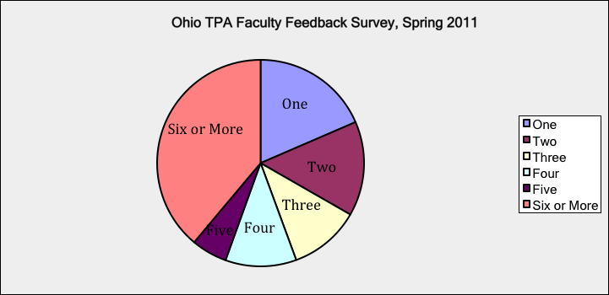
Faculty Survey Results
N-31 (33% State IHEs/65% Private IHEs)
Q1. How many candidates did you assist with a TPA task this academic year?
6
12
2
5
1
5

Slide 15
Q2. Which TPA task(s) did you assist a candidate(s) to complete?
Task 1: Planning Instruction & Assessment | 25%
Task 2: Instructing & Engaging Students in Learning | 6%
Task 3: Assessing Student Learning | 13%
Task 4: Final Retrospective Reflection | 3%

Slide 16
Q3. Which content area(s) were used for the implementation of the task(s)?

Slide 17
Q4. Reflecting upon your experience with the task(s) and the content area assessments for your candidates, what were some noted positives about the TPA experience?
Theme | % of Respondents
Increased Candidate Competency | 55%
Increased Awareness of Student Learning | 13%
TPA Materials/Information | 11%
Familiar Evaluation Method | 5%
Candidate Evaluation | 4%

Slide 18
Q5. What supports were beneficial to your success in assisting them with the implementation of the task(s)?
Themes | % of Respondents
TPA Materials/Information/Training | 40%
Supervisor/Colleague Support | 20%
Meetings/Communication | 13%
University/College Resources | 7%

Slide 19
Q6. Related to question #4, what were some challenges you experienced while assisting them with the task(s)?
Themes | % of Respondents
TPA Requirements/Timeline | 38%
Limited Training/Instructions/Examples | 35%
Candidate Competency/Experience | 11%

Slide 20
Q7. What supports might have been helpful during the preparation, teaching, and follow up of the task(s)?
Themes | % of Respondents
Explanation/Examples of Tasks/Requirements | 40%
Additional Meetings/Trainings | 27%
Additional Time | 15%

Slide 21
Q8. Did you feel the process was educational?
Yes – 71% No – 7% Undecided – 22%
“Yes, this process has merit. It requires students to synthesize their teaching experience and to demonstrate their ability to use planning and reflection in preparation for future instruction.”
“We certainly learned a great deal. I also realize that we are on the right track when preparing our future teachers because all the elements are there. It was just a matter of organizing them into the required format.”
“Yes, it forced the teacher candidates to examine what they were doing as beginning teachers. It also forced me to look at the materials that I was including in my seminar and the relevance of these materials to my students.”
“Though we felt like we were ‘stumbling through’ the process (and have not yet completed it), we learned a lot about both the needed changes in procedures, prior instruction, and completion of the TPA itself. We need continued training to be able to competently implement this in the future.”

Slide 22
Q9. Did you or your candidates find any part of the task instructions difficult to understand? Please explain.
Yes – 49% No – 31% Undecided – 20%
“Terminology, for example, essential question, academic language.”
“Some candidates had difficulty with indicating specific research/theory, which guided their selection of specific strategies and materials to help students develop the factual knowledge, conceptual understanding, and interpretative skills to meet the learning objectives.”
“My students did not find the instructions difficult but they felt that the 7-9 pages of single-spaced narrative was unnecessary.”
“Not really. They had a few questions related to how to submit the video etc., but nothing major.”

Slide 23
Q10. Were there any questions for the commentary that seemed confusing or unclear? If so please share details.
Yes – 31% No – 36% Undecided – 31%
“Students felt that some of the questions (they didn’t specify which ones) were rather redundant. They felt they repeated themselves a bit. Perhaps the questions could be streamlined.”
“We started with the idea that our preservice students would likely fall at the level 1 or 2. We did have some that were very nearly a 3, but not exactly there. I felt the need distinguish them so used a check/check plus type notation… I felt like it would have been nice to have a box called ‘emerging’ or some way to reflect this better. I think it might be useful to revise the rubric for this content areas and that might ease this issue I encountered.”

Slide 24
Q11. Did you or your candidates find any part of the rubrics difficult to understand? Please explain.
Yes – 44% No – 31% Undecided – 25%
“Rubrics are not clearly aligned with each piece of Task #1 (Context for Learning is not evaluated).”
“Without proper training the rubrics seem vague and subjective.”
“We talked through them beforehand, so it was a non-issue.”
“The rubrics were very helpful.”
“There seemed to be a disconnect between the rubric and our lesson plan format.”

Slide 25
Q12. Other than finding time to complete the task(s), did your candidate(s) have difficulty with non-instructional components such as locating information about students (task 1), collecting assessments (task 3) or completing filming (task 2)?
Theme | % of Respondents
Yes | 25%
No | 44%
Undecided/Not Applicable | 31%
“In some districts, cooperating teachers are not allowed to release IEPs to candidates or for candidates to read these documents. This creates difficulty in locating information for the Context for Learning section of the Planning Instruction and Assessment task.”
“No they were actually pretty excited to tackle this.”
“Completing filming was difficult for one student due to the lack of access to good equipment. Also the legalities of permission slips was unclear and difficult for another student.”

Slide 26
Q13. Was there anything about the task that would be difficult to do because of a type of teaching context in your regional area (e.g., using a prescriptive curriculum)?
Yes – 20% No – 31% Undecided – 49%
“Student teachers in the spring have a difficult time planning with the OGT tests and other state assessments. Cooperating teachers do not seem to be as willing to stray from the very prescribed curriculum.”
“I think everyone, including CTs, will need to be flexible If that’s not possible the ST will have a problem. I’m concerned that the CTs are not going to be able to support the ST.”
“Prescriptive curriculum.”
“There were some difficulties but the students worked around them.”

Slide 27
Q14. Is there anything else you’d like to share about the process that you feel might be helpful to us to know?
Theme | % of Respondents
Increased training needed | 23%
Unclear directions/expectations | 10%
Repetitive/Unrealistic tasks | 6%
Poor Timelines | 6%
“Our STs must attend 4 seminars during student teaching; I believe that these seminars may need to be focused on this project.”
“It was a good learning experience for all of us, and we appreciated the opportunity to participate.”
“I believe the tasks of TPA are very worthwhile and the State of Ohio has chosen a good alternative to the Praxis II PLT.”

Slide 28
Annual Reports
N – 33 TPA Contact Persons submitted a TPA Report
77% noted the greatest strength of implementing TPA was the increased professional development and competency for their candidates.
39% shared benefits of the assessment materials and requirements
23% noted it encouraged program evaluation.

Slide 29
Annual Reports Data…
10% completed more tasks than originally projected
Total Tasks Completed: 1303
Greatest #s - Science~ Planning (117) Elementary Math~ Planning (114)
Smallest #s – Sec. Math ~ Instruction (40) Ele. Literacy ~ Instruction (43)

Slide 30
Noted Strength/Challenges as the TPA Contact Person
Theme | % of Respondents
Strengths
Collaboration between Faculty/Students | 16%
Access to Resources (i.e., webinar, trainings, state rep.) | 45%
Candidate Competency | 6%
Challenges
Limited Time/Resources | 45%
Need for Additional Training/Samples of Completed Assessments | 45%
External Stressors (i.e., weather, state testing) | 6%

Slide 31
Q6. In preparation for next year’s full assessment process, what do you perceive may be an institution’s greatest need/challenge?
Theme | % of Respondents
Technological Concerns (i.e., video consent, downloading samples) | 48%
Increased Faculty/Supervisor Training | 45%
Time Requirements/Deadlines | 30%
Cost of Implementation/Compensation | 13%
Unclear Expectations/Task Requirements | 10%
Increase Collaboration Needed with School Districts | 6%

Slide 32
Portfolio Insights
Three IHEs (University of Cincinnati, University of Dayton and Wright State University) had 91 portfolios scored by calibrated scorers from May-Aug. of 2011
  20% were to be sent to Stanford.
35 Scorers (university/school faculty) from 9 different institutions:
UC = 6 UD = 8 WSU = 24 OSU = 11 YSU = 5
MU = 5 CSU = 3 BGSU = 1 UA = 3

Slide 33
Portfolios Scored/Spring 2011/3 Accelerated IHEs
Rubric 1 – Planning focused, sequenced instruction (Task 1)
Rubric 2 – Using Knowledge of students to inform teaching (Task 1)
Rubric 3 – Planning assessments to monitor and support student teaching (Task 1)
Rubric 4 – Engaging students in learning (Task 2)
Rubric 5 – Deepening students learning during instruction (Task 2)
Rubric 6 – Analyzing student work (Task 3)
Rubric 7 – Using assessment to inform instruction (Task 3)
Rubric 8 – Using feedback to guide further learning (Task 3)
Rubric 9 – Monitoring student progress (Task 4)
Rubric 10 – Understanding language demands (Academic Language)
Rubric 11 – Developing student’s academic language (Academic Language)

Slide 34
Lessons Learned from Phase I & II IHEs…
Katie Kinnucan-Welsch – University of Dayton
Iris DeLoach-Johnson – Miami University
Theresa Dorn – Wright State University
Mary Ellen Carpenter – Bellbrook-Sugarcreek Schools/ WSU

Slide 35
Audience Sharing…
Describe Your Leg of the Journey…
Successes Challenges
How has your TPA journey been
educative to date?

