Slide 1
Revised Standards and
Model curriculum
October, 2010
Denny Thompson
Director
Center for Curriculum and Instruction
Ohio Department of Education

Slide 2
Topics of Interest
Standards Revision
Model Curricula
New Assessments

Slide 3
Topics of Interest
Standards Revision
Model Curricula
New Assessments

Slide 4

International Benchmarking
Ohio’s Process
High performing countries
Three lenses
  Standards
  Teacher Effects
  Learning conditions
What fits best for Ohio?

Slide 5
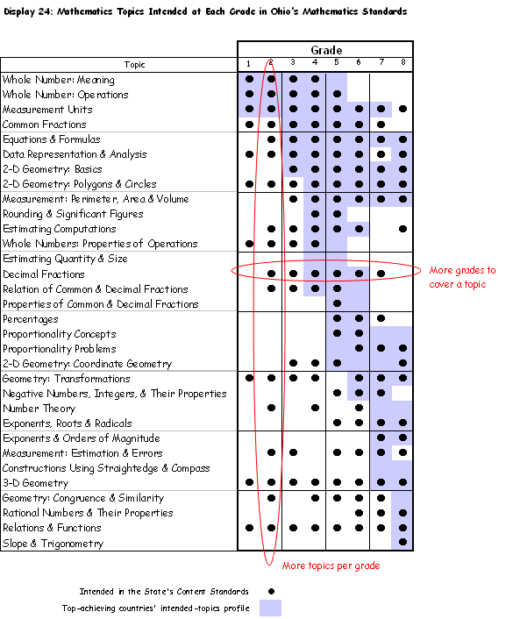
Benchmarking to the standards of high performing countries
More grades to cover a topic
Intended in the State’s Content Standards
Top-achieving countries’ intended-topics profile
Dr. William Schmidt,
Michigan State University
More topics per grade

Slide 6
Standards Revision
Not later than June 30, 2010…the state board of education shall adopt statewide academic standards with emphasis on coherence, focus, and rigor for each of grades kindergarten through twelve in English language arts, mathematics, science, and social studies.
ORC §3301.079(A)(1)

Slide 7
Standards Must Reflect:
  College and career readiness
  Content and skills
  Coherence, focus, rigor
  Aligned model curriculum

Slide 8
Stakeholder Engagement
  Content specific focus groups involving 200 teachers
  Meeting with 55 professional organizations
  Over 800 individual responses to online survey

Slide 9
What Did We Hear?
  Too many standards
  Not easily managed
  No time to teach in depth
  Some need clarity
  Technical corrections

Slide 10
Stakeholder Needs—June 2009
Improvement needed or critical in all areas!

Slide 11
Two Development Tracks
Ohio Revised Standards
Common Core
  Science
  Social Studies
Mathematics
English language arts

Slide 12
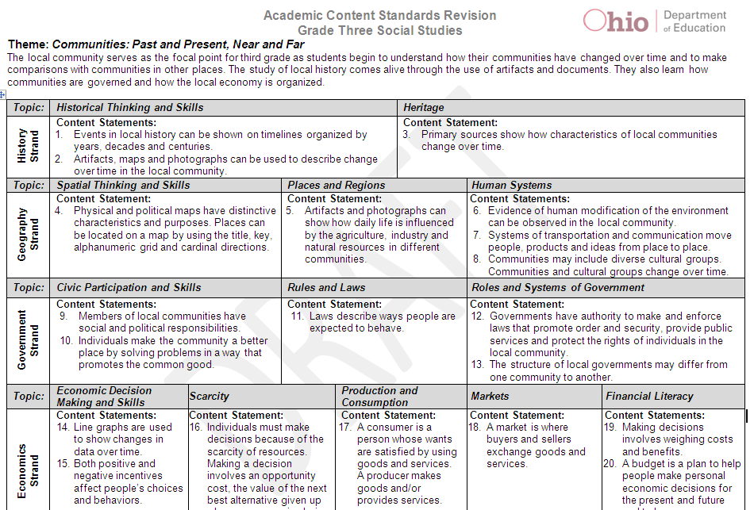
Science and Social Studies Format
Themes
Grade Descriptions
Topics
Strands
Content Statements
Skills

Slide 13
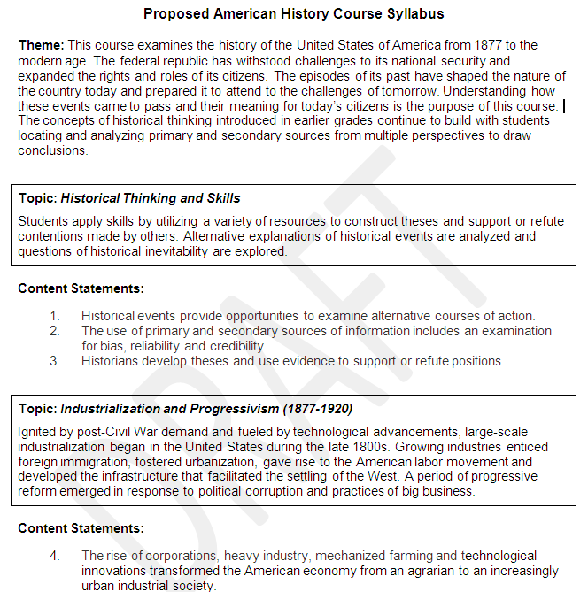
Sample Syllabus
Theme/ Course Descriptions
Skills
Topics
Content Statements

Slide 14
Ohio Science Standards
Strands:
  Earth and space science
  Physical science
  Life science
Skills:
  Science inquiry
  Applications

Slide 15
Ohio Social Studies Standards
Strands:
  History
  Geography
Skills:
  Historical thinking
  Spatial thinking
  Civic participation
  Government
  Economics
  Economic decision making
  Financial literacy

Slide 16
Mathematics Common Core
Describes the work of mathematically proficient students:
Descriptions of Mathematical Practice
  Examples: reasoning, problem-solving
Standards Include:
  Concepts
  Skills

Slide 17
English Common Core
English Language Arts
  Reading
  Writing
Standards Include:
  Knowledge and skills leading to college and career readiness
  Progressions of learning across the grades
Literacy Standards for History/Social Studies, Science and Technical Subjects
  Speaking and Listening
  Language

Slide 18
Implementation Timeline
Transition:
Teacher development
Local curriculum revision
Test development
2011 - 2014
State Board Adopts Standards
June, 2010
State Board Adopts Model Curriculum
March, 2011
Transition Complete
June, 2014
2010
2011
2012
2013
2014
Notes:
Animation: Each click reveals a milestone, left to right.

Slide 19
Topics of Interest
Standards Revision
Model Curricula
New Assessments
Credit Flexibility

Slide 20
Why a Model Curriculum?
…the state board shall adopt a model curriculum…The model curriculum shall be aligned with the standards, to ensure that the academic content and skills specified for each grade level are taught to students, and shall demonstrate vertical articulation and emphasize coherence, focus, and rigor.
ORC §3301.079(B)

Slide 21
One Piece of an Integrated Whole
Model Curricula: March 2011
Aligned System of Assessments: 2014
Revised Academic Content Standards: June 2010

Slide 22
What is the Model Curriculum?
A web-based tool, aligned to the standards, that:
Presents information specific to the content area by grade level, grade band and course
Provides curricular and instructional guidance
Includes instructional strategies and resources
Informs assessment development

Slide 23
Model Curriculum
Teacher Teams
Content Review Committee
Nationally and State Developed
Model Curriculum
Content Elaborations
Expectations for Learning
Content Specific Sections
Instructional Strategies and Resources
Common Core and State Standards
Notes:
For our work today, further understanding of the Model Curriculum is needed.
This represents the different cogs in the process of developing the Model Curriculum.

Slide 24
Model Curriculum Components
Content Elaboration
  Applies to all content areas.
  In-depth information about “what” should be taught
Expectations for Learning
  Recommendations for how students may be assessed
  Applies only to science and social studies

Slide 25
Model Curriculum Components
Instructional Strategies and Resources
  Guidance and support for instructional, curricular and assessment design
  Applies to all content areas.
Content Specific Sections
  Address elements specific to a subject area,
  such as
      Misconceptions (science and mathematics)
      Enduring Understandings(English language arts and social studies)

Slide 26
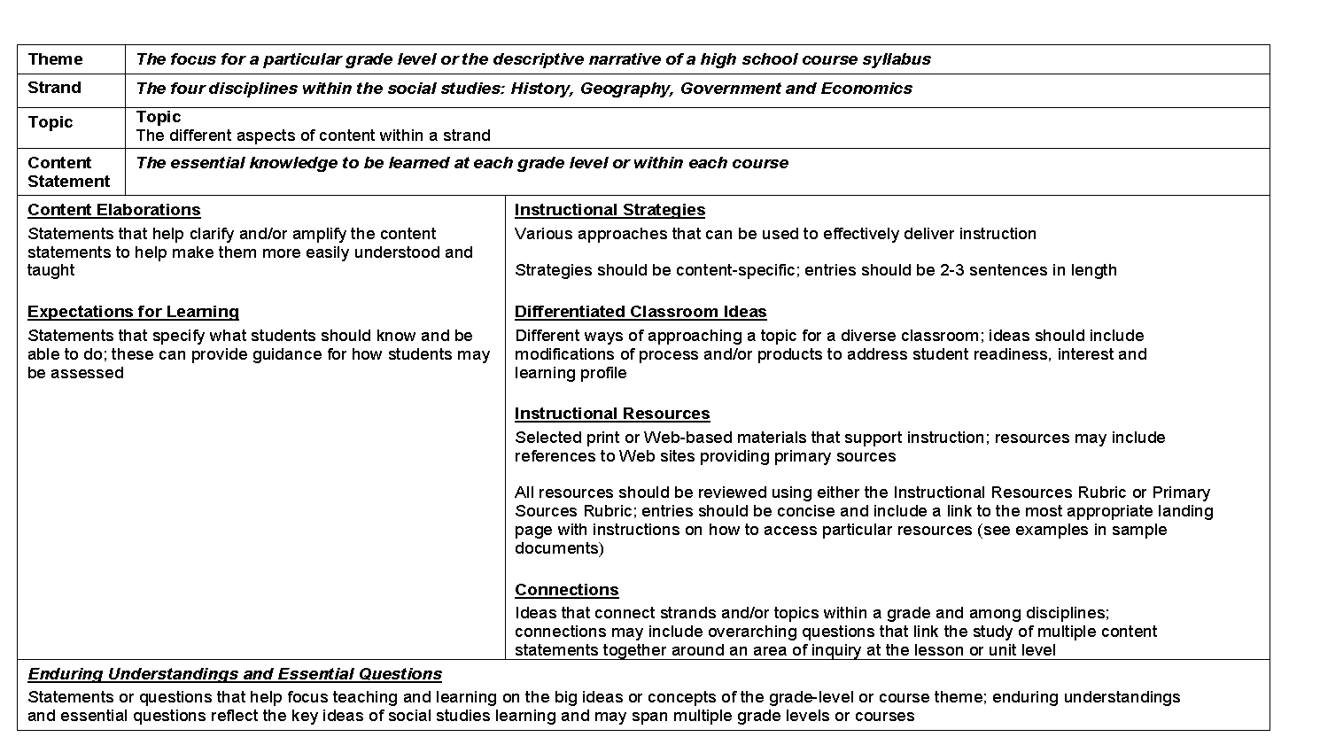
Model Curriculum Template
Content Elaborations
Instructional Strategies and Resources
Expectations for Learning
Content Specific Sections

Slide 27
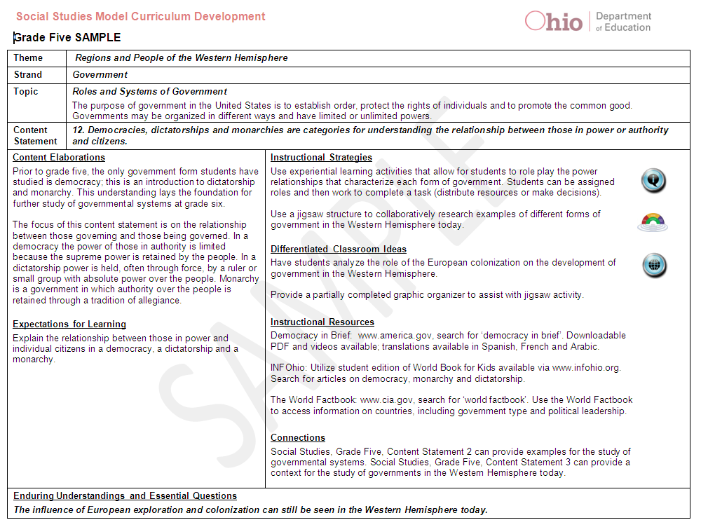
Model Curriculum Example
Inquiry-based
Twenty-first Century Skills
Global Connections
Notes:
Did you intend for this slide to not have the matching template?

Slide 28

Who will contribute?
ODE will convene:
Teacher Teams
Content Review Committee
ODE will solicit:
Public Feedback

Slide 29
Sample Regional Structure
Regional Coordinator
Lead
Content Expert
Lead Content Expert
Lead Content Expert
Lead
Content
Expert
Teacher Teams
Pre-K
K
1
2
3
4
5
6
7
8
Course 1
Course 2
Course 3
Notes:
Stan wants to reverse the order of this slide and the next one.

Slide 30
Teacher Teams
Teachers collaborate to suggest instructional strategies and resources
Part of a continuous conversation
Both face-to-face and online opportunities
The model curricula are teacher-driven
Additional meetings hosted by ESCs beginning September 18

Slide 31
Content Review Committees
Committee members will collaborate with the ODE to inform the development of:
  Content Elaborations
  Expectations for Learning
  Content Specific Sections
Review committees meet from June– September 2010.
ODE will facilitate these meetings.

Slide 32
Public Feedback
All components of the model curriculum
Online
October-November 2010
Educators and non-educators across the state
Notes:
Stan asked if this slide should follow the one that comes next.

Slide 33
Draft Framework
 |  | The Physical Setting |  | The Living Environment
Themes |  | Earth and Space Science | Physical Science | Life Science | Science Inquiry and Applications
Observations of The Environment | P | Observations of nature | Observations of objects and materials | Observations of living things | PreK to grade 4 Observe and ask questions . . . Plan and conduct simple investigations…. . . . Use appropriate mathematics …. Communicate …. Review ….
 | K | Daily and seasonal changes | Properties of everyday objects and materials | Physical and behavioral traits of living things
 | 1 | Sun, energy, and weather | Motion and materials | Basic needs of living things
 | 2 | The atmosphere | Changes in motion | Interactions within habitats
Interconnections within Systems | 3 | Earth's resources | Matter and forms of energy | Behavior, growth and changes
 | 4 | Earth's surface | Electricity, heat and matter | Earth’s living history
 | 5 | Cycles and patterns in the Solar System | Light, sound and motion | Interactions within ecosystems | Grades 5 through 8 Identify questions …. Design and conduct …. . . . Analyze and interpret…. Think critically …. Communicate ….
Order/ Organization | 6 | Rocks, minerals, and soil | Matter and motion | Cellular to multicellular
 | 7 | Cycles and patterns of the Earth and moon | Conservation of mass and energy | Cycles of matter and flow of energy
 | 8 | Physical Earth | Forces and motion | Species and reproduction
Notes:
33

Slide 34
Theme: Interconnections within Systems Grade 3 This theme focuses on investigating dynamic and sustainable relationships that enable systems to function as whole units thereby characterizing them as inclusive or exclusive.
Earth and Space Science | Physical Science | Life Science
Earth’s Resources | Nature of Matter | Life Cycles
This topic focuses on Earth's resources. While resources can be living and nonliving, within this strand the emphasis will be on Earth's nonliving… | This topic introduces matter as it relates to chemical and physical changes and its different states. | This topic focuses on the relationship of animal and plant observable macroscopic structures and life cycles to the organism’s ability to survive in its natural environment.
Content Statements
Earth's nonliving resources have specific properties. Soil is composed of weathered rock and organic material and has characteristics that can be measured. Rocks are composed of minerals. Rocks have unique characteristics… | Matter has specific physical properties. All substances on Earth are made of matter. There are different states of matter; solid, liquid, and gas. Each state of matter has unique physical properties. | Plants and animals have life cycles that are part of their adaptations for survival in their natural environment. Over the whole earth, organisms are growing, dying, and decaying, and new organisms are being produced by the old ones.
Earth's resources can be used for energy. Many of Earth’s resources can be used for energy. Renewable energy is an energy resource, such as wind, water, or solar energy that can be replenished within a short amount of time. Nonrenewable energy is an energy resource, such as coal or oil that is a finite energy source that cannot be replenished quickly. | Chemical and physical changes have specific characteristics. Physical changes do not change the identity of the material, but may change its appearance. Temperature can affect the physical and chemical properties of materials. Chemical changes alter the identity of the material. Some chemical changes can occur by combining different materials to create a new material. | Individuals of the same kind differ in their characteristics, and sometimes the differences give individual an advantage in surviving and reproducing. Species acquire many of their unique characteristics through biological adaptation, which involves the selection of naturally occurring variations in populations.
Some of Earth’s resources are limited. Some of Earth’s resources become limited due to overuse and/or contamination. Reducing resource use, decreasing waste and/or pollution, recycling, and reusing can help conserve these resources. |  | Offspring are very much, but not exactly, like their parents and like one another. Many characteristics of an organism are inherited from the parents of the organism, but other characteristics result from an individual’s interactions with the environment.
Notes:
34

Slide 35
Theme: Interconnections within Systems This theme focuses on investigating dynamic and sustainable relationships that enable systems to function as whole units thereby characterizing them as inclusive or exclusive.
Topic: Earth’s resources This topic focuses on Earth's resources. While resources can be living and nonliving, within this strand the emphasis will be on Earth's nonliving resources, such as water, air, rock, minerals, soil, and forms of energy resources.
Content Statement Earth’s nonliving resources have specific properties. | Content Description Soil is composed of weathered rock and organic material and has characteristics that can be measured. Rocks are composed of minerals. Rocks have unique characteristics that allow them to be classified. Air and water are also nonliving resources. Note: Specific properties of water are found in grades 1 and 2. Specific properties of air are found in grades K and 2. These properties can be discussed as they relate to this content, but should not be re-taught.
 | Instructional Strategies Classroom Resources Classroom Portal: These are windows into the classroom through Webcasts, Podcasts, or video clips to exemplify and model classroom methods of teaching science using inquiry Differentiated Learning Strategies http://www.learner.org/resources/series21.html Common Misconceptions Students often think soil is alive. While living things live in soil and organic soil is composed of once-living things they need to understand that soil itself is not alive. http://www.wastatelaser.org/support/toolkits/stc/soils/misconcepts.asp Learning Expectations Compare distinct characteristics between different rock or soil samples. Be able to describe and document the similarities and differences. Eye of Integration This is a link to the graphic assistant that helps teachers integrate lessons about soils.
2002 Ohio Academic Content Standards Earth and Space Science, Grades 3-5, Benchmark C and D
Notes:
35

Slide 36
Crosswalk to 2002 Standards
Content Strand | Grade Level | Topic | Content Statement | 2002 Benchmark Reference
ES | PreK | Observations of Nature | Weather changes every day. | Gr. K-2 ES-A
ES | PreK | Observations of Nature | The sun and the moon are visible at different times of the day or night. | Gr. K-2 ES-A
ES | PreK | Observations of Nature | Water can be observed as lakes, ponds, rivers, streams, the ocean, rainfall, hail, sleet or snow. | Gr. K-2 ES-C
ES | PreK | Observations of Nature | Rocks and soil have properties that can help identify them. | Not present in 2002
PS | PreK | Observations of Objects and Materials | Objects and materials are described by their properties. | Gr. K-2 PS-A
PS | PreK | Observations of Objects and Materials | Many objects can be made to produce sound. | Gr. K-2 PS-A&B

Slide 37
Topics of Interest
Standards Revision
Model Curricula
New Assessments

Slide 38
Why Develop New Assessments?
OGT Passage
College Ready

Slide 39
Ready for College and Career?
CCR
OGT

Slide 40
Jobs Today Require More Education & Training
Source: Carnevale, Anthony P. and Donna M. Desrochers, Standards for What? The Economic Roots of K–16 Reform, Educational Testing Service, 2003.

Slide 41
Perceptions of College Preparedness
Very
Very
Based on survey of 800 voters, sponsored by Achieve, May 2010

Slide 42
Support for Rigorous Graduation Requirements for ALL Students
Based on survey of 800 voters, sponsored by Achieve, May 2010

Slide 43
America’s International Edge in Postsecondary Degree Attainment is Slipping
% of Citizens with Postsecondary Degrees Among OECD Countries, by Age Group (2006)
 | 55-64 | 45-54 | 35-44 | 25-34 | ALL (25-64)
1 | U.S. (38%) | Canada (43%) | Canada (51%) | Canada (55%) | Canada (47%)
2 | Canada (37%) | U.S. (40%) | Japan (46%) | Japan (54%) | Japan (40%)
3 | N.Z. (30%) | Japan (39%) | Finland (41%) | Korea (53%) | U.S. (39%)
4 | Denmark (28%) | N.Z. (38%) | U.S. (41%) | N.Z. (44%) | N.Z. (38%)
5 | Finland (27%) | Finland (34%) | N.Z. (39%) | Ireland (42%) | Finland (35%)
6 | Australia (26%) | Denmark (33%) | Korea (37%) | Belgium (42%) | Denmark (35%)
7 | Sweden (25%) | Australia (32%) | Denmark (36%) | Norway (42%) | Australia (33%)
8 | Norway (25%) | Norway (30%) | Belgium (35%) | France (41%) | Korea (33%)
9 | Neth. (25%) | Neth. (30%) | Norway (35%) | Denmark (41%) | Norway (33%)
10 | U.K. (24%) | Switz. (29%) | Iceland (34%) | U.S. (39%) | Belgium (32%)
11 | Switz. (24%) | Iceland (29%) | Australia (33%) | Spain (39%) | Ireland (31%)
12 | Japan (23%) | U.K. (29%) | Switz. (33%) | Sweden (39%) | Sweden (31%)
13 | Germany (23%) | Sweden (29%) | Ireland (33%) | Australia (39%) | U.K. (30%)
14 | Belgium (22%) | Belgium (27%) | Spain (31%) | Finland (38%) | Neth. (30%)
15 | Iceland (21%) | Germany (25%) | U.K. (31%) | U.K. (37%) | Switz. (30%)
 | Ohio (33%) |  | Ohio (37%) | Ohio (36%) | Ohio (35%)

Slide 44
Ohio College Students
Needing Remediation
Source: Ohio Board of Regents

Slide 45
Ohio Core Requirements
For the class of 2014:
English Language Arts:
4 unit
Mathematics: 4 units
Science: 3 units
Social Studies: 3 units
Physical Education: ½ unit
Health: ½ unit
Electives: 5 units
Fine Arts: 2 ½ units

Slide 46
Ohio’s New Assessments
High School
  College Test
  Series of End of Course exams
  Senior Project
K-8
  Combine reading and writing into a single English language arts assessment
  Establish 3 performance levels (instead of 5)

Slide 47
Common Assessment Elements
Both Achieve & SMARTER Balanced
consortia have:
On-line testing
Interim and summative components
Item Types
  Multiple choice
  Extended response
  Technology-enhanced
  Performance assessments
High school tests: End-of-course vs. End-of-year
Rapid reporting system to inform instruction
Teachers involved in developing and scoring tests

Slide 48
Summative Assessment =
Interim
Performance Based
Summative
Sum
Sum of the Assessments

Slide 49
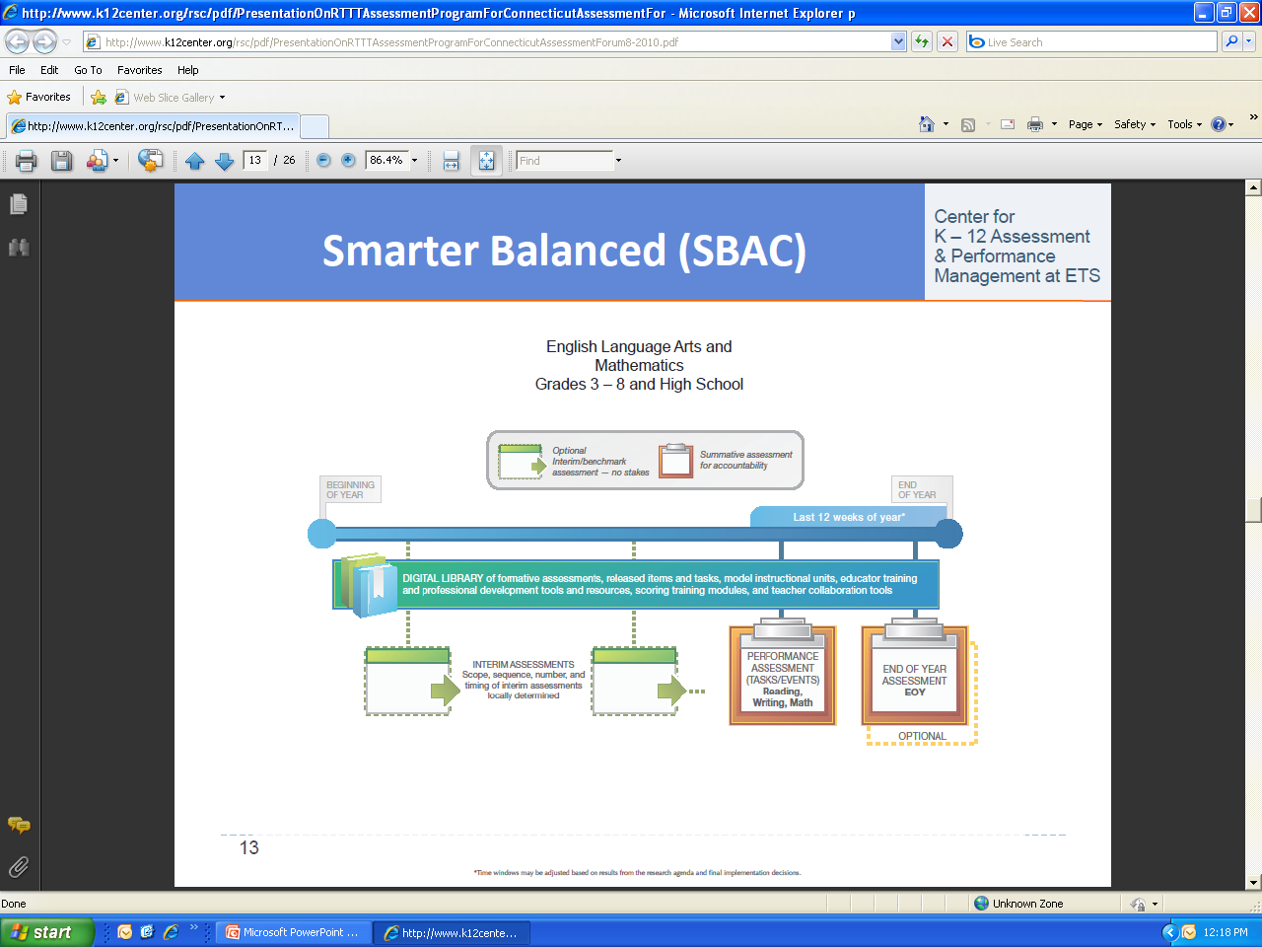
SMARTER Balanced Chart

Slide 50
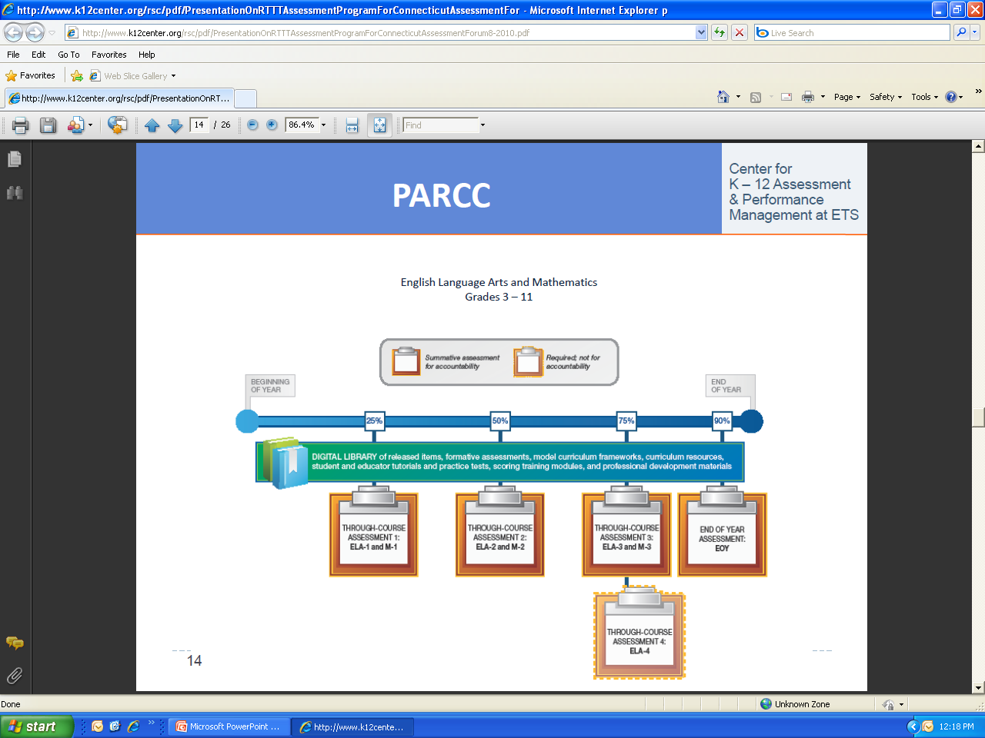
Achieve Chart

Slide 51
Common Assessment Elements
Both Achieve & SMARTER Balanced consortia have:
On-line testing
Interim and summative components
Item Types
  Multiple choice
  Extended response
  Technology-enhanced
  Performance assessments
High school tests: End-of-course vs. End-of-year
Rapid reporting system to inform instruction
Teachers involved in developing and scoring tests

Slide 52
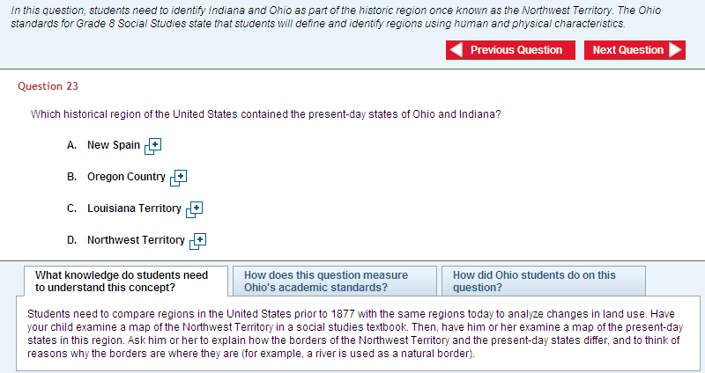
Four Types of Assessment Items
Multiple Choice

Slide 53
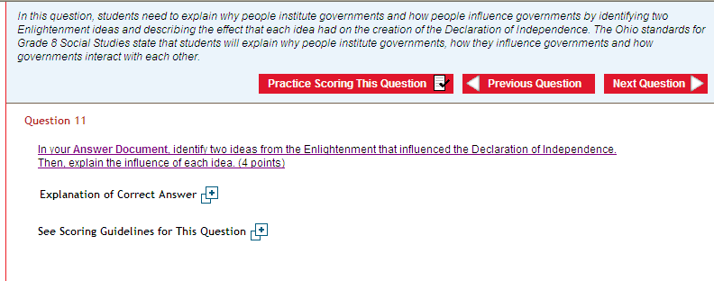
Four Types of Assessment Items
Extended Response

Slide 54
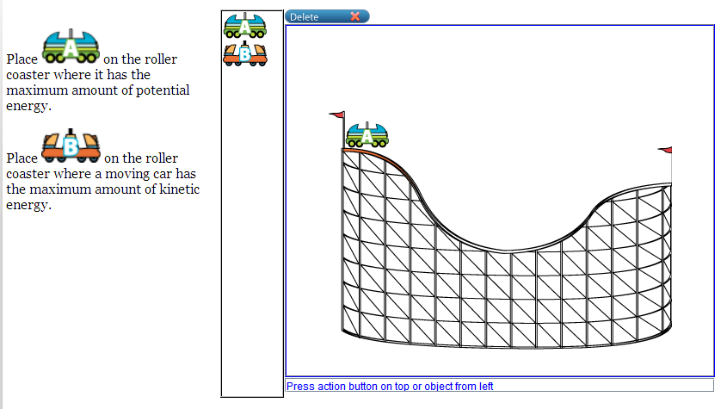
Four Types of Assessment Items
Computer Enhanced
?
When you click on ?, you see other possible prerequisite benchmarks.
Practice Activity
Your Goal: Understanding Inertia
?
Kinds of energy
You may need to understand…
Instruction
Go
Practice
Gravity: why things fall
Quiz
Go
Go
Kinds of energy
Go
Min and Max
Go
Feedback
Done
Go

Slide 55
Four Types of Assessment Items
Performance Tasks
Developed:
Performance Tasks:
    Performance outcomes
    Rubrics
    Performance tasks
    English language arts: 4
    Science: 8
    Mathematics: 7

Slide 56
Performance-Based Assessments
Task Examples
Musical performances
Speeches
Analysis and interpretation of reading
Research projects
Portfolios
Written compositions
Open-ended problems
Works of art
Apprenticeships
Internships

Slide 57
Assessments
  Field testing:
    2012-2013
  Standard setting:
    2013-2014
  New tests implemented:
    2014-2015

Slide 58
Implementation Timeline
Transition:
Teacher development
Local curriculum revision
Test development
2011 - 2014
State Board Adopts Standards
June, 2010
State Board Adopts Model Curriculum
March, 2011
Transition Complete
June, 2014
2010
2011
2012
2013
2014
Notes:
Animation: Each click reveals a milestone, left to right.

Slide 59
Preparation for New Standards
Tasks for Districts
2010-2011
Introduce new standards
2011-2012
2012-2013
Introduce performance tasks and scoring rubrics
Practice online formative assessments
2013-2014
Integrate standards and curricula into district curricula and teachers’ course planning
Integrate performance tasks in course activities
Participate in creating model curricula
Build awareness of new standards
Introduce model curricula
Conduct crosswalk activities
Initiate formative instruction PD
Continue formative instruction PD
Introduce instructional improvement system
Prepare for online testing
Complete formative instruction PD

Slide 60
Implications for ESCs
Coordinate Model Curricula Development
Professional Development
  Awareness
  Project-based instruction and transition to new system
  Performance tasks
Task Scoring and Moderation
  Use of scoring rubrics
  Social moderation
College and Employer Coordination
Credit Flex Appeals

Slide 61

Questions?

