Slide 1
Educational Technology: Research & Integration
Dr. Kurt Schulze
Walden University
Preble Shawnee Local School District
kurtschulze82@gmail.com
3/19/14

Slide 2
Goals
Provide research-based information on the benefits of utilizing educational technology
Provide integration information on student response systems

Slide 3
Think – Pair – Share
Why integrate? Why not integrate?
How do students learn best?

Slide 4
Notes:
Poll Title: What is you current knowledge level of educational technology? http://www.polleverywhere.com/multiple_choice_polls/2mdANcEHcxYkKgl

Slide 5
Notes:
Poll Title: Words that describe your feeling towards educational technology http://www.polleverywhere.com/free_text_polls/HMIXgWSaUd8qjxl

Slide 6
Notes:
Poll Title: What is your current comfort level of educational technology http://www.polleverywhere.com/multiple_choice_polls/eji9NSxzA2L0Qzv

Slide 7
Educational Technology
Three broad categories
Delivery
Learning Tool
Preparation
(Inan & Lowther, 2010)

Slide 8
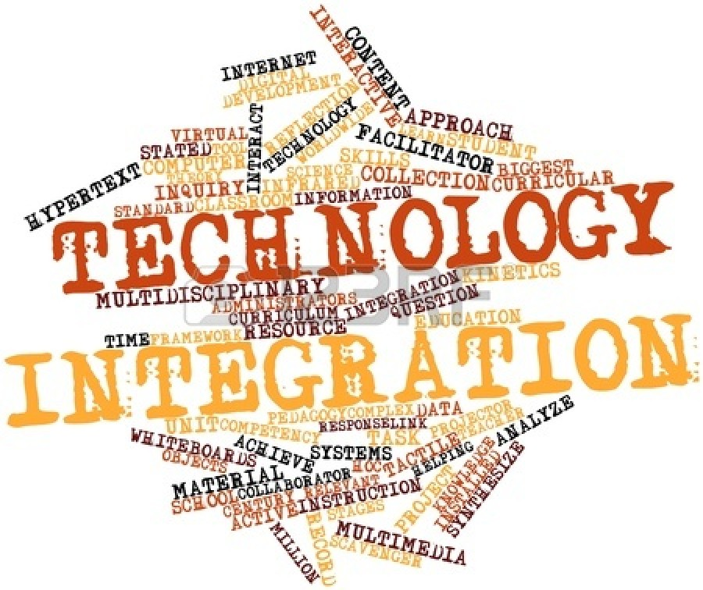
Technology Integration
Traditional & technology instructional practices should compliment each other (Walker, 2010)
Using technology does not ensure effective integration (Parker et al., 2008)
Need to know how and why

Slide 9
Technology Integration
Student achievement negligible when integrated improperly (Shapley et al., 2010)
Done correctly, technology will be “invisible”
Natural part of the classroom
Desks, pencil sharpeners, & staplers
(Schrum et al., 2011)

Slide 10
Technology Integration
Most common classroom uses
Low-level tasks
Direct instruction
(Berry, 2011; Lowther et al., 2012)
My results confirmed
Relationships between Teacher Characteristics and Educational Technology
Should be…
Student-centered
Problem-based learning
Independent inquiry
(Berry, 2011; Lowther et al., 2012)

Slide 11
Benefits
Transforms educational environment (Ball & Levy, 2008; Panigrahi, 2011)
Teachers use technology to…
Motivate
Engage
Increase comprehension & high-order thinking
Increase skills for future applications
(Ottenbreit-Leftwich et al., 2010)

Slide 12
More Benefits
Personal instruction for students (Project Tomorrow, 2012)
Increase student knowledge & ability
(Lowther et al., 2008)
Prepare students for 21st century
Teachers facilitate not transmit
(An & Reigeluth, 2011; James, 2009)

Slide 13
More Benefits
Create student-centered learning environments (Alam, 2011)
Constructivism
Cognitive Flexibility Learning Theory
Both authentic experiences (An & Reigeluth, 2011)
Allows students to perform powerful tasks
Computation
Construction
Simulations
Visual representations
(Wachira & Keengwe, 2011)

Slide 14
Additional Benefits
Technology integration takes time & may be an inconvenience
When mastered, will save time & money
(Loertscher, 2010)
Reduces teachers’ workload
Improves efficacy in job performance
Significant effect on teacher quality & instruction (Loertscher, 2010)

Slide 15
Predictors
Four major factors influence integration
Beliefs towards technology & pedagogy
Attitude
Knowledge & skills
Time & workload
(Marwan, & Sweeney, 2010)
Most important factor is teachers’ competency & ability to meet student needs (Gorder, 2008)

Slide 16
More Predictors
When teachers believe resources are valuable, they integrate quicker (Hutchison & Reinking, 2011; Ottenbreit-Leftwich et al, 2010)
Teachers not proficient or unfamiliar are resistant to change
Creates sense of inadequacy & intimidation (Loertscher, 2010)

Slide 17
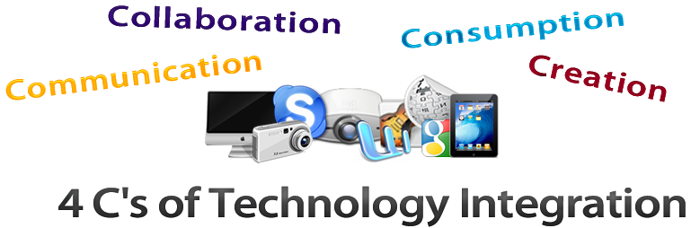
Integration
Before integrating technology, know the purpose
Notes:
http://www.newschooltechnology.org/2011/08/tpack-and-systemic-integration-the-four-cs-of-tech-integration/

Slide 18
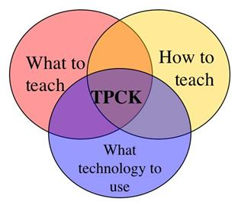
Integrating Technology

Slide 19
TPCK
Teachers must balance technology, pedagogy, & content (Lee & Spires, 2009)
Technology integration not always best practices (Ottenbreit-Leftwich et al., 2010)
Low TPCK can cause teachers to be reluctant to integrate (Pierce & Ball, 2009)
NEVER integrate technology for technology’s sake (Ottenbreit-Leftwich et al., 2010)

Slide 20
Notes:
Poll Title: What barriers have you faced when integrating educational technology? http://www.polleverywhere.com/free_text_polls/QKtNKcP7m6ZYJRu

Slide 21
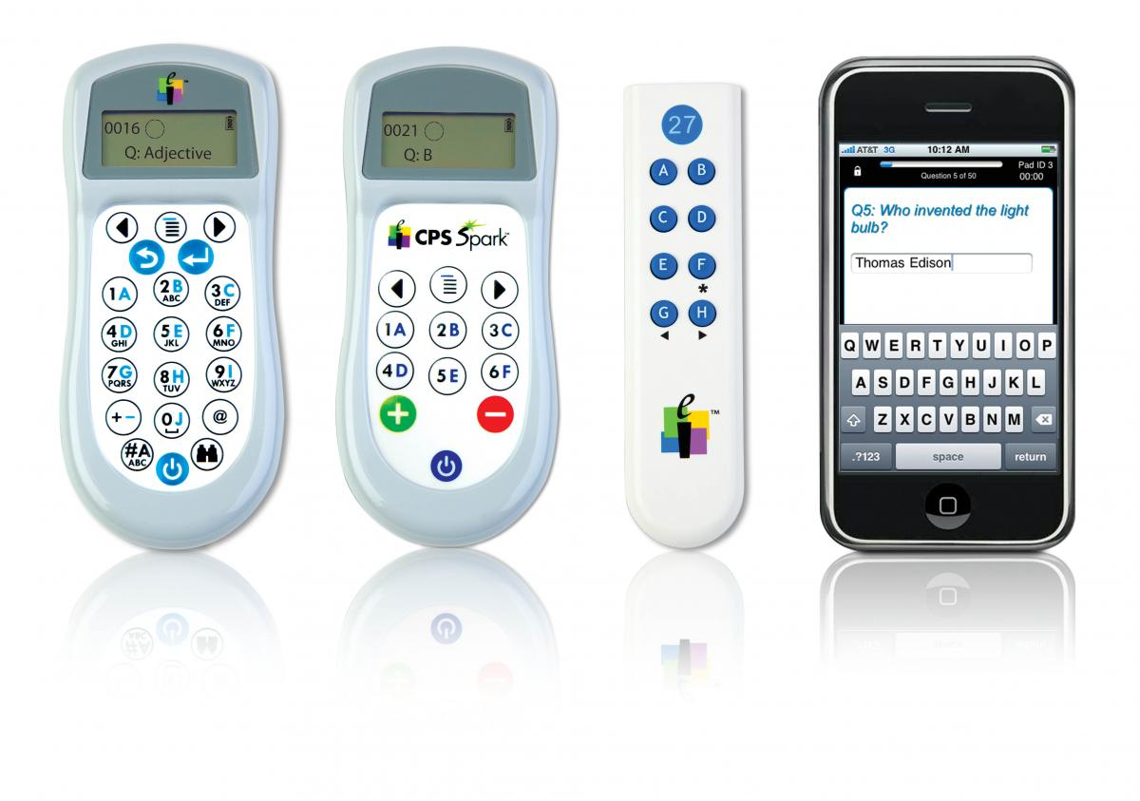
Student Response Systems (Clickers)

Slide 22
Notes:
Poll Title: Describe your current comfort level/use of clickers http://www.polleverywhere.com/free_text_polls/zDyzrloQIy016HA

Slide 23
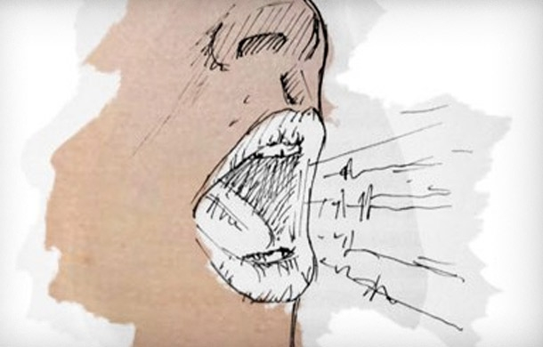
Benefits
Instant results & feedback
Provides everyone a “voice”
Eliminates: “Because everyone else raised their hand”
Data driven decision making
Increase interaction & class participation

Slide 24
Additional Benefits
Teacher or student paced
Reduced paperwork & grading
Detailed reports
Multiple choice, numbers, & short answer response (most systems)

Slide 25
Think – Pair – Share
Do you currently use clickers? In what ways?
If you had them, how would they be used?

Slide 26
Still Not Convinced?
Survey Question | Used Clicker (n=45) Mean | Used Class Discussion (n=47) Mean
Participation with clickers (or class discussion) improved my grade in the course. | 3.60 | 3.20
Participation with clickers (or class discussion) improved my understanding of the subject content. | 4.03 | 3.61
Participation with clickers (or class discussion) increased my feeling of belonging in this course. | 3.78 | 3.48
Participation with clickers (or class discussion) increased my interaction with the instructor. | 4.15 | 3.62
Participation with clickers (or class discussion) increased my interaction with other students. | 3.45 | 3.17
I enjoyed participation with clickers (or class discussion). | 4.14 | 3.93
I would recommend using clicker (or class discussion) again in this course. | 4.12 | 4.05
*Strongly Disagree = 1; Disagree = 2; Unsure = 3; Agree = 4; Strongly Agree = 5; Martyn (2007)
Notes:
http://www.educause.edu/ero/article/clickers-classroom-active-learning-approach

Slide 27
Clicker Reports
Notes:
Provide hands-on training on clickers

Slide 28
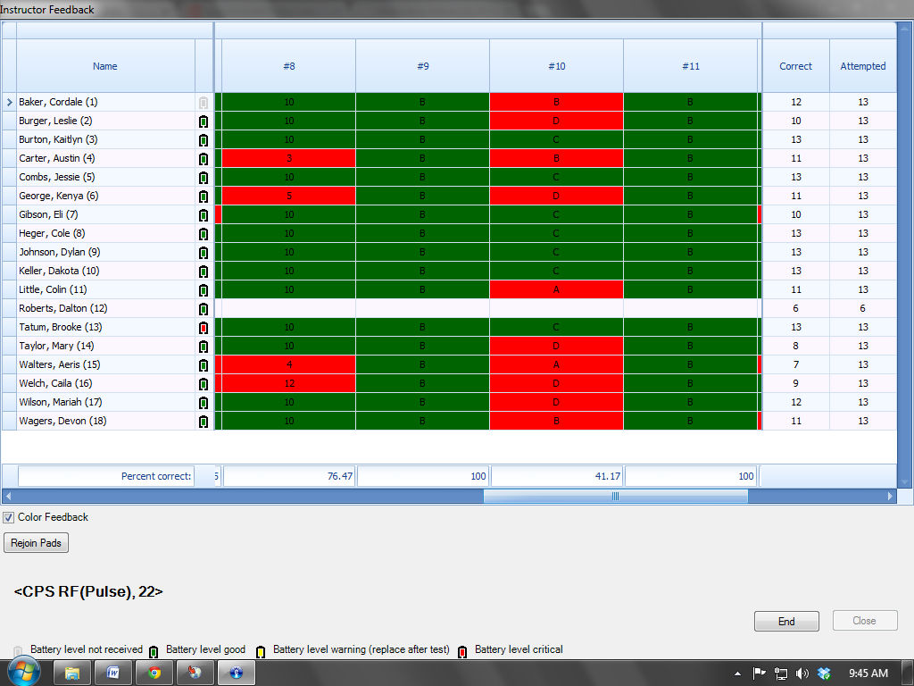

Slide 31
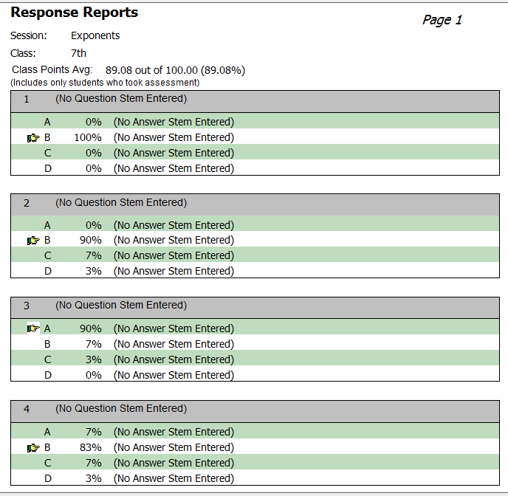

Slide 33
Poll Everywhere
Pre-load questions
On the fly
Embedded into presentations
Use own device
Phone, tablet, or computer
Free & purchase options
Excellent for 1 to 1 classrooms or BYOD

Slide 34
Socrative
Teachers create questions
On the fly
Pre-loaded
Game mode
Import quizzes
Create reports
Mobile App
Excellent for 1 to 1 classrooms or BYOD

Slide 37
Why Technology???
http://www.youtube.com/watch?v=HbVKPhVCRFI

Slide 38
My Research
Relationships between Teacher Characteristics and Educational Technology
Investigated
Characteristics & Perception
Characteristics & Integration
Characteristics: Age, gender, teaching experience, subject, grade level, and educational attainment
Overall positive perceptions
Technology resources available, but low integration
Please contact for detailed findings

Slide 39
Questions

Slide 40
References
Alam, M. (2011). Technology supported teaching and learning. Technolearn: An International Journal of Educational Technology, 1(1), 95-104. Retrieved from http://www.ndpublisher.in/ndpjournal.php?j=TL
An, Y., & Reigeluth, C. (2011). Creating technology-enhanced, learner-centered classrooms: K-12 teachers' beliefs, perceptions, barriers, and support needs. Journal of Digital Learning in Teacher Education, 28(2), 54-62.
Ball, D. M., & Levy, Y. (2008). Emerging educational technology: Assessing the factors that influence instructors' acceptance in information systems and other classrooms. Journal of Information Systems Education, 19(4), 431-444.
Berry, R. L. (2011). Teachers’ perception of computer use and technical support in a rural Virginia school division: A case study (Doctoral dissertation). Available from ProQuest Dissertations and Theses database. (UMI No. 3490693).
Gorder, L. (2008). A study of teacher perceptions of instructional technology integration in the classroom. Delta Pi Epsilon Journal, 50(2), 63-76.
Hutchison, A., & Reinking, D. (2011). Teachers' perceptions of integrating information and communication technologies into literacy instruction: A National survey in the United States. Reading Research Quarterly, 46(4), 312-333. doi:10.1002/RRQ.002
Inan, F. A., & Lowther, D. L. (2010). Factors affecting technology integration in K-12 classrooms: A path model. Educational Technology Research and Development, 58(2).
James, M. L. (2009). Middle school teachers’ understanding of technology integration (Doctoral dissertation). Available from ProQuest Dissertations and Theses database. (UMI No. 3387974).
Lee, J. & Spires, H. (2009). What students think about technology and academic engagement in school: Implications for middle grades teaching and learning. AACE Journal, 17(2), 61-81. Retrieved from http://edtech.phoenix.wikispaces.net/file/view/article_27007.pdf.
Loertscher, D. (2010). Technology and tough economic times. Teacher Librarian, 38(1), 42-43.
Lowther, D. L., Inan, F. A., Daniel Strahl, J. J., & Ross, S. M. (2008). Does technology integration “work” when key barriers are removed?. Educational Media International, 45(3), 195-213. doi:10.1080/09523980802284317
Lowther, D., Inan, F., Ross, S., & Strahl, J. (2012). Do one-to-one initiatives bridge the way to 21st century knowledge and skills?. Journal of Educational Computing Research, 46(1), 1-30.

Slide 41
Martyn, M. (2007). Clickers in the classroom: An active learning approach. Educause Review. retrieved from http://www.educause.edu/ero/article/clickers-classroom-active-learning-approach
Marwan, A., & Sweeney, T. (2010). Teachers' perceptions of educational technology integration in an Indonesian Polytechnic. Asia Pacific Journal of Education, 30(4), 463-476.
Ottenbreit-Leftwich, A. T., Glazewski, K. D., Newby, T. J., & Ertmer, P. A. (2010). Teacher value beliefs associated with using technology: Addressing professional and student needs. Computers & Education, 55(3), 1321-1335.
Panigrahi, M. (2011). Perception of teachers’ towards extensive utilization of information and communication technology. Turkish Online Journal of Distance Education (TOJDE), 12(4), 45-57.
Pierce, R., & Ball, L. (2009). Perceptions that may affect teachers' intention to use technology in secondary mathematics classes. Educational Studies in Mathematics, 71(3), 299-317.
Project Tomorrow. (2012). Personalizing the classroom experience – Teachers, librarians and administrators connect the dots with digital learning. Retrieved from http://www.tomorrow.org/speakup/pdfs/SU11_PersonalizedLearning_Educators.pdf
Schrum, L., Galizio, L. M., & Ledesma, P. (2011). Educational leadership and technology integration: An investigation into preparation, experiences, and roles. Journal of School Leadership, 21(2), 241-261.
Shapley, K., Sheehan, D., Maloney, C., & Caranikas-Walker, F. (2010). Effects of technology immersion on teachers' growth in technology competency, ideology, and practices. Journal of Educational Computing Research, 42(1), 1-33.
Wachira, P., & Keengwe, J. (2011). Technology integration barriers: Urban school mathematics teachers perspectives. Journal of Science Education and Technology, 20(1), 17-25.
Walker, L. R. (2010). A phenomenological investigation of elementary school teachers who successfully integrated instructional technology into the curriculum (Doctoral dissertation). Available from ProQuest Dissertations and Theses database. (UMI No. 3427041).

