Slide 1

Building e-Internships in Teacher Preparation: Ohio University and ECOT Partnering in a New Direction for Teaching and Learning
OCTEO, March 20, 2014

Slide 2
Presenters
Dr. Laura Hibbard
Dr. John Henning
Stephanie Goodrich
Tian (Tintin) Luo
Alexander Murray
Additional Support: Dr. Teresa Franklin
Notes:
Laura introduces panel:
Dr. John Henning – Professor and Associate Dean, Patton College of Education, Ohio University
Stephanie Goodrich – Manager, Mentorship Programs, Ohio University
Tian Luo, Alexander Murry – Teaching Assistants, Doctoral Candidates, Instructional Technology, Ohio University
Dr. Teresa Franklin – Professor, Instructional Technology, Patten College of Education, Ohio University

Slide 3
Beginning Steps
Ohio University proposes partnership; May 2013
Ohio University tours ECOT headquarters
Goals of each school shared
Notes:
John shares Ohio University’s goals:
Stephanie shares ECOT’s goals:

Slide 4
Ohio University’s Fall Semester; 2013
Approximately 100 OU undergraduates enrolled in EDCT 2030; Technological Applications in Education
Blended class
Focus of class: Online teaching pedagogy plus technological tools in education
Today’s Focus: Online teaching pedagogy
Notes:
Alex presents this slide
Describe class structure, goals, blended class schedule, focus

Slide 5
Ohio University’s Fall Semester; 2013:
Activities to introduce online learning at K-12 level
Demographic Survey
Pre-perception papers
Introductory ECOT video; then choice of three videos to observe – RTOP (Reformed Teaching Observation Protocol)
Guest speakers
Second round of videos – RTOP
Post-perception papers
Student interviews
Notes:
Laura’s slide
Survey: Program year, major, prior online learning experience, interest in teaching in a virtual environment
RTOP: Survey in public domain to rate lesson design, content, classroom culture
Guest Speakers: Face-to-face class, shared recording on live session, discussed a typical day, Q and A

Slide 6
Results – Demographic Surveys
Notes:
Alex presents. 70 survey participants. All EDCT 2030 students invited to participate.

Slide 7
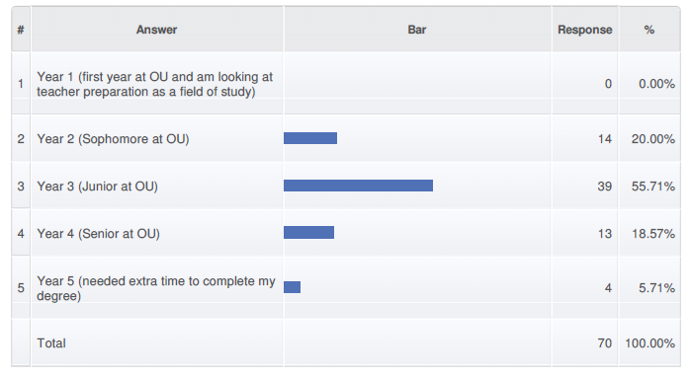
Year in Teacher Preparation Program
Notes:
55% juniors, 20% sophomores, 19% seniors

Slide 8
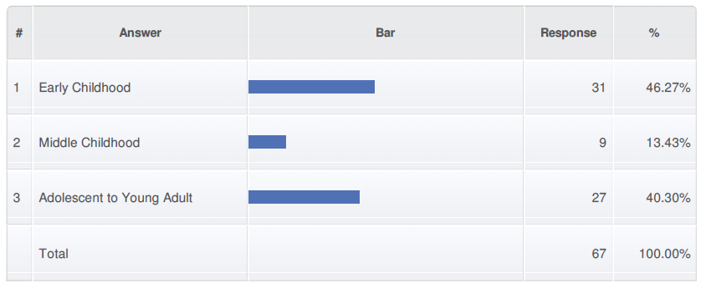
Major Area of Study
Notes:
46% Early Childhood, 40% AYA, 13% Middle Childhood

Slide 9
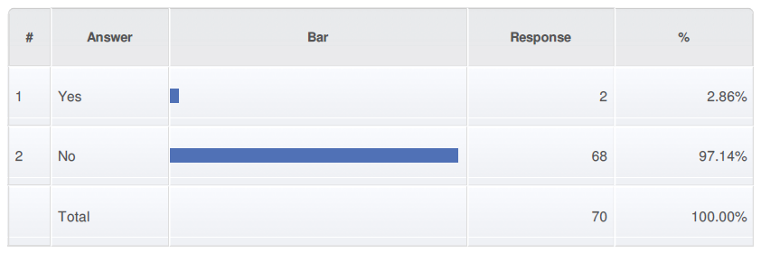
Question: Did you take a course completely online during your K-12 experience?
Notes:
97% No

Slide 10
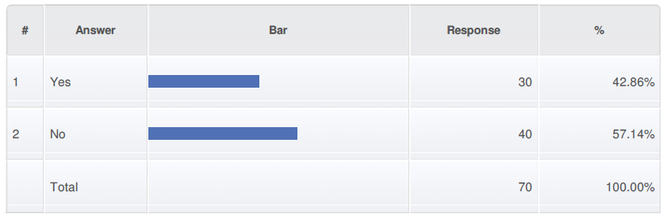
Question: Have you taken a course fully online during your university experience?
Notes:
57% No

Slide 11
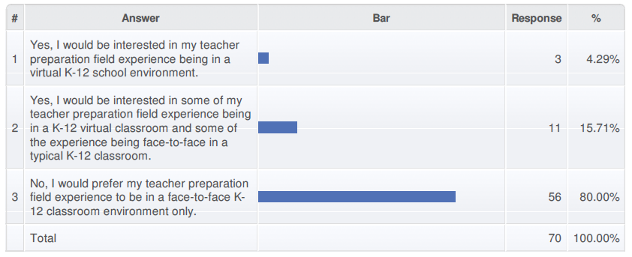
Question: Do you think you would be interested in teaching in a virtual K-12 school as part of your teacher preparation field experience?
Notes:
80% No – Prefer teacher prep classes to be only in face-to-face classrooms
16% Interested in a mix

Slide 12
Results: Pre and Post-Perception Papers
Notes:
Tintin presents the data from the .pre and post-perception papers

Slide 13
Data Analysis
A preliminary read-through of student reflection paper data and finalization of coding scheme
TAs randomly selected student reflection papers and coded them using the pre-established codes
Two researchers conducted an initial screening of all individually-coded data and complied them
Descriptive analyses
Paired t-tests

Slide 14
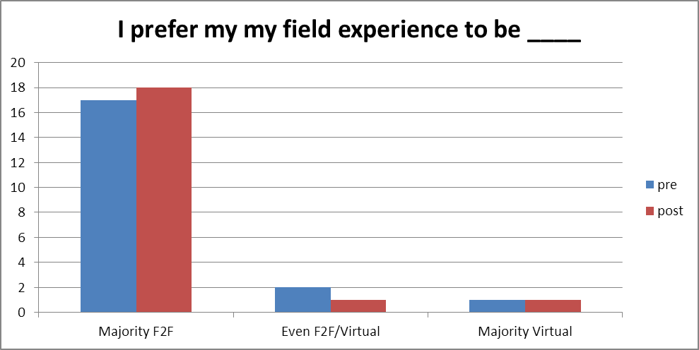

Slide 15
What do you believe are the benefits of online K-12 learning?
Pre-Perception
Technology literate (6)
Attend class at any time, any place (6)
Students work at own pace (6)
Personalized content (2)
Increased focus (2)
Immediate feedback (1)
Exciting, interesting (1)
Ability to pursue other activities (1)
Post-Perception
Students work at own pace (10)
Technology literate (4)
Interact in bully-free environment (2)
Personalized content (2)
Immediate feedback (1)
1-on-1 help (1)
Teachers in co-teaching environment (1)
Students can review prior sessions (1)
Teaches independence (1)
Exciting, interesting (1)
Fosters problem-based learning (1)
Notes:
Note: Some students listed more than one benefit

Slide 16
What do you believe are the challenges of online K-12 learning?
Post-Perception
Lack of socialization (13)
Students need self-discipline/engagement issues (5)
Problems with technology (3)
Lack of hands-on lessons (2)
Lack of collaborative learning (2)
No separation between home and school (1)
Concern about integrity of work/cheating (1)
Pre-Perception
Lack of socialization (11)
Lack of student/teacher relationships (6)
Students need self-discipline (5)
Lack of collaborative learning (3)
Lack of creativity in lessons (2)
Students face distractions (1)
Too new, error-prone (1)
Less rigorous (1)
Notes:
Note: Some students listed more than one challenge

Slide 17
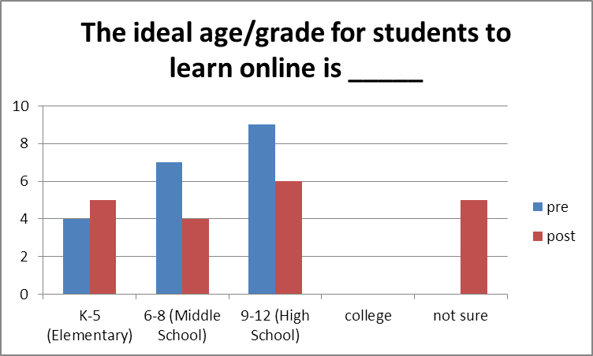

Slide 18
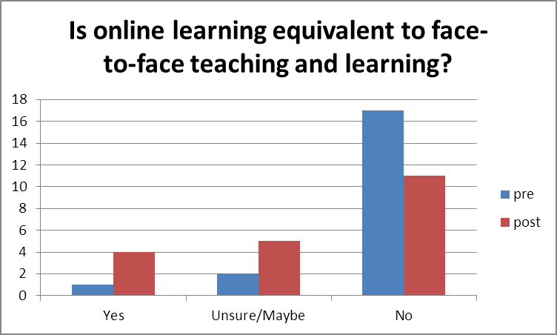

Slide 19
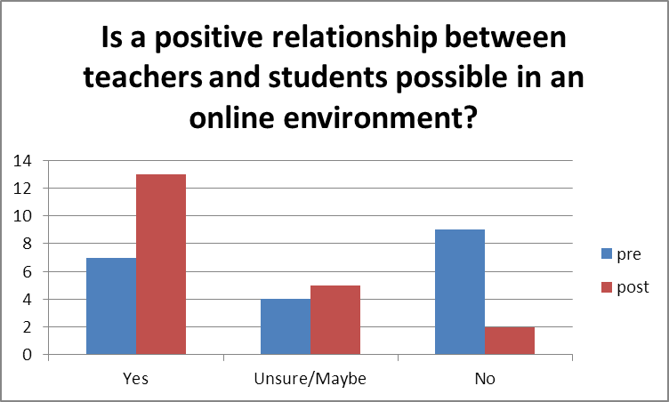

Slide 20
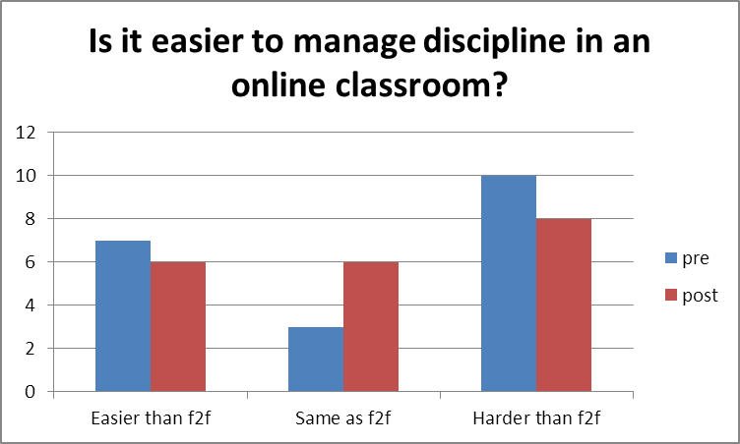

Slide 21
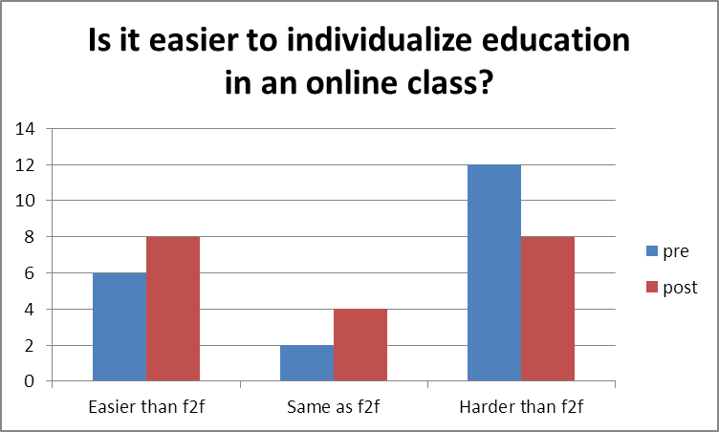

Slide 22
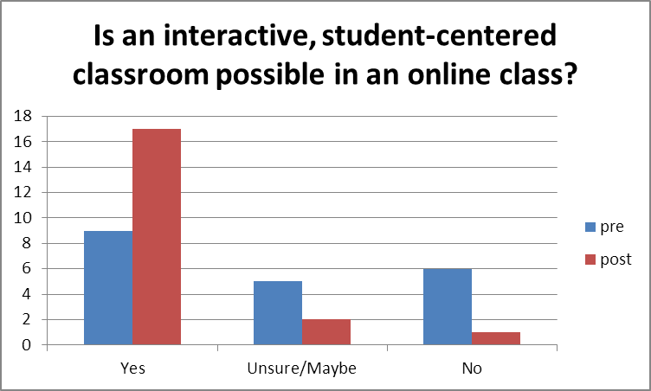

Slide 23
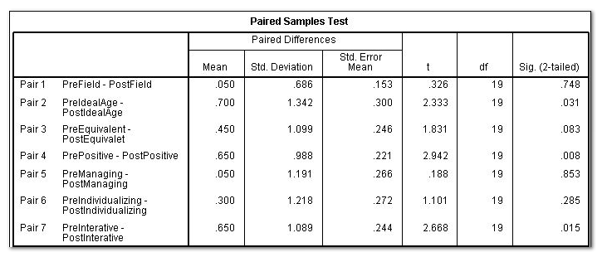
Pair T-test for all Coded Items

Slide 24
Results: Student Interviews

Slide 25
Observation Form
Presentations: “It’s hard for us to wrap our brains around it.”
Clarification of terms
More teacher stories
More grade levels
Virtual field experience presentations
Let us interact and discuss
Simulations
Visit live, real-time sessions
Notes:
Laura goes through this.
-Video observation form was confusing
-Guest speakers were essential and clarified videos, but it was hard to ask questions because online learning was still very foreign:
-Term need clarified: online learning, blended learning, synchronous & asynchronous learning
-Requested more stories from online teachers –personalize online teaching
-Expansion of grade levels for presentations and video observations
-Inclusion of OU students who have worked in a virtual room in presentations
-Allow OU students time to interact and discuss online teaching phenomenon
-Incorporate online teaching simulations
-Opportunity for OU students to observe live, virtual teaching sessions

Slide 26
Discussion & Implications: Changes implemented in Spring Semester, 2014

Slide 27
Formal introduction to terms
New observation sheet
Student interaction, discussion
More videos at beginning of term
Class discussion – Why are we studying this?
Simulations (Pending)
ECOT Teacher Presentations
Notes:
Laura will go through this. Tintin will discuss the Twitter feed.
-Added: Early discussion regarding online vocabulary and concepts; class discussion on prior experience, knowledge, etc.
-Amended observation sheet: Added questions for group discussion
-After first video, students meet in groups to discuss observations
-Second set of videos mid-term
-Class discussion:
Whether you teach in a full-time online school or in a traditional school, why is it important for you to learn how to engage learners from a distance?
Where/when might these skills be needed in your future careers?
What might a classroom look like in 2020? 2030?
-Online simulations – ECOT teachers present lesson to OU students as if they were actual online students
-ECOT Teacher Presentations: Moved to last face-to-face class
Twitter feed for questions
Include OU students who have completed virtual field experiences

Slide 28
Next Steps: Virtual Field Experiences
Expansion: OU students participate in a pilot virtual field experiences program
Notes:
Stephanie and John discuss this.

