Slide 1

Ohio Department of Education
OCTEO Conference
March 8, 2013
www.education.ohio.gov

Slide 2
Educator Licensure Testing Requirements
Educator Licensure Testing (Praxis II and ACTFL/LTI) requirements are available on the ODE website
The Educator Licensure Testing Chart will be updated in July
www.education.ohio.gov
search: Educator Licensure Examinations

Slide 3

http://www.oh.nesinc.com
April, 2-12, 2013: Validation of assessments in Columbus
OAE Tests are to be proposed to ESB and SBOE in late Spring 2013 and available starting September 3, 2013
ACTFL/LTI OPI and WPT will continue

Slide 4
Faculty Resources http://www.oh.nesinc.com/faculty.asp
OAE include tools, strategies, and support materials to help faculty prepare their candidates for testing.
The assessment frameworks provide the structure of the assessment, the major domains of knowledge and skills, and the assessment competencies that describe the content covered by the assessments.
Alignment studies provide information about the alignment between the knowledge and skills addressed by the OAE and the national and/or Ohio educational standards relevant to that field.

Slide 5
Data Reporting for IHEs
Institutions will be able to view and analyze the performance of their candidates—individually or in aggregate—by using ResultsAnalyzer™, a data analysis tool provided for the program.
The ResultsAnalyzer™ tool will allow users to access candidate, assessment data, giving them the capability to: Export data to Microsoft® Excel or other report software; and print graphics and Analyze candidate and institution data for numerous variables (including self-reported data such as gender and ethnicity)

Slide 6
OAE Validation Studies:
OAE Validation Studies need additional
P-12 and IHE faculty nominations:
  Nominations Weblink: http://www.cvent.com/d/jcqc82
  Password: OH!2013

Slide 7
Educator Licensure Testing
Disclaimer: Educator Licensure tests and qualifying scores listed in the ODE charts and on the ODE website are subject to change
by the Ohio State Board of Education.

Slide 8


CORE/ My Educator Profile
On-line Licensure Application
Pay by Credit Card
IHEs to Enroll Electronic Signatures
(614) 466-3593

Slide 9
Resident Educator Program
Year 2 (2012-2013)
Resident Educator Summative Assessment (RESA)
Resident Educator Program and RESA Presentation for IHE faculty late Spring 2013 (TBA)

Slide 10

Teacher Evaluation (OTES)
Principal Evaluation (OPES)
Student Growth Measure (SGM)
Student Learning Objectives (SLO)
Student Growth Measures is 50% of the teacher’s evaluation rating.

Slide 11
Teacher Evaluation System in Ohio
(OTES)

Slide 12
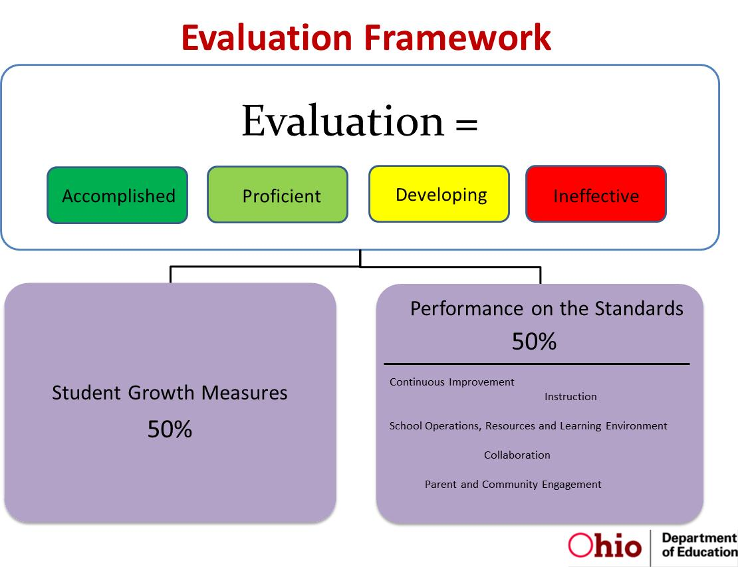
Principal Evaluation System in Ohio
(OPES)

Slide 13

Electronic-Teacher and Principal Evaluation System (eTPES)
Web-based electronic reporting of Teacher and Principal Evaluation Results:
Accomplished
Developing
Proficient
Ineffective

Slide 14

Future Educators Association of Ohio
(FEA Ohio)
Annual FEA Ohio State Conference
This year’s host institution: University of Findlay
Host institution needed for 2014

Slide 15
Third Grade Reading Guarantee
ORC 3313.608
(H)(1) Prior to July 1, 2014, each student described in … shall be assigned a teacher who has been actively engaged in the reading instruction of students for the previous three years and who satisfies one or more of the following criteria:
(a) The teacher holds a reading endorsement ...
(b) The teacher has completed a master’s degree program with a major in reading.
(c) The teacher has … a credential earned from a list of scientifically research-based reading instruction programs ....
(d) The teacher was rated “above value added,” …

Slide 16
Third Grade Reading Guarantee
ORC 3313.608
(H)(2) Effective July 1, 2014, each student described in … shall be assigned a teacher who has been actively engaged in the reading instruction of students for the previous three years and who satisfies one or more of the following criteria:
(a) The teacher holds a reading endorsement ...
(b) The teacher has completed a master’s degree program with a major in reading.
(c) The teacher was rated “above value added,” …
d) The teacher has … a passing score on a rigorous test of principles of scientifically research-based reading instruction ....

Slide 17
Teacher Shortage Index (TSI)
Federal program benefits include student loan deferment, forgiveness, cancellation.
If teaching in a Shortage Area:
Art, English/Language Arts,
Foreign Languages, Mathematics, Science, Social Studies, Special Education, TESOL, Speech Pathology

Slide 18
Title II Report
Westat Title II Report Card Training
April, 16 and April, 18
Deadline for certifying your IHE’s IPRC report is April 30
The Title II website address is:
https://title2.ed.gov/Title2IPRC/default.aspx

Slide 19

Website Address: http://toolsforteachersohio.wordpress.com/
Tools for Teachers is an updated monthly webpage for teachers that provides timely announcements and information on licensure, scholarships, professional development and study opportunities, award and recognition programs, and links to classroom resources and tools.

Slide 20
Contact Information
John W. Soloninka
ODE Center for the Teaching Profession
Office: (614) 387-0161
Email: John.Soloninka@education.ohio.gov
Toll Free: (877) 644-6338

