Slide 1
OcTEO Introduction to Value-Added Analysis
October 25, 2012

Slide 2
Presenter
Dr. Mike Thomas
Senior Director of Innovation
mthomas@BattelleforKids.org

Slide 3
Understanding Value-Added Information
Learning Targets:
The Ohio context
Understand where and how to access value-added tools and resources
Higher Education training opportunity
Understand value-added and diagnostic reports

Slide 4
Common Core Standards
Ohio Teacher Evaluation System
Ohio Principal Evaluation System
Doing Lesson Plans
Student Growth Measures
Teacher Evaluation
PARCC Assessments
Race to the Top
Keeping Students Busy
Ohio Educator Preparation Metrics
Teacher Effectiveness
Formative Instructional Practices
Value-Added Analysis
College & Career Readiness
Performance-Based Compensation
Student Learning Objectives
Grading Homework
Performance Assessments
21st Century Skills
Teacher-Based-Teams
New Accountability System
Evidence of Student Learning
Defending Student Grades
Ohio Improvement Process

Slide 5
The Ohio Context

Slide 6
Ohio Accountability System
District and School Accountability System is being reformulated
Ohio’s ESEA waiver is approved
Teacher Accountability—OTES
Principal Accountability—OPES

Slide 7
ESEA Waiver Approved (Highlights)
Implementation of rigorous standards, assessments and evaluations
Replacement of AYP
Cutting achievement gaps in half in 6 years
Change rating system to A-F system
Freeing schools from some federal reporting requirements

Slide 8
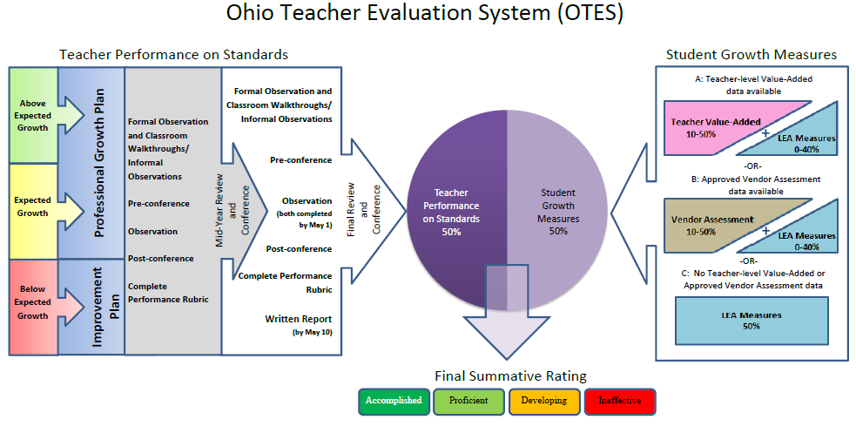
www.ode.state.oh.us > “Teaching” tab > Ohio Educator Standards > Educator Evaluation Systems in Ohio
Notes:
Reference handout – full page print out of graphic

Slide 9
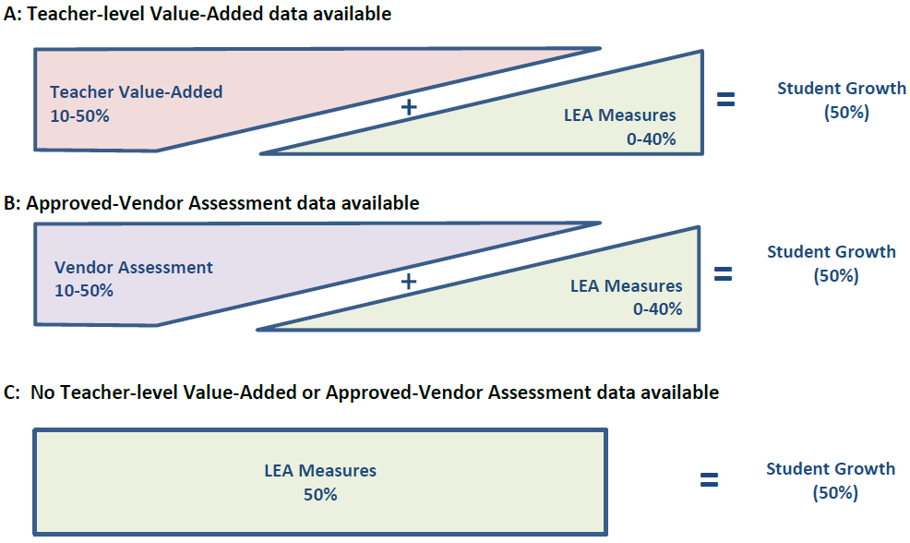
Student Growth Measures

Slide 10
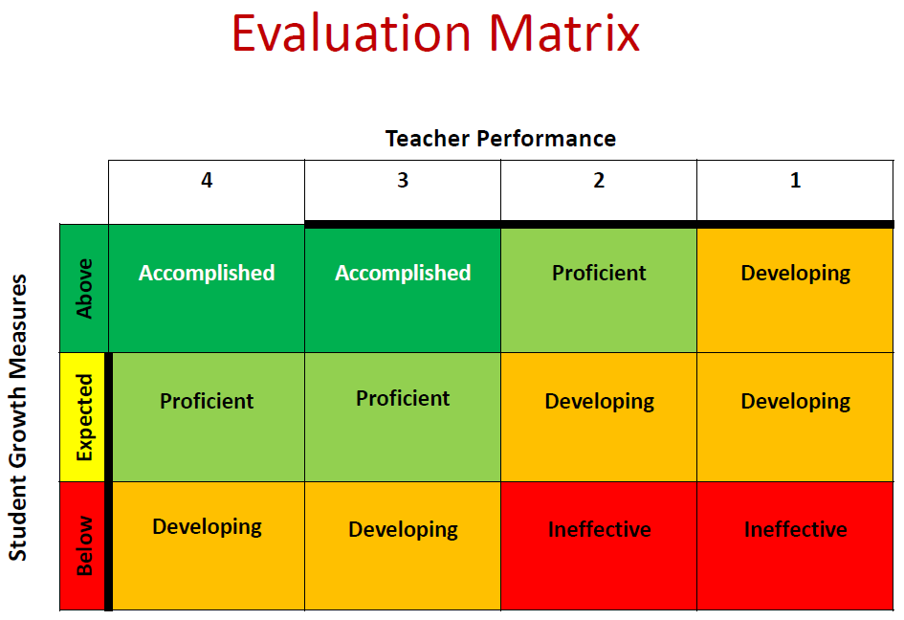
OTES Look-Up Table, End Result Must be One of Three SGM Categories
EVAAS® Teacher Value-Added Report Categories
Most Effective
Above Average
Average
Approaching Average
Least Effective

Slide 11
Ohio Principal Evaluation System

Slide 12
Value-Added Impacts All Stakeholders
Higher Ed
Improve quality of teacher preparation program
Value-added is a required component of the educator licensure program
Teachers
Improve quality of instruction
Value-added information can improve areas of strength and areas of challenge
Students
Improve student achievement
Value-added information can help identify student needs
Value-Added Metric Impacts Oho Teacher Evaluation
Value-Added Metric Impacts Authorization to Offer Teacher Prep Program

Slide 13
Key Statewide Deliverables of RttT
Teacher Value-Added Reporting
30% of LEAs link in Year 1 RttT (reports received fall 2011)
primarily LEAs in Battelle for Kids’ expanded value-added reports projects along with some SIG schools
60% of all LEAs link in Year 2 (represents RttT LEAs)
100% of all LEAs in Ohio link in Years 3 & 4
Requires teacher linkage each spring to verify teacher assignments and teachers’ instructional time with students
Professional development and resources will address the use of value-added for school improvement and implications of teacher-level reporting

Slide 14
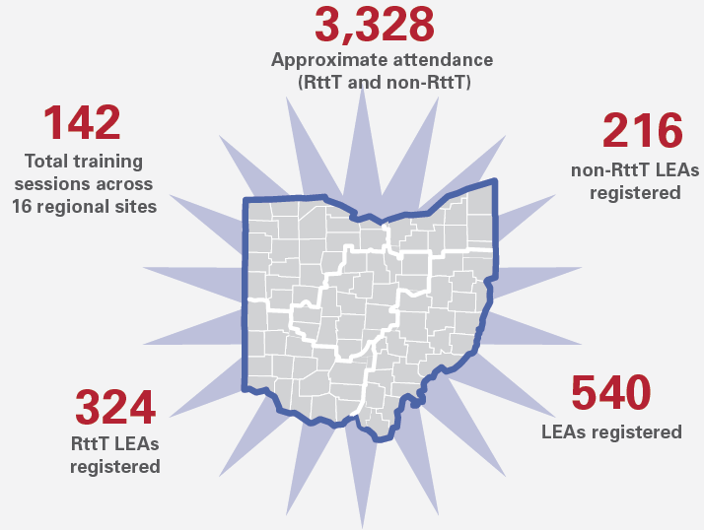
Ohio Regional Fall Workshops 2011 and 2012

Slide 15
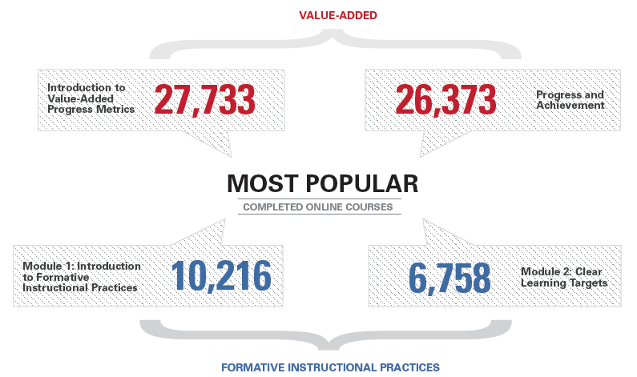
Online Courses Completed

Slide 16
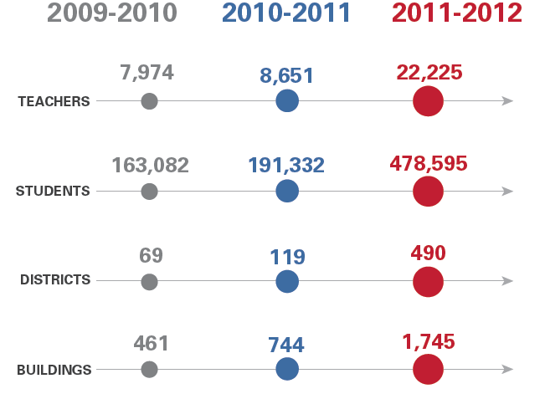
Link/Roster Verification

Slide 17
Resources to Support Value-Added in Ohio

Slide 18
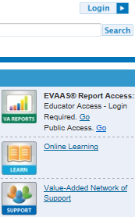
Ohio’s Value-Added Network of Support: VALs & DVALs
Value-Added Leaders (VALs): 90 VALs who support district/community school value-added teams
District Value-Added Leaders (DVALs): On average, 3-5 person team from districts/community schools who provide support to principals and teachers in the use of value-added information
Go to the Ohio Student Progress Portal, www.BattelleforKids.org/Ohio
Choose “Value-Added Network of Support” from Quicklinks
Utilize “Find your VAL/DVAL” feature to contact your local support system.

Slide 19
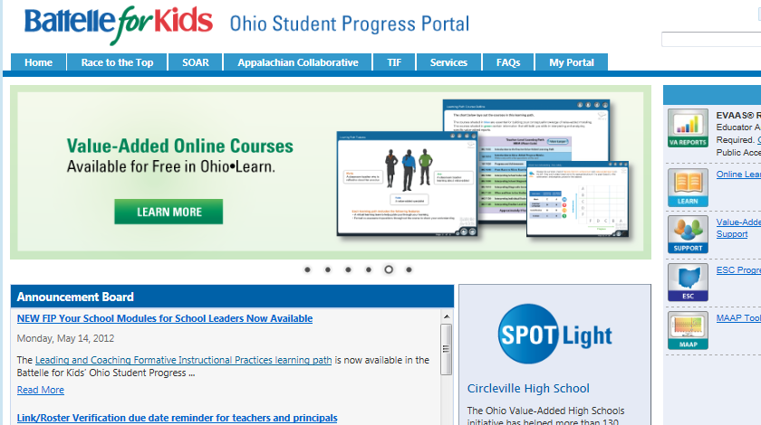
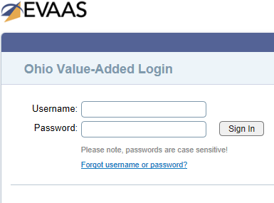
Helpful Tools For Your Use
EVAAS® Interactive Site – Diagnostic Tool
BFK Ohio Student Progress Portal, www.BattelleforKids.org/Ohio
Online Courses via Ohio•Learn: value-added and FIP
Focus Guides, A system of continuous improvement
Understanding & Using Value-Added Analysis Toolkit
VA Book: How to Use Value-Added to Improve Student Learning

Slide 20
Resources Available to You
December 13 Value-Added Training
A.M. Session (8:30 – Noon) — OCLC Lakeview Room
Value-Added in the Ohio Context
Using Value-Added for School Improvement
Working Lunch
Getting access to resources
Value-Added Toolkit
How to Use Value-Added Analysis to Improve Student Learning: A Field Guide for School and District Leaders (Corwin)
Access to online courses
Focus Guides
Syllabus ideas
P.M Session (12:45-3:30)
John White from SAS EVAAS
Value-Added Modeling for Ohio
Registration
www.BattelleforKids.org/Ohio
Click on Education in Ohio

Slide 21
Understanding Key Value-Added Reports

Slide 22
Why Value-Added is Necessary
We must expect progress for ALL students
Jacob-like
Proficiency
Standard
Adam-like
Grade
Notes:
Value-added provides a picture of student growth regardless of students’ achievement levels.
Value-added can help us understand whether high-achieving students are making enough progress to sustain or even improve their achievement levels.
Value-added can help us understand whether low-achieving students are making enough progress to close the proficiency gap.
Talk about this slide from a perspective of a school with Jacob-like students or Adam-like students since value-added is a group effect versus individual student results.
In this slide, Student A is currently above the proficiency bar, but is losing ground relative to proficiency.
In this slide, Student B is not yet proficient, but is closing the gap on the proficiency bar.

Slide 23
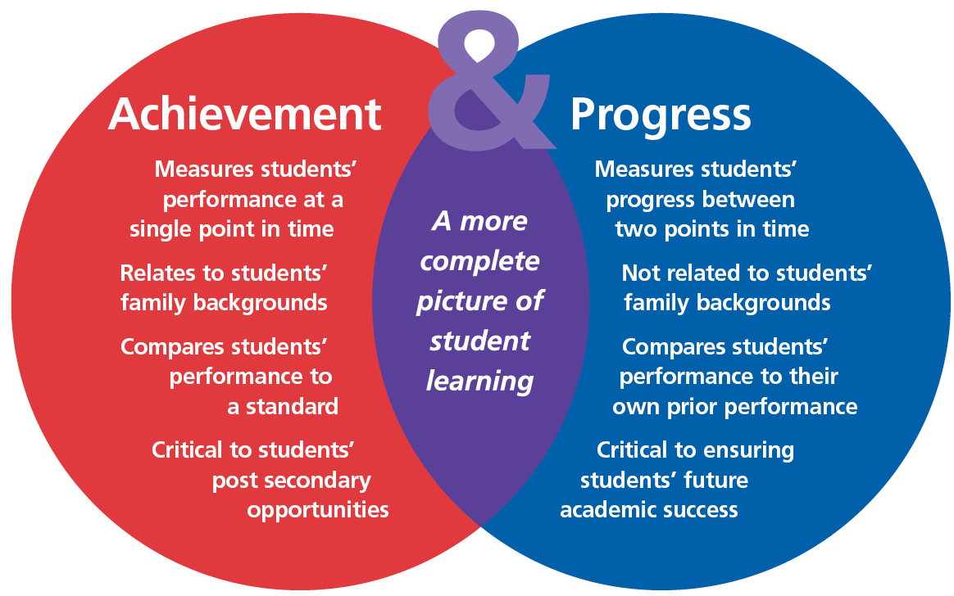
Achievement and Progress
Notes:
This is the Power of Two, Achievement & Progress information combined

Slide 24
School Performance and Poverty Level – Math
Battelle for Kids is utilizing visual representations of copyrighted EVAAS® Web reporting software from SAS Institute Inc. in this document for instructional purposes.
Notes:
Entering Achievement is defined as the average predicted score (NCE for OAA Acct or scale score for all other tests) for students within the group chosen. This represents the entering achievement level of that group of students and assumes the average schooling experience in Ohio (OAA Acct, OAA Science, and OGT) or in the SOAR districts (all other tests).
The Growth Index is the ratio of the value-added measure to its standard error. It represents the amount of growth students are making compared to the State Growth Standard (OAA Acct), State Average (OAA Science and OGT), SOAR Schools Average (all other tests). The Growth Index is set at zero for all tests. A Growth Index significantly above zero indicates progress greater than the Growth Measure. Small positives and small negatives indicate progress similar to the Growth Measure.
% Free/Reduced Price Lunch - The percent of students tested within the group chosen in each school that were flagged as Free/Reduced Price Lunch.
% Tested Proficient - The percent of students tested within the group chosen in each school that were flagged as Proficient, Accelerated, or Advanced.

Slide 25
School V-A Gains and Poverty Level – Math
Battelle for Kids is utilizing visual representations of copyrighted EVAAS® Web reporting software from SAS Institute Inc. in this document for instructional purposes.
Notes:
Entering Achievement is defined as the average predicted score (NCE for OAA Acct or scale score for all other tests) for students within the group chosen. This represents the entering achievement level of that group of students and assumes the average schooling experience in Ohio (OAA Acct, OAA Science, and OGT) or in the SOAR districts (all other tests).
The Growth Index is the ratio of the value-added measure to its standard error. It represents the amount of growth students are making compared to the State Growth Standard (OAA Acct), State Average (OAA Science and OGT), SOAR Schools Average (all other tests). The Growth Index is set at zero for all tests. A Growth Index significantly above zero indicates progress greater than the Growth Measure. Small positives and small negatives indicate progress similar to the Growth Measure.
% Free/Reduced Price Lunch - The percent of students tested within the group chosen in each school that were flagged as Free/Reduced Price Lunch.
% Tested Proficient - The percent of students tested within the group chosen in each school that were flagged as Proficient, Accelerated, or Advanced.

Slide 26
The Power of Two: Achievement & Progress
How do value-added measures support what we know about schools?
High Progress
Low Achievement
High Progress
High Achievement
School A
School J
School H
School E
Progress
One Year’s Growth
Standard
School C
School K
School G
School F
School B
School D
Low Progress
Low Achievement
Low Progress
High Achievement
Achievement
Test Results
Notes:
This chart shows data from a variety of schools, and portrays a more complete picture of schools’ effectiveness.
Schools D, G and K are low-achieving and low-progressing. These schools are not likely to change their results without a change in curriculum, school processes, personnel or instruction.
Schools F and B are currently above the “Standard”, but students, in general, are not making a year’s growth in a year’s time.
Schools A and H have not yet reached the “Standard” passage rate, but because they are high-progressing, they are making up ground on the proficiency bar. Chances are good that the students in these schools will soon become proficient and meet the standard.
Schools C, E and J are high-achieving and high-progressing.

Slide 27
What is a Growth Measure?
“Growth, in its simplest form, is a comparison of the test results of a student or group of students between two points in time where a positive difference would imply growth.”
— Excerpted from Selecting Growth Measures: A Guide for Educational Leaders, Battelle for Kids.
Notes:
“The change in student achievement for an individual student between two or more points in time” (ODE, excerpted from Measuring Student Growth for Teachers in Non–Tested Grades and Subjects: A Primer). “

Slide 28
Why is it so difficult to measure growth?
Tests are the most convenient way to measure students’ achievement levels, but:
All measures have error
Students don’t always score where they should
Guessing
Cheating
Other outside factors beyond a teacher’s control
Small numbers of students in some teachers’ classrooms make it even more difficult to produce a system that is fair
Notes:
NOTE: MEASUREMENT “ERROR” does not mean mistakes!
For tests to be used in the EVAAS® value-added calculation they must exhibit three properties.
Tests must be highly correlated, but not necessarily perfectly correlated to curricular objectives or standards.
Tests must have stretch. Stretch is determined across the series of tests a student has taken, not only by the stretch in a single test.
There may be a few isolated cases where students who top out on a test, but these cases do not typically rise to the level of statistical significance.
Finally, tests must be reliable and produce consistent results for students.
NOTE: SAS EVAAS dampens measurement error and in doing so increases rigor of its conclusions.

Slide 29
Required Test Properties for Value-Added Analysis
Tests must possess the following three properties:
They must be highly correlated to curricular objectives
They must have sufficient stretch to differentiate student achievement levels at both the lower and higher ends
They must be sufficiently reliable
Notes:
For tests to be used in the EVAAS® value-added calculation they must exhibit three properties.
Tests must be highly correlated, but not necessarily perfectly correlated to curricular objectives or standards.
Tests must have stretch. Stretch is determined across the series of tests a student has taken, not only by the stretch in a single test.
There may be a few isolated cases where students who top out on a test, but these cases do not typically rise to the level of statistical significance.
Finally, tests must be reliable and produce consistent results for students.

Slide 30
EVAAS®: Value-Added Analysis Overview
Follows individual students across time
Uses all available student test data
Students’ growth is compared to their own history
Estimates the school’s influence or “school effect” on a group of students
Growth expectations are a policy decision and can be fixed (pre-determined standard) or normative (compared to the pool)
Statistical models can accommodate various testing regimens
Notes:
SAS EVAAS is an ADVANCED Value-Added model
An advanced value-added model develops estimates of students’ achievement using multiple prior test scores. These advanced models also use sophisticated statistical approaches to minimize interference from external factors and often include information about confidence intervals of estimates.

Slide 31
EVAAS® Information Used for Diagnostic Purposes
Value-added measure
Group statistic – measures the impact schools and teachers have on a group of students
It’s about us, the adults
Tells us: Is this “program” working? For whom?
It’s about the past – fall report release represents the effects of the program the prior school year
Projection information
It’s about individual students
Tells us: To what extent are students on a positive trajectory?
It’s about the future – probability of future success
Notes:
The intent of this slide is to DISTINGUISH between data for accountability and data for diagnostic purposes. Note how data differs.
Every EVAAS report is not a Value-Added report.
Good time to note REPORTS-at-a-Glance handout. Those reports that are Value-Added all state so in their titles.

Slide 32
What are you going to see in your value-added reports?
Standard error calculations
Establishes confidence band or range of values plus or minus the most likely value
Scores represented on Normal Curve Equivalency scale versus scaled scores or percentiles
Provides equal intervals from 1 to 99
Allows for averaging over time
Notes:
Quick way to explain standard error (sampling activity, pick out tall person in room, etc)

Slide 33
What is a Normal Curve Equivalent (NCE)?
Normal Curve
Equivalent
Distribution
of Scores
Normal Curve
Equivalents
1 10 20 30 40 50 60 70 80 90 99
Percentile
Equivalents
1 5 10 20 30 40 50 60 70 80 90 95 99
Notes:
Make NCE line standout more- red line?
BACKGROUND INFORMATION:
A normal curve equivalent (NCE), indicates a student's rank compared to other students on the same test (similar to Percentile):
NCEs run from 1 to 99 with 50 at the center of the base year distribution.
BUT:
Normal curve equivalents convert scaled scores to an equal-interval scale
Since NCEs are represented on an equal-interval scale, scores can be averaged and compared longitudinally
The NCE scale enables longitudinal data connections and the definition of a growth standard that does not change from year to year
NCEs represent where a student’s score would place that student relative to student performance in the state’s base year 2010 for OH
See conversion table at:
http://www.cal.org/twi/evaltoolkit/appendix/nce2percentile.pdf
A normal curve equivalent (NCE), indicates a student's rank compared to other students on the same test (similar to Percentile):
NCEs run from 1 to 99 with 50 at the center of the base year distribution.
BUT:
Normal curve equivalents convert scaled scores to an equal-interval scale
Since NCEs are represented on an equal-interval scale, scores can be averaged and compared longitudinally
The NCE scale enables longitudinal data connections and the definition of a growth standard that does not change from year to year.
NCEs represent where a student’s score would place that student relative to student performance in a state base year 2010 for OH

Slide 34
Conceptual Example
Scale scores are converted to NCEs
Grade 6
Baseline
Grade 7
Observed
The actual scale scores are adjusted based on prior testing to protect teachers from errors of measurement (on a given day, one test may not accurately reflect the students proficiency level)
394 = 46 Student 1 430 = 59
402 = 50 Student 2 417 = 54
384 = 42 Student 3 400 = 49
394 = 46 Student 4 390 = 44
410 = 52 Student 5 425 = 57
Mean Baseline = 47.2
Mean Observed = 52.6
Growth = Mean Observed – Mean Baseline
Growth = 52.6 – 47.2 = 5.4 (Mean NCE Gain)
A crude measure of the growth for this group is 5.4 NCEs
Notes:
This is an example for teaching purposes only. EVAAS® calculations are more statistically sophisticated to ensure that all students are included in the analysis and that confidence intervals reflect the entire history of student testing.
The EVAAS® methodology also allows future data to refine past data estimates for more accuracy.
NCEs are Normal Curve Equivalents. The NCE scale enables longitudinal data connections and the definition of a growth standard that does not change from year-to-year.
This model links student data from one year to the next.
Obviously this is representation of a low performing group of students

Slide 35
Important Notice
Battelle for Kids is utilizing visual representations of copyrighted EVAAS® Web reporting software from SAS Institute, Inc. in this presentation for instructional purposes.

Slide 36
Key Reports School Value-Added (MRM)
Battelle for Kids is utilizing visual representations of copyrighted EVAAS® web reporting software from SAS Institute Inc. in this document for instructional purposes.

Slide 37
Key Reports School Diagnostic (MRM)
Notes:
This is one of the most helpful reports for teachers
Diagnostic reports are especially helpful in identifying student patterns
Students are placed in the state quintile subgroups based on the average between their current and prior year scores. This is an approximation of their prior achievement level.
Minimum of 5 students is needed in any subgroup in order to display a bar for that subgroup.

Slide 38
Key Reports School Value-Added (URM)

Slide 39
Sample Teacher Value-Added Report
View students linked/included in this report.
View Teacher Diagnostic Report
Battelle for Kids is utilizing visual representations of copyrighted EVAAS® Web reporting software from SAS Institute Inc. in this document for instructional purposes.

Slide 40
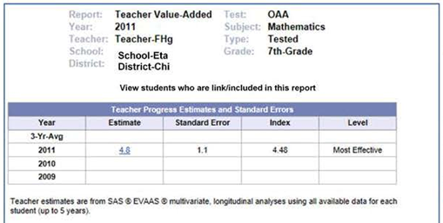
Teacher Value-Added Report (Aggregate portion of report)
What do the levels mean?

Slide 41
Sample Teacher Diagnostic Report
View students in the first tertile
Battelle for Kids is utilizing visual representations of copyrighted EVAAS® Web reporting software from SAS Institute Inc. in this document for instructional purposes.

Slide 42
School Teacher Effectiveness Summary (Math)

Slide 43
Questions?
Resource information found on the Ohio Student Progress Portal: www.BattelleforKids.org/Ohio
Support Desk: Support@BattelleforKids.org or (866) 543-7555
Thank you!

Slide 44
www.BattelleforKids.org http://twitter.com/BattelleforKids

