Slide 1
Center for Teaching, Leading and Learning
OCTEO Conference ∙ April 12, 2019

Slide 2
Notes:
Note this group’s strong connection to strategy one. Add notes here from Strategic Plan strategy 1 HCMS.
A steady stream of highly effective new teacher is necessary to educator Ohio’s increasingly diver body of student with nuanced learning needs. This can be achieved through attracting, preparing, recruiting, hiring, developing , and retaining quality educators.
Recruiting and supporting effective teachers is one significant step toward addressing Ohio’s equity challenges. This can include “grow your own” programs and regionally collaborative hiring alliances.

Slide 3
Center for Teaching, Leading and Learning
Educator Effectiveness
Educator Licensure
Professional Conduct
Learning and Instructional Strategies
Career Technical Education
Approaches to Teaching and Professional Learning

Slide 4
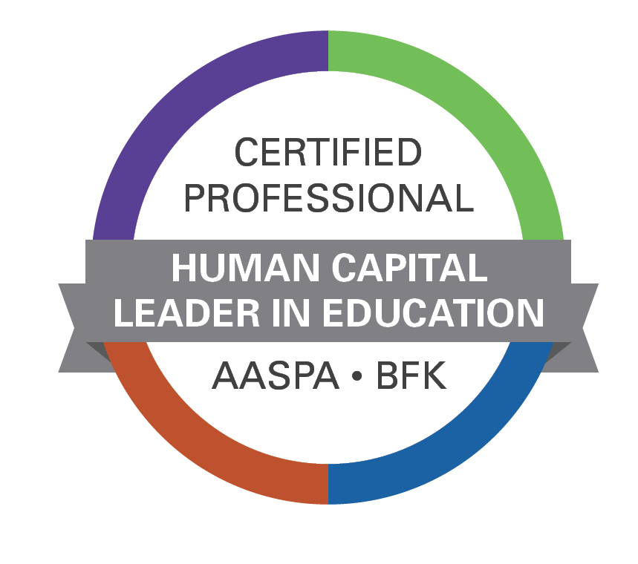
Human Capital Leaders in Education Learning Opportunity
Three-day learning session June 4-6, 2019
At BFK in Hilliard, OH
The Department covers 60 percent of the cost (for up to two districts)
8 a.m. to 4 p.m. each day
Districts may pay the full cost to attend.

Slide 5
Ohio Teacher Evaluation System
The Teacher Evaluation Process remains unchanged for 2018-2019 and 2019-2020
Timeline
1) Prototype: Spring 2019
2) Pilot: 2019-2020
3) Implementation 2020-2021
evaluation@education.ohio.gov
Notes:
We evaluate to inform and support professional development and provide opportunities for structured and informal feedback throughout the performance evaluation process

Slide 6
OTES Timeline
2019-2020
Statewide OTES Pilot
SBOE Committee 1st Review
February 2020
SBOE Committee 2nd Review
March 2020
SBOE Full Board Adoption Vote
April 2020
2020-2021
Revised OTES Implementation

Slide 7
2018 Ohio Standards for Principals
Standards were revised to align to updated national standards
Better reflect the work of today’s building leaders
Notes:
The revised standards were informed by the principal standards writing team by examining the work of principals in Ohio and aligning the standards with the national work of the Professional Standards for Educational Leaders (PSEL) standards. The standards were refined in order to better reflect the roles and responsibilities of today’s building leaders.
The writing team organized the standards into four domains: leadership, learning, management, and culture.
At the center of everything, though is EACH child’s well-being and academic success. This aligns to Ohio’s Strategic Plan.

Slide 8
OPES Update
Summer 2019
Fall 2019
Work with state associations to identify writing team members
Begin work to revise OPES to align to the new standards and to OTES
Notes:
The Department will work with OASSA, OAESA, and BASA to identify writing team members.
We will ask the prior principal standards writing team first if they’d like to participate.
The law requires OPES to align to OTES where applicable. So this OPES work had to be slightly delayed while we prototype and then pilot OTES, so relevant changes, where applicable, can be added to OPES.

Slide 9
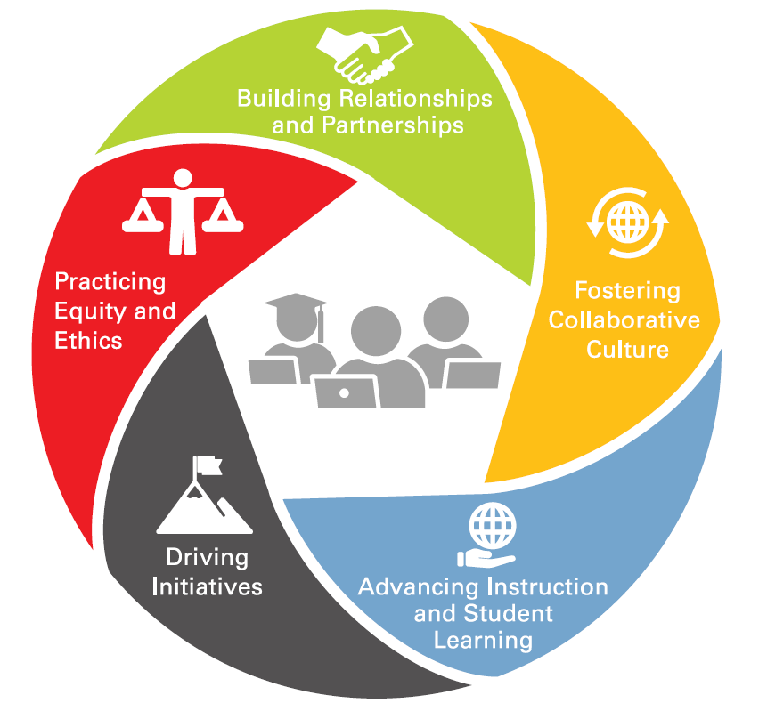
Teacher Leadership
Essential Work:
Teacher-in-Residence
Teacher Leader Advisory Council
Teacher Leadership Resources
teacher.leadership@education.ohio.gov
Notes:
When teacher leadership occurs in schools, positive effects extend to the teacher leaders, to their colleagues, and, most especially, to the students. –Angelle & DeHart, 2016
Teacher leaders hold the expertise to lead and expand the professional learning opportunities and supports available to fellow educators, enabling them to strengthen the profession and enhance student success.
Fostering Collaborative Culture:
Teacher leaders ground their work in mutual trust and clear communication with
colleagues, administrators, students, and families. Teacher leaders use effective interactions among colleagues that engage different back- grounds to respond to challenges and build consensus.
Advancing Instruction and Student Learning:
Teacher leaders advance teachers’ instructional practices and student learning by sharing research on best teaching practices, leading the use of data to inform and guide instructional decisions, and by engaging their colleagues in reflective dialogue.
Driving Initiatives:
Teacher leaders actively identify challenges/areas for improvement and innovation in the school, district, and state/national educational landscape.
Practicing Ethics and Equity:
Teacher leaders foster a positive and inclusive culture that seeks to understand students’ needs and respect the uniqueness of individual students and champion cultural competency and culturally-responsive practice.
Building Relationships and Partnerships:
Teacher leaders create and build strategic relationships and partnerships with colleagues, families, administrators, community members, public officials, higher education, etc. to address immediate and future needs of students, colleagues, school, their profession, and their community.
Teacher Leadership Toolkit:
A toolkit of resources and case studies to further help districts and schools with teacher leadership implementation is being developed for release next spring/early summer.

Slide 10
Educator Licensure
New assessments
Proper certification and licensure
Licensure system changes

Slide 11
Grade Band Changes
PK-5 and PK-5 Intervention Specialist
Available for out of state applicants beginning July 1, 2019
Available for Ohio institutions to e-sign beginning spring 2020
Phase out issuing PK-3 and PK-3 ECIS licenses on June 30, 2024

Slide 12
New OAE Assessments Coming
PK-5 and PK-5 Intervention Specialist Licenses
New OAE test for P-5 Primary
New OAE test for P-5 IS Primary
New OAE test for P-5 APK
PK-12 Computer Science License
-New OAE test for Computer Science

Slide 13
Proper Certification
Subject (Course)
Grade Level
Student Population

Slide 14
Intervention Specialists
Properly licensed for teaching most subjects to students with disabilities in grade range of license
HQT additional content requirements no longer apply
Mild/Moderate and Moderate/Intensive valid for teaching students with any disability
Exception: Courses specifically for students with visual impairments or hearing impairments

Slide 15
System Access Change
Notes:
System Upgrade in mid May – to change gateway access
Keep a look out for email messages, social media posts, and website updates with additional information.
-Improved security: dual authentication and align with security best practices to safeguard personal data
-One login for all state agencies
-More user friendly interface

Slide 16
Office of Professional Conduct
#ABConduct Tip Sheets
Review of Licensure Code of Professional Conduct
Professional Conduct Process

Slide 17
#ABConduct
http://education.ohio.gov/ABConduct
Notes:
Proactive tip sheets to help navigate grey areas of professional conduct
Joint effort with the Ohio Education Association and Ohio Federation of Teachers

Slide 18
#ABConduct Topics
Social media
Extracurricular leaders
Handling funds
Drugs and alcohol
Classroom management
Top 10 professional conduct concerns
Testing and academic integrity
Rapback and applications

Slide 19
Licensure Code of Professional Conduct
Licensure Code is being reviewed and updated
Proposed updates:
Ninth principle surrounding the use of technology
Defines grooming and academic dishonesty
Clarifies accurate reporting requirements
Adding nepotism and sexual harassment

Slide 20
Licensure Code of Professional Conduct
Revising the Licensure Code of Professional Conduct
Collecting second round of public comment until April 24, 2019
A draft of the proposed Licensure Code and a link to the public comment survey can be found at: education.ohio.gov/LicensureCode

Slide 21
Educator Discipline Process
Provides guidance on how a referral progresses through the discipline process
education.ohio.gov Search keywords: Discipline Process
Notes:
Provides guidance on how a referral progresses through the discipline process
Includes timeframes and potential roadblocks
Can be found on the Department’s website by searching for <<discipline process>>

Slide 22
Improving Literacy Instruction
Legislative Requirements
State Systemic Improvement Plan ($20M+)
Striving Readers Comprehensive Literacy Grant ($35M)
State Personnel Development Grant ($6M)
Ohio’s Plan to Raise Literacy Achievement
Notes:
The Department has made explicit efforts to support Ohio’s educators in increasing literacy outcomes for all students.
As you know, Ohio has legislative efforts to increase literacy outcomes for early learners k-3 through the Third Grade Reading Guarantee
In 2016 the Department began implementing the State Systemic Improvement Plan with 16 districts building educator knowledge on the science of reading and evidence-based literacy practices.
In 2018, the Department was awarded a $6Million federal State Personnel Development Grant to scale up the Improvement Plan efforts with district leaders.
In 2018 the Department was awarded a $35 million federal Striving Readers grant to increase literacy outcomes for Ohio’s most vulnerable students birth to grade 12.
One of the Federal requirements of the Striving Readers award was to develop a state wide plan for raising literacy achievement. The Department published Ohio’s Plan to Raise Literacy Achievement in January of 2018. This plan promotes evidence-based literacy practices for all learners birth through grade 12. Specifically, Section 4 outlines the state’s vision. You can access the plan on the Ohio Department of Educations website on the Striving Readers page.

Slide 23
Statewide Literacy Supports
Data-driven decision-making
Use of child/student performance assessments to monitor progress toward meeting the learner performance goals
Selection and implementation of evidence-based practices
Monitor adult implementation of the evidence-based practice(s)/intervention(s)
Notes:
Supports promoted through Ohio’s Plan to Raise Literacy Achievement include:
Data-driven decision-making
Use of child/student performance assessments to monitor progress toward meeting the learner performance goals
Selection and implementation of evidence-based practices
Monitor adult implementation of the evidence-based practice(s)/intervention(s)
If you have questions regarding Ohio’s plan or would like to participate in our stakeholder group focused on literacy improvements please contact Dr. Weber-Mayrer who’s email is listed on this slide.

Slide 24
State Approach to Improving Literacy Outcomes for All Children
Melissa Weber-Mayrer, Ph.D.
Director
Office of Approaches to Teaching and Professional Learning
Melissa.Weber-Mayrer@education.ohio.gov

Slide 25
Office of Learning and Instructional Strategies
Focus Strategies: 3 and 4
Maintaining high quality standards, model curricula, instructional supports and resources
Engage educators and other key stakeholders

Slide 26
Spring/Summer 2019 Updates
Science, Social Studies and Financial Literacy Update
Model Curriculum updates and revisions
State Board of Education vote
Computer Science Instructional Supports
Fine Arts and World Language Standards
Writing and Advisory groups

Slide 27
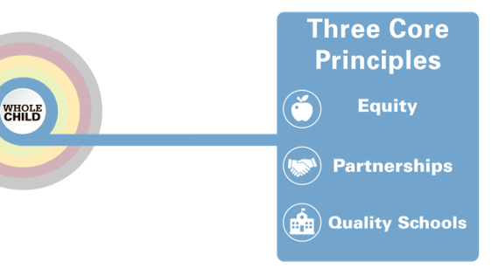
Building Partnerships
Public engagement
Advisory and working groups
Professional organizations
Feedback from field

Slide 28
Center Contacts
Carolyn.Everidge-Frey@education.ohio.gov
Sherry.Birchem@education.ohio.gov
Yenetta.Harper@education.ohio.gov
Immy.Singh@education.ohio.gov
Melissa.Weber-Mayrer@education.ohio.gov
Sophia.Hubbell@education.ohio.gov
Aaron.Ross@education.ohio.gov

Slide 29
education.ohio.gov

Slide 30
Join the Conversation
OHEducation
@OHEducation
@OHEducationSupt
OHEducation
OhioEdDept
education.ohio.gov/text

