Slide 1
Stepping out of the Ivory Tower to Advocate for Education:
How Academics Can Utilize Social Media and Blogging to Make an Impact
Bradley Conrad, PhD
Capital University

Slide 2
Academic/Policy Disconnect
Academics are of little or no consequence in influencing or shaping educational policy (Swanson and Barladge, 2006)

Slide 3
Academic/Policy Disconnect
Of the ten most influential institutions, publications, and people in impacting educational policy:
0 were higher education institutions
0 were scholarly journals
1 was an academic (also a policy person)

Slide 4
Who Does Influence Policy?
Think Tanks
Advocacy/Special Interest Groups
Publishing Houses
Commissioned Research Organizations
Labor Unions & Trade Associations
Philanthropies

Slide 5
Examples: Research Informing Policy
Kenneth Clark’s research on children’s perception of race – Brown vs. Board of Education
Moynihan Report on poverty cycle (commissioned by Dept. of Labor) – ESEA 1965
Mortimer Adler’s Paideia Proposal – liberal arts curriculum
E.D. Hirsch’s Cultural Literacy – standards and accountability
Jonathan Kozol’s Savage Inequalities - focus on urban education

Slide 6
The “New Way” to Influence Policy
Digital technology has led to the democratization of information with digital technology lowering costs and barriers to the production and consumption of information (Lubienski, Scott, & Debray, 2014)

Slide 7
The “New Way” to Influence Policy
Technology and multimedia make it possible to share information with broader audiences, bypassing policymaking gatekeepers (e.g. special interest groups, lobbyists), and can lead to the widespread dissemination of research (Goldhaber and Brewer, 2008).

Slide 8
The “New Way” to Influence Policy
Reaching broader audiences through multimedia/technology leads to a grassroots-like groundswell of public support for a policy issue and can ultimately lead to social change.

Slide 9
Targeting Policy Elites for Change
The policy elites tend to be:
Young
Technology savvy
More likely to get information from the Internet than from books
“They can still be reached by books, but the volume would have to be written with them in mind rather than the traditional educator audience” (Greene, 2011, p. 80).

Slide 10
Using Multimedia for Change
Need a vision for what needs changed
Develop a brand
Build multimedia platform
Blog, blog, blog
Social media marketing

Slide 11
Developing a Vision
What change do you want to see?
What will your message look like?
Who is your target audience?
What are the appropriate platforms
Blog
Social media

Slide 12
Developing the Brand
Logo design
Sending the right message
An image that stands alone
Symbolic elements
Multiple mock-ups
Field testing (focus groups)
Logos: the face of the movement

Slide 13
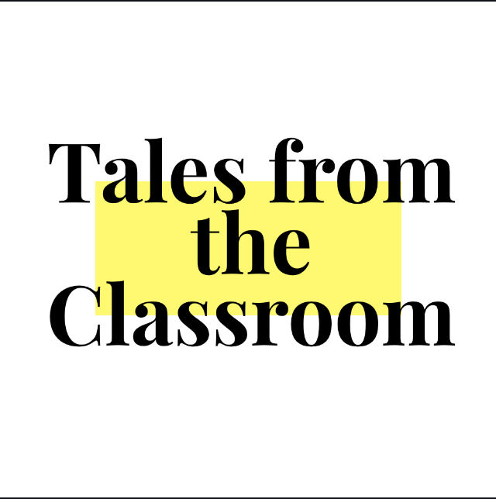
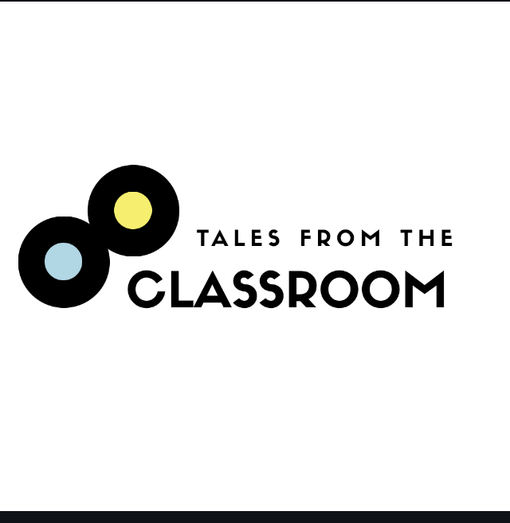
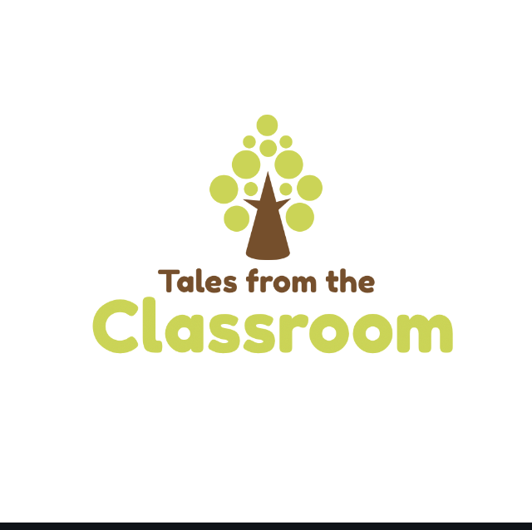
Tales from the Classroom Brand
Canva.com
Mock-ups

Slide 14
Building the Multimedia Platform
Start with the website
Domain name purchase (Go Daddy)
Choose a site good for blogging (Wix, Weebly, Tumblr)
Organize the website
Choose the right layout/design
Images (Wix free, other stock sites)
Fill the content

Slide 15
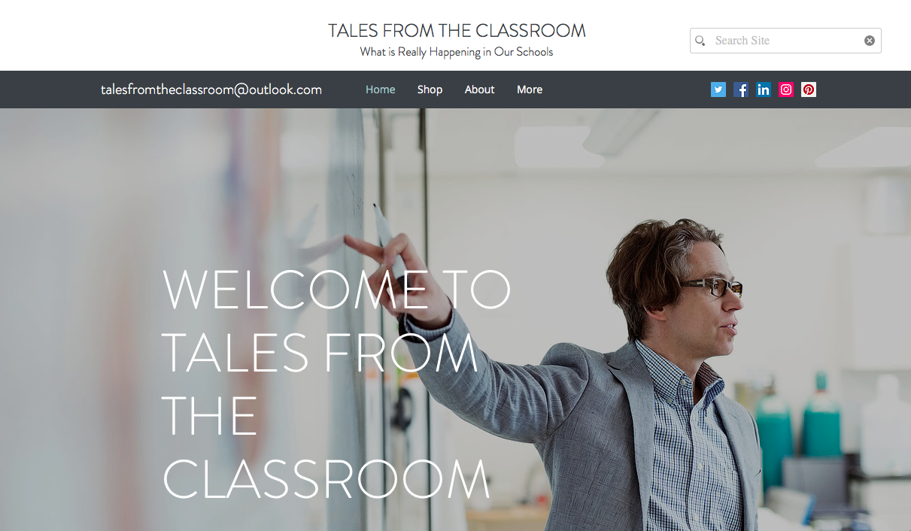
Tales from the Classroom Website
https://www.talesfromtheclassroom.com

Slide 16
Building the Multimedia Platform
Percentage of adults who use:
Facebook: 68%
Instagram: 35%
Pinterest: 29%
Snapchat: 27%
LinkedIn: 25%
Twitter: 24%
*Pew Research Center, 2018

Slide 17
Facebook
Need a personal page
https://www.facebook.com/business/learn/set-up-facebook-page
Choose the right handle
Icon and Banner Images
Our Story
Connecting to other Social Media

Slide 18
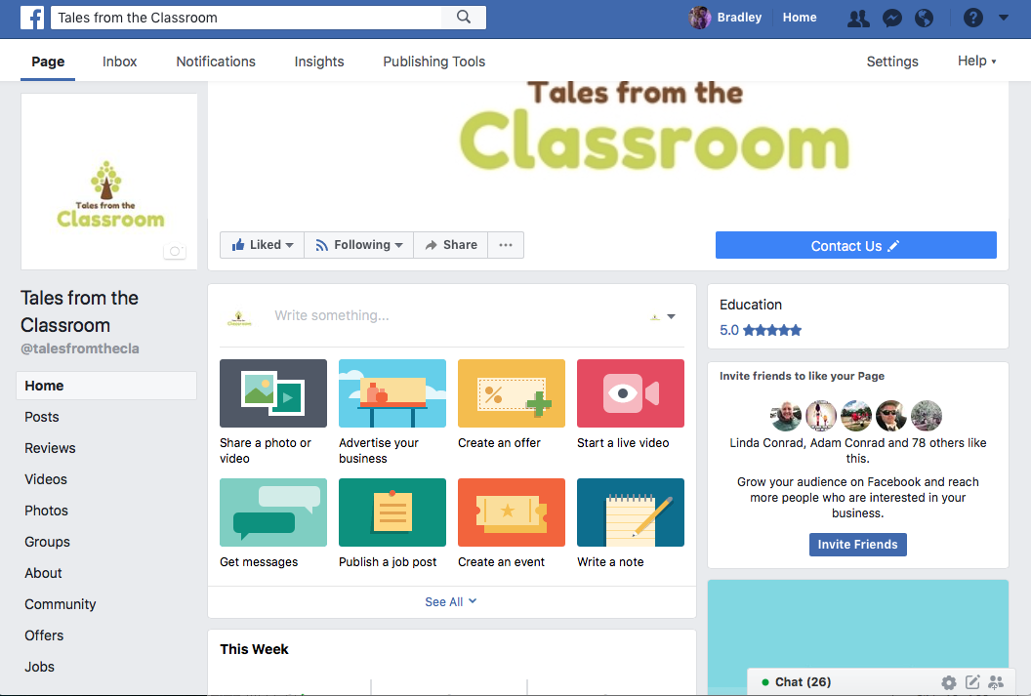
Tales from the Classroom Facebook
https://www.facebook.com/talesfromthecla/

Slide 19
Twitter
https://www.twitter.com
Choose the same handle
Theme colors
Icon and Banner Images
Profile with popular hashtags
Connecting to other Social Media

Slide 20
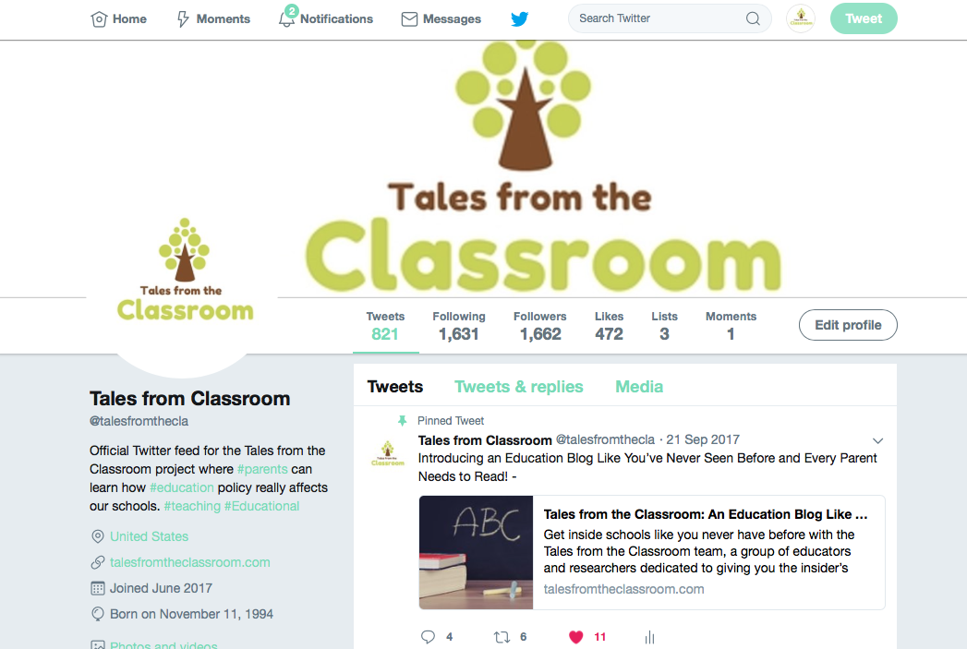
Tales from the Classroom Twitter
https://twitter.com/talesfromthecla

Slide 21
Other Media Platforms
Pinterest
LinkedIn
Instagram
Medium

Slide 22
Other Media Platforms
Bing
Google
Search Engine Optimization (SEO)
Google+
Yelp

Slide 23
Blogging
Editorial Content Calendar
Frequent Blogging
Promotion on Social Media
Cross-promotion
Invited Bloggers
Guest Blogging
Images (stock photos free and paid)

Slide 24
Social Media Marketing
Post and re-post blog stories
Building a following on social media
Influencers
Virtual PLNs
#chats

Slide 25
One Success Story
Ohio School Report Card Bill

Slide 26
Contact Information
Bradley Conrad
Capital University
Email: bconrad2@capital.edu or
info@talesfromtheclassroom.com
Twitter: @bconradcapital or @talesfromthecla

