Slide 1
Finding Your Match:
An Innovative Approach to Placing Student Teachers

Slide 2
Agenda
Introductions
Teacher Match Background
Teacher Match Logistics
Teacher Match Benefits/Challenges
Q & A

Slide 3
Office of Field Experiences:
Place 550-600 Teacher Candidates per year
Full Year placements (methods/student teaching for most programs
Place within a 60 mile radius of Bowling Green

Slide 4
Teacher Match
Piloted in 2014
BGSU looking for ways to increase and encourage partner districts to take candidates

Slide 5
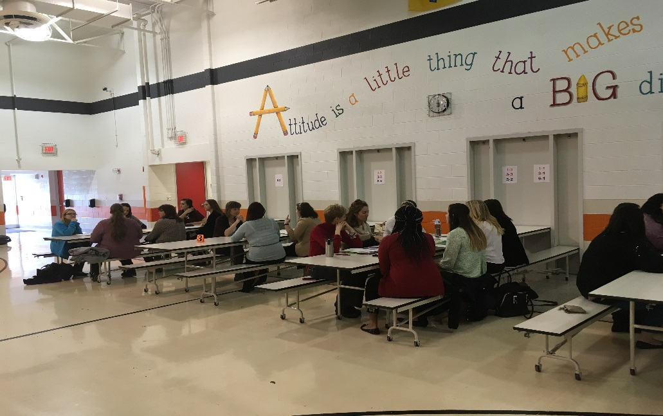
Teacher Match
Speed Interviews
Classroom Mentors select Teacher Candidate

Slide 6
Teacher Match
2015: 6 districts, 82 TCs placed
2016: 13 districts, 189 TCs placed
2017: 15 districts, 210 TCs placed

Slide 7
Partner Districts Love It…
Notes:
Anthony Wayne Video #2

Slide 8
Pre-Match…
Contact district to select date, time, and location
Student sign-up meetings
Receive CMT lists from districts

Slide 9
Match Prep
Identify Teacher Candidates (random selection)
Teacher Candidate Notification via Email
Professor/Instructor Notification
Carpool List
Personal Data Records (PDRs) sent to CMTs
Email Match Groupings to Principals
Match reminders sent
Prepare folders for CMTs
Notes:
A lot of prep work
Lots of emails-require students to follow-up to confirm attendance-phone calls for students as needed
Office of 5-divide and conquer
Sample emails to copy and paste; email from dean for missed class time-particularly for other colleges not familiar with Teacher Match
Folders-Match Day Design, Sample Interview Questions, Exit Survey, Feedback forms, and PDRs

Slide 10
Teacher Match Prep Session
Held multiple sessions
Optional
What to Expect at Match
Preparing for the Match
Tips for Success
Notes:
Dress Dos and Donts
Sample Difficult Interview Questions with sample answers or things to think about
-What are your biggest weaknesses?
-What is your classroom management style?
-How to answer when you have no idea what to say or how to answer?
-Social Media warnings

Slide 11
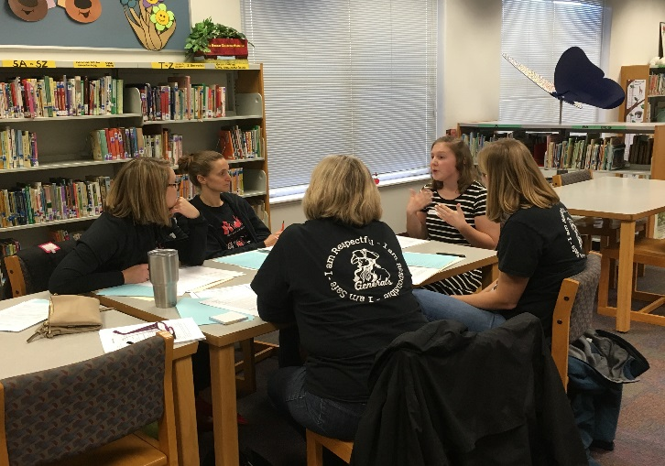
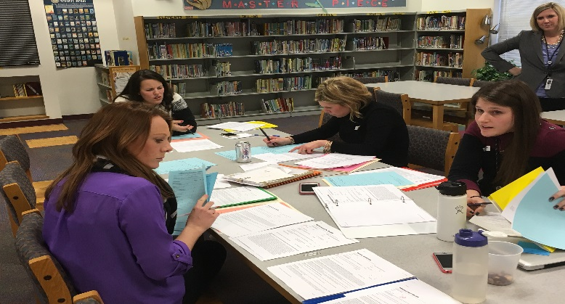
Match Event
Set up
CMT Orientation
TC Orientation
Speed Interviews
Deliberation and Selection
Notes:
Set-Up (arrive 45-60 minutes early) to move tables, assign table numbers, put out sign-in sheets, greet students and CMTs
CMTs-show contents of folder; stress the feedback form and being clear on who you want
Circulate, chat with students to keep calm, watch for issues
Be available for questions during deliberation; sounding board

Slide 12
Post-Match
Match list sent to district liaison
Selected or Not Selected emails to TCs
TCs can request feedback from match
Email contact information to TC and CMT
Notes:
3 sample emails-congrats, sorry, pending (teachers deliberating, maybe want same student, teachers loved all students and want to find placements for them, etc.)
GA compiles and sends feedback to students as well as feedback from Exit Survey

Slide 13
Benefits for District
Able to choose good fit for teaching style, classroom and students
More teachers willing to host Teacher Candidate
Early contact and collaboration
Notes:
Anthony Wayne Video #1

Slide 14
Benefits for District
Question | 2015 | 2016 | 2017
I feel more comfortable hosting a BGSU TC… | 96.1% | 97.7% | 97.9%
I would recommend a BGSU TC to a colleague… | 94.6% | 92.5% | 97.9%
Interviewing multiple TC's is a better way to place… | 98.6% | 97.1% | 97.9%

Slide 15
Benefits for Teacher Candidates
Interview Experience
Early involvement
Attending more than 1 match builds grit
Notes:
Fostoria Video

Slide 16
Benefits for Office of Field Experiences
Large number of placements complete by March
Additional placements
Opportunity to build partnership
Address dispositional issues
Notes:
Dispositional: Social Media, PDRs, Interview attire/makeup, Professionalism Communication

Slide 17
Challenges
Timeliness of communication
Day of cancellations
Weather
Campus expectations
Notes:
Springfield Video

Slide 18
Q & A
Contact Information:
Ben Martin, Director, benmart@bgsu.edu
Beth Ralph, Field Partnership Coordinator, eralph@bgsu.edu
Jen St. Louis, Field Partnership Coordinator,
jstloui@bgsu.edu

