Slide 1
GRIT and Other Essential Traits of Success!
OTECO Conference
Columbus, OH,
March 30, 2017, 9:00-10:30
Dr. Tom Hoerr
trhoerr@newcityschool.org
@TomHoerr

Slide 2
My goals…
To raise issues in an interesting and enlightening way
To help you think about what you can do to prepare your students to prepare their students for the real world
To give you ideas and strategies that you can use in preparing teachers – Lead To Succeed.

Slide 3
Who are you?
Free day?
Hardest thing?
Enjoy the most?

Slide 5
A two question test for you…

Slide 6
1. Are there differences between success in school and success in life?

Slide 7
Yes, technology…
74 consecutive wins by Ken Jennings -$2,520,700
Then defeated by IBM’s Watson
> 1B websites and 3.5B daily Google searches
“In the 21st century, knowing all the answers won’t distinguish someone’s intelligence – rather, the ability to ask all the right questions will be the mark of true genius” (from Thank You For Being Late by Thomas Friedman).

Slide 8
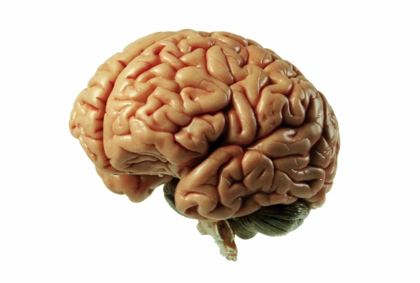
YES, character counts…
Daniel Goleman: “… At best, IQ contributes about 20 percent of the factors that determine life success, which leaves 80 percent to other forces.”
Paul Tough: “What matters most (in success) is a list that includes persistence, self-control, curiosity, conscientiousness, grit, and self-confidence.”

Slide 9
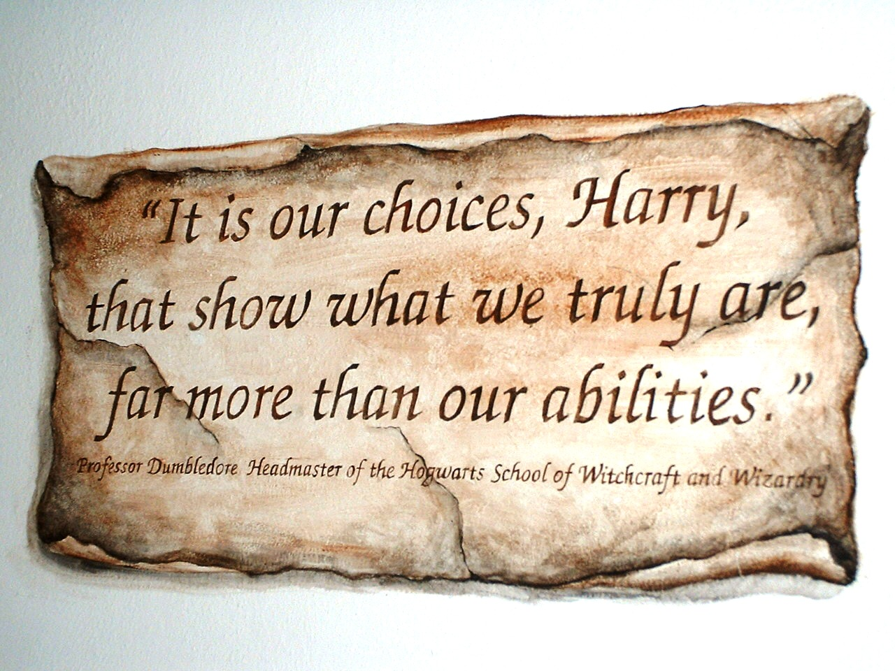
YES
Who you are is more important than what you know.

Slide 10
2. Are these differences reflected in what and how we teach our students?
- in preschool and K-12
- in higher education

Slide 11
Scholastics should be the floor, not the ceiling.
But too often our schools – our teachers and principals – focus virtually all of their energies on the 3 R’s.
That’s a mistake if we truly want to lead to succeed.

Slide 12
Success Skills
Empathy
Self-control
Integrity
Embracing Diversity
Grit

Slide 13
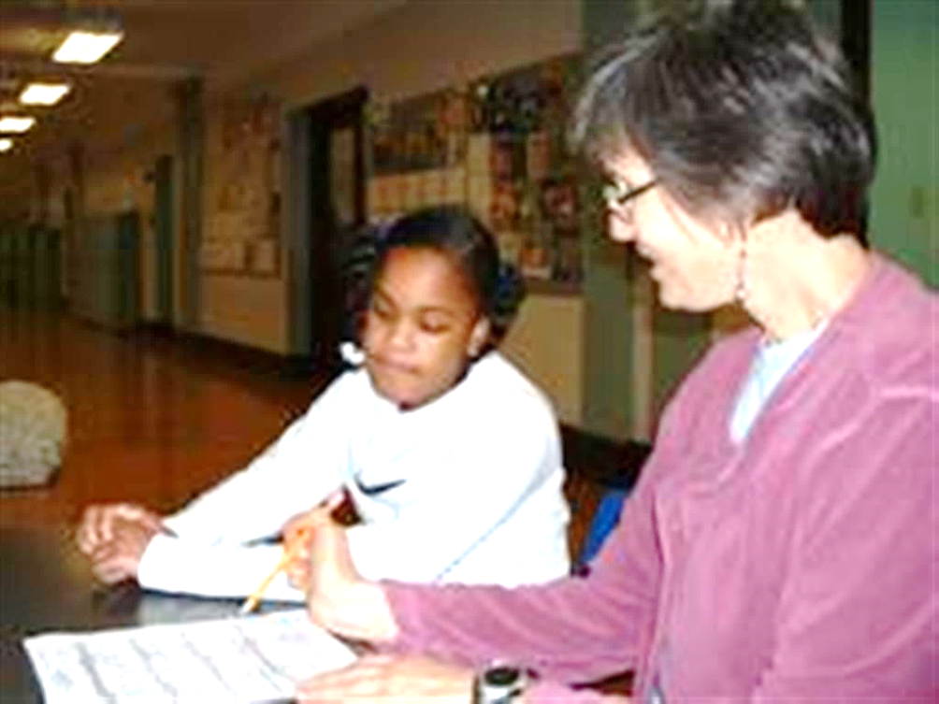
My Grit Hypotheses
Who you are is more important than what you know.

Slide 14
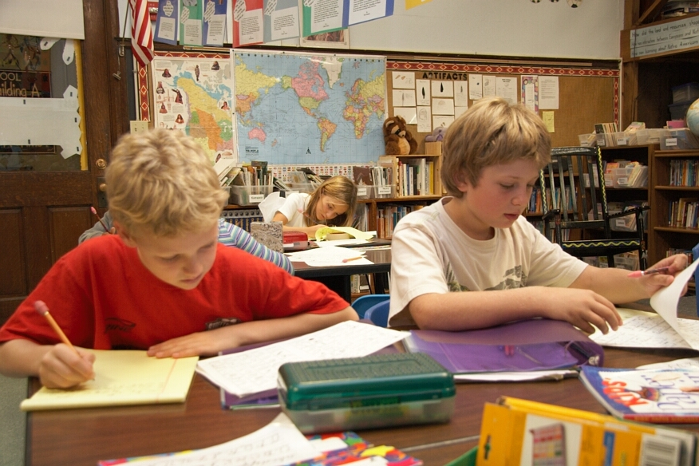
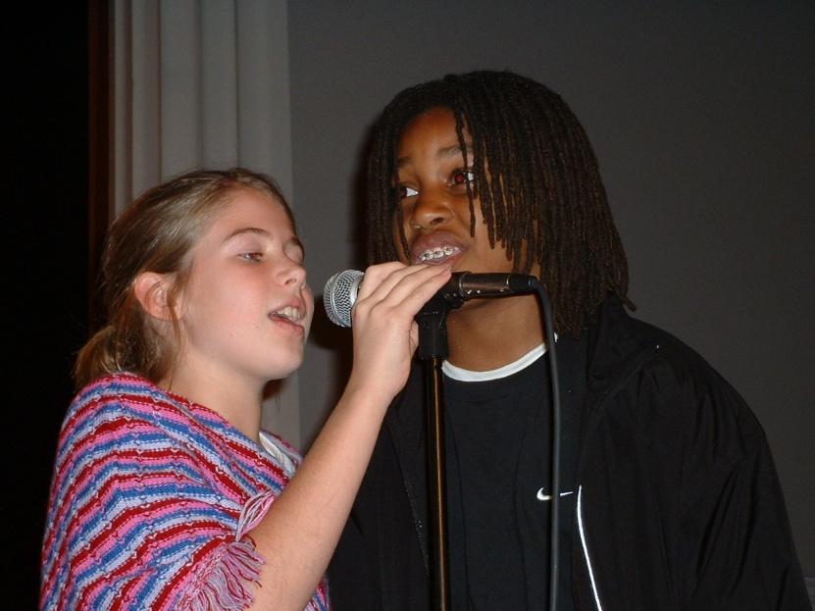
2. Academics and the arts have value.

Slide 15
3. We will all fail at something; we will all hit the wall. Our response – our grit - is what’s important.

Slide 16
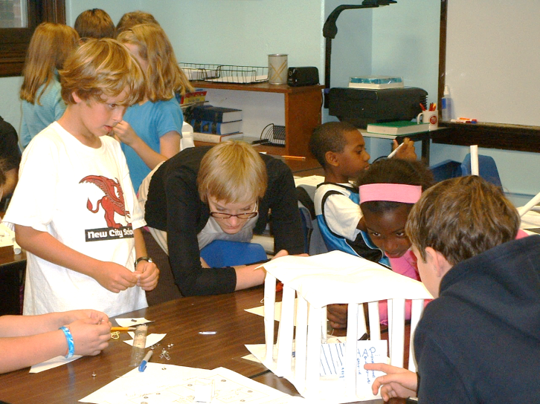
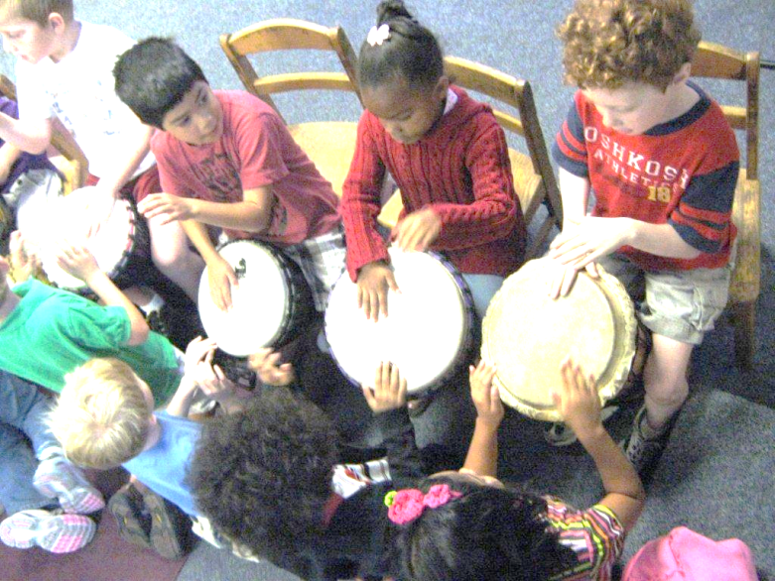
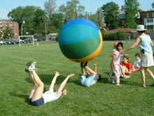
4. Grit can be taught, but it’s not enough to talk about the merit of grit. We educators must actually pursue teaching it.

Slide 17
Do you agree with my hypotheses???

Slide 18
This morning
The Formative Five
Empathy
Self-Control
Integrity
Celebrating Diversity
Grit

Slide 19
First and always
Children must know that we embrace them regardless of their success.
We embrace them as people.

Slide 20
YOU
Think of something very difficult that you have accomplished, either in your personal or professional life.
Where/how did you develop the grit that enabled you not give up, to keep trying, to persevere?

Slide 21
Grit is a part of
Non-cognitive growth
Social Emotional learning
Soft Skills
Emotional Intelligence
The Personal Intelligences
Success Skills

Slide 22
Derivation Goleman -EQ Gardner - MI
Self-awareness: reading one’s emotions and recognizing their impact
Self-management: keeping disruptive emotions and impulses under control
Social Awareness: sensing others’ emotions, understanding their perspectives
Relationship management: navigating and negotiating relationships, inspiring others
Intrapersonal intelligence: the ability to understand people and relationships
Interpersonal intelligence: access to one's emotional life as a means to understand oneself and others

Slide 23
Grit can be taught.

Slide 24
What is grit???
Grit is:
Passion + persistence
overcoming boredom
overcoming frustration
overcoming failure
making new mistakes.

Slide 25
The question…
Should an educator ever cause a student to be frustrated or, even, to fail?
Should a parent ever do this?
Should an supervisor ever do this with an employee???
My bias: YES.

Slide 26
It’s HARD to do!
Teaching and leading for grit feels
Uncomfortable
Awkward
Uncaring
Politically unwise
And counter to all of our training…
But we must do this to prepare students for success in the real world.

Slide 27
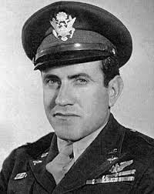
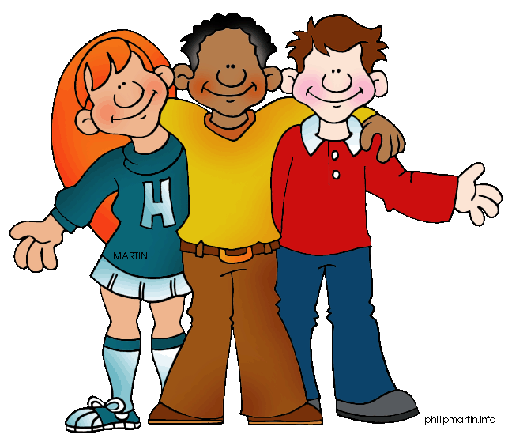
GRIT
Who had it?
Who needs it now?

Slide 28
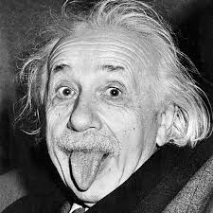
GRIT is not about IQ
Grit is not tied to intelligence, knowledge, test scores, or skills

Slide 29
GRIT is an attitude that can be taught
About life
About learning
About how success is defined
About reacting to adversity

Slide 30
GRIT is a dialogue
Among everyone with a vested interest
Among teachers, students, parents
Between parents and children
It’s overt and transparent
WITH, not to…

Slide 31
Teachers must know that the dialogue includes listening to students
We need to know what students know
We need to know how students learn
We need to know how students feel about learning.

Slide 32
Still and always
Children must know that we embrace them regardless of their success.
We embrace them as people.

Slide 33
November 18, 2011 NYT by Paul Tough
“The Character Test Why our kids’ success – and happiness – may depend less on perfect performance than on learning how to deal with failure” What if the secret to success is failure?

Slide 34
Riverdale school leader on students who get 800 on their SAT…
“When that person suddenly has to face up to a difficult moment, then I think they’re screwed, to be honest. I don’t think they’ve grown the capacities to be able to handle that.”
Dominic Randolph

Slide 35
Angela Duckworth
“What struck me was that IQ was not the only difference between my best and my worst students. Some of my strongest students did not have stratospheric IQ scores. Some of my smartest kids weren’t doing so well.”

Slide 36
Relationship between grit and talent?
“Sometimes the more talented you are, the less gritty you are,” says Duckworth.

Slide 37
True Grit Café in Ridgeway, CO

Slide 38
“Principal Connection,” Educational Leadership, January 2008
“What standardized tests cannot do – indeed, what almost no test can do – is capture a child’s essence. Tests don’t speak to the internal factors that play a major role in life success: curiosity, effort, resilience, and compassion.”

Slide 39
My shorthand…
Who you are is more important than what
you know.

Slide 41
Grit is:
Passion + persistence
overcoming boredom
overcoming frustration
overcoming failure
making new mistakes.

Slide 42
Mistakes and Implications
Kinds of mistakes | What do they mean for us? | They are

Slide 43
Mistakes and Implications
Kinds of mistakes | What do they mean for us? | They are
OLD mistakes | We repeat our errors and do not learn from our experiences. | Dumb

Slide 44
Mistakes and Implications
Kinds of mistakes | What do they mean for us? | They are
OLD mistakes | We repeat our errors and do not learn from our experiences. | Dumb
NO mistakes | We continue to use the same approach. We are error-free but little learning takes place. | Not smart

Slide 45
Mistakes and Implications
Kinds of mistakes | What do they mean for us? | They are
OLD mistakes | We repeat our errors and do not learn from our experiences. | Dumb
NO mistakes | We continue to use the same approach. We are error-free but little learning takes place. | Not smart
NEW mistakes | We try new ideas and strategies and learn from our experiences. | Brave and wise

Slide 46
Make NEW Mistakes
evidences the growth mindset
leads to continued learning
is necessary for success
embodies grit.

Slide 47
Grit is
An attitude
A dialogue
A strategy!

Slide 48
Duckworth’s Grit Formula
Passion + Perseverance = Grit
Step 1
talent + effort = skill
Step 2
skill + eeefffooorrrttt = achievement

Slide 49
Every student needs grit
HIGH FLYERS
Not used to failing
Quick to give up
Narrow in hesitations
Need to be taught to persevere
Can be taught to transfer grit
Small steps
STRUGGLERS
Too used to failing
Quick to give up
General in hesitations
Need to be taught to persevere
Can be taught to transfer grit
Small steps

Slide 50
There’s a push-back against grit…
Some people think
Endorsing grit means it is a panacea.
Endorsing grit means ignoring kids’ differences.
Endorsing grit means discounting the settings in which students live.
WRONG!

Slide 51
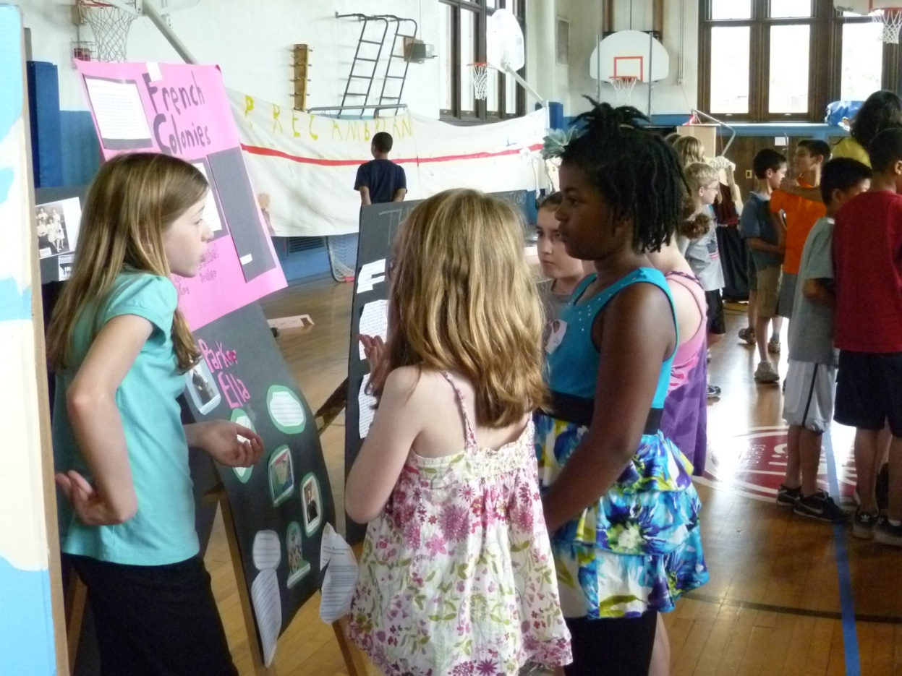
Every student needs grit!

Slide 52
Grit means pushing yourself:
Mario Andretti: “If things seem under control, you are just not going fast enough.”
Tony Wagner: "If you don't fail, then you are probably playing it too safe."

Slide 53
“Many of life's failures are people who did not realize how close they were to success when they gave up”
Thomas Edison

Slide 54
“I’ve missed more than 9,000 shots in my career. I’ve lost more than 300 games. Twenty-six times I’ve been trusted to take the winning shot, and I’ve missed. I’ve failed over and over and over again in my life. And that is why I succeed.”
Michael Jordan

Slide 55
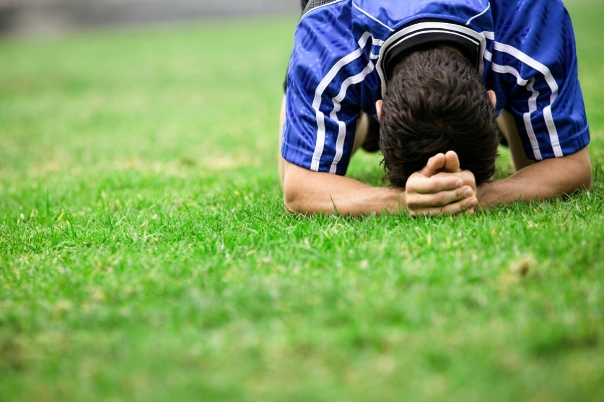
Mia Ham: “Failure happens all the time. It happens every day in practice. What makes you better is how you react to it.”

Slide 56
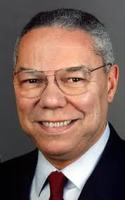
Colin Powell: “There are no secrets to success. It is the result of preparation, hard work, and learning from failure.”

Slide 57
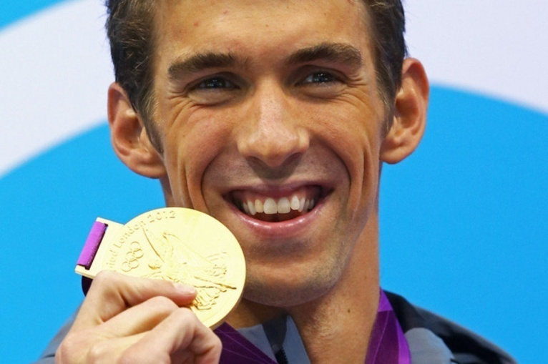
Michael Phelps: “I think that everything is possible as long as you put your mind to it and you put the work and time into it. I think your mind really controls everything.”

Slide 58
Today’s youth:
“The ‘see and get it’ generation seem flummoxed when told that things take time. They are happy to give lots of short bursts of energy and effort to get things done, but commitment and grit come harder.”
Simon Sinek, Leaders Eat Last, 2014

Slide 59
But because
Educators like kids
Educators want to see students succeed
Students want to succeed
Their parents want them to succeed
Fostering grit doesn’t come naturally!

Slide 60
Intentionally fostering grit in students is a six-step process for teachers and administrators
Establish the environment
Set the expectations
Teach the vocabulary
Create the frustration
Closely monitor
Reflect and learn

Slide 61
1. Establish the environment for grit, be obvious and transparent
Anticipate the student’s perspective:
Talk about grit with students, parents, and people in the community.
How is success is measured?
How are students acknowledged beyond academic success?
How are improvement and effort recognized?
What is posted on walls and in the halls?
Is it cool to be seen as hard working?

Slide 62
No to

Slide 63
Yes to

Slide 64
2. Set the expectation: Grit is key and it can be fostered.
Be overt about the importance of grit
Teach that it’s how we respond to failure that matters most
Intentionally focus on gaining grit
Use all intelligences to gain grit: musical, bodily-kinesthetic, spatial, naturalist, scholastics, and the personals
Teach that mistakes are lessons: “good failures.”

Slide 65
Parent education is part of the dialogue! No snowplow parents
“What worry me most are the examples of over-parenting that have the potential to ruin a child's confidence and undermine an education in independence.”
“Why Parents Need to Let Their Children Fail” by Jessica Lahey, The Atlantic, January 29, 2013

Slide 66
We are part of the dialogue. Adults should share their stories.
Children need to know that our successes were not always easy
They need to understand that we encountered hardships on our journeys
They need to see that grit is an important life-long attribute
They need to know our grit

Slide 67
3. Own the grit vocabulary
Good things don’t happen without intention
Good things don’t happen by accident
How we frame our efforts determines how we view them and how our students view them

Slide 68
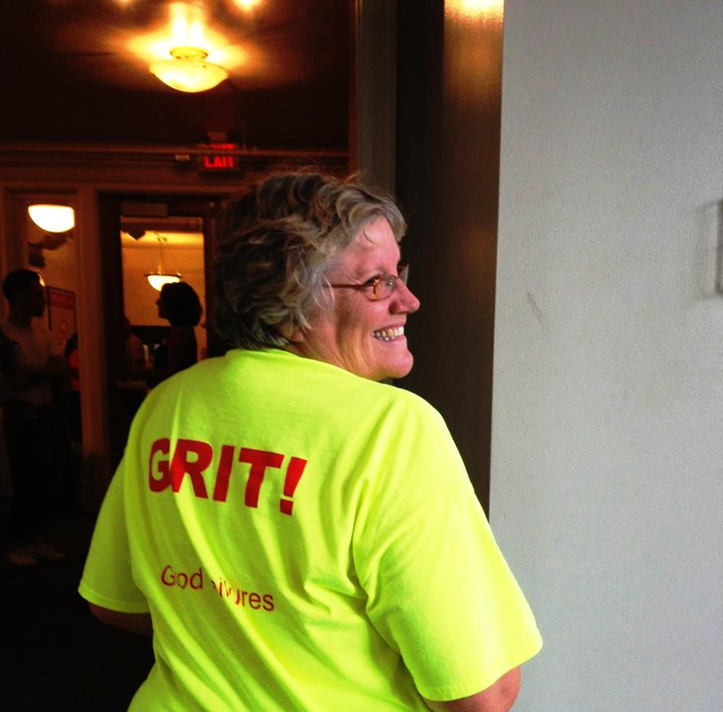
Other terms also support teaching grit
failure
frustration
tenacity
perseverance
resilience
self-confidence
self-image
comfort zone

Slide 69
AZ & WA

Slide 70
Failure is a bruise
NOT a tattoo.
Jon Sinclair, author

Slide 71
4. Embrace/create the frustration
Grit can be learned when children are ready to give up because of
frustration
failure
ambiguity
boredom
We all hit different walls at different times.
Think “teachable moments.”

Slide 72
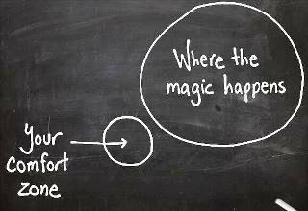
Consciously leave your comfort zone:
Do it, talk about it, encourage it
Eleanor Roosevelt: "Do one thing every day that scares you."

Slide 73
Grit is a dialogue.
Teachers, children, parents, and administrators are on the same journey.

Slide 74
To keep children persevering…
Focus on trajectory and improvement
Have them anticipate the level of difficulty and identify something they’ve done that seems to be comparably challenging
Ask them to think of a task on which they’ve succeed when they had not thought they would do so. Set a time expectation for full-force effort
Have a GRIT DAY
Remind them that a good failure is one from which they learn.

Slide 75
5. Monitor the experience
Teachers and parents need to be attuned to the student’s emotions, attitude, and confidence, so they know when to intervene.
Timing is very important; think teachable moment!
We need to be very aware of the student’s frustration level. Sometimes students may continue at the task but have quit emotionally.
More parent education!

Slide 76
Solicit feedback throughout
Thumbs up/down
Likert-type scale
Use a rubric
Student Grit Reflection
Frustration Level | The work is | How I’m feeling
1 | Easy | No problem!
2 | OK | I’m in good shape
3 | Hard | I’ll figure it out
4 | Very difficult | Not sure I can succeed
5 | Too hard! | I want to quit

Slide 77
6. Reflect and learn
“What did you do when you wanted to quit?”
“Think about a good failure. What made it good? What did you learn?”
Students should ask themselves:
“When did I give up? What caused it?”
“Why didn’t I give up? How could I hang in?”
“What have I learned that will help me when I get frustrated in the future?”

Slide 78
Gaining grit should be a goal!

Slide 79
GOOD GRIT
and
SMART
GRIT

Slide 80
Children must know that we embrace them regardless of their success.

Slide 81
What did you learn that you can use?

Slide 82
Comments or questions? I’d be pleased to hear from you. Tom Hoerr trhoerr@newcityschool.org

