Slide 1
K-16 Partners in Co-Teaching: Beyond the Buzz and in Spite of the Hype
Karen Kaye, Ph.D.
Rochelle Berndt, M.A. Ed.
Clayton Dusek, Ph.D.
School of Education
Baldwin Wallace University

Slide 2
Partnership…
Baldwin Wallace University
Berea City School District
Brookview Elementary School
Principal Tracy Schneid
4-Kindergarten Classrooms
Co-Teaching Approach in Literacy and Numeracy
Brook Park Memorial School
Principal Michael Kostyak
3-Third Grade Classrooms
Co-Teaching Approach in Literacy and Numeracy

Slide 3
Timeline…
January 2014: Superintendent and Principals contacted
March 2014: Martha Holden Jennings Grant received
April 2014: BW early childhood education methods candidates were recommended by faculty members for participation in the pilot program.
May 2014: Candidates were selected and notified of their participation in the co-teaching pilot program.
August 2014: BW faculty and supervisors attended a co-teaching training session in cooperation with Cleveland State University presented by Dr. Wendy Murawski.
August 2014: The candidates and cooperating teachers met and participated in an icebreaker activity to get to know one another. The cooperating teachers were able to preference the candidates with whom they would like to work.

Slide 4
Timeline…
September 2014: Candidates and cooperating teachers were matched and notified of their placements.
September-October 2014: Candidates spent a minimum of one hour per week observing in their classrooms.
October 2014: Cooperating teachers received co-teaching training at Baldwin Wallace University.
November 2014: Candidates completed their methods hours/requirements in their respective classrooms.
November 2014: Candidates received co-teaching training at Baldwin Wallace University.
January 2015-present: Candidates returned to their placements for their clinical practice experiences. Cooperating teachers and candidates began transitioning into the use of co-teaching strategies.

Slide 5
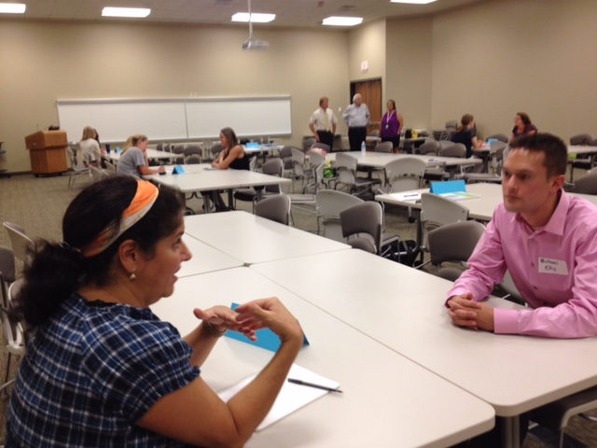
Matching Session…

Slide 6
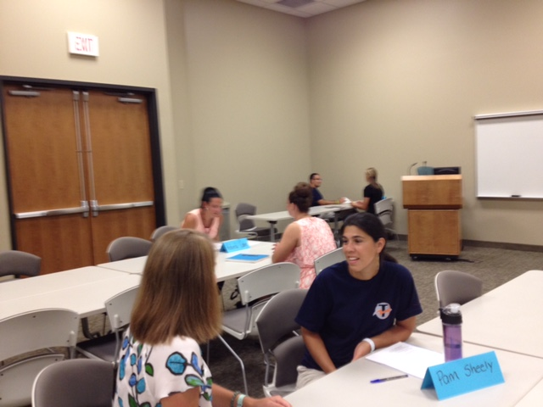
Matching Session…

Slide 7
Co-Teaching Training…
The sessions included…
Overview and Rationale
Instructional Models
Critical Elements
The Co-Teaching Relationship
Support

Slide 8
Co-Teaching Training
Example Slides, Activities, and Modules

Slide 9
Table Talk
How is the traditional model of student teaching different than a co-taught model?

Slide 10
Elements of Student Teaching
Element | Traditional | Co-Taught
Preparation | -TC has limited preparation in expectations, guidelines, and transitioning -CT is expected to monitor and guide TC with little university support | -All members of the triad (TC, CT, and US) are provided information about the role of each member including expectations, co-teaching, co-planning, and strategies for building relationships
Introduction | -TC is referred to as “student teacher” -TC begins experience as an observer -TC is rather passive until later in experience | -TC is referred to as a “teacher candidate” or “co-teacher” -TC is incorporated into routines and instruction from the first day
Involvement | -One teacher is active while the other is passive. -One teacher is “on” while the other is “off” | -Both the CT and the TC are “on”

Slide 11
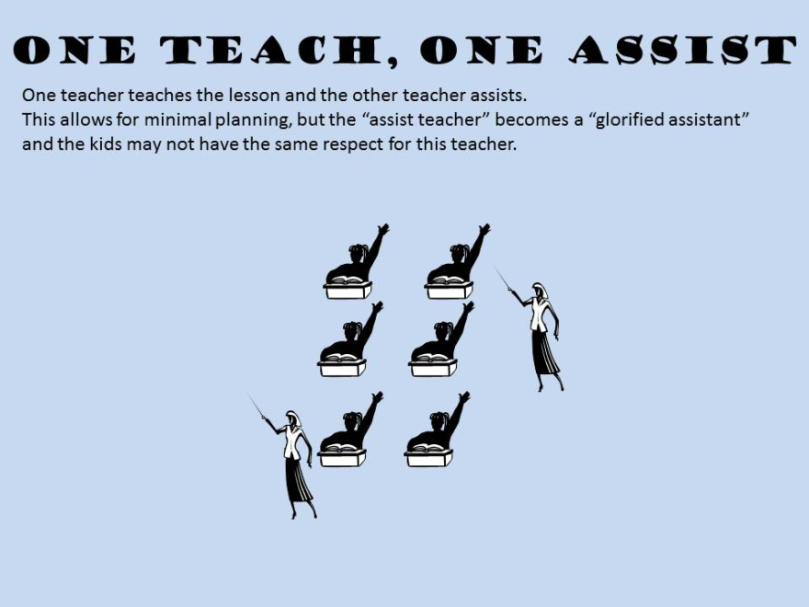
One Teach, One Assist
One teacher leads the instruction while the other teacher monitors student work, addresses behavior issues, answers students’ questions, and facilitates instruction by distributing papers or other materials.
Opportunity: Students may be more comfortable asking the assisting teacher for clarification of information.
Challenges: Students may become too dependent on the assisting teacher; the assisting teacher is in a passive role.
Recommended Use: Seldom

Slide 12
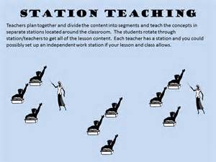
Station Teaching
Teachers divide the content to be addressed into three segments, and then they group the students.
Each teacher works with a group, while the third group works independently.
The student groups rotate through the stations so by the end of the lesson, both teachers have worked with all the students.
Opportunities: Reduced student/teacher ratio; students can be grouped in a variety of ways.
Challenges: Activities must function independent of each other; noise, timing, management.
Recommended Use: Frequent

Slide 13
“How is what we are doing together substantively better for students then what one of us would do alone?”~Murawski & Spencer, 2011

Slide 14
Co-Planning
Establish a regular time to co-plan.
Find a meeting place that is free from distractions.
Save rapport-building for another time.
Create an agenda or checklist to focus your planning.
Determine roles and responsibilities.
Use the “What-How-Who” Approach.

Slide 15
What-How-Who Approach
What (Curriculum)
Standards
Objectives
Timeframe
Materials
How (Pedagogy)
Comfort level with content
Co-teaching strategies to use beginning, middle, end of lessons
Teachers’ responsibilities
Who (Students and Supports)
Behavioral, social, academic accommodations needed
Differentiated instruction
Other professionals included or needed for the lesson (i.e. speech teacher, occupational therapist, parent volunteer)
Planning Form

Slide 16
Co-Teaching
Teach according to the plan that has been outlined for each lesson.
Maintain your defined role for each co-teaching strategy.
Co-teaching can involve teaching the full-class, half the class, small groups, assisting the lead teacher, or observing students.

Slide 17
Co-Assessing
Purposeful assessment before teams begin…
Co-teachers should discuss and agree on how they will share responsibility for:
Grading
Developing rubrics, checklists, and scoring sheets
Maintaining the gradebook
Communicating student progress to parents and students
Gathering data for RTI and other instructional decision-making
Preparing for test accommodations

Slide 18
Co-Reflection
Plan time to engage in conversations about the co-teaching process.
What is going well for you?
What areas are challenging for you?
How can you overcome these challenges?
Use your journal entries to initiate conversations about specific co-teaching issues that need to be addressed.
Celebrate your successes, as well as your students.

Slide 19
The Co-Teaching Relationship
Teacher Candidate and Cooperating Teacher
Communication before project begins
Communication during class time
Signal
Timing (timer, bell, chimes)
“Brain Breaks”
Notes to Self
Classroom Management
Clear procedures in place for overall class and individual lessons
Feedback to the candidate
Other professionals in the room

Slide 20
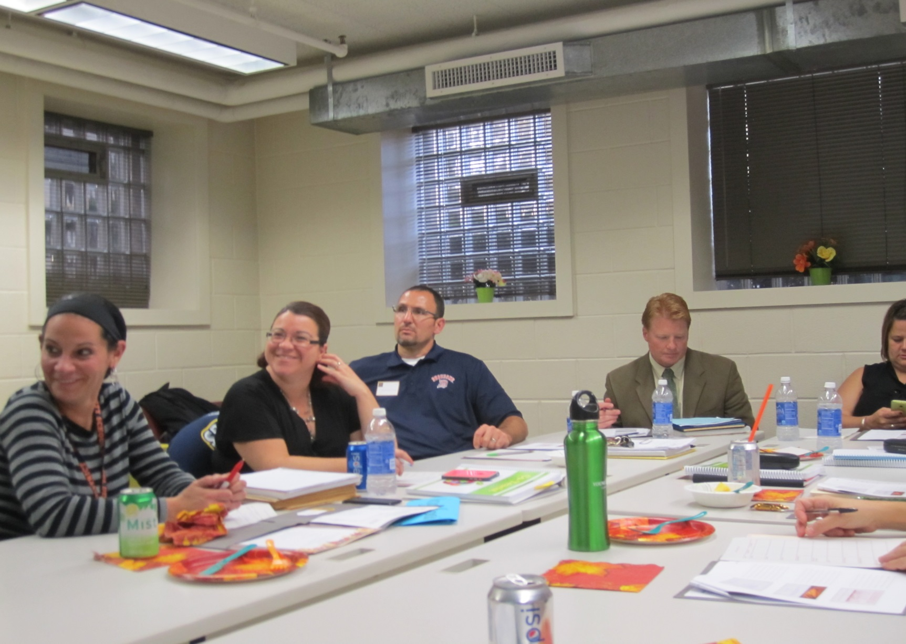
Training Sessions…

Slide 21
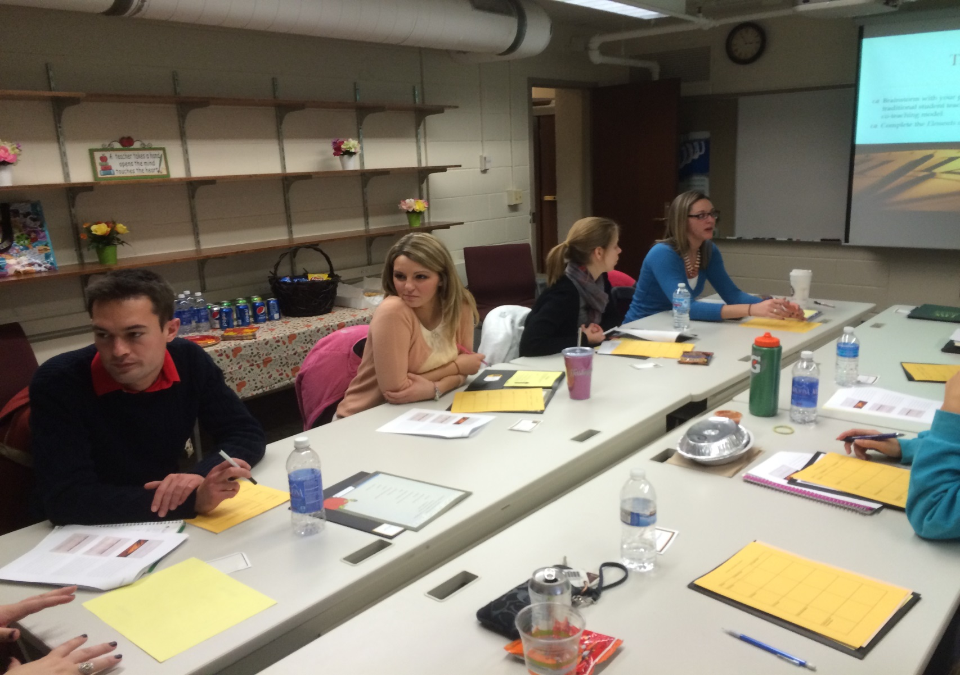
Training Sessions…

Slide 22
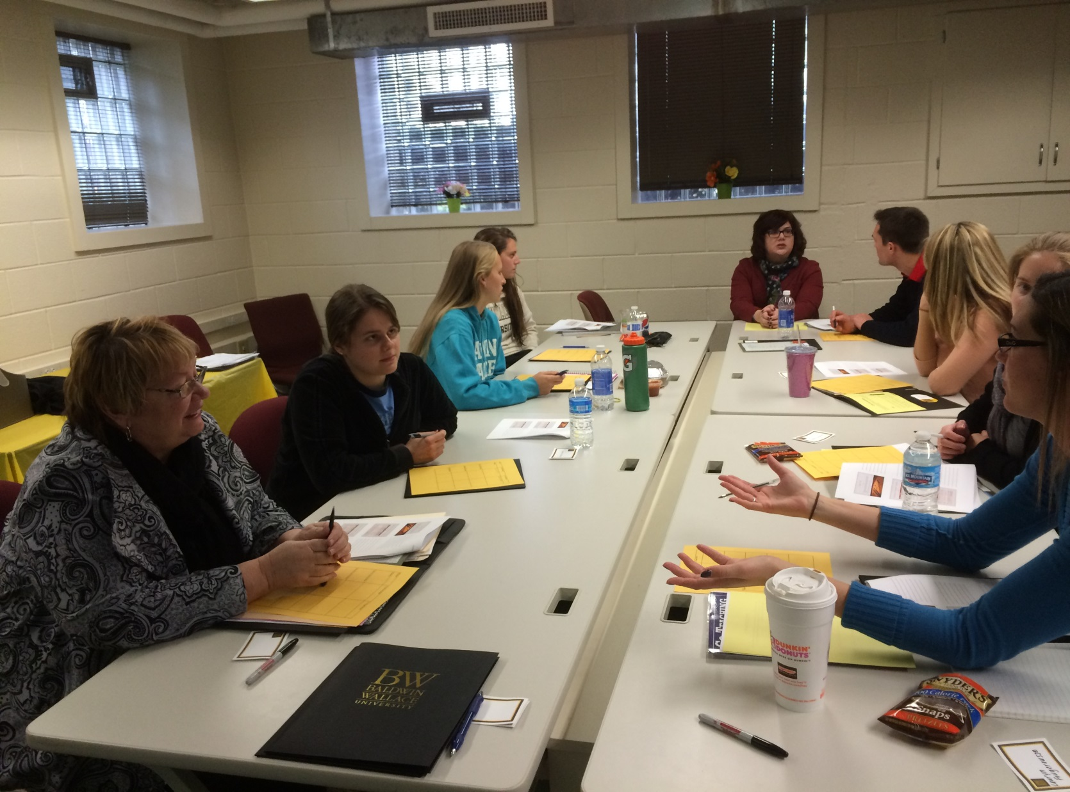
Training Sessions…

Slide 23
Teacher Candidates’ Reflections…
Ms. Ashley Stevens and Ms. Lauryn Fougerousse
Interest in co-teaching pilot program…
Initial expectations…
Benefits…
Challenges…

Slide 24
Cooperating Teachers’ Reflections…
Mrs. Roselle Orlando
Brookview Elementary School
Kindergarten
Mrs. Roberta Caleris
Ms. Carly Norman
Brook Park Memorial School
Third Grade

Slide 25
Support…
Three support sessions were planned for the cooperating teachers (February, March, and April).
One support session has taken place with the teacher candidates. Additional sessions will be scheduled based on the teacher candidates’ requests.
Website of information for the cooperating teachers and candidates was created. https://sites.google.com/site/bwcoteaching/

Slide 26
Lessons Learned…
Involvement and support of principals/superintendent
Importance of matching process
Awareness of classroom schedules
Time needed for co-planning
Use of classroom time
Dual majors (split placements)
Lesson planning variations
Methods requirements

Slide 27
References…
Bacharach, N., Heck, T., & Dahlberg, K. (2010). Changing the Face of Student Teaching
through Co-teaching. Action in Teacher Education, 32(1), 3-14.
Conderman, G., Bresnahan, V., & Pedersen, T. (2009). Purposeful co-teaching: Real cases of
effective strategies. Thousand Oaks, CA: Corwin Press.
Friend, M. (2014). Co-Teaching: Building and sustaining effective classroom partnerships in
inclusive schools. Greensboro, NC: Marilyn Friend, Inc.
Murawski, W. (2013). Leading the co-teaching dance: Leadership strategies to enhance team
outcomes. Arlington, VA: Council for Exceptional Children.
Murawski, W. (2011). Collaborate, communicate, and differentiate: How to increase student
learning in today’s diverse schools. Thousand Oaks, CA: Corwin Press.
Perez, K. (2012). The co-teaching book of lists. San Francisco, CA. Jossey-Bass.
Villa, R., Thousand, J., & Nevin, A. (2008). A guide to co-teaching: Practical tips for facilitating student learning. ( 2nd edition). Thousand Oaks, CA: Corwin Press.

