Slide 1
Conflict handling styles: Merging voices of Personality and Family
Abel Gitimu Waithaka
Youngstown State University
Raphael K. Birya
Indiana University of Pennsylvania

Slide 2
Purpose of the study
The purpose of the study was to examine the influence of personality and family conflict resolution on conflict handling styles of college students.

Slide 3
Research Question
RQ Is there a statistically significant difference in how personality and family conflict resolution influence an individual’s conflict handling style?

Slide 4
Instrumentation:
Thomas –Kilmann Conflict Mode Instrument (MODE)
Measures conflict handling styles.
Allocates individuals into two dimensions in dealing with conflict.
Assertiveness (satisfy one concerns).
Cooperativeness (satisfy concerns for others).

Slide 5
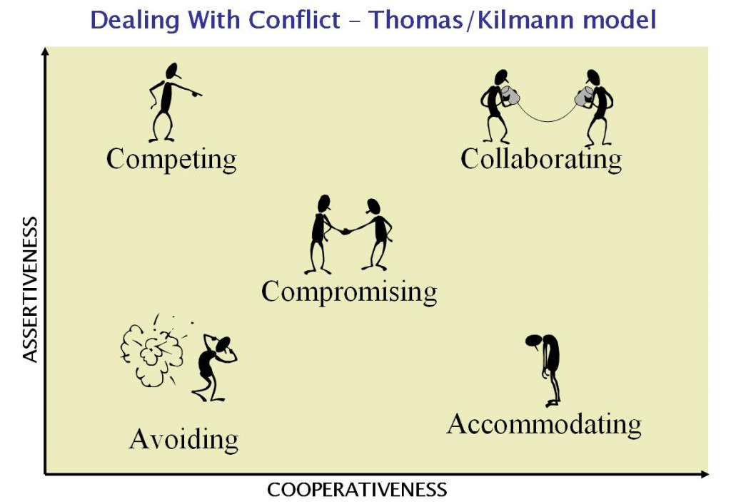

Slide 6
Instrumentation
The Five Big Inventory Instrument:
Personality measured includes:
Extraversion
Agreeableness
Conscientiousness
Neuroticism
Openness

Slide 7
Instrumentation
3. Family conflict resolution scale (FCRS)
Consists of 18 items
17 of items provide a total score for family conflict resolution.

Slide 8
MANOVA of Big Five Inventory (BFI) by Conflict Handling MODE
MANOVA was conducted with Thomas-Kilmann conflict MODE styles as the dependent variables and each of the five personalities as measured by BFI personality instrument as the factor or independent variable.
MANOVA results indicated significant effect was found for personality of Extraversion and Agreeableness on conflict handling MODE.
*Please see more details on the table
in the next slide

Slide 9
MANOVA of Big Five Inventory (BFI) by Conflict Handling MODE
Multivariate Testsª
Effect Wilks' Lambda |  | Value | F | Hypothesis df | Error df | Sig.
Extraversion |  | .645 | 1.402 | 108.000 | 1296.623 | .006*
Agreeableness |  | .632 | 1.414 | 112.000 | 1293.357 | .004*
Conscientiousness |  | .711 | 1.116 | 104.000 | 1295.835 | .207
Neuroticism |  | .687 | 1.100 | 116.000 | 1290.018 | .228
Openness |  | .690 | 1.172 | 108.000 | 1298.000 | .114

Slide 10
ANOVA of Big Five Inventory (BFI) by Conflict Handling MODE
One Way ANOVA was conducted with Thomas-Kilmann conflict MODE and the two BFI personalities that showed significant effect in the MANOVA (Extraversion and Agreeableness).
Extraversion personality showed statistically significant difference on conflict handling styles for competing and avoiding.
Agreeableness personality showed statistically significant difference on conflict handling styles for competing and accommodating
* Please see more details on the table in the next slide

Slide 11
ANOVA of Big Five Inventory (BFI) by Conflict Handling MODE
BFI Subscales | MODE Subscales | Mean Square | F | Sig.
Extraversion | Competing | 15.168 | 2.018 | .002*
 | Collaboration | 4.662 | 1.098 | .340
 | Compromising | 4.768 | 1.042 | .410
 | Avoiding | 8.975 | 2.172 | .001*
 | Accommodating | 5.395 | 1.109 | .327
Agreeableness | Competing | 13.484 | 1.766 | .011*
 | Collaboration | 5.459 | 1.307 | .142
 | Compromising | 6.535 | 1.477 | .060
 | Avoiding | 3.834 | .841 | .701
 | Accommodating | 7.767 | 1.666 | .021*

Slide 12
ANOVA of Family Conflict Resolution by MODE
One Way ANOVA was conducted with Thomas-Kilmann conflict MODE styles as the dependent variables and the Family Conflict Resolution scale totals as the independent variable.
The results showed that there was no statistically significant difference in how participants’ family conflict resolution totals impacted conflict handling styles.
* Please see more details on the table in the next slide

Slide 13
ANOVA Family Conflict Resolution by MODE
 |  | Mean Square | F | Sig.
COMPETING |  | 6.639 | .806 | .761
COLLABORATING |  | 3.040 | .691 | .893
COMPROMISING |  | 4.806 | 1.052 | .396
AVOIDING |  | 4.448 | .987 | .490
ACCOMMODATING |  | 3.342 | .661 | .918

Slide 14
Summary, Conclusion and Recommendations
Influence of BFI personality on MODE conflict handling styles
MANOVA indicated significant influence on two BFI personalities (Extraversion and Agreeableness).
ANOVA results showed a statistically significant difference in some subscales of personality and some conflict handling styles.
Extraversion was statistically significant on Competing and Avoiding styles
Agreeableness was statistically significant to competing and Accommodating styles.

Slide 15
Findings from other studies
This evidence supports research findings that indicate some personality tends to influence the choice of conflict handling styles (Moberg, 2001).
The current study did not agree with Olekalns and Smith (1999) study that argued that individuals with high extraversion tend to use integrating and compromising styles while handling conflicts (Olekalns & Smith, 1999).
This finding concurs with Kilpatrick and Johnson’s, (2001) study that reasoned that agreeableness is characterized by a strong motivation to maintain positive relationships with other people involved in a conflict.

Slide 16
Influence of family conflict resolution on MODE conflict handling styles
ANOVA showed no statistically significant difference on how participants family conflict resolution impacted conflict handling styles in all the subscales.
All participants regardless of their age, ethnicity or year of study indicated no significant difference on how their family influences their MODE of conflict handling.

Slide 17
Findings from other studies
The results defy the Social learning theory and the coercion theory
Social learning theory predicts that behavior patterns learned in the family are practiced in young adulthood (Andrews, Foster, Capaldi, & Hops, 2000).
Coercion theory predicts that infective parental conflict management styles will produce coercive, unskilled responses to family, young adult, and peer relationships (Andrews, at el., 2000).

Slide 18
Findings from other studies
Amett (1999) noted, intergenerational family conflict between parents and children is usually on the rise during early adolescence and declines by late adolescence and young adulthood
The movement from home to college leads to further loosen parental control, and this results in a decrease in overall family conflict (Lee, Su, & Yoshida, 2005).

Slide 19
Conclusion
MANOVA indicated that there was significant influence of two BFI personalities (Extraversion and Agreeableness) on the conflict handling styles as measured by the MODE instrument.
ANOVA indicated there was no impact of family conflict resolution on conflict handling styles.

Slide 20
References
Antonioni, D (1999).Predicting approaches to conflict resolution
from big five personality, Madison, WI: University of Wisconsin.
Bandura, A. (1977). Social learning theory. Englewood Cliffs, NJ:
Prentice Hall.
Breunlin, D. C., Cimmarusti, R. A., Bryant-Edwards, T. L., &
Hetherington, J. S. (2002). Conflict Resolution Training as an Alternative to Suspension for Violent Behavior. Journal of Educational Research, 95(6), 349.
Connolly, J., White, D., Stevens, R., & Burstein, L. (1987), Adolescent
self-reports of social activity: Assessment of stability and relations to social adjustment. Journal of Adolescence,10, 83- 95.
Costa, P. T., & McCrae, R. R. (1995). Solid ground in wetland: A reply to block. Psychological Bulletin, 117, 216-220.
Dadds, M. R., Atkinson. E., Turner, C., Blums, G. J., Lendich, B. (1999). Family conflict and child adjustment: Evidence for a cognitive contextual model in intergenerational transmission. Journal of Family Psychology, 13, 194-208.
Johnson, D. W., & Johnson, R. (1996). Conflict resolution and peer mediation programs in elementary and secondary schools: A review of the research. Review of Educational Research, 66, 459–506.

Slide 21
References
Katz, L. F., & Woodin. E. M. (2002). Hostility, hostility detachment, and
conflict engagement in marriage: effects of child and family functioning. Child Development, 73, 636-652.
Moskowitz, D. S., & Cote, S. (1995). Do interpersonal traits
predictaffect? A comparision of three models. Journal of Personality and Social Psychology, 69, 630-637.
Park, H. & Antonioni, D. (2007). Personality, reciprocity, and strength of
conflict resolution strategy. Journal of Research in Personality,41, 110-125.
Reese-Weber, M. (2000). Middle and late adolescents conflict resolution
skills with siblings: Associations with interparental and parent- adolescent conflict resolution. Journal of Youth Adolescence, 29, 6, 697-711
Stevahn, L. (2004). Integrating conflict resolution training into the
curriculum. Theory Into Practice, 43(1), 50-58.
Stevahn, L., Johnson, D. W., Johnson, R. T., & Schultz, R. (2002). Effects of conflict resolution training integrated into a high school social studies curriculum. Journal of Social Psychology, 142(3), 305-331.
Tedeschi, J., and R. Felson. 1994. Violence, aggression, & coercive actions.Washington, DC: American Psychological Association.

