Slide 1
Chad Wick • Katherine Prince February 25, 2013

Slide 2
Humor Me
Notes:
Brought to mind how it feels to think you going in the right direction, just to have the rug pulled out from under you………..(Funny dog video)

Slide 3
Humor Me
Notes:
Or how it feels when you do your best to collaborate and then get hit over the head…(Boehner video)

Slide 5
Stuck in Old Ways of Thinking
Notes:
In many ways, where I think we are trapped in finding our place in this day and age, goes back to the philosopher Rene Descartes who believed that the mind was separate from the body…we seem to still be caught in this philosophy…that we are somehow separate from our environment, e.g. the world, the climate, the internet,..that they are separate from ‘us.’ The revelation is that now “we” are the “we.” (slide pic of Descartes)

Slide 6
# of Mobile Devices to Exceed Human Population
Notes:
Inserting various images for you to choose from regarding mobile devices. “Mobile Darwinism” is not a hi res image—but I love the phrase; perhaps just a mention of the iPass report name “iPass released their new quarterly report entitled “The iPass Global Mobile Workforce Report: Understanding Mobility Trends and Mobile Usage Among Business Users“ covering Q1 2012. source: http://www.sharepointdownunder.com/ipass-global-mobile-workforce-report/
The colorful graphic of all the different mobile devices (against the black background is my fav and has a great RECENT article attached to it): Number of mobile phones to exceed world population by 2014 By Joshua Pramis — February 28, 2013 http://www.digitaltrends.com/mobile/mobile-phone-world-population-2014/
The ‘we’ are now 2.4 billion people connected to each other thru the internet…and, by the way, the number of digital devices connected to each other or to machines – with no humans involved – already exceeds the population of the earth—7+ billion. The latest thinking is that in another 35 years, more than 50 billion devices will be connected to the internet. The number of mobile-only users is expected to increase 56 fold over the next 5 years because in just a few years, its projected there will be as many mobile devices as there are people in the world. (slide showing mobile devices or connectivity

Slide 7
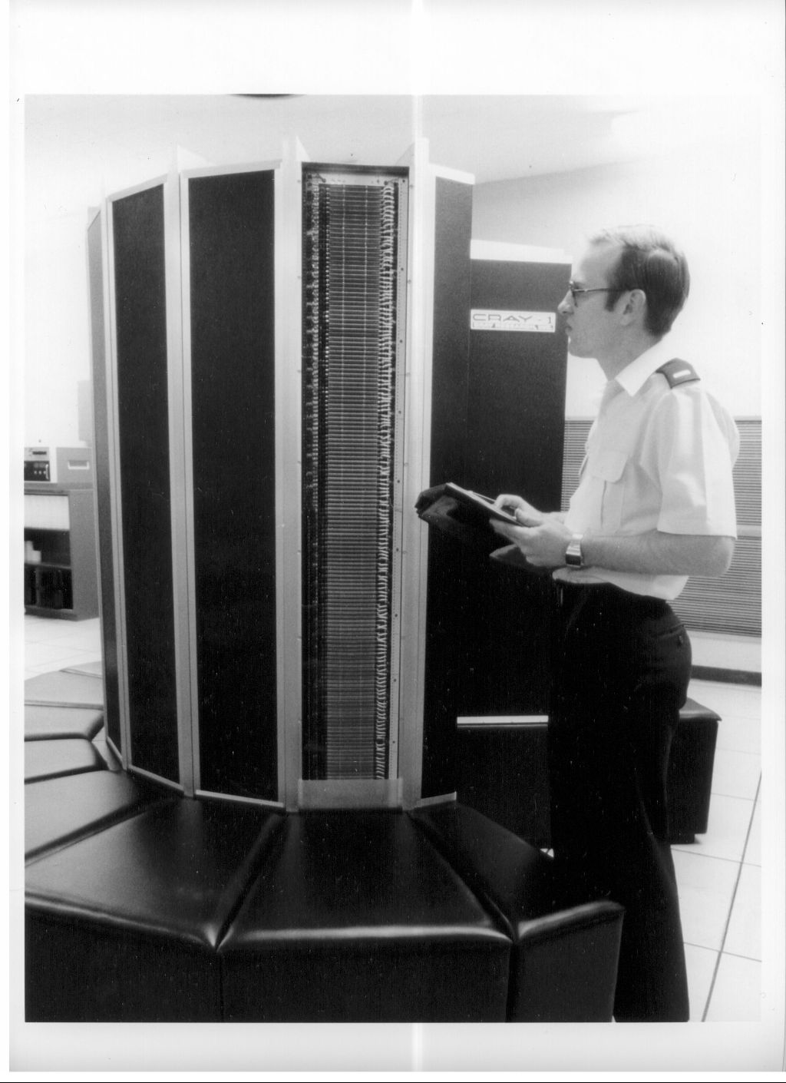
A New Epoch
Notes:
Now we are in a new epoch… and to illustrate the pace, as an example, just think, the 4th generation iPad now has more computing power than the most powerful Cray supercomputer (slide pic of Cray computer) in the world 30 years ago. Or…

Slide 8
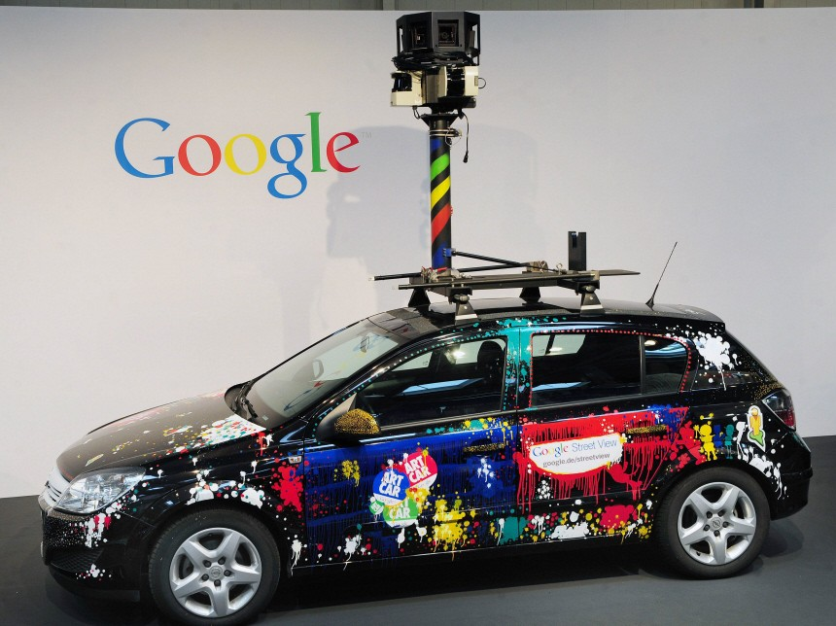
Buckle Up!
Notes:
(Slide of Google car) Google’s self-driving cars that have traveled 300,000 miles in all kinds of conditions without an accident…(BTW, what does that mean for the 373,000 taxi drivers and chauffeured cars).

Slide 9
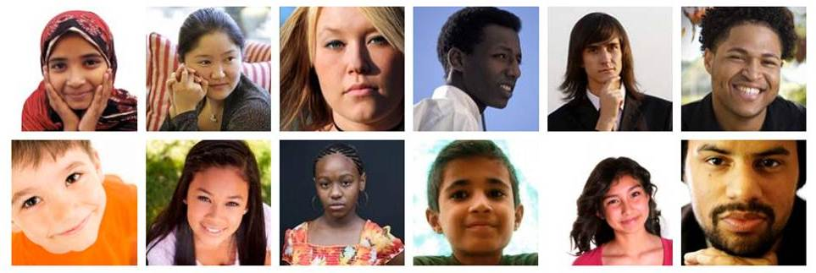
Who Are Today’s Learners?
Notes:
So who are today’s learners?...both figuratively and literally, some of the 500 million people in the world now playing online games at least 1 hour a day. In the US, students from grades 6 thru 12 on average now spend almost as much time playing online games as they spend in classrooms.
And if we harbor any notion that education is immune from dramatic change, look at the cover of this month’s Atlantic (Robots as Drs.) or even the work of a company, Narrative Science, which has developed an algorithm that produces and sells articles based on analysis of statistical data from sports events and financial news.

Slide 10
What’s That Going to Cost Us?
Notes:
And what does all this technology project regarding costs (slide – the micro picture from what you pulled out before or something representing the human genome project or the genome itself )?
One way to look at it was that 10 yrs. ago the cost to sequence the 1st human genome was about $3 billion. In 2013, detailed digital genomes of individuals will be available at about $1000 per person. So extrapolate that to education…if we can tailor pharmaceuticals to an individual’s genetic design, when we understand the equivalent ‘learning genome’ for each individual, its virtually certain we will see tools that tailor content to individual learning needs as well. (I’m on the board of ACT and they are investing heavily to get us closer to that point based on synthesizing all the vast data they have.)

Slide 11
Looking Ahead
“You can’t rely on your eyes when your imagination is out of focus.”
Mark Twain
Notes:
Quoted in A Failure of Nerve: Leadership in the Age of the Quick Fix by Edwin Friedman
KnowledgeWorks’ history with forecasting the future of learning

Slide 12
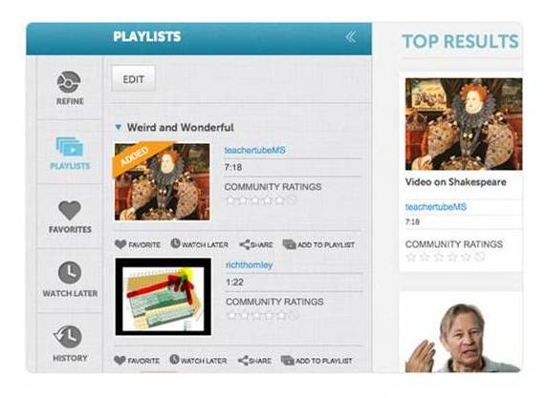
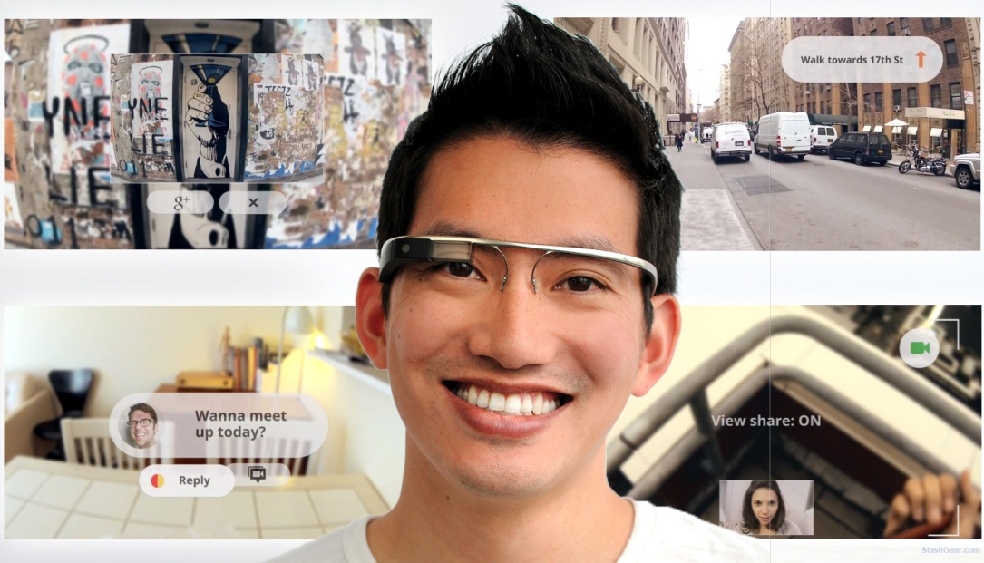
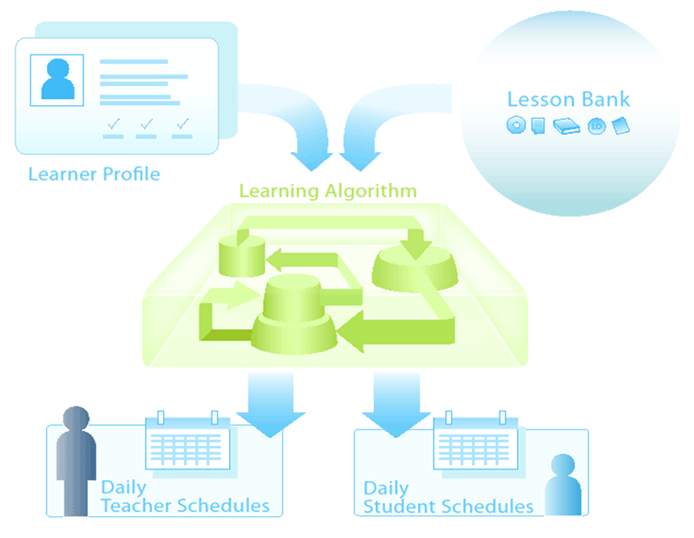
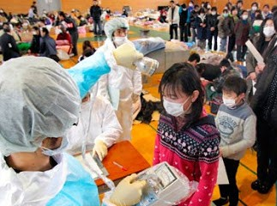
The Map of Future Forces Is Here
Notes:
We used to always refer to sci-fi writer William Gibson’s quote, “The future of education is here. It is just unevenly distributed.”
Well, seven years out from the 2006-2016 Map of Future Forces Affecting Education, we’re seeing that the future that it forecast is here.
To highlight how some of the hotspots have evolved from forecasts to reality:
Media-rich pervasive learning (Google Glass) – as of 2/20, letting people beyond developers sign up to test them by paying $1500, justifying their use, and attending a launch event
Expanded learning economy (Noodle) – “best fit opportunities from cradle to career,” founded 2010
From Mashable:
“Noodle has created the very first search engine of its kind, devoted solely to navigating the vast sea of educational information available online. Noodle’s customized search engine helps students and their families to find resources for tutors, pre-K schooling options, guidance counselors, summer camps, MBA programs, and much more. Basically, this service is revolutionizing the way we search for and locate educational opportunities suited to our needs.”
Deep personalization (School of One learning algorithm)
VUCA as the new normal (Fukushima earthquake, tsunami, and nuclear meltdown) – also constrained governmental resources at multiple levels, climate instability, etc. (define VUCA – volatile, uncertain, complex, and ambiguous)

Slide 13
Reinventing Education
Notes:
These are general notes (two versions), not a script
Continued disruption will keep breaking down traditional models, assumptions, and relationships. It will also create unexpected possibilities for those willing to experiment with the novel recombination of resources, talent, and technology.
The digital explosion has sparked innovation after innovation in how we thinking about learning and how we organize talent and resources for learning experiences. “School” as we knew it has become unbundled. Teaching and learning flow through a vibrant learning ecosystem. They’re no longer the sole purview of traditional educational institutions.
Now, all the unbundling leads to re-bundling in multiple possible recombination to create a resilient learning ecosystem comprised of many innovations and solutions. We’ll put long-established and new pieces together in many new sequences to meet learners’ needs and pursue equity for all learners.
Similar breaking apart of old models and finding new combinations as for other knowledge-based industries:
Publishers leveraging tablet computing and social media apps
US doctors making themselves to patients 24/7 via mobile comms and video conferencing to improve access to health care.
But what could learning and assessment look like if education faced the kind of disruption that Amazon brought to local bookstores or that iTunes brought to music? Or if new models emerged to meet unmet needs the way Zip Car has come to fill a niche in the car rental market?
Zipcar – “cars by the hour, ready when you are”
Now Getaround – peer-to-peer car sharing marketplace using smartphone app
Our future forecasts suggest that, during the next decade, education will go through a time of such disruptive change.
The digital explosion has sparked innovation after innovation in how we thinking about learning and how we organize talent and resources for learning experiences. “School” as we knew it has become unbundled. Teaching and learning flow through a vibrant learning ecosystem. They’re no longer the sole purview of traditional educational institutions.
But Recombinant Education forecasts that education is facing the same kind of deep disruption and reconfiguration that Amazon brought to bookselling, and then to retail more generally, and that iTunes brought to the music industry.
We expect to see learning resources and experiences fit together in a much more modular way than we are used to thinking of it, the way we now purchase individual songs more often than whole albums. To see learners develop what we might think of as individual learning playlists to meet their specific needs and goals. Some learners’ playlists will mainly or only involve a brick and mortar school. But the range of choices will go far beyond today’s spectrum of in-person, blended, or digital. So far that some learning playlists might involve learning agents accessed directly from the talent cloud but no formal organization.
For an institution to remain viable in a world of free-flowing learning experiences, the question of value will critical. Quality could be part of the answer. So could specialization. Opening boundaries might be necessary too. Because even for those students who say “yes” to a particular value proposition, their engagement with it might not be an exclusive learning relationship.

Slide 14
Five Disruptions
Notes:
Five disruptions are reshaping the learning system and leading to the rebundling that I’ve been describing.
I’ll give a brief overview of the five and then share more about the three in the middle.
New sources of innovation
Democratized Startup
Shareable Cities
New tools for understanding learning and motivation and for personalizing learning
High-Fidelity Living
New world for which we’re educating learners, with new ways of demonstrating learning
De-Institutionalized Production
New flows of learning across the ecosystem (learning resources, digital brokers and web servers, learning infrastructure, learning agents mediating across experiences, new roles for educators as learning is flipped beyond recognition)
Customizable Value Webs

Slide 15
Reimagining Educator Roles
An expanded set of learning agent roles and activities will support rich, relevant, and authentic learning in multiple settings, providing exciting career paths for existing educators and attracting new talent while also sparking creative thinking about learning.
Notes:
With our 2006 Map of Future Forces, we began to see that the trends shaping learning would have a profound impact on the teaching profession and on other educator roles.
We began exploring what was happening around multiple career pathways and new ways of conceptualizing what it meant to work with students.
With our 2020 Forecast, which we released in the spring of 2009, we started calling the educators of the future “learning agents” to help the field imagine more specifically how roles might diversify.

Slide 16
Ad-Hoc, Dynamic, and Networked Contributions +
Diverse, Specialized Talent =
Increasing Independence from Institutions
Notes:
Huge shift in the way we work and pursue other meaningful activities
Social networking has already changed how we organize and the role that organizations play.
But we’ll see organizational boundaries continue to blur
And people will depend less and less on formal organizations and institutions such as colleges and universities

Slide 17
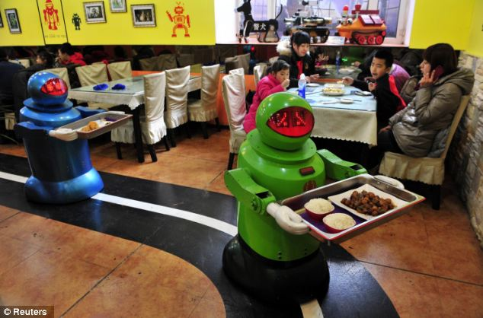
Notes:
This will be enabled by more and more organization of productive activity via social production networks
E.g., Hour Exchange Portland (time banking)
It will also be, at least for some, enforced because of two shifts
One being increasingly ad hoc employment via a global talent cloud (explain)
Another being more and more automation of routine tasks
E.g., restaurant in China with no human workers
Such shifts will radically change the skills that today’s learners need to succeed in a globally networked world
Skills in networking itself, across multiple media and platforms
Also personal brand management
And continuous career readiness to roll with ongoing changes in the employment landscape as we increasingly see the demise of full-time employment

Slide 18
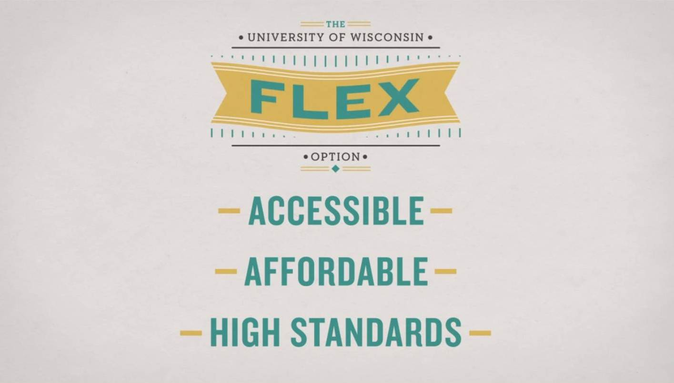
Notes:
So how does this affect learning?
We’re seeing the talent cloud come into play in the K-12 system in examples such as Presence Learning, which matches speech pathologists (shortage) with districts (budget constraints) for the specific amount of time needed to support their learners.
And tomorrow’s teachers – along with many of those who are in the classroom today – will need to shift toward more ad hoc employment.
In addition, credentialing will be completely blown open as we assemble various combinations of learning experiences and skill demonstrations across a lifetime.
We’re seeing platforms emerge that enable learners to document what they’ve learned and can do. For example, Degreed helps people credential their education experiences from both accredited and non-accredited sources, adding it all up toward the equivalent of a Bachelor’s degree. They put it in terms “jailbreak[ing] your degree.” And they’ve recently added support of over 13,000 international universities to enable learners to do this using the best courses from around the globe.
And some colleges and universities, such as Western Governor’s University, have been offering credit for mastery and life experience. In January, the University of Wisconsin launched UW Flexible Option, enabling learners to gain competency-based degrees without any class time, except for clinical or practicum work for certain degrees.
Degreed Launches Support of International Universities
By David Blake 8 February 2013 08:48
Today, we are pleased to announce that we have launched the support of over 13,000 international universities on Degreed. This is a big first step towards making Degreed the global standard by which education is measured and tracked. This is a big first step towards "jailbreaking the degree" and empowering learners worldwide to access the best courses from around the globe and collectively make something of it.
http://www.insidehighered.com/blogs/hack-higher-education/hands-degreed-%E2%80%94-jailbreaking-my-transcript
University of Wisconsin’s competency-based degrees
The UW Flexible Option: A more accessible and affordable way for working adults to reach their education and career goals. College Degree, No Class Time Required (WSJ, January 24, 2013) …Wisconsin officials tout the UW Flexible Option as the first to offer multiple, competency-based bachelor's degrees from a public university system. Officials encourage students to complete their education independently through online courses, which have grown in popularity through efforts by companies such as Coursera, edX and Udacity…No classroom time is required under the Wisconsin program except for clinical or practicum work for certain degrees. Elsewhere, some schools offer competency-based credits or associate degrees in areas such as nursing and business, while Northern Arizona University plans a similar program that would offer bachelor's degrees for a flat fee, said spokesman Eric Dieterle. But no other state system is offering competency-based bachelor's degrees on a systemwide basis. Wisconsin's Flexible Option program is "quite visionary," said Molly Corbett Broad, president of the American Council on Education, an education policy and lobbying group that represents some 1,800 accredited colleges and universities. In Wisconsin, officials say that about 20% of adult residents have some college credits but lack a degree. Given that a growing number of jobs require a degree, the new program appeals to potential students who lack the time or resources to go back to school full time. "It is a big new idea in a system like ours, and it is part of the way the ground is shifting under us in higher education," said Kevin Reilly, president of the University of Wisconsin System, which runs the state's 26 public-university campuses.

Slide 19
What skills will your graduates need to succeed amid the talent cloud?
How might you support new and existing educators in creating and preparing for a wider variety of learning agent roles?
How could the rise of flexible credentials affect your markets?
How might the need for continuous career readiness provide new opportunities for you?

Slide 20
Big Data +
Cognitive Assistants +
Contextual Feedback Systems =
Precisely Targeted Interactions
Notes:
With this next disruption, High-Fidelity Living, we’re seeing the world of information amp up.
And we’re also creating new tools and feedback systems that will help us bring a whole new level of personalization to learning.

Slide 21
Notes:
Overload plus
Ever-expanding pool of information resulting from things like GPSs, cell phones, and our online activity
From The Human Face of Big Data
http://www.humanfaceofbigdata.com/
“The average person today processes more data in a single day than a person in the 1500’s did in an entire lifetime.”
“During the first day of a baby’s life, the amount of data generated by humanity is equivalent to 70 times the information contained in the Library of Congress.”

Slide 22
Notes:
Need help managing the expanding infosphere
Use social bots and cognitive prosthetics to help manage and extend our individual capacity
We’re already changing how we manage information by using cognitive assistants
e.g. Google research on offloading memory
And we’ll see new tools for managing the information that we take in and the contributions that we make
e.g. Social bots competition (Web Ecology Project)
We’re also developing an ever-deepening understanding of cognition and motivation
So this is related to brain-based learning, but it takes it much further.
e.g., Neurofocus
Moving toward much more precise understanding of how people learn and how many kinds of factors influence learning.

Slide 23
Notes:
Rich opportunity to use data to drive decision making
In education, we’ll be able to corral data about learners’ academic performance, and also data about their social and emotional needs, to match each learner with the particular learning experiences that will help them move forward. So we’re looking at a new frontier of personalized learning.
Learning analytics and dashboards will help enable this radically personalized learning that reflects what we know of how people learn, as well as individual factors and experiences.
Desire2Learn
Suggests learning experiences and predicts performance based on past academic performance and also social and emotional condition
Rio Salado College
From AACTE scan: In another example, Rio Salado College, one of the nation’s fastest-growing public colleges, offers more than 500 relatively short online courses. Because most courses start every two weeks, students can set their own pace for learning. The college helps ensure their success by using analytics to determine within the first eight days of instruction, with seventy-percent certainty, whether a student is at risk of failing without interventions (Lumina Foundation, 2011).
Eye tracking technology is being refined at great pace allowing devices to understand our visual cues and use that data to alter the user experience. This technology will allow teachers to collect and align data from student eye movement to understand what topics students may be having trouble with, what they enjoy and what they find stimulating. Software can then read this data to tailor course material to students, customizing the learning experience. This will lead the way to gaining more accurate statistics on student understanding than is currently available from assessment and quiz based approaches. (Source: http://www.fractuslearning.com/2011/10/27/5-current-technologies-that-will-shape-our-classrooms/)
Tensions
Watch for inequities on both sides of the digital divide (flips how we’re used to thinking about it)

Slide 24
Notes:
Learning fitness instructor -- a possible learning agent role
How to help kids be aware of themselves as learners, read their own minds, understand the full spectrum of supports that they need
It can involve high-tech tools, but it doesn’t have to

Slide 25
What training will learning agents need to provide deep personalization that takes into account students’ social and emotional conditions?
Do all learning agents need to engage with learning analytics to the same extent?
How might you provide highly personalized learning agent preparation?

Slide 26
Innovative, Open Business Models +
Complex Networks of Assets and Relationships =
Customer-Centric Experiences
Notes:
I see this disruption as being core to putting things together in multiple new combinations to meet learners’ needs.
Building off what we’ve seen for some time now with open education resources and practices such as flipping classrooms, and more recently MOOC’s, we’ll have blockbuster quality learning resources that raise the question of what happens in any given learning experience.
And there will be many ways of using them – and other learning assets – to create value and meet learners’ needs.
As those ways proliferate, learners will increasingly expect to find the perfect combination of learning experiences. And if they can’t find them, they just might create them on their own.

Slide 27
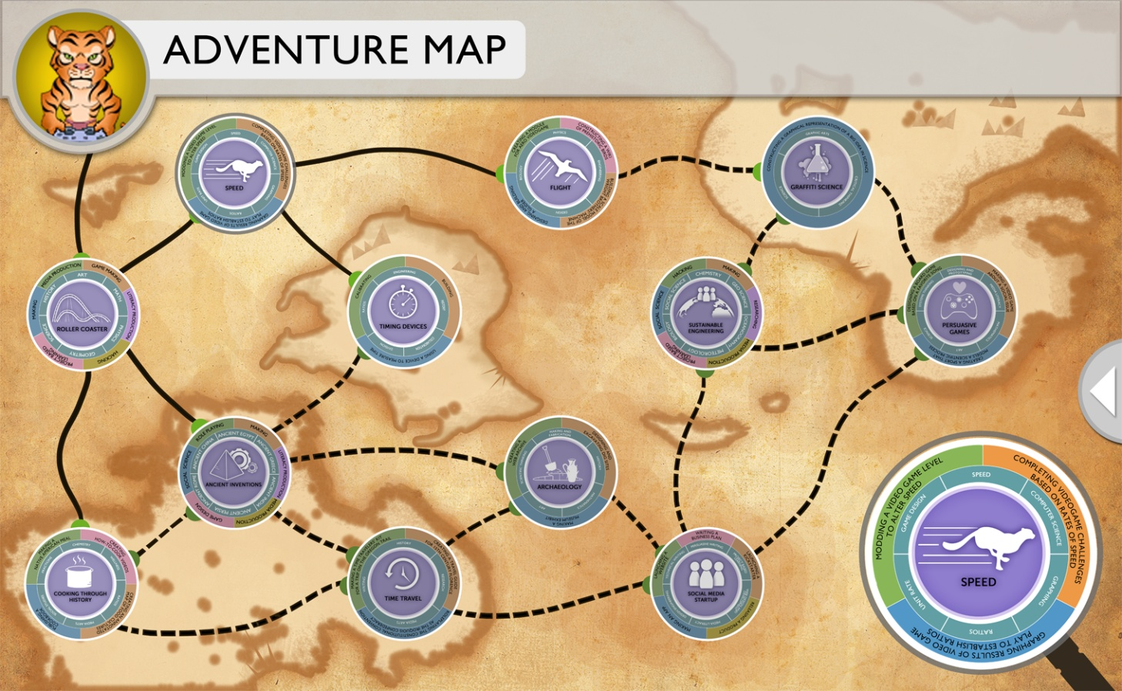
Notes:
We’re seeing learning platforms proliferate and more and more options for hyper-focused, or agile, “schools” to emerge.
Playmakers’ School – middle school students chart their own paths through the school year by building their own Adventure Maps; students learn through play, making, discovery and inquiry, and interest-driven design; funded by Gates Foundation
CalStateTEACH
From AACTE scan: Taking blended learning even further in the field of teacher preparation, CalStateTEACH, one of the California State University’s System-wide Teacher Preparation programs, blends a totally field-based course of preparation with web-based “class discussions,” with candidates never attending traditional college classes. Instead, they rely on on-site coaching and an online self-study format (Bishop and Foster, 2009).
Skillshare is a global learning community where you can learn real-world skills from real people. (skillshare.com)
Who teaches Skillshare classes?
Anyone who has knowledge to share can teach on Skillshare. You can apply to teach a global, online Skillshare class, or create a local workshop with a click of a button.
What types of classes are offered on Skillshare?
A wide range of classes are offered on Skillshare, ranging from design to entrepreneurship to crafts. At Skillshare, we believe in creative, collaborative workshops with hands-on projects to build your real-world skills.
Do Skillshare classes happen online or offline?
Both! People teach offline, in-person classes in their local communities as well as online, global classes that can be taken from around the world. You can browse both online classes as well as local classes happening in your area here.
How does Skillshare pay the bills?
Skillshare charges a 15% fee on all tickets sold. This only affects teachers; for students, the price you see is the price you pay. Posting a Skillshare class is always free, and it’s a great way to earn money while connecting to your community - some teachers even make their living off of Skillshare!

Slide 28
Notes:
Some learners could chose to have a pretty traditional brick and mortar experience as their only or primary one.
Others will could access the services of many learning agents via the talent cloud.
Still others will create individualized combinations of experiences along that spectrum.
You might think of this in terms of each learner having a learning playlist.
This is a very simple example from a website called MentorMob.
People can create, share, modify, and rate learning playlists – share skills, get feedback
“real organization when learning online”
Also a version for educators, MentorMob University, to organize playlists for learners and get real-time feedback on progress and impact
Aristotle Circle provides a similar service, but at the learning provider level. It matches learners as young as kindergarten age with learning experiences that meet their needs.
We’ll also need new kinds of infrastructure to help learners move seamlessly across learning experiences.
Shared Learning Collaborative – Platform for enabling exchange of information across learning experiences – backbone for helping learners move among rich array of choices
Shared infrastructure that enables learners to move seamlessly across multiple learning experiences and learning providers will be key in supporting the flow of learning across the ecosystem.
Shared Learning Collaborative (Gates initiative – common infrastructure aligned with Common Core)
The Shared Learning Collaborative (SLC) “supports personalized learning for all K-12 students by building an integrated and scalable technology infrastructure that links to the Common Core State Standards.” It’s providing the kind of backbone that will help individuals and learning resources move across a much more modular learning ecosystem.
This kind of digital brokering and mediation will be increasingly important in helping learners and their families make sense of their choices.
But learning agents will also be key in guiding learners and their families through a broad range of choices, and some might specialize in doing so.

Slide 29
In what ways might your institution’s value proposition(s) need to shift to remain distinct amid an increasing array of choices?
How might your institution broker learning and resources across traditional boundaries?
How might you contribute to the redefinition of teaching for a world of freely available, blockbuster-quality content?
What role will faculty play in such a learning ecosystem?

Slide 30
Collaborating to Support Learning
“Knowing how to prepare students for a lifetime of learning and the ability to diagnose why students are not learning are essential skills that teachers must have. In fact, the knowledge and skills required of today’s teachers are so extensive that it makes the creation of teams of teachers more necessary. It also reinforces the need for shared leadership and restructuring of the school day to ensure that all students are engaged in learning.”
CCSSO Task Force on Educator Preparation and Entry into the Profession
Notes:
Our Responsibility, Our Promise: Transforming Educator Preparation and Entry into the Profession, CCSSO Task Force on Educator Preparation and Entry into the Profession, 2012
For back pocket:
“States have three key policy levers — licensure; program approval; and data collection,
analysis, and reporting — they can use to drive development of these new entry systems into
the education profession. States must oversee construction of a data feedback infrastructure
that will be essential to implementation of the new entry systems. Listed below are specific
actions we will ask states to commit to take in each of the three leverage areas.”

Slide 31
A World of Continuous Learning
“Learning is no longer preparation for the job; it is the job. Today’s students are preparing for a future in which they will invent and reinvent their work, team up to solve problems, develop new knowledge, and continuously acquire new skills. They need teachers who know how to create schools that look like the learning organizations they will work in for the rest of their lives.”
Kathleen Fulton, NCTAF
Ted Britton, WestEd
Notes:
STEM Teachers in Professional Learning Communities: From Good Teachers to Great Teaching (2011)

Slide 32
Follow
knowledgeworks.org/futures-thinking
knowledgeworks.org/worldoflearning
Contact
Chad Wick
wickc@knowledgeworks.com
Katherine Prince
princek@knowledgeworks.com

