Slide 1
Ohio Department of Education
OCTEO Conference
March 23, 2012
www.education.ohio.gov

Slide 2
Contact Information
John W. Soloninka
ODE Center for the Teaching Profession
Office: (614) 387-0161
Email: John.Soloninka@ode.state.oh.us
Toll Free: (877) 644-6338

Slide 3
Educator Licensure Testing Requirements Updates:
Educator Licensure Testing (Praxis II and ACTFL/LTI) requirements are available on the ODE website
This Educator Licensure Testing Chart is updated in January and July of each year.
www.education.ohio.gov
search: Educator Licensure Examinations

Slide 4
Educator Licensure Testing Chart:
Early Childhood
(Grades PK-3)
Area of Licensure (Type and Code) | Praxis II PLT required |  |  | Praxis II subject test required
 | Test name | Test number | Qualifying score | Test name | Test number | Qualifying score
Early Childhood (71-no code) | Principles of Learning and Teaching Early Childhood (P-3) | 0521 | 166 | Education of Young Children | 0021 Or *5021 | 166

Slide 5
Educator Licensure Testing:
Disclaimer: Educator Licensure tests and qualifying scores listed in the ODE charts and on the ETS website are subject to change
by the Ohio State Board of Education.

Slide 6
Educator Licensure Testing Requirements Updates:
Praxis test code numbers that begin with a “5” indicate that the test is available in computer format.
These tests will continue to be available in paper format.
The qualifying score for both computer and written format is the same.

Slide 7
Educator Licensure Testing Requirements Updates:
Effective September 2012 qualifying scores and/or code numbers for the following tests will change as indicated.
- The qualifying score for #0101 Business Education will change from 148 to 154
- The qualifying score for #0204 Teaching Reading will change from 154 to 159
- The qualifying score for #0354 Special Education: Core Knowledge and Application will change from 145 to 151

Slide 8
Educator Licensure Testing Requirements Updates:
Pending State Board of Education Action: The following tests are being recommended to replace previous tests:
#0621 Principles of Learning and Teaching Early Childhood will replace #0521. The proposed qualifying score is 157.
#0622 Principles of Learning and Teaching K-6 will replace #0522. The qualifying score is 160.
#0623 Principles of Learning and Teaching 5-9 will replace #523. The qualifying score is 160.
#0624 Principles of Learning and Teaching 7-12 will replace #0524. The qualifying score is 157.

Slide 9
Educator Licensure Testing Requirements Updates:
Pending State Board of Education Action: The following tests are being recommended:
#0134 Art: Content Knowledge will replace #0133. The proposed qualifying score is 158.
#0051 Technology Education is a new test with a qualifying score of 159.

Slide 10
Educator Licensure Testing Requirements Updates:
Other Praxis tests under consideration:
#0272 Deaf and Hard of Hearing
#0282 Visual Impairment
#0421 School Counselor
#0691 Early Childhood Intervention Specialist

Slide 11
Title II Report
The Title II website is open through April 30, 2012 for IHEs to complete the institutional report which includes editing and changing specific sections of the report:
Admission Requirements
Goals
Assurances
ETS is providing all IHE assessment data to Westat which will then be uploaded into each IHE report.
The Title II website is:
https://title2.ed.gov/Title2IPRC/default.aspx

Slide 12
Resident Educator Program Summative Assessment
- Advisory Group for the Ohio Resident Educator Summative Assessment
Teachscape
OSTP

Slide 13
Common Core Standards and PARCC
James Wright
ODE Office of Curriculum and Assessment
Email: James.Wright@ode.state.oh.us
Toll Free: (877) 644-6338

Slide 14
PARCC Overview
Presenter: James Wright, ODE Director Curriculum and Assessment
OCTEO March 23, 2012

Slide 15
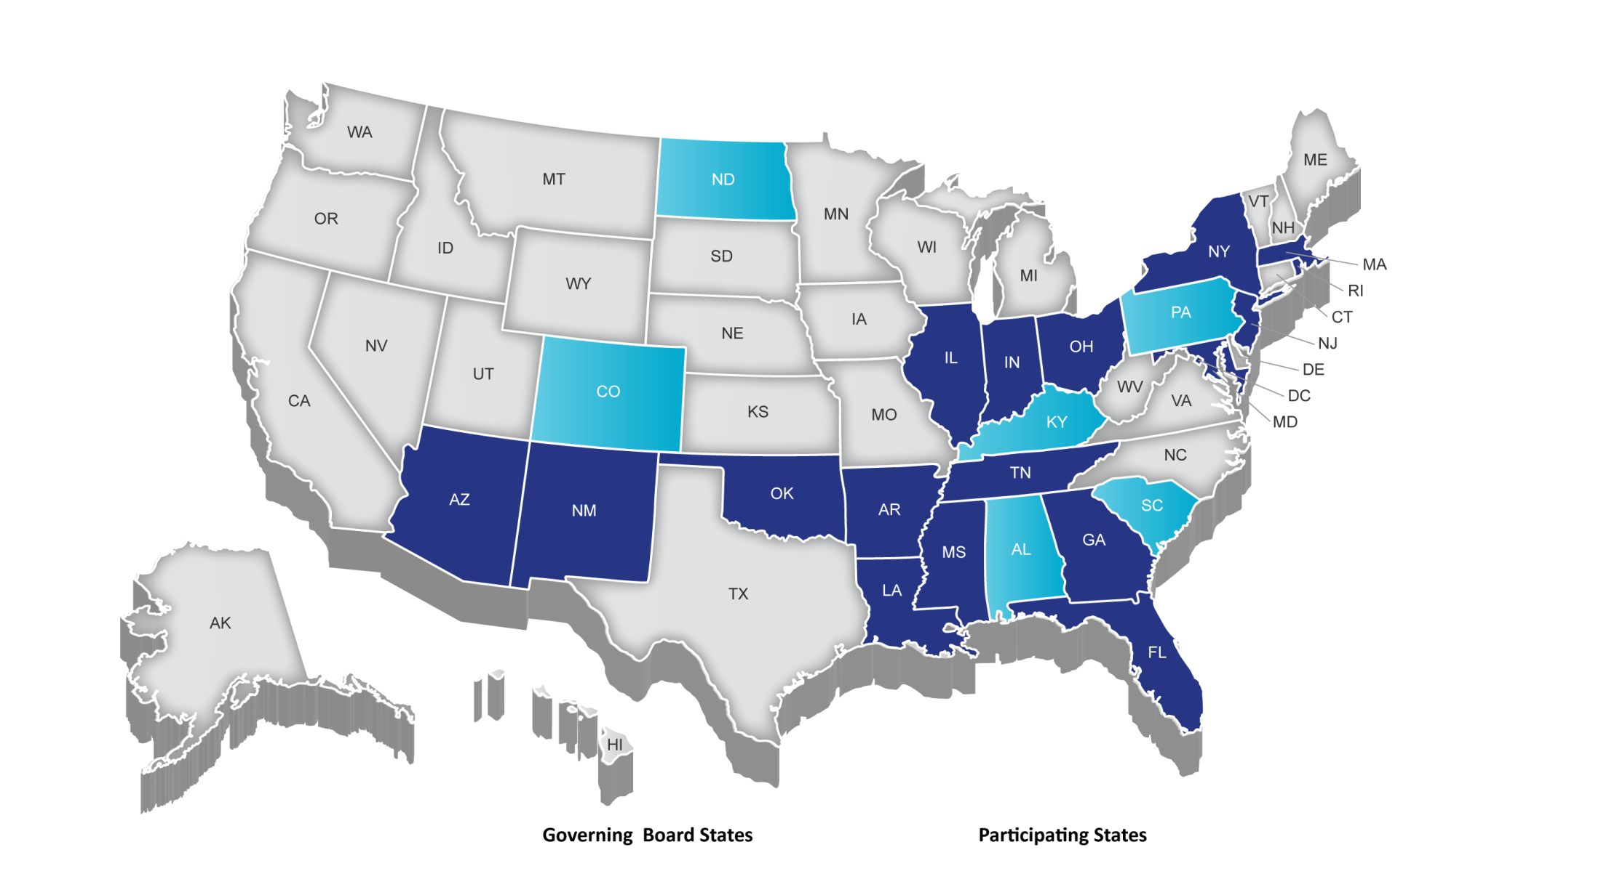
Partnership for Assessment of Readiness for College and Careers (PARCC)
Governing Board States Participating States

Slide 16
PARCC Governance
Governing Board
Deals with major policy issues
Advisory Committee on College Readiness (ACCR)
Advises Governing Board on postsecondary issues
Steering Committee
Technical Advisory Committee (TAC)
Responsible for technical and research work
Leadership Team (LT)
Responsible for operation and management
Higher Education Leadership Team (HELT)
Responsible for postsecondary engagement to advance college readiness
Technical Working Groups (TWG)
Domain-specific technical advisors, appointed by TAC and Leadership
Operational Working Groups (OWG)
Responsible for day-to-day-aspects of specific areas (e.g. design, research, technology, accessibility & accommodations)
Content Leads
Groups responsible for aspects of content-specific areas
HELT Working Groups
Responsible for advancing research and planning around key higher education issues
Notes:
You might want to reference who on staff is responsible for each area.
Established OWGs
assessment design; research; technology; accessibility, accommodations and fairness; CCSS implementation and educator engagement; procurement; K-2; performance levels; and communications. OWGs are comprised of state and district leaders with relevant expertise, and each working group is chaired by a member of the K-12 Leadership Team.

Slide 17
Goals of the PARCC System
Create high-quality assessments
Build a pathway to college and career readiness for all students
Support educators in the classroom
Develop 21st century, technology-based assessments
Advance accountability at all levels
Build an assessment that is sustainable and affordable
Notes:
Notes:
4. Develop 21st century, technology-based assessments includes developing and implementing automated scoring systems and processes to deliver quick results

Slide 18
Building a Pathway to College and Career Readiness for All Students
Optional K-2 formative assessment being developed, aligned to the PARCC system
Timely student achievement data showing students, parents and educators whether ALL students are on-track to college and career readiness
College readiness score to identify who is ready for college-level coursework
Targeted interventions & supports:
12th-grade bridge courses
PD for educators
K-2
3-8
High School
SUCCESS IN FIRST-YEAR, CREDIT-BEARING, POSTSECONDARY COURSEWORK
ONGOING STUDENT SUPPORTS/INTERVENTIONS
Notes:
Optional K-2 Formative Tools : Measure student knowledge and skills across the full range of CCSS; produce results that identify appropriate interventions or enrichment activities; support measures of growth.
To help states measure student knowledge and skills across the full range of the CCSS, PARCC will develop optional assessment components for grades K–2. These formative tools will consist of developmentally-appropriate measures, including observations, checklists, running records and performance tasks that reflect milestones within given windows during the school year. The measures will produce results that identify appropriate interventions or enrichment activities and will be capable of supporting measures of growth.
The voluntary K-2 tools will provide states with a model for administering a fully aligned K-12 assessment system, measuring the full range of the Common Core State Standards.
The K-2 tools will help educators prepare students for later grades and provide information for educators about the knowledge and skills of the students entering third grade, allowing classroom teachers and administrators to adjust instruction as necessary.
The K-2 tools are being designed to curtail learning gaps that develop during these early years, gaps that are often very hard to mitigate in later years.
Timeline: Development expected Spring 2013
College Bridge Courses: Develop a set of college readiness tools aligned to the CCSS and PARCC assessments; strengthen alignment between K-12 and postsecondary; prepare students for postsecondary opportunities
Timeline: Expected Winter/Spring 2014

Slide 19
Developing the PARCC Assessment System
Notes:
K-12 Educators
HE Faculty

Slide 20
Key Advances of the Common Core
ENGLISH LANGUAGE ARTS/LITERACY
Balance of literature and informational texts; focus on text complexity
Emphasis on argument, informative/ explanatory writing, and research
Literacy standards for history, science and technical subjects
MATHEMATICS
Focus, coherence and clarity: emphasis on key topics at each grade level and coherent progression across grades
Balance between procedural fluency and understanding of concepts and skills
Promote rigor through mathematical proficiencies that foster reasoning and understanding across discipline
ANCHORED IN COLLEGE AND CAREER READINESS
Notes:
TALKING POINTS
ELA/LITERACY
Reading
Balance of literature and informational texts
Focus on text complexity and what students read
Writing
Emphasis on argument and informative/explanatory writing
Writing about sources (evidence) – answer questions that require students to have read the text
Inclusion of formal and informal talk
Literacy standards for history, science and technical subjects
Promotes the idea that teaching literacy skills is not just the job of the English teacher
Complements rather than replaces those subjects
MATHEMATICS
Focus, coherence and clarity
Focus on key topics at each grade level
Coherent progressions across grade levels
Addresses long-heard criticism of mile-wide, inch-deep math curricula
Balance between procedural fluency and understanding of concepts and skills
Content standards require both conceptual understanding and procedural fluency
Mathematical proficiencies
Mathematical proficiencies students should develop (e.g., abstract reasoning, modeling, precision, perseverance, strategic use of tools, making arguments)
Using mathematics to understand a problem – even in new or unfamiliar contexts
Speaking and Listening (if you want to discuss)
BOTH CONTENT AREAS
Anchored in college and career readiness
Explicitly define the knowledge and skills that students must master to be college and career ready by the end of high school, and the knowledge and skills in each grade that build towards that goal
These are the key “shifts” in the Common Core.
Work that is being informed by these shifts. Model Content Frameworks
Item Prototypes
Item Development work

Slide 21
PARCC Assessment Design English Language Arts/Literacy and Mathematics, Grades 3-11
2 Optional Assessments/Flexible Administration
Diagnostic Assessment
Early indicator of student knowledge and skills to inform instruction, supports, and PD
Non-summative
Mid-Year Assessment
Performance-based
Emphasis on hard-to-measure standards
Potentially summative
Performance-Based
Assessment (PBA)
Extended tasks
Applications of concepts and skills
Required
End-of-Year
Assessment
Innovative, computer-based items
Required
Speaking And Listening
Assessment
Locally scored
Non-summative, required
Notes:
UNIVERSAL DESIGN
To address the priority purposes, PARCC states are developing an assessment system comprised of four components. Each component will be computer-delivered and will leverage technology to incorporate innovations.
Two summative, required assessment components designed to
Make “college- and career-readiness” and “on-track” determinations
Measure the full range of standards and full performance continuum
Provide data for accountability uses, including measures of growth
Two interim, optional assessment components designed to
Generate timely information for informing instruction, interventions, and professional development during the school year
In English language arts/literacy, an additional required, non-summative component will assess students’ speaking and listening skills
TALKING POINTS
Graphic depiction of the assessment system. The system includes a suite of assessments and tools that, taken together, provide a more complete picture of student mastery of standards and progress throughout the year than is currently available on state assessments.
Considerations Leading to 2 optional assessments:
The cost of the assessments
Flexibility on when to administer the optional assessments
The amount of testing time needed to administer the assessments
Possible disruption to school schedules caused by through-course assessment preparation and administration
Constraints the distributed design might have on the flexibility of state and local educators to sequence instruction of the CCSS and to implement their own benchmark and formative assessment initiatives
The PARCC assessment system will:
Reflect the sophisticated knowledge and skills found in the English and math Common Core State Standards
Include a mix of item types (e.g., short answer, richer multiple choice, longer open response, performance-based)
Make significant use of technology
Include testing at key points throughout the year to give teachers, parents and students better information about whether students are on track or need additional support in particular areas
Diagnostic Assessments
One element of the reading diagnostic assessment is a text complexity tool, which will provide a diagnostic of a student’s ability to read texts independently in order to provide useful guidance to educators, parents, and students about appropriate texts for students when reading independently.
These assessments will be useful for the implementation of the ELA/Literacy CCSS in the classroom, as they will help educators meet the demands of the ELA/Literacy standards to teach appropriately complex texts by helping teachers understand what “appropriately complex” really means.
The diagnostic assessment in math will help educators understand the extent to which students have mastered the key ideas in mathematics ("highlighted domains") in order to pinpoint areas needing improvement or identify areas in which students are excelling. In addition, it will provide greater detail about students who are above and below grade level so teachers can individualize instruction
Timeline: Expected Summer/Fall 2014
HS Assessments
Taken together, the PARCC assessment components comprise a comprehensive system of assessments that will provide timely information to teachers throughout the year, and provide students with meaningful information about their progress toward college and career readiness

Slide 22
Claims Driving Design: ELA/Literacy
Students are on-track or ready for college and careers
Students build and present knowledge through research and the integration, comparison, and synthesis of ideas.
Reading Literature
Students read and comprehend a range of sufficiently complex texts independently
Students write effectively when using and/or analyzing sources.
Reading Informational Text
Vocabulary Interpretation and Use
Written Expression
Conventions and Knowledge of Language
Notes:
These are the areas emphasized on the assessment.

Slide 23
Claims Driving Design: Mathematics
Students are on-track or ready for college and careers
Students solve problems involving the major content for their grade level with connections to practices
Student demonstrate fluency in areas set forth in the Standards for Content in grades 3-6
Students solve problems involving the additional and supporting content for their grade level with connections to practices
Students express mathematical reasoning by constructing mathematical arguments and critiques
Students solve real world problems engaging particularly in the modeling practice
Notes:
All on the same level

Slide 24
PARCC: More Than Just Another Test
To support state efforts to implement and transition to the Common Core and next generation assessments, PARCC will facilitate:
Strategic planning and collective problem solving for the implementation of CCSS and PARCC assessments
Collaborative efforts to develop the highest priority instructional and support tools
Multi-state support to build leadership cadres of educators
Multi-state support to engage the postsecondary community around the design and use of the assessments
Technology transition support for state and district
Notes:
Institutes and TIPS
Model Content Frameworks
Model Instructional Units
Professional Development Modules
Partnership Resource Center
Item Prototypes
K-2 diagnostic
ELCs
Postsecondary Outreach
Technology transition – Tech Readiness Tool (needs assessement), working with states to look at purchases that they use for instruction and that can be used to administer the assessment

Slide 25
PARCC Timeline Through 2011-12
PARCC Tools & Resources
Model Content Frameworks released
(Nov 2011)
Educator Leader Cadres launched
Item & task prototypes released
Fall
2011
Winter
2012
Spring
2012
Summer
2012
Fall
2012
Updated Model Content Frameworks Released
Item development begins
PARCC Assessment Implementation

Slide 26
Timeline Through First PARCC Administration in 2014-2015
PARCC Tools & Resources
Partnership Resource Center launched
Professional development modules released
K-2 Formative Tools Released
College-ready tools released
Diagnostic assessments released
Summative PARCC Assessments
Spring
2013
Summer
2013
Fall
2013
Winter
2014
Spring
2014
Summer
2014
Fall
2014
Winter
2015
Spring
2015
Pilot/field testing begins
Model Instructional Units Released
Expanded field testing of diagnostic assessment
Expanded field testing
Optional Diagnostic and Midyear PARCC Assessments
Standard Setting
PARCC Assessment Implementation

Slide 27
The Partnership for Assessment of Readiness for College and Careers
March 2012
Sign up for PARCC Place Newsletter and Updates at www.parcconline.org

