Slide 1
Tech Tools We’ll Keep After COVID
that You Should, Too!
Jennifer Garrette Lisy & Michele Nobel
Ohio Wesleyan University
OCTEO Fall 2020

Slide 2
Scan to download the presentation and links
https://tinyurl.com/techocteo

Slide 3
Zoom Tools We Love
Breakout rooms
For group work - Have each group fill out a Google Slide about their discussion
For individual conferencing - Put each student in their own room and conference with each student
Polling Features
Automatic cloud recording
Don’t have to remember to record
Can automatically save chat & audio transcript - loosely CC
Jen is recording traditional classes for students who are absent!
Need help getting started?

Slide 4
Google Docs to capture/monitor group discussions in video breakout rooms
Examples:
TDQs Stalin Article
Google Doc for Discussion Groups
Google Doc for Student-led Groups
Need help getting started?

Slide 5
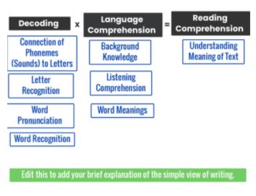
SeeSaw
Create a class
Assign task
Practice skills
Can include writing, drawing, video, audio, photos!
100 ways to use Seesaw
Simple View of Reading activity
Demonstration here

Slide 6
Helpful hints:
Do a low-stakes one first
Be sure they can use it
Private or public topics
Helpful for checking in with remote learners or on project status
Accessibility features
Including some automatic CC
Ease of use
Mobile & low bandwidth friendly
Leave open long enough for viewing & responding
Michele’s Educator Login for Flipgrid
Need help getting started?
Use?
Replacement for discussion board/in-person
Fun way to build classroom culture
Include remote/hybrid learners
Assessment
Presentations
The basics:
Flipgrid is free… Just open an educator account
Create a Group… then a Topic
Share & Connect!

Slide 7
Edpuzzle
Tool to have students engage with videos
Embed questions into videos: Multiple choice or short answer
Note taking option available as well
Sound Wall Lesson Example
Gradebook Page Sample
Grading Page Example
Need help getting started?

Slide 8
Podcasts
Great alternatives to journal articles
Created guided questions to use while they listen to podcast
Come to class ready to discuss
Submit a podcast rather than a traditional assignment
Sample Podcast Response Form: Science of Reading Podcast
Need help getting started?

Slide 9
Google Forms for Quick Check-in/Reflections
Check-in at the end of an online module
Example of Reading Reflection for semester readings
Need help getting started?

Slide 10
Want to check out more tech tools you may love?
Here are some of our favorite resources:
Epic Etext of Web Tools and Apps
Cult of Pedagogy Podcast
House of Ed Tech

Slide 11
Thank you!
Jennifer Garrette Lisy
Visiting Professor of Literacy Education
jglisy@owu.edu
Michele Nobel
Assistant Professor of Special Education
mmnobel@owu.edu
@michele_nobel

