Slide 1
Integrating Technology to Support Personal Learning Goals for College and Career

Slide 2
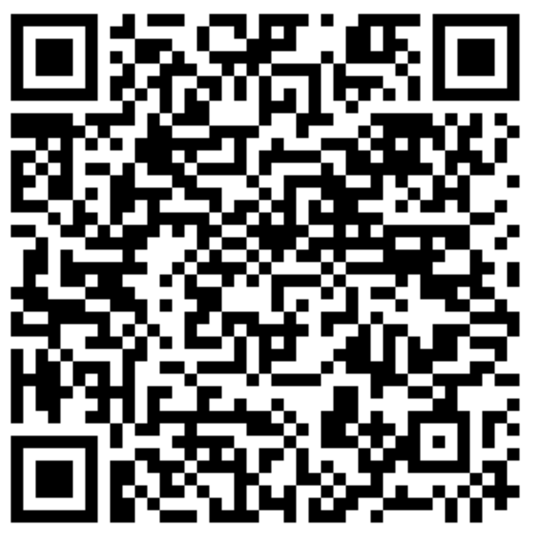
This session seeks to provide teacher educators unique technology resources which they could share with teacher candidates to empower P-12 students to embrace the vision outline in ISTE Student Standard 1A.
Students:
articulate and set personal learning goals,
develop strategies leveraging technology to achieve them,
and reflect on the learning process itself to improve learning outcomes.

Slide 3
The Problem

Slide 6
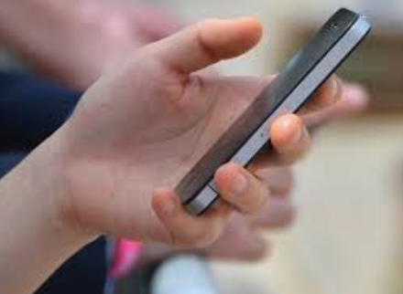
Pickups
Deloitte (2018): Americans are viewing their smartphones on average 52 times per day
Asurian (2017): Americans check their phones 80 times daily—or once every 12 minutes
Mayyasi (2016): Millennials check their phones 150 times daily

Slide 7
Multitasking
Does it exist? Simple tasks only.
Folding laundry
Watching TV
“Rapid toggling”
Brief "bottleneck" in the prefrontal cortex
“Switching costs”
Marshmallow Test v. Buzzing Phone
(Sullivan, 2013; Murphy Paul, 2013)
Notes:
What many call multitasking is really “rapid toggling” between tasks
The brain focuses one one and then quickly switches to the other
But there’s a cost: it takes time to re-immerse your mind in one topic or another.
She compares it to the famous marshmallow test, which shows that children who can delay eating one marshmallow for 10 or 15 minutes on the promise of gaining a second one are the most likely to succeed later in life. In a new "marshmallow" test, educators or employers might test to see how long people can resist "a blinking inbox or a buzzing phone."

Slide 8
Multitasking Costs
Time increases
Mental fatigue = more mistakes
Impaired memory with divided attention
Poorer grades
Temporarily reduce IQ by 15 points
Increases stress, anxiety, and depression
Simply being in view of multitasking can lower your comprehension by 17%
(Alban, 2019; Murphy Paul, 2013; Sana, Weston, & Cepeda, 2013)

Slide 9
College Transition
Research has shown that first-year students spend time in inefficient ways (Thibodeaux, J., Deutsch, A., Kitsantas, A., & Winsler, A., 2017).
Connection between GPA goal setting and achievement revealed that first year students may lack the self-regulation needed to meet these goals, possess unrealistic expectations, or struggle to override prior habits (Thibodeaux, J., Deutsch, A., Kitsantas, A., & Winsler, A., 2017).
Social Media creates greater funds of knowledge and social capital for first-generation college students (Rowan-Kenyon, H. T., M. Martínez Alemán Ana, & Savitz-Romer, M., 2018).
“Cyber-slacking” has become an increasingly large problem for college students, and instructors can help students by:
Building student awareness about their actions
Integrating mobile technology into the classroom as a teaching strategy
“Teach students self-regulation strategies such as goal setting, behavior monitoring, time management, and environmental arrangement” (Flanigan, A. E., & Kiewra, K. A., 2018, p. 592).

Slide 10
Session Overview
This session challenges instructors and teachers to consider integrating digital tools in content area courses that support self-regulation and promote student agency beyond the P-12 setting which could assist in successful college-transition.
Time Management & Organization
Study Skills & Supports
Social Capital

Slide 11
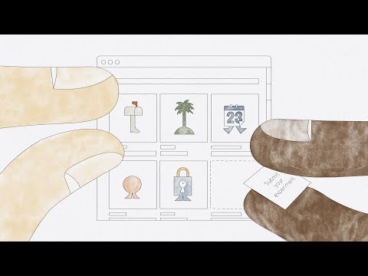

Slide 12
Time Management & Organization

Slide 13
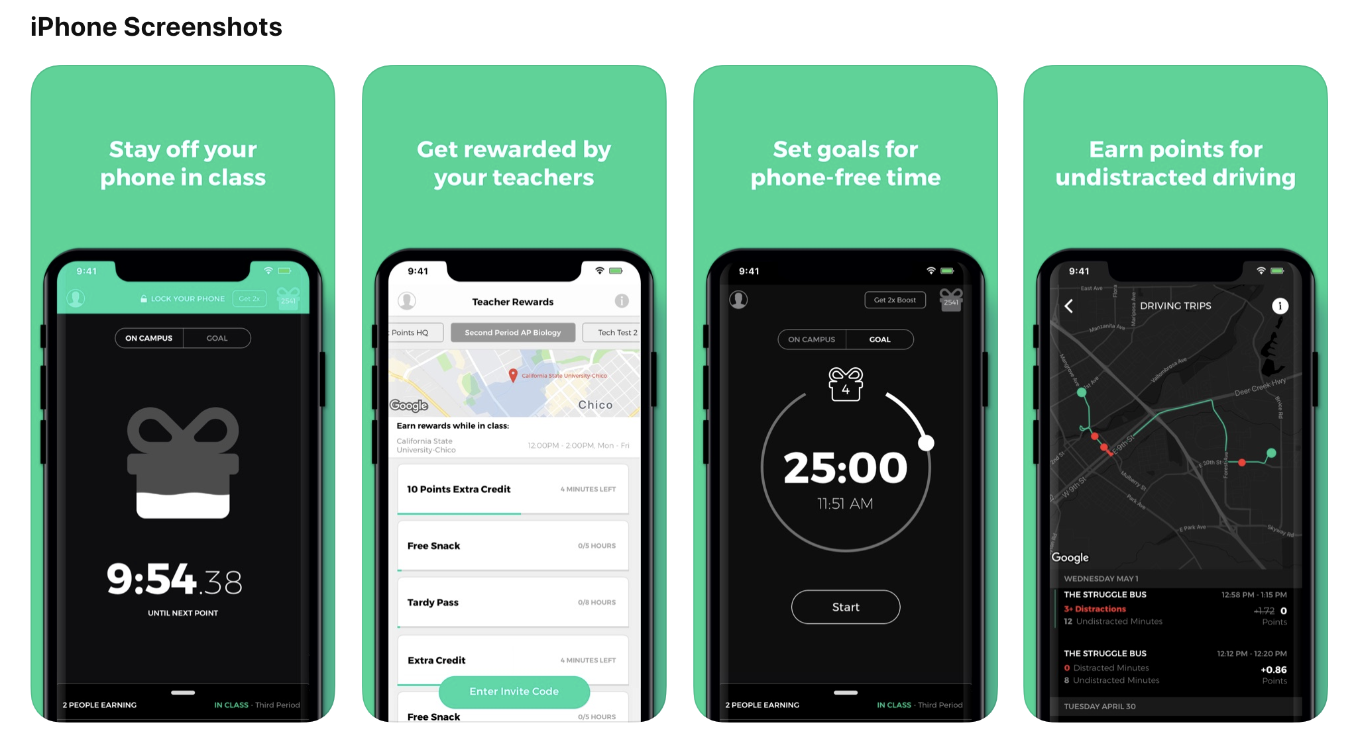
Pocket Points App

Slide 14
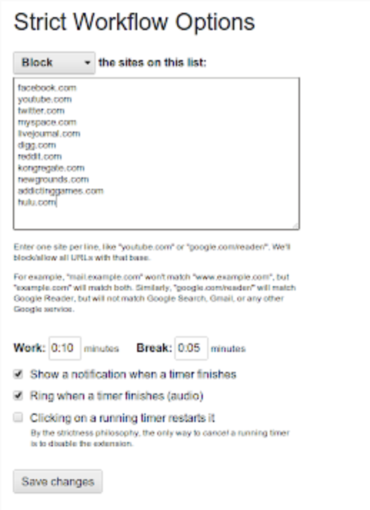
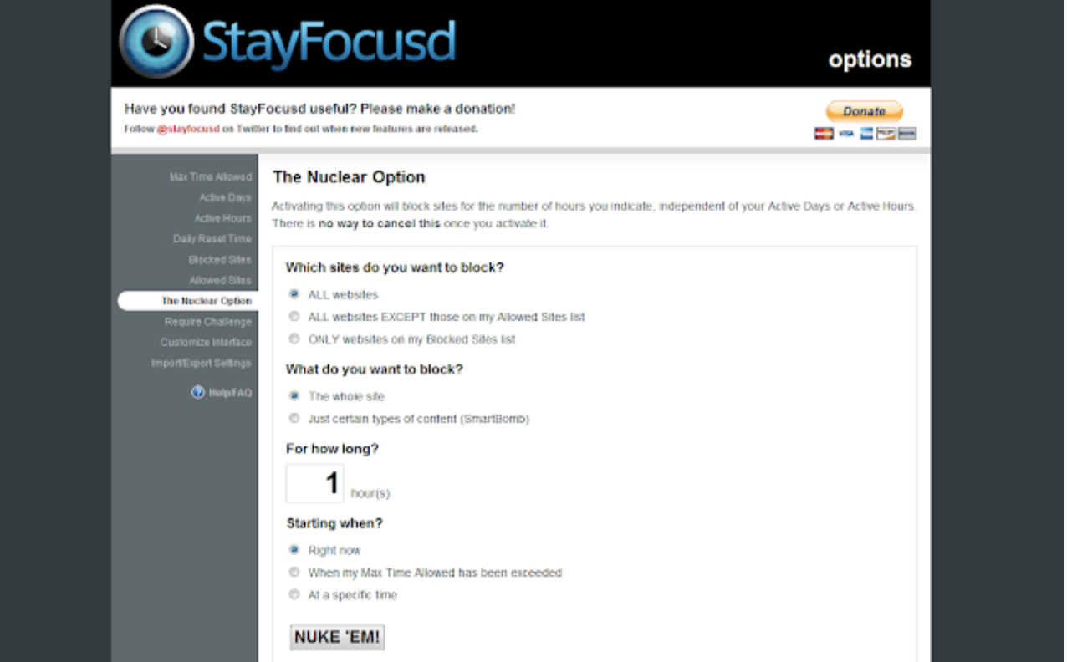
Focusing Google Chrome Extensions

Slide 15
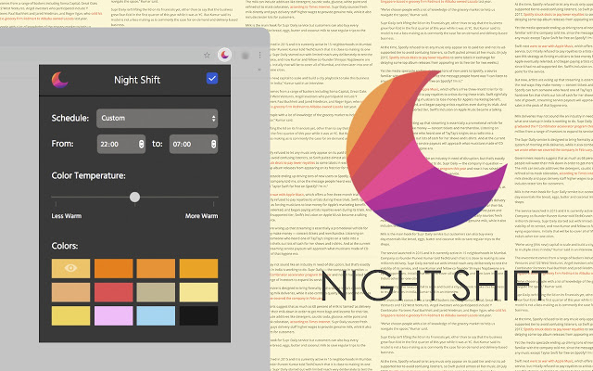
Night Shift

Slide 16
Study Skills & Supports

Slide 17
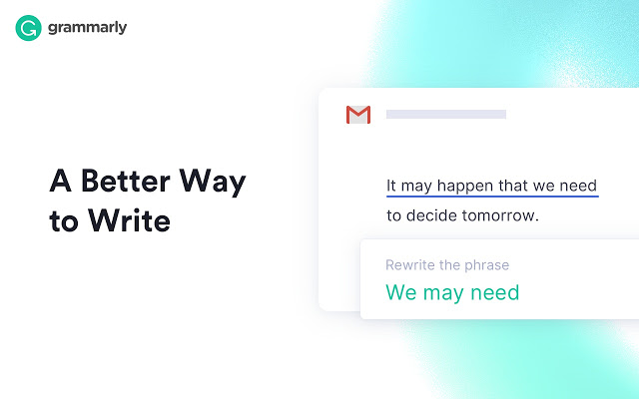
Grammarly

Slide 18
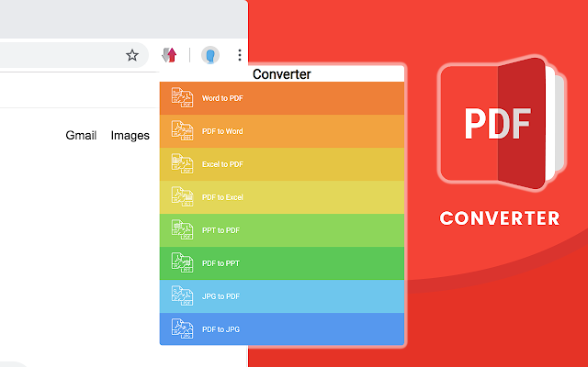
PDF Converter

Slide 19
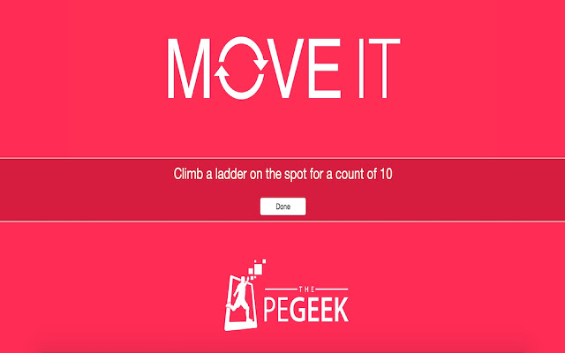
Brain Breaks

Slide 20
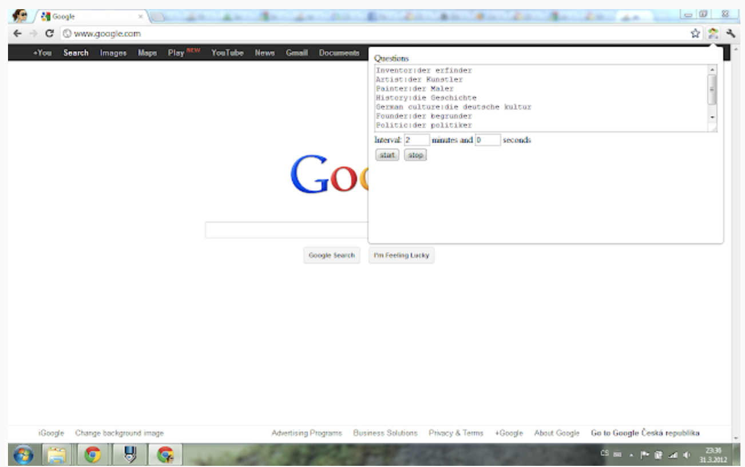
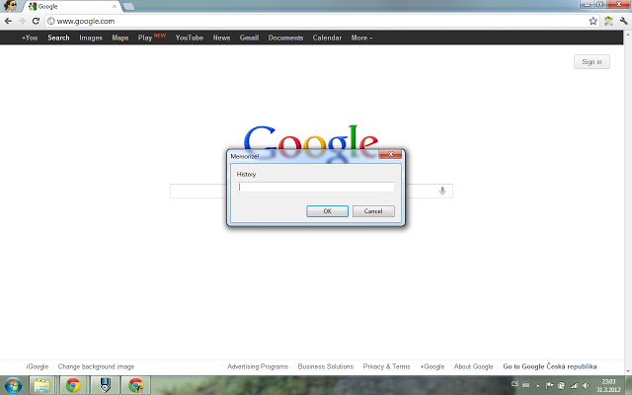
Study/Memorize

Slide 21
Discussion
In what courses at your university could these technology ideas be introduced to teacher educators?

Slide 22
Social Capital

Slide 23
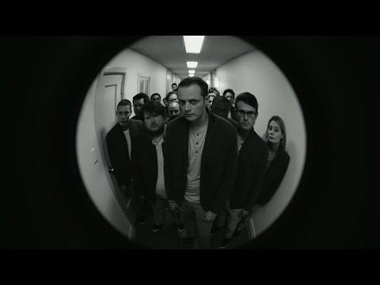

Slide 24
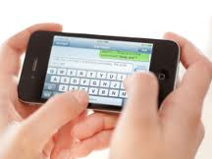
College Students and Texting
91% text during class
62% felt texting should be allowed
75% checked for texts at least once an hour
35% checked social networks at least once an hour
41% felt moderately to highly anxious if they could not check in with their text messages
(McCoy, 2016; Tindell & Bohlander, 2012; Rosen, Whaling, Rab, Carrier & Cheever, 2012)

Slide 25
Impacts on Grades in 30 Minutes?
Moderate texting (4):
Excessive texting (8):
Caveat: When texts are related to the lesson
no negative impact
strong negative impact
(Kuznekoff, 2015; Rosen, et al, 2011)

Slide 26
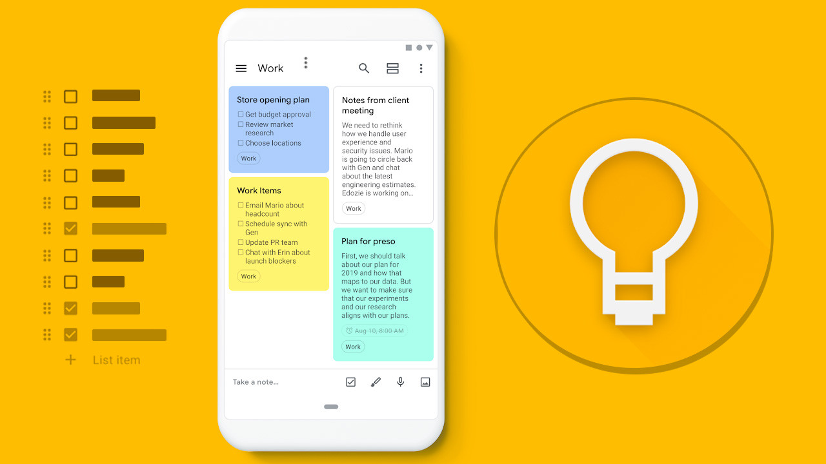
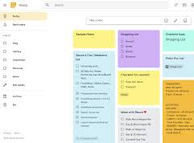
Social Apps

Slide 27
Could this benefit you?

Slide 28
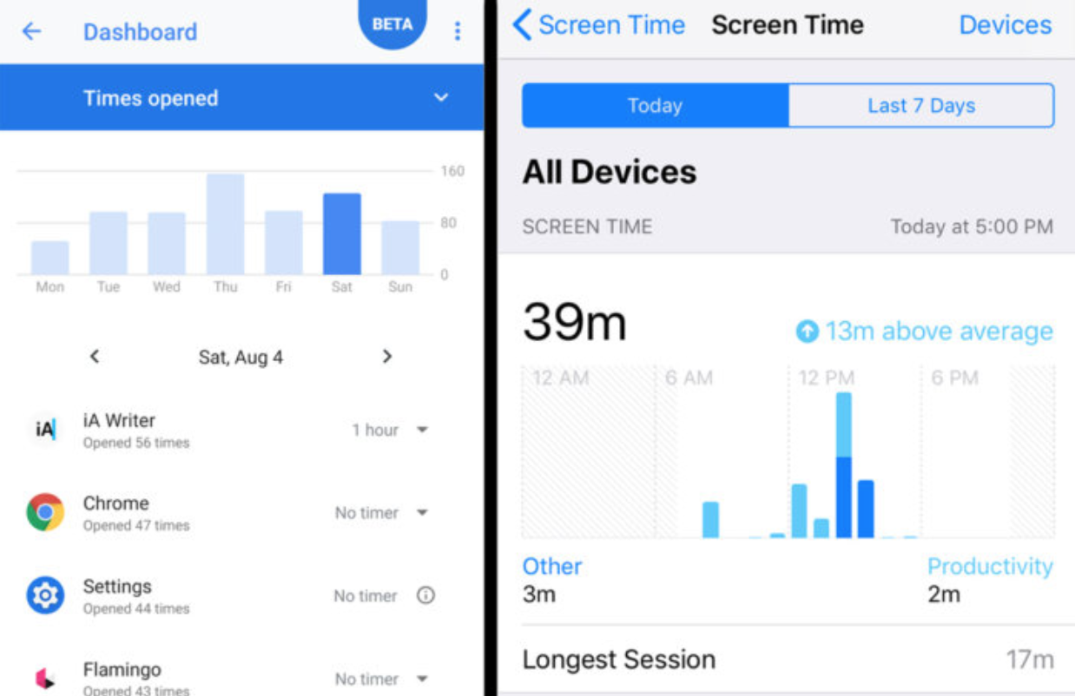
How Often Do You Check Your Phone Each Day?
Digital Wellbeing (Google) v. Screen Time (Apple)

Slide 29
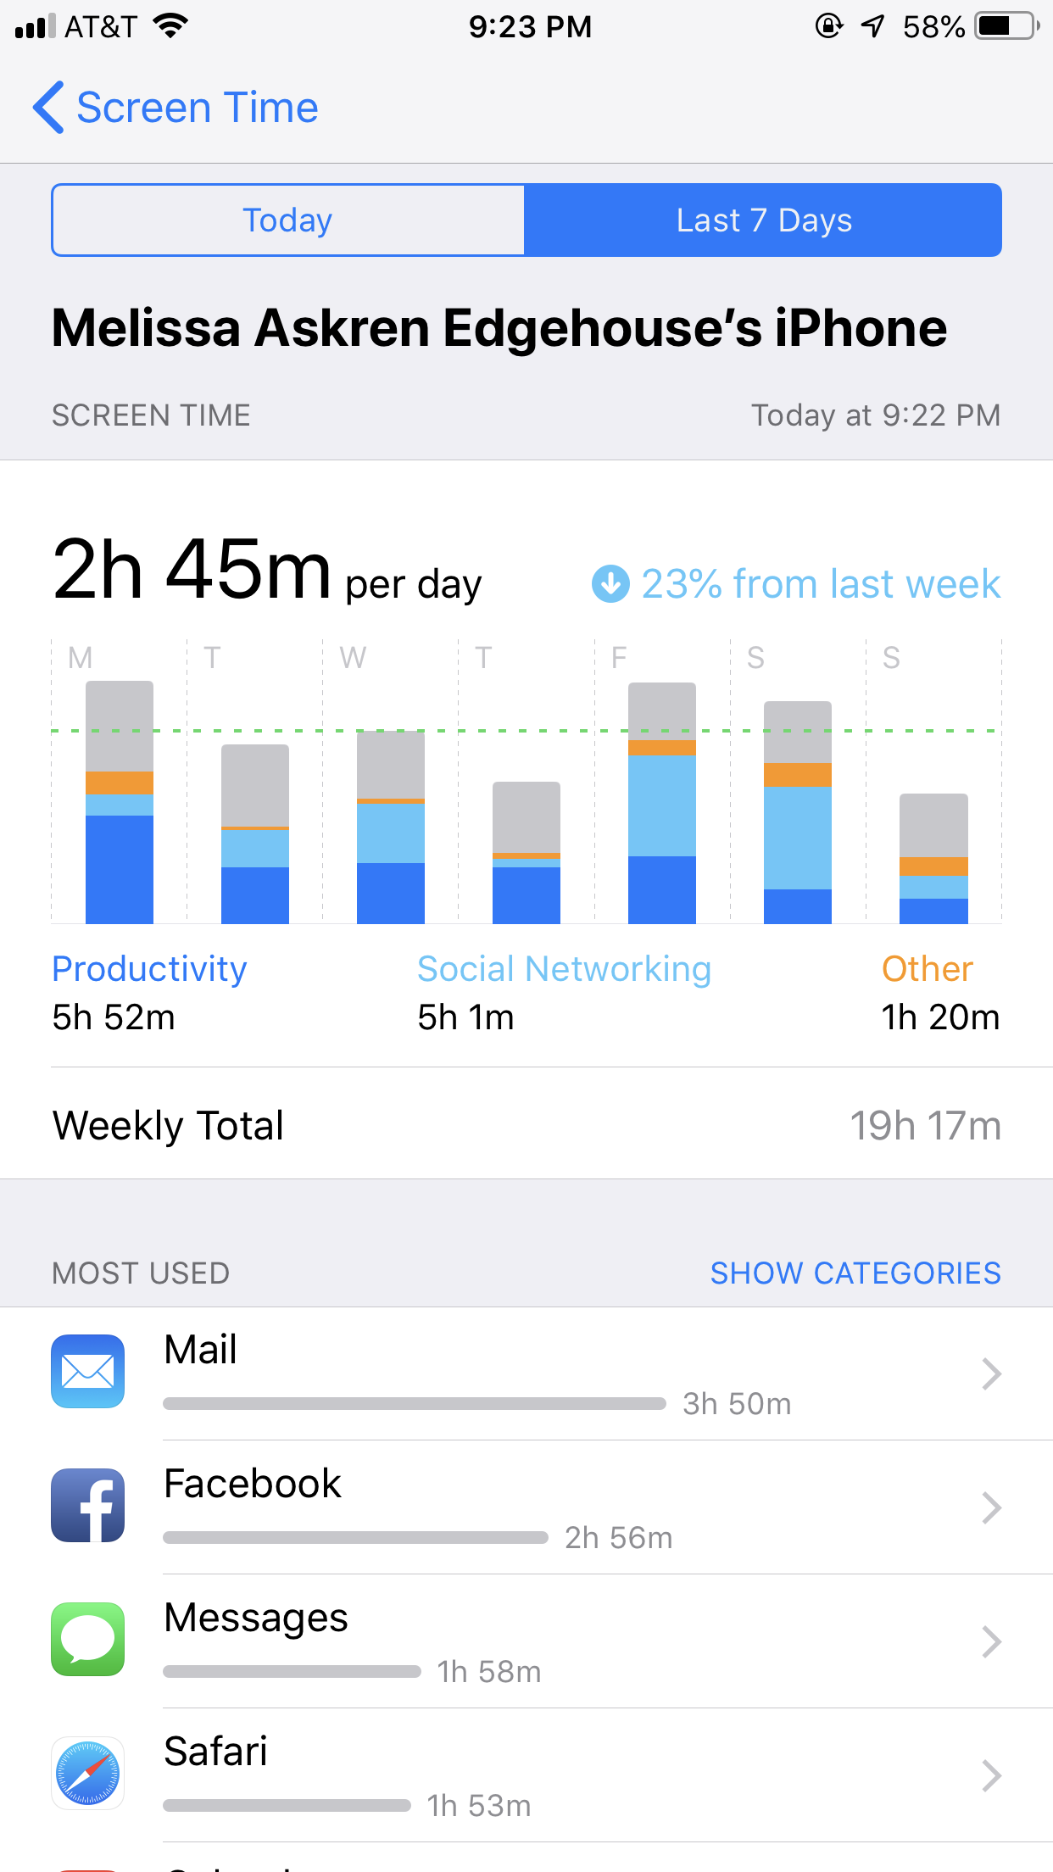

Slide 30
