Slide 1
Lead to Achieve: Penguin Assistants for Student Success
Youngstown State University

Slide 2
Introductions
Dr. Mary Lou DiPillo, Associate Dean, Youngstown State University
Dr. Gail Saunders-Smith, Literacy Program Coordinator
Kristen Italiano, Project PASS Coordinator
Janet Donofrio, Literacy Coordinator for Youngstown City Schools/Liaison for Project PASS
Jaclynn Cupp, Teacher Candidate/Program Tutor
Katie Fleming, Teacher Candidate/Program Tutor

Slide 3
Project PASS
Rationale for Project
What is Project PASS?
Project PASS requirements
Fieldwork component/ CAEP
Short and long term goals of Project PASS

Slide 4
Sometimes the stars align…
CAEP Standard 2 for Selected Improvement Plan
Candidates have multiple opportunities to develop, practice, and demonstrate evidence-based pedagogical practices that improve student learning and development.
State mandates on field experiences
Ohio Administrative Code 3301-24-03
BCOE goal of effective, classroom ready teachers on the first day
Youngstown City Schools District needs

Slide 5
Timing is EVERYTHING….
Youngstown State University had a need:
Youngstown City Schools had a need:
The Objective is twofold and for the betterment of both YSU Student and YCS students:

Slide 6
So what IS Project PASS?
Pair up ONE YCS second-grader with ONE YSU student
Nonacademic times
2 or more times a week/ minimum of 30 hours a semester
In all 6 YCS buildings
Staggered start…. 3 schools… then 3 more
All YSU students were placed and tutoring by end of February 2015
Talk about HIT THE GROUND RUNNING…

Slide 7
Project PASS facts:
McGuffey | 85% | 64 students with tutors
Taft | 100% | 48 students with tutors
Bunn | 92% | 33 students with tutors
MLK | 73% | 37 students with tutors
Williamson | 94% | 47 students with tutors
Harding | 97% | 59 students with tutors
Overall As of 5/19/15 | 90% of all teacher requested YCS second -graders have YSU tutors | 288 YCS second- graders have YSU Tutors
Nearly 300 tutors Fall 2015 (Current)
S15, X15, F15 over 15,000 hours of one-on-one literacy tutoring has been provided!

Slide 8
Application process:

Slide 9
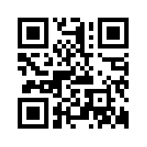
Communication is KEY:
Project PASS website:
Professional development sessions
REMIND 101
Project PASS is now using REMIND 101 to better increase communication. This provides text alerts regarding Project PASS, PD, Due dates and school closings
Graduate Assistants
Project PASS Office
Positive praise emails
on specific elements of tutoring
Anecdotal records

Slide 10
Tutoring sessions should be:
Hands on
Student centered
Evidence driven
Need based
Meaningful
Relevant
Focus on fluency, comprehension and writing

Slide 11
LOGS:

Slide 12
PASS Logs Rubric
The quality of the logs will be measured using the following rubric. Thirty points are possible for completing the logs. The total number of points earned will be determined using the range of quality on the following traits.
08-15
 | Unsatisfactory 3 pts. | Satisfactory 4 pts. | Competent 5 pts. | Exemplary 6 pts. | Total
Materials | Materials are not listed. | Materials are listed for some of the lessons. | Various types of materials are listed for most lessons. Materials include reading to and with the child. | Various types of materials are listed representing each segment of the lesson. Specific books are identified for reading to, with, and by the child. Writing materials are identified. Hands-on materials are identified.
Activities | Few or no reading, writing, comprehension, and phonics activities are described in. | Some reading, writing, comprehension, and phonics activities are described in detail. | Most reading, writing, comprehension, and phonics activities are described in detail as to who will do what and what is expected from the student. Steps for each activity are provided. | Each reading, writing, comprehension, and phonics activity is described in detail as to who will do what and what is expected from the student. Steps for each activity are provided.
APA | Few or no books or games are cited; or, incorrect citations are used. | Some books and/or games are cited; or, incorrect citations are used. | Most books and/or games are correctly cited using APA 6th ed. | Each book and/or game is correctly cited using APA 6th ed.
Reflection | Reflections include few or no details of activities. | Reflections include details for some of the activities. Details include specifics of what worked and what didn’t work. | Reflections include details for most of the activities. Details include specifics of what worked and what didn’t work including an explanation of why. A projection of what should happen next details how the lesson should be revised to improve student performance. | Reflections include details for each of the activities. Details include specifics of what worked and what didn’t work including an explanation of why. A projection of what should happen next details how the lesson should be revised to improve student performance.
Thoroughness | Few or no details for activities are included. | Details for some of the activities are included. | Details for most of the activities are included. | Specific details for each activity are included such as the writing prompt being used; the phonics element being addressed in the lesson; and, the type of reading being done.

Slide 13
Professional Development sessions:
Offered monthly/ 3-5 different times/days
Focus on best practices, student needs, hands on learning
Count towards fieldwork requirements
Data based Exit Slips

Slide 14
What Types of Professional Development sessions are Offered?
YSU Student surveys and discussions help drive the topics for future PD sessions
Feedback from Youngstown City teachers and administrators also play a part in planning PDs
Third grade state assessments and understanding the curricular needs is addressed in the PD
All PDs sessions are meant to be applicable to the future needs of the YSU tutors as they enter into their teaching profession

Slide 15
PD topics:
Professional Development Topics and Presenters:

Slide 16
How do the YSU STUDENTS FEEL…
Overall impact of Project PASS
Rapport with their student
Professional confidence
Personal investment
Short term successes / long term successes
Lessons learned

Slide 17
It is more than tutoring for our tutors
Being embedded in a school climate(depth/breathe)
Exposure and understanding of urban education
Building professional relationship within the schools
Participating in family literacy nights, school events and classroom projects
The need for differentiation and meaningful learning
Knowing their student’s story has made all the difference

Slide 18
Success and Struggles :
What is working well…..
-communication
-professional development sessions-monitoring the onsite sessions
-anecdotal records
-use of Google Docs
-authentic field experiences for tutors
-collecting/ using data
Surveys from parents/students/teachers
Logs
Exit slip data
Struggles…
-attendance of YCS students
-transient YCS students
-scheduling by building/ only using nonacademic times
-space/time
-motivation of YCS student
-quality and uniformity of the logs
- understanding expectations

Slide 19
How it all comes together
Janet Donofrio:
Youngstown City Schools Liaison
YCS Third-graders
YSU Tutors
YCS Teachers/Principals
YSU Professors
Professional developments

Slide 20
Literacy Collaborative:
Where we started….

Slide 21
A Liaison is NECESSARY for success
Access to class lists from YCS
Student benchmark data
Testing dates
Curriculum needs
School calendar
PD topics based of
district needs
Staff go between
Scheduling
Insight on specific building climates
YCS + Liaison + YSU= Success

Slide 22
What does the data show?
Teacher feedback
Student feedback
Parent feedback
Professional Development Exit Slip
OERC
Third grade reading benchmarks
Third grade state test scores

Slide 23
END OF SEMESTER DATA:
Each YSU tutor is asked to complete a “best practice” survey to best track their tutoring activities and plan for future PD sessions
End of the Semester Survey for YSU Students
Best Practice May Survey Data
Best Practice June Survey Data

Slide 24
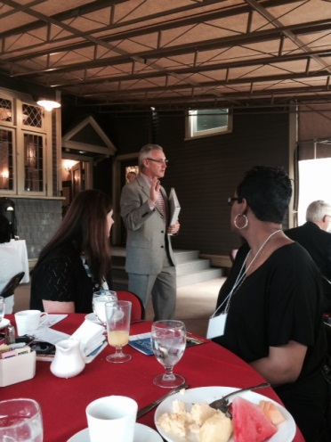
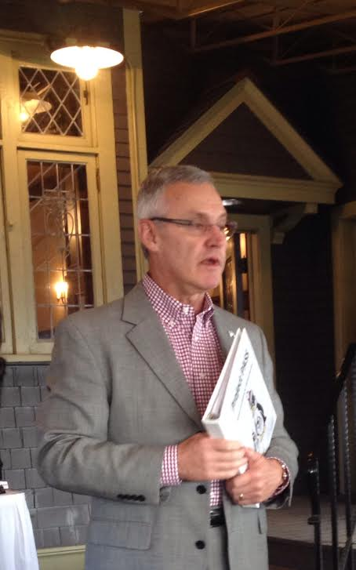
Motivate and Celebrate
2nd and 7 Foundation:
Breakfast with President Tressel:

Slide 25
Additional Facts on PASS:
To date over 15,000 hours of one-on-one literacy tutoring has been provided
Over 525 people are directly involved in the development and execution of Project PASS
OERC will be collecting data and evaluating the success of Project PASS
YSU students focus on 3 main areas: reading comprehension, fluency, and writing
YSU students are stating that they feel more invested in their student’s success and have a better understanding of their student’s literacy needs

Slide 26
Project PASS…
Questions?
For more information on Project PASS please contact:
Kristen Italiano
klitaliano01@ysu.edu
330. 941.3472
LEAD TO ACHIEVE!

