Slide 1
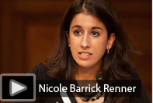
TEACHING 2030 Leveraging Teacher Prep 2.0
Will teacher educators
transform teacher education?
#teaching2030

Slide 2
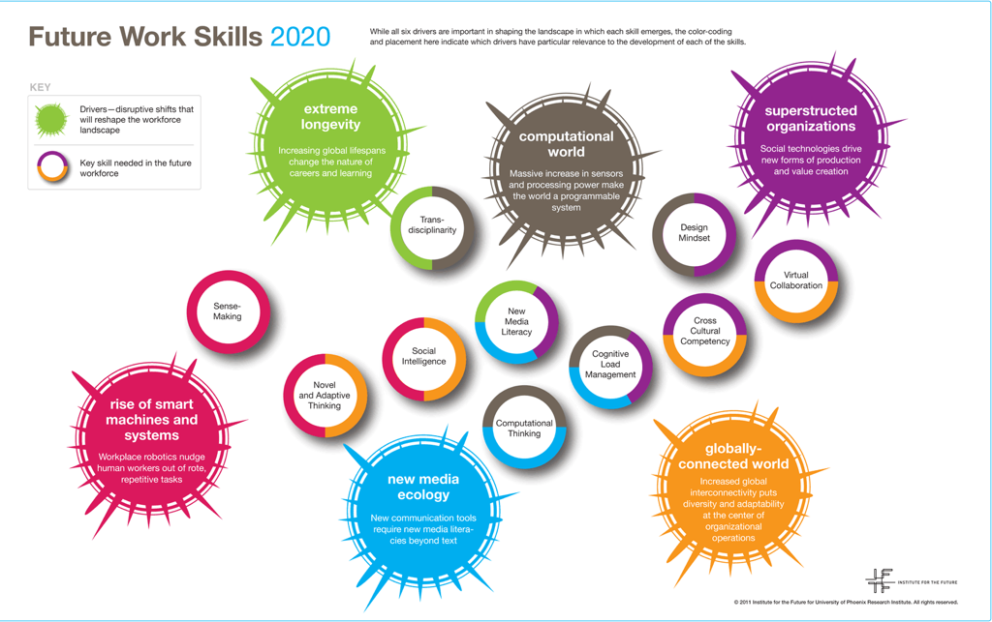
The School of Tomorrow (Today)

Slide 3
Ten Future Work Skills

Slide 4
Ten Future Work Skills

Slide 5
PISA 2006 and 2009
2009 (Reading skills, math, science) | 2006 (Math)
Shanghai-China | Finland
Korea | Korea
Finland | Canada
Hong Kong-China | Netherlands
Singapore | Japan
Canada | Switzerland
New Zealand | Belgium
Japan | Australia
Australia | New Zealand
Netherlands | Iceland
#teaching2030

Slide 6
The Finnish Assessment System
“assimilated the knowledge and skills required by the curriculum”
“reached an adequate level of maturity in line with that school`s goals”
Schools and teachers have freedom how they assess students learning and schools effectiveness
For basic education national sample based assessments of learning outcomes (National Board of Education )
Thematic evaluations (The National Education Evaluation Council)

Slide 7
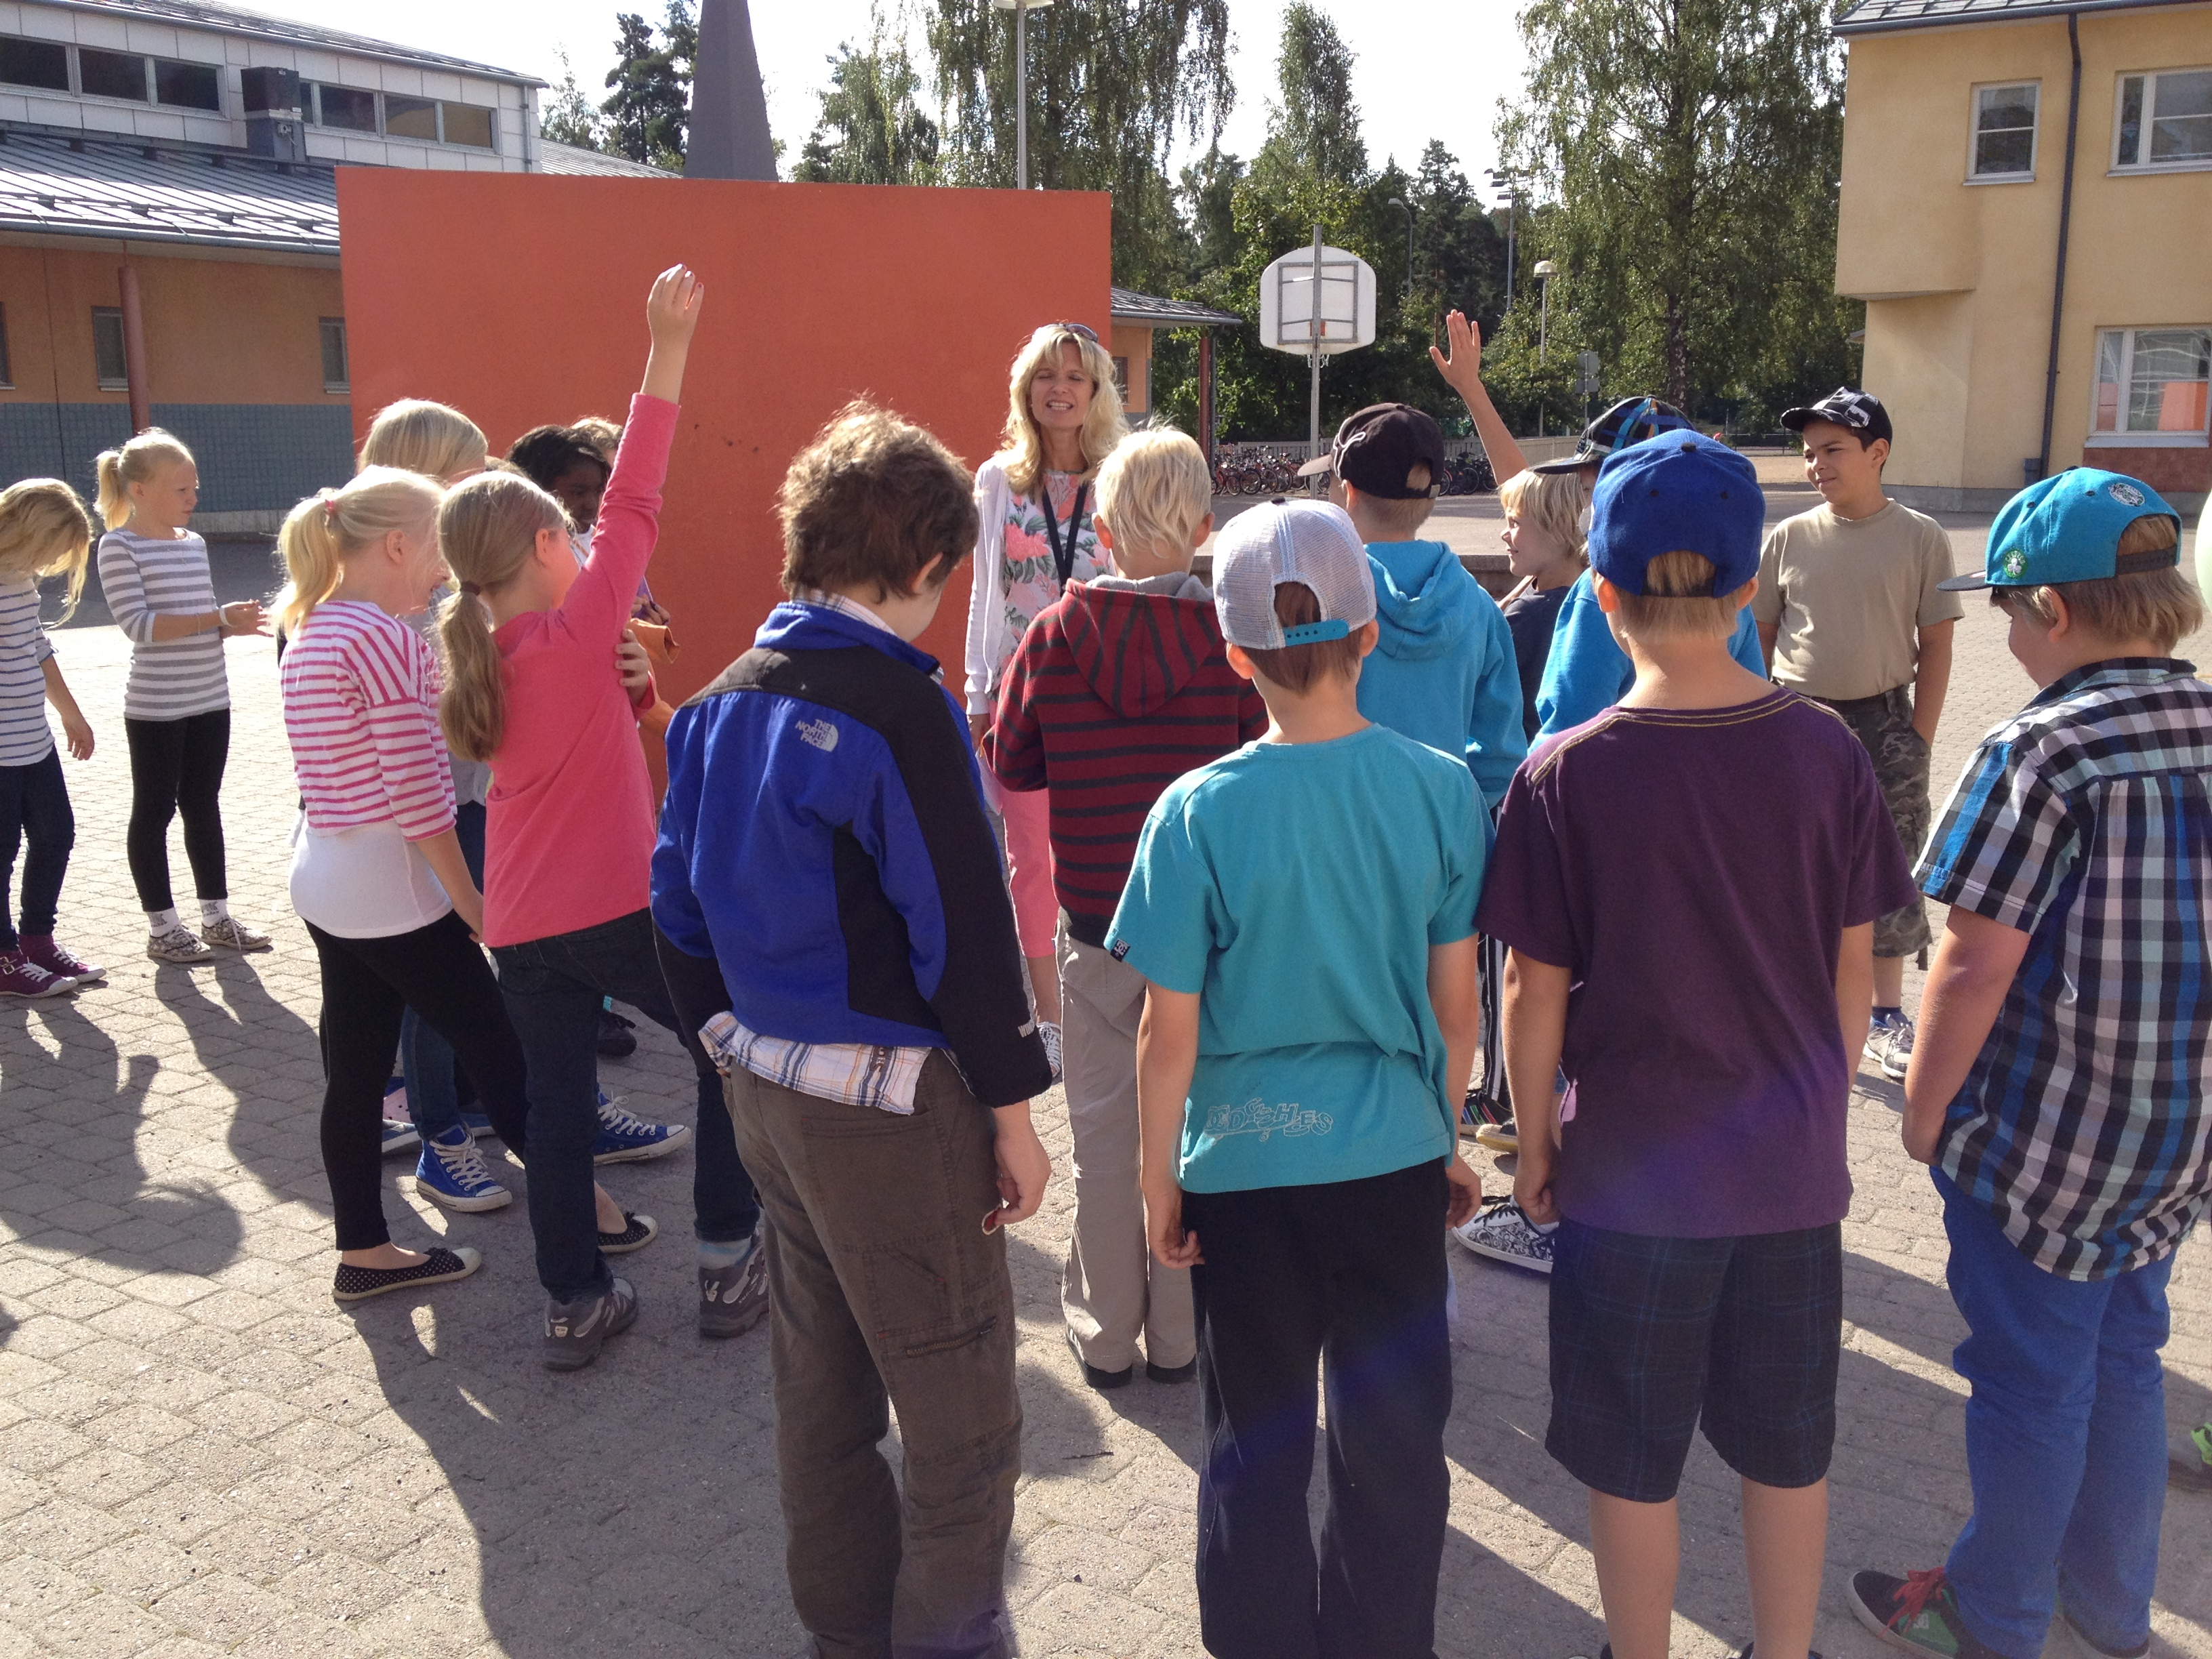
What Makes for High Quality Teachers in Finland
Teachers are expected to take the responsibility to develop their profession.
To analyze complex situations like a researcher and
To make conclusions and decisions to develop their teaching to different learners.

Slide 8
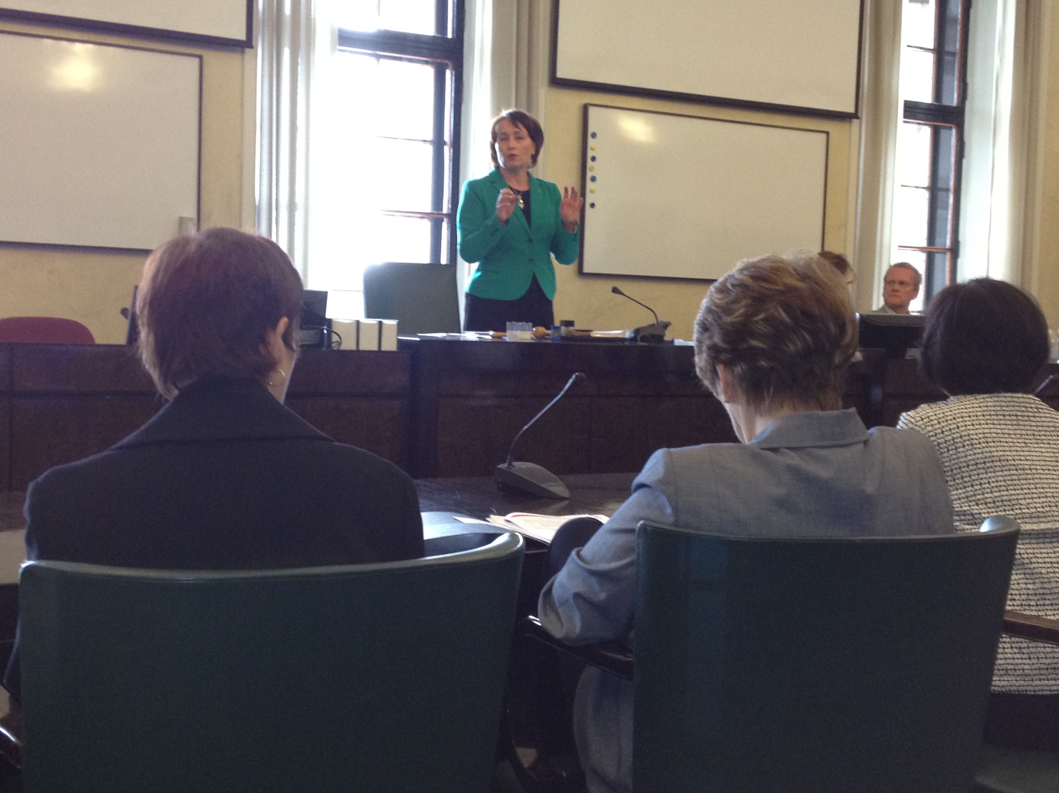
What makes Finnish teachers different?
All have MA degree
No school achievement testing
No probation time
No inspectorate
All belong to Teacher Union
Not high salary – moderate level
Commitment to their profession
Raija Vahasalo (Chair, Education and Culture Committee): “Our students do well because all our teachers have master’s degrees in education.”

Slide 9
Becoming a teacher in Finland
A very popular academic career
10 % of the high-talented applicants are selected to start their studies
Entrance examinations
skills needed in high quality profession
Interviews - motivation
Social skills in a group

Slide 10
Serious preparation for teaching in Finland
Class teachers: Master of Education
Major in Education
Minors in 1-2 subject matter disciplines
Secondary teachers: Master of Sciences. Arts etc.
Major in subject a matter
Minor in Education
Minors in 1-2 subject matter disciplines
#teaching2030

Slide 11
Quality in the Finnish teacher education system
The latest research of
content knowledge
The latest research in pedagogy
Student teachers
Competences of
teacher educators:
mainly PhD
Cooperation at the University and with teacher training schools
#teaching2030

Slide 12
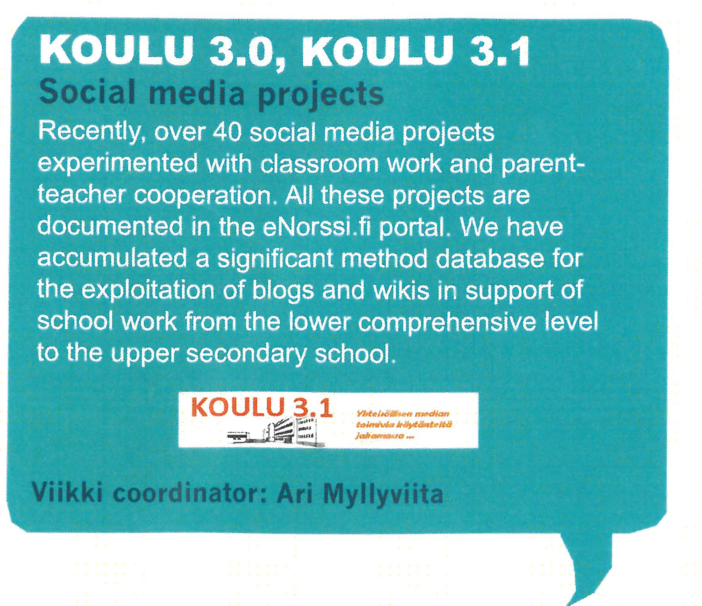
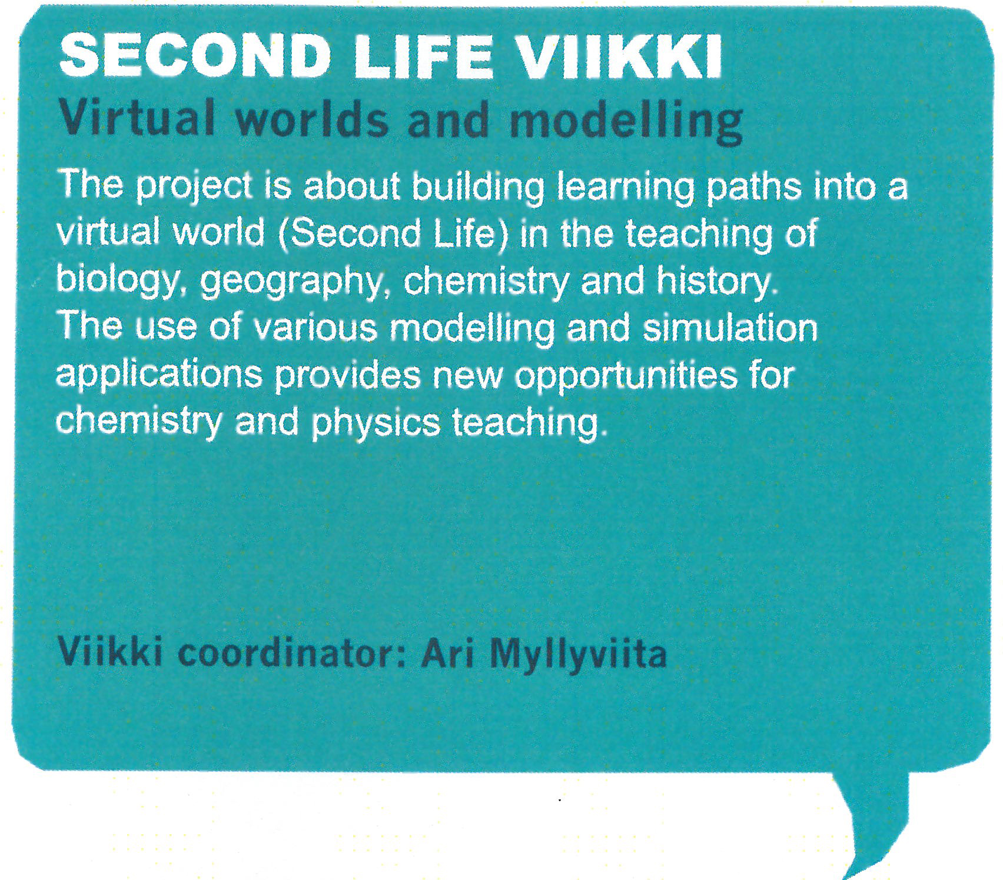
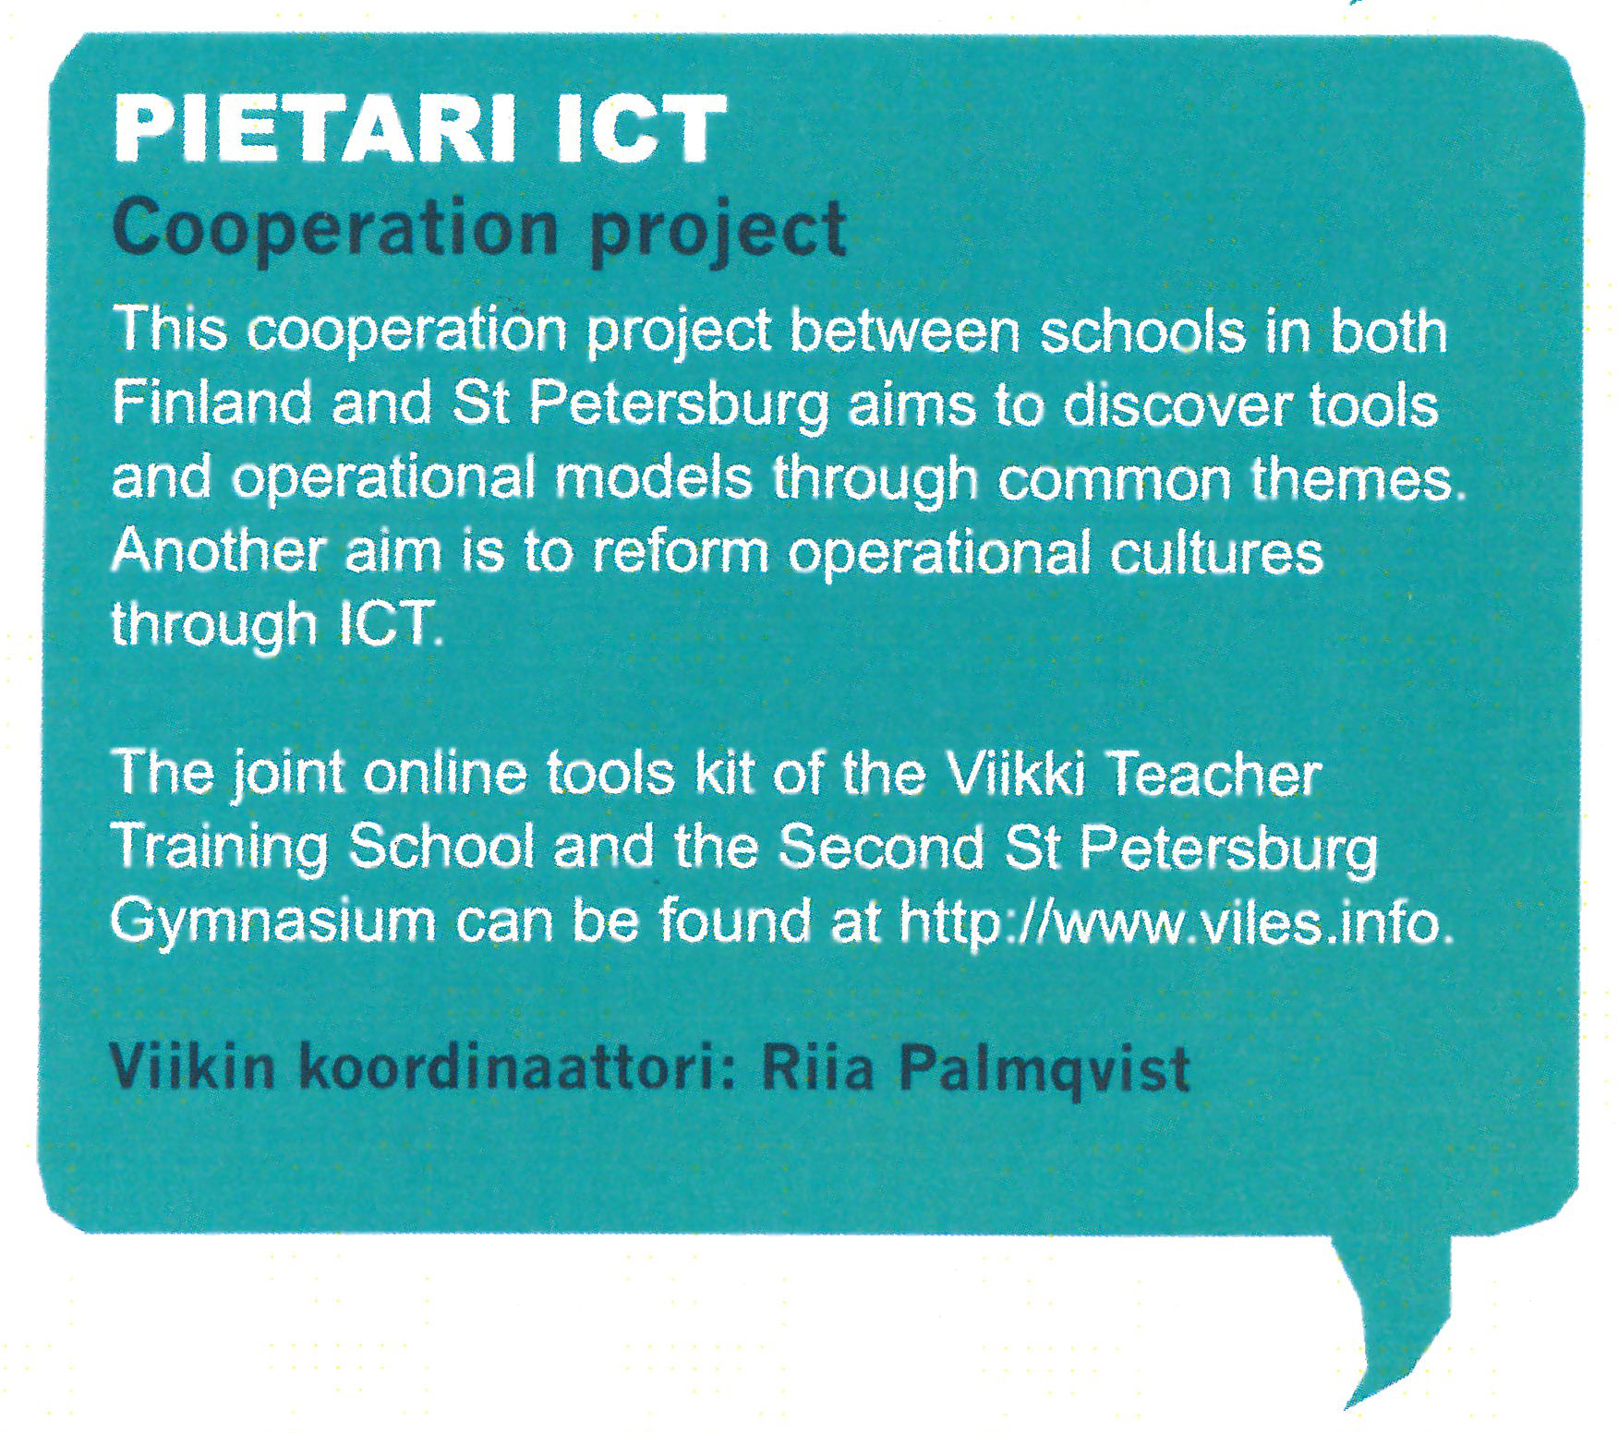
The Future of Finnish Teacher Education

Slide 13
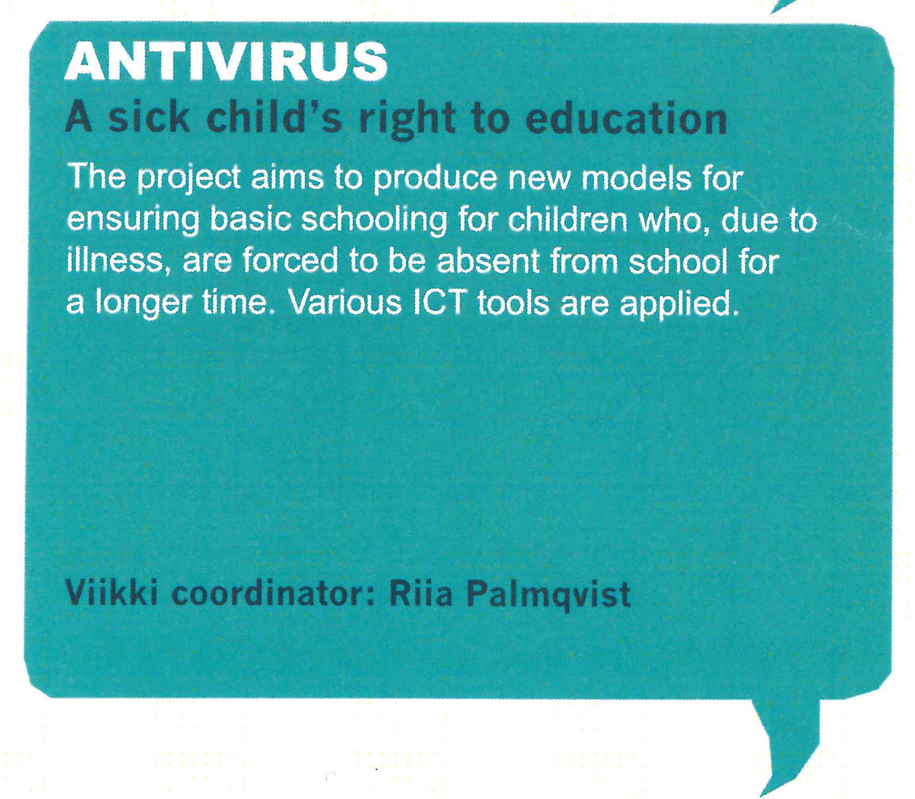
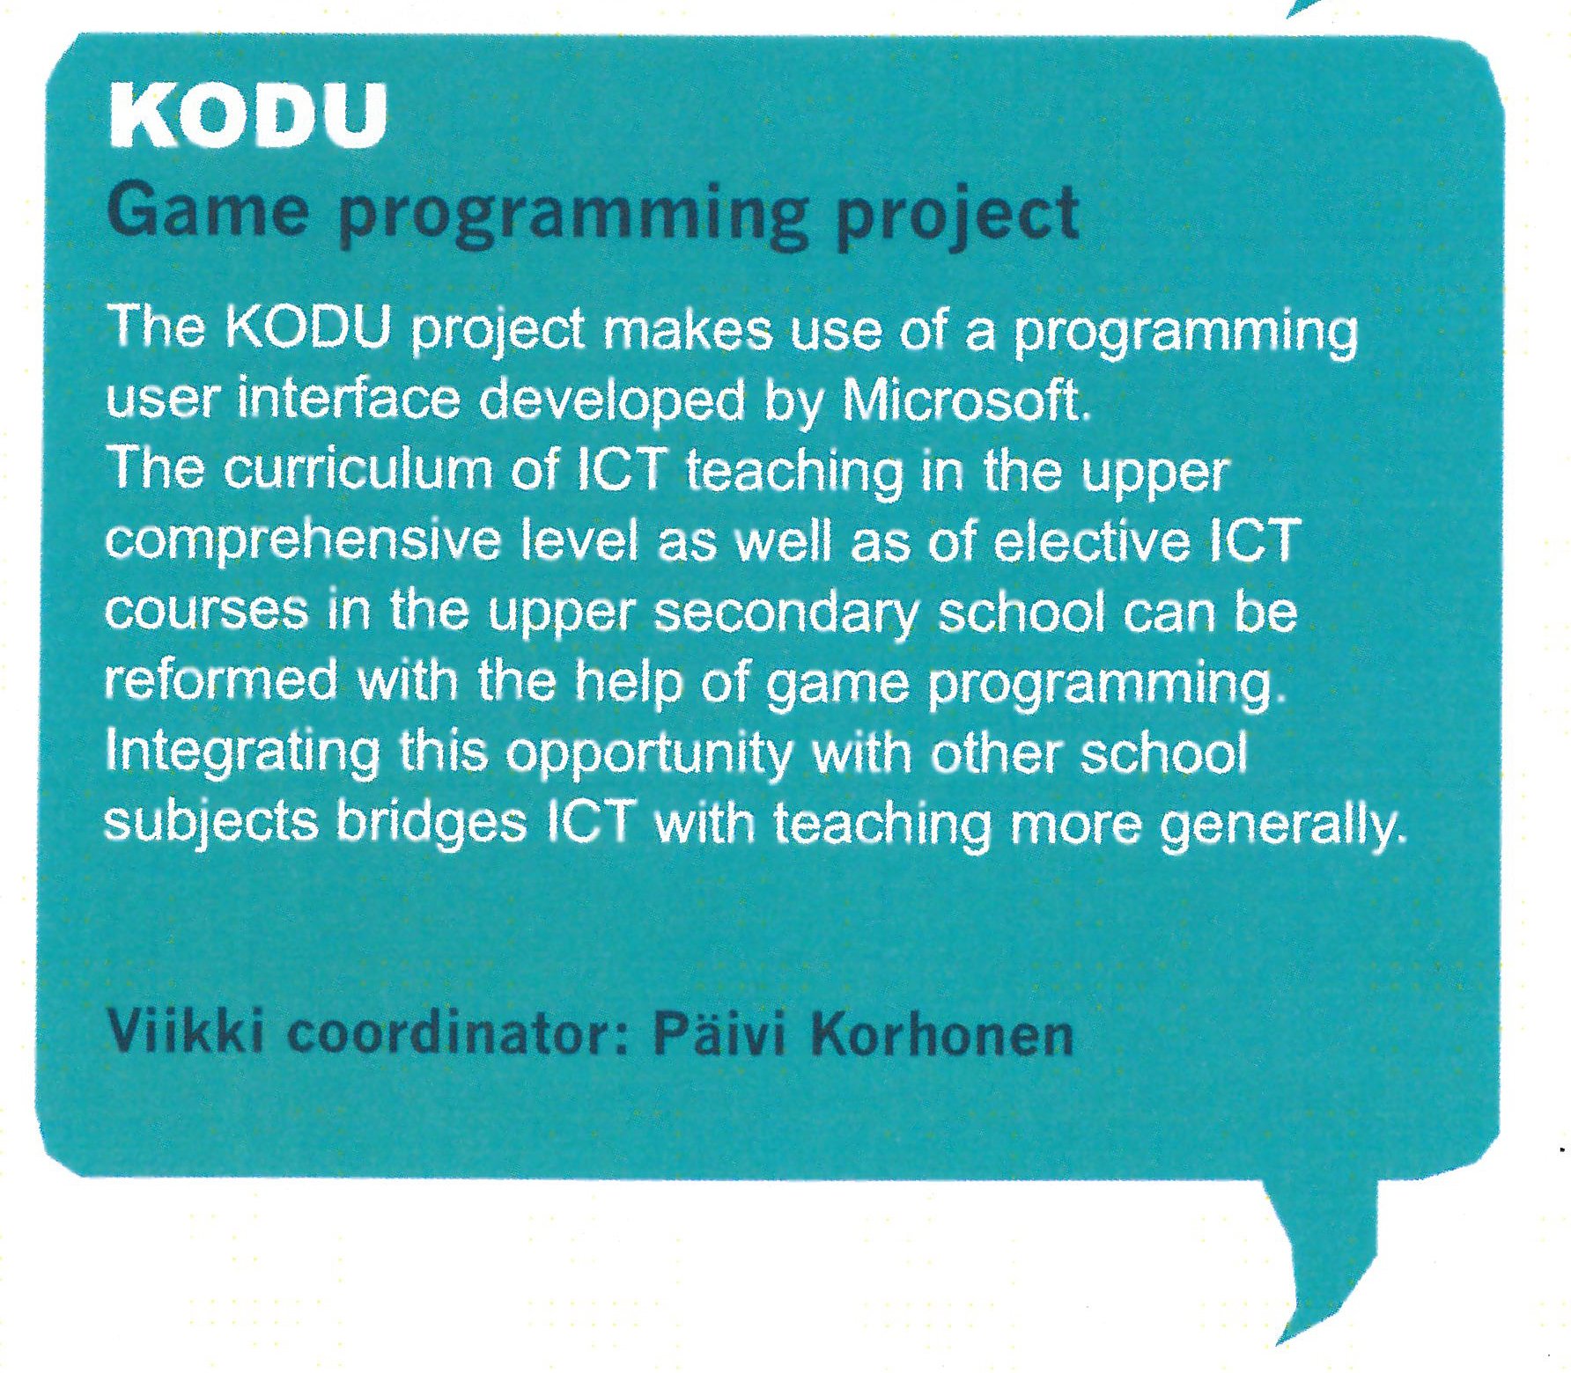
The Future of Finnish Teacher Education

Slide 15
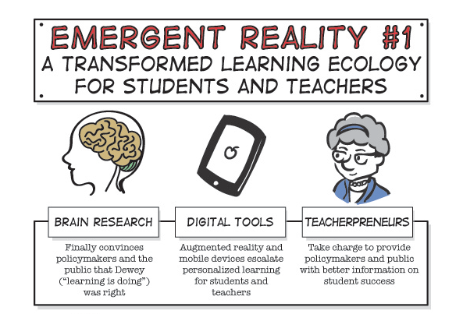

Slide 16
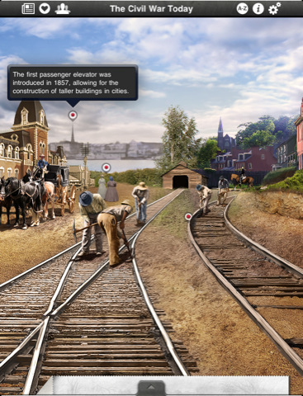
Edugames & the Personalization of Teaching and Learning

Slide 18
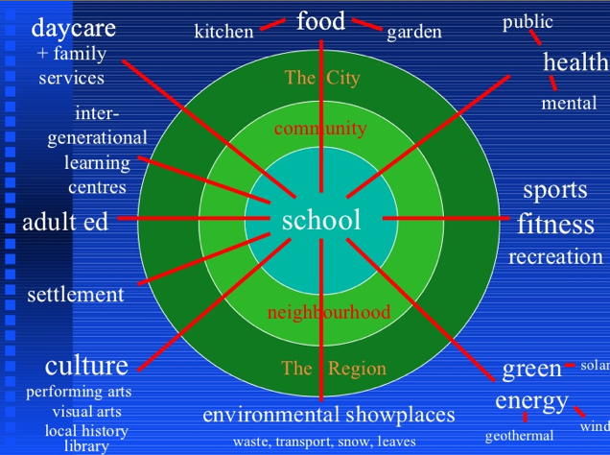
Schools as Hubs of the Community

Slide 20
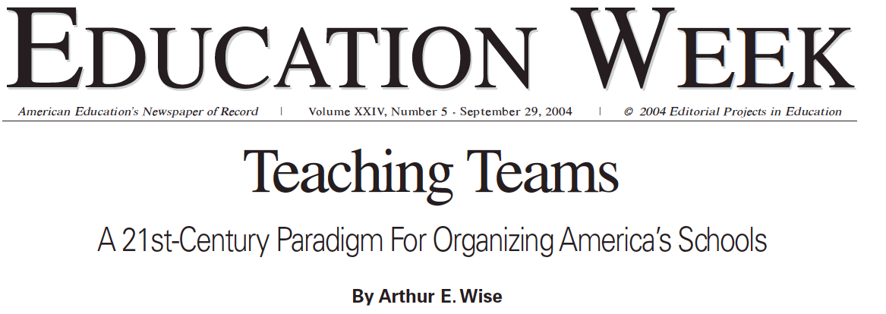
Pathways to Careers in Teaching in Singapore

Slide 21
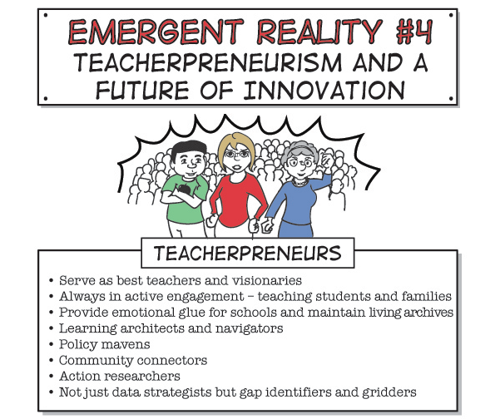

Slide 22
The “Networked Teacher”

Slide 24
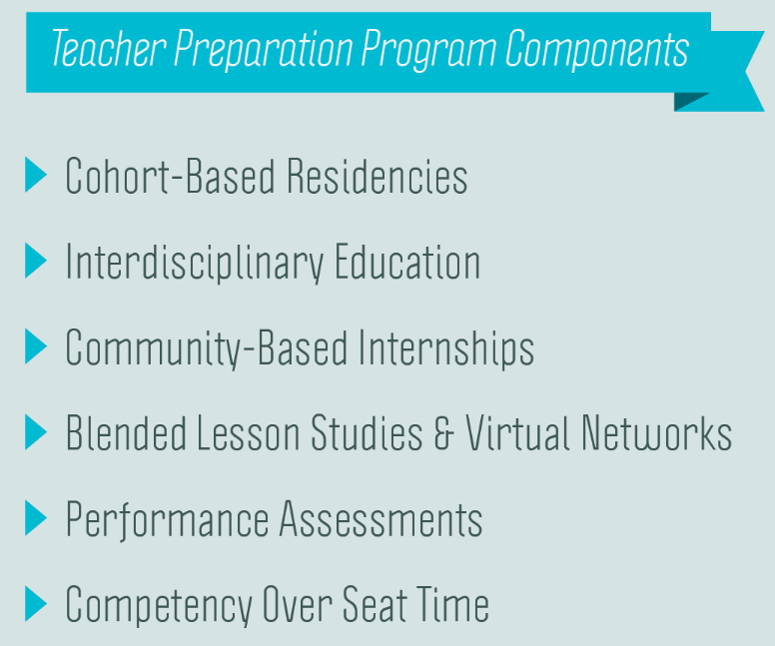

Slide 25
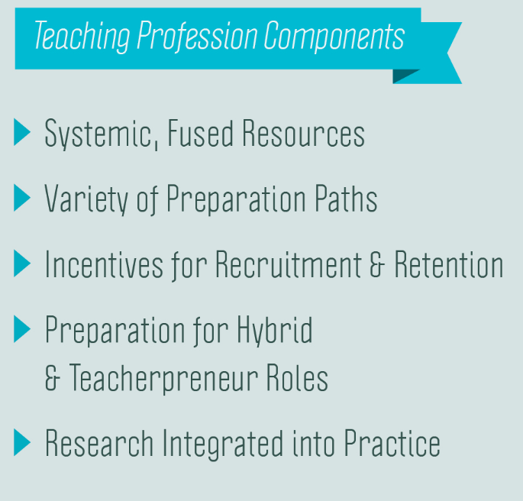

Slide 26
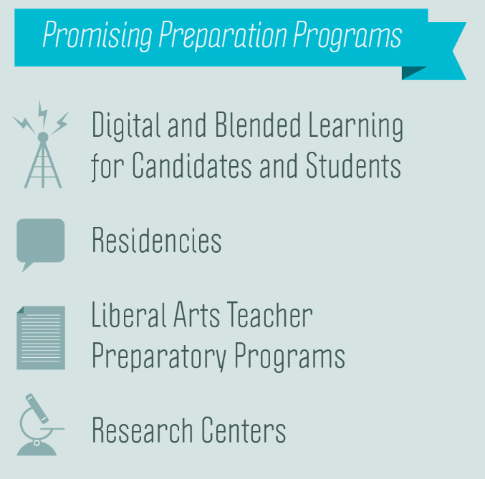

Slide 29
Leveraging Teacher Prep 3.0 Next Steps
Summarize key points
Identify opportunities for collaboration
What can OCTEO do collectively?
Where are you already doing 2.0? Where thinking 3.0?
What must do you differently?
Who will you need to convince, and how?
How will you know when you are successful?

Slide 30
For More Information
Please visit our website
at www.teaching2030.org.
Contact Kristoffer Kohl
kkohl@teachingquality.org
to join our ongoing conversation
about TEACHING 2030.

